Slide 1
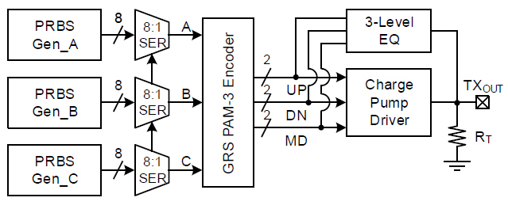
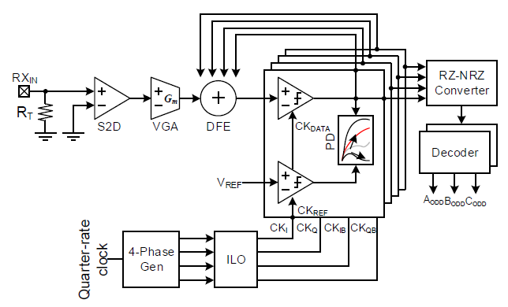
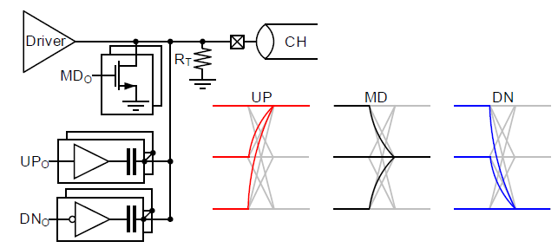
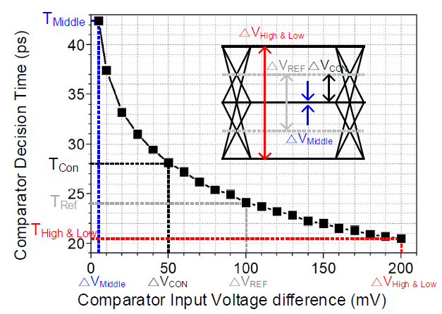
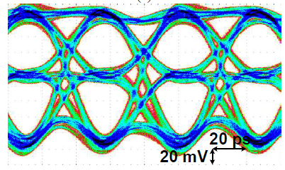
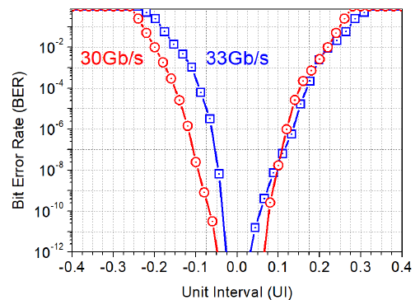
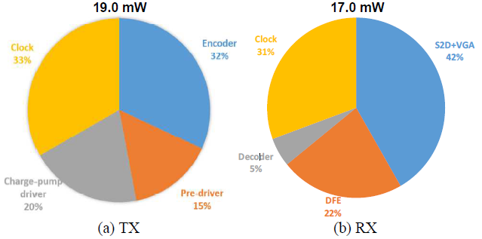
Single-ended PAM-3 Transceiver with Time-domain Decision Technique and Ground-referenced Signaling for Memory Interfaces
Youngwook Kwon, Seungwoo Park, and Chulwoo Kim
High bandwidth and noise-tolerant transceiver (TRX) is proposed in this paper. Inserting 3 bits in 2 unit intervals (UI) with 3-level pulse amplitude modulation (PAM-3) signaling is implemented using upper, under, and the ground voltage, raising pin efficiency 1.5 times. The charge pump driver in ground-referenced signaling (GRS) reduces simultaneous switching output (SSO) noise and keeps only one return current path.
Introduction
Transmitter
Receiver
Time-domain decision technique
Reduced DFE feedback time
Increased PAM-3 voltage margin
1.5 times higher data rate and SSO noise reduction
PAM-3 FFE with capacitive and resistive
Experiment results
<TX Eye-diagram>
<RX Bathtub>
<TRX Power dissipation>
Conclusion
A TRX with increased bandwidth and decreased noise vulnerability was implemented in 28 nm CMOS technology, targeting MCM applications whose pin numbers were increased significantly.
Acknowledgement
The chip fabrication and EDA tool were supported by the IC Design Education Center(IDEC), Korea.

