Slide 1

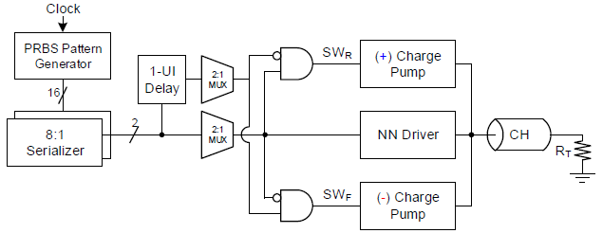
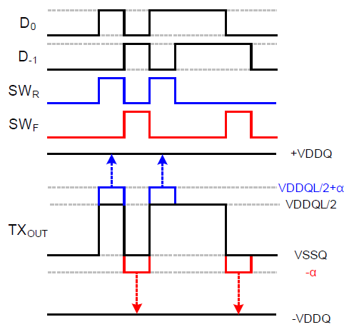
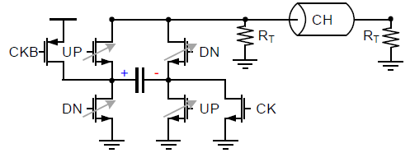
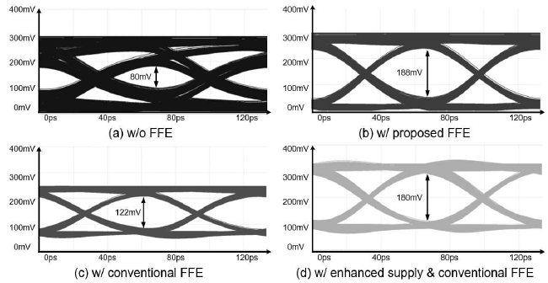
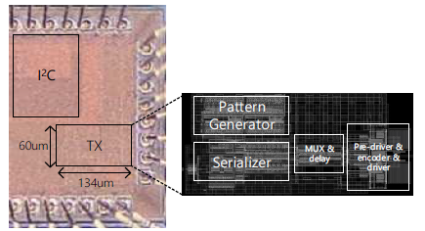
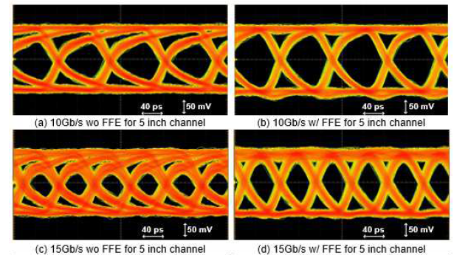
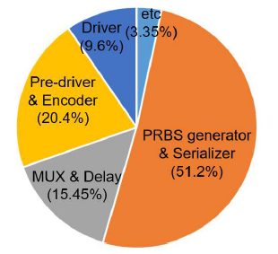
A 15 Gb/s Non-return-to-zero Transmitter with 1-tap Pre-emphasis Feed-forward Equalizer for Low-power Memory Interfaces
Youngwook Kwon, Jincheol Sim, and Chulwoo Kim
A 1-tap pre-emphasis transmitter (TX) for a single-ended ground-terminated memory interface with 28 nm CMOS technology. By employing a charge pump scheme, a voltage level below ground was used to remove inter-symbol interference (ISI). The data rate of the proposed work is 15 Gb/s, and the data path power dissipation for the entire design is 20.3 mW. The measured energy efficiency is 1.35 pJ/bit, and the total area occupation is 0.008 mm2.
Introduction
Transmitter top architecture
Simulation results
No short current by pre-emphasis FFE
No termination aggravation by charge pump
Increased voltage margin compared to de-emphasis FFE
<Charge pump scheme>
NN driver for low swing low power TX
Encoder for charge pump FFE
Experiment results
<Chip microphotograph>
<TX Eye-diagram>
<TX Power dissipation>
Conclusion
A single-ended TX with a 1-tap FFE for ground-termination logic memory interfaces is presented. Using a charge pump scheme, which pulls or pushes the charge for the data transition case, the ISI is canceled with minimizing the reduction of the vertical voltage margin for RX.
Acknowledgement
The chip fabrication and EDA tool were supported by the IC Design Education Center(IDEC), Korea.

