Slide 1

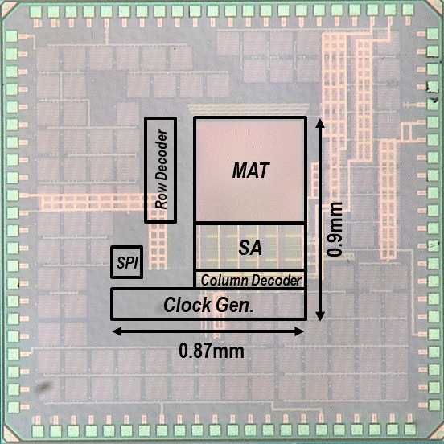
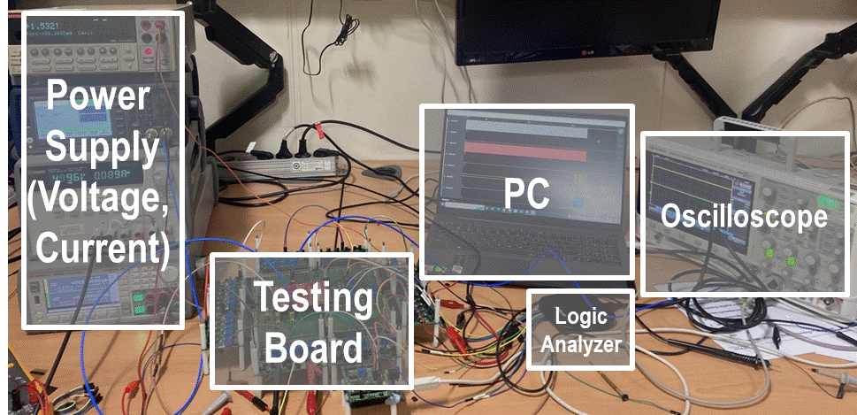
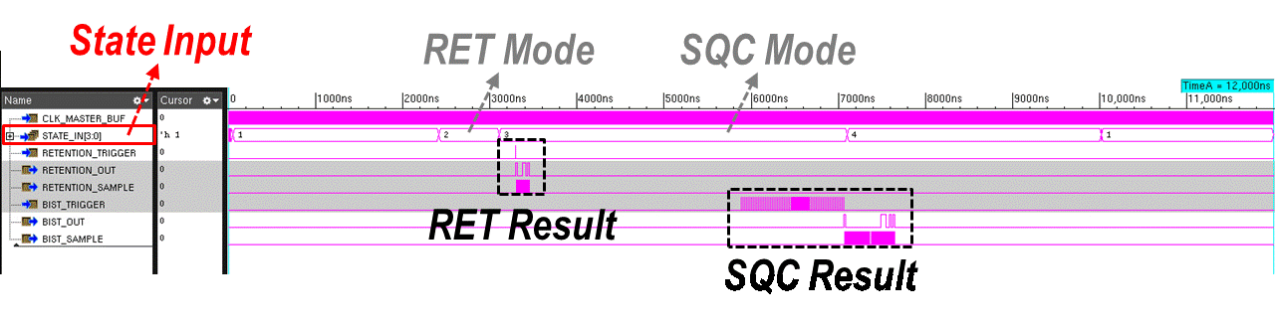
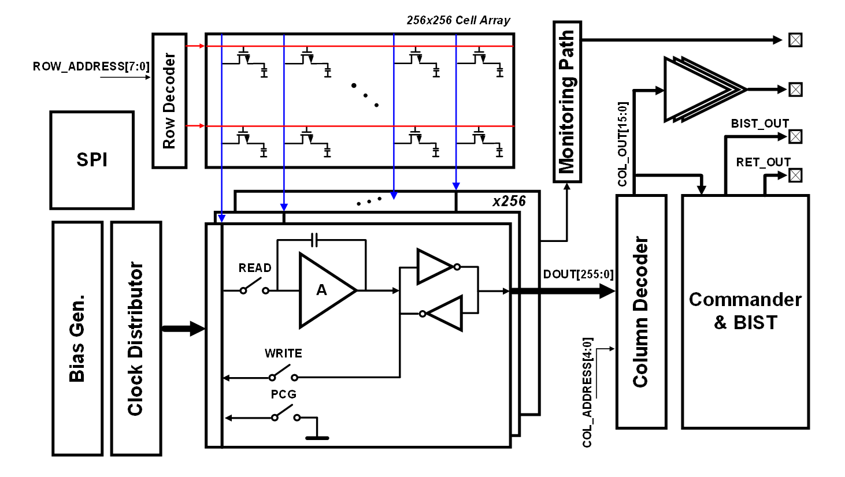
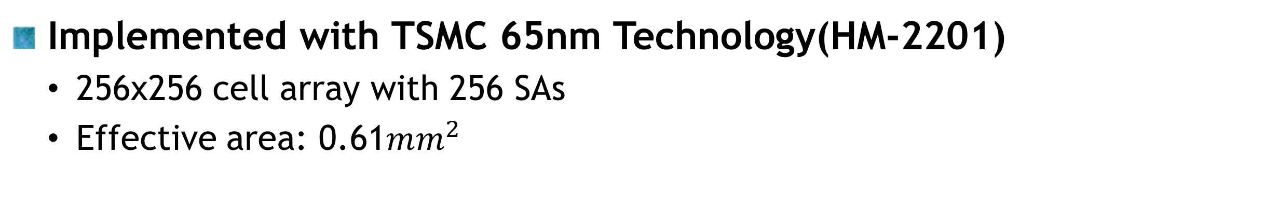
Enhancing Performance and Reliability of eDRAM
with Pre-Amplifier-Based Sense Amplifier and BIST
Donghwan Kim*, Gi-Woo Lee* and SeongHwan Cho
Department of Electrical Engineering, KAIST, Daejeon, Korea
Introduction
BIST Logic for eDRAM
Challenges of eDRAM Implementation
  Insufficient sensing margin due to high parasitic-to-cell cap. ratio
  High Cost at Reliability Testing
Bad Sensing Margin
5 BIST Modes
- RESET
- PRESET
- NORMAL
- RETENTION(RET)
- Sequential Check(SQC)
Sensing Failure
State Machine of BIST Modes
Sensing Margin Relationship w/ respect to # of WLs
  The five individual modes are designed to automatically produce their respective outputs, thus reducing the testing cost significantly
Chip Photo, Measurement and Future Plan
Implemented with TSMC 65nm Technology(HM-2201)
  256x256 cell array with 256 SAs
  Effective area: 0.61$mm^{2}$
Expensive Cost for DRAM Reliability Testing
Contributions and Scope of the Work
Sense Amplifier with Pre-amplifier
Built-In Self Test(BIST) Logic for eDRAM
Chip Photo
Measurement Set-up
Enlarges sensing margin using high gain of pre-AMP
Reduces the testing cost using 5 adjustable modes
Verification of BIST Logic through Simulation
Overall Architecture
Implementation of eDRAM Macro
Verification of Two Modes(RET and SQC)
Among the 256 bits from the memory MAT, the 16 bits selected by the column decoder are sent to the chip's external interface and the BIST block.
Large Variation of Pre-Amplifier due to Offset Mismatch
Analysis
The offset of Pre-AMP is amplified by C_{P}/C₀(1st AMP)
The offset variation of AMP should be minimized
Overall Architecture of eDRAM Macro
Sense Amplifier with Pre-Amplifier
1st AMP→ large Mismatch
The preamplifier consists of two stages in total. The first stage adopts a folded cascode structure to achieve high gain.
Meas. #1
1
V_{OUT1}(V)
Large Mismatch
(370mV variation)
Meas. #2
V_{OUT2}(V)
0.6
62mV
0.2
1
By the operation of switched capacitor amplifiers, it is possible to convert the charge stored in the cell directly into voltage without any charge sharing.
V_{IN1}(V)
0.2
0.6
V_{IN2}(V)
Measurement of Pre-AMP Over Multiple Chips
Future Plan
  Auto-zeroing technique can relieve the mismatch effects
Acknowledgement
Configuration and the operation of the proposed Sense Amplifier
The chip fabrication and EDA tool were supported by the IC Design Education Center(IDEC), Korea.

