Slide 1

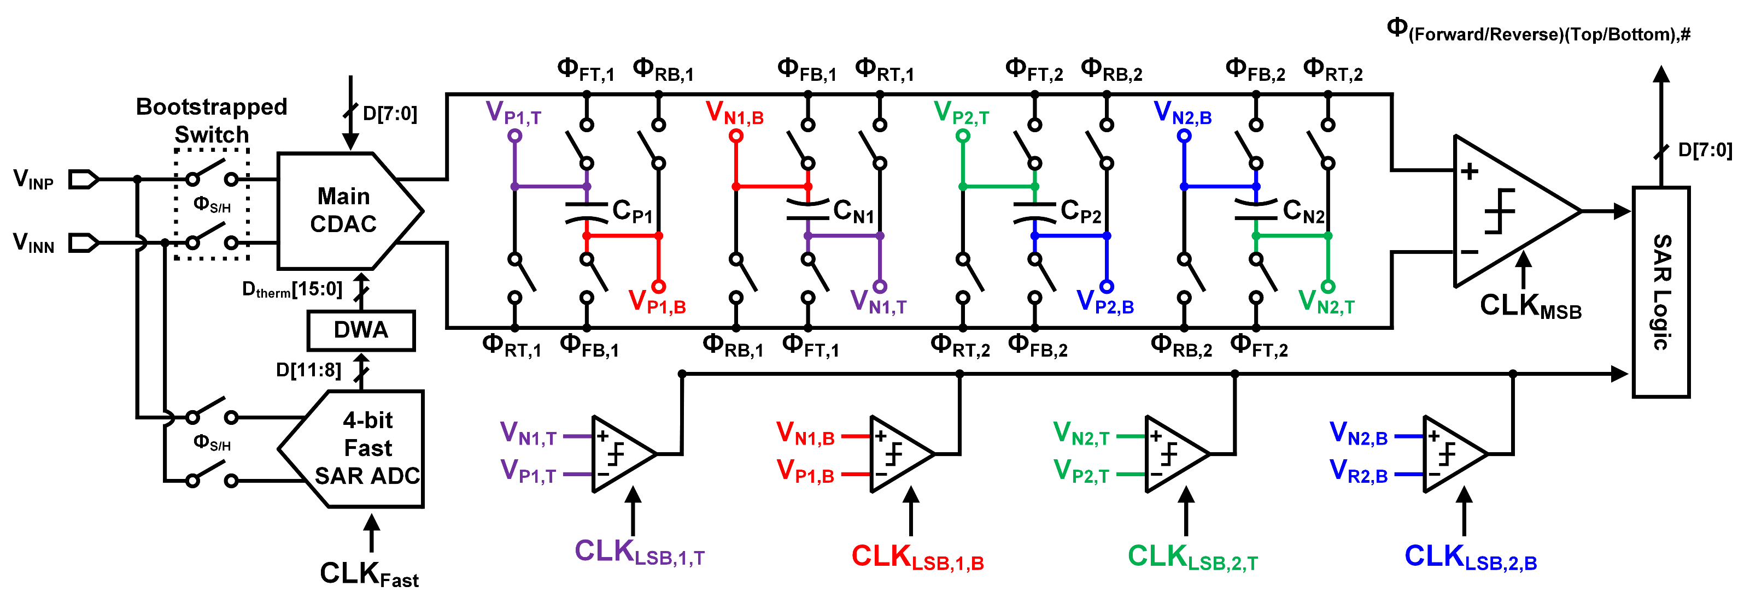
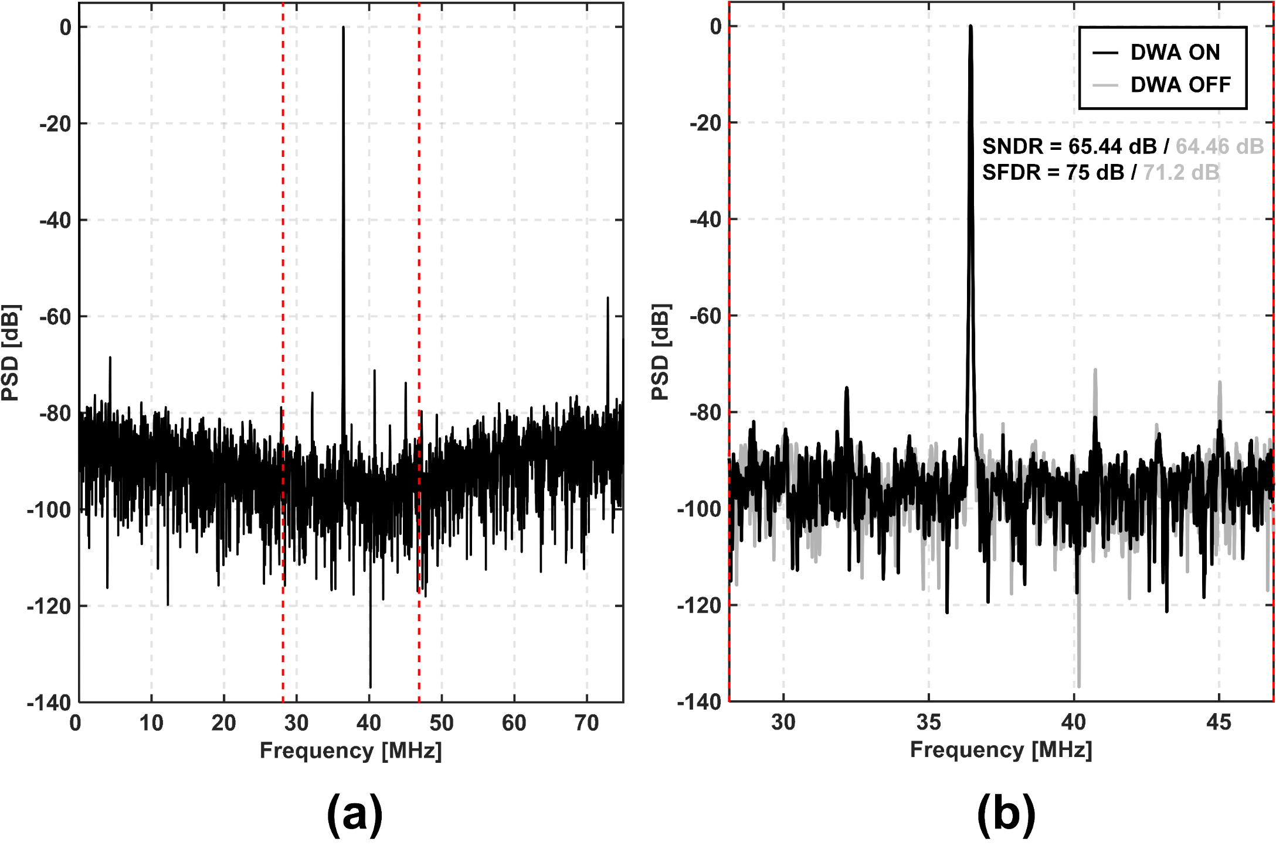
A 150MS/s, 65dB SNDR Fully Passive Bandpass Noise-Shaping SAR ADC
Dongsik Lee, Seungjun Lee and Hyungil Chae
Department of Electrical and Electronics Engineering, Konkuk University
Introduction
Bandpass (BP) ΔΣ analog-to-digital converters (ADCs) can simplify the receiver structure by directly digitizing signals at an intermediate frequency (IF) or RF region. However, the performance of a BP ΔΣ ADC often bottlenecks the receiver performance, and it is essential to achieve high energy efficiency of a BP ΔΣ ADC. In this work, a passive BP NS-SAR ADC structure is introduced. The proposed structure is created by applying z → -z² transformation to an existing passive LP NS-SAR ADC structure. The BP NS-SAR ADC can achieve high energy efficiency with simple circuit implementation as LP counterparts.
Circuit Implementation
The source ADC in Fig. 1(a) passively summates signal and residue by connecting the residue capacitor in series with the CDAC to the single-input comparator input.
This passive filter and summation can be applied to the passive BP NS-SAR ADC similarly if the block diagram of it is modified appropriately.
The negative sign of -z⁻² at the input of the passive filter needs to be moved to the comparator input as in Fig. 1(b), which does not change the overall transfer function.
Fig. 1. Signal flow diagram of fully passive (a) lowpass (b) bandpass NS-SAR ADC
The ADC does coarse-fine SAR conversion for power and speed optimization as well as the use of the midway feedback method.
There is fast SAR conversion using a separate CDAC for data weighted averaging (DWA).
Fig. 3. Top level structure of proposed BP NS-SAR ADC
Fig. 2. Passive filter operation with residue capacitors
(a) charge sharing [2k] (b) subtraction & conversion [2k+2] (c) charge sharing [2k+2] (d) subtraction & conversion [2k+4]
Measurement Results
Conclusion
The structure of the proposed ADC is converted from the existing passive NS-SAR ADCs, and the resulting BP ΔΣ ADC inherits the advantages of them including power efficiency and PVT robustness.
The proposed ADC has a low circuit complexity by using single-input comparators and a minimized switching network.
The proposed ADC is very helpful to simplify the structure of the direct sampling receiver.
OSR : 4
BW : 18.75MHz
Fig. 5. Measured output power spectral density for (a) full spectrum (b) signal band with DWA on/off
Acknowledgment
The chip fabrication and EDA tool were supported by the IC Design Education Center(IDEC), Korea.

