Slide 1

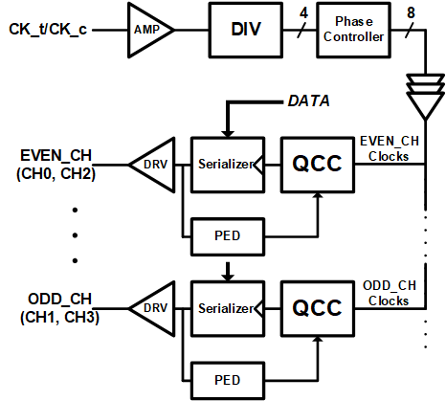
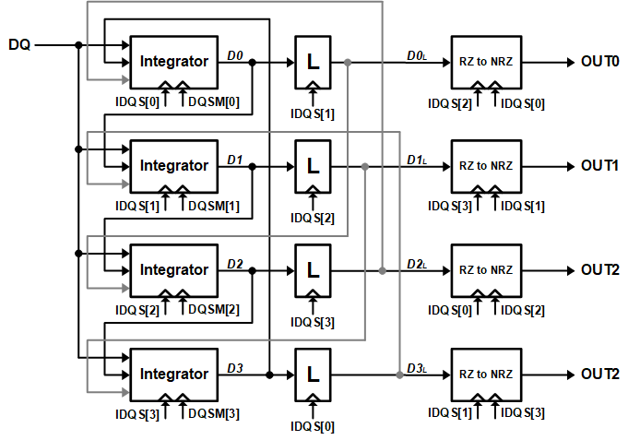
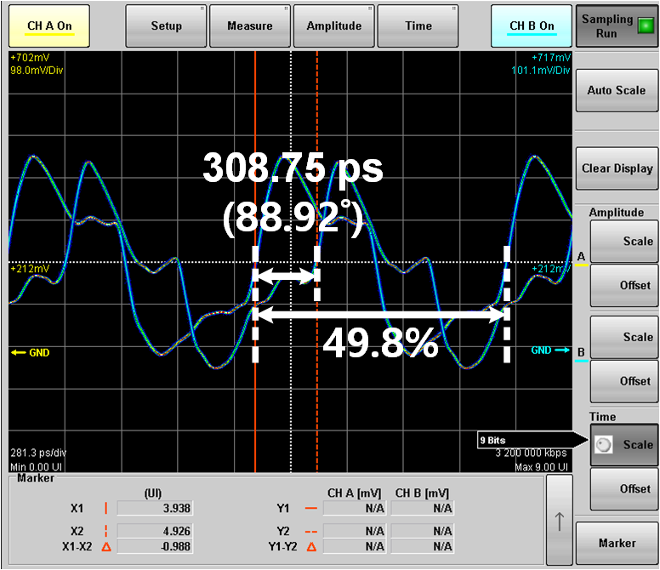
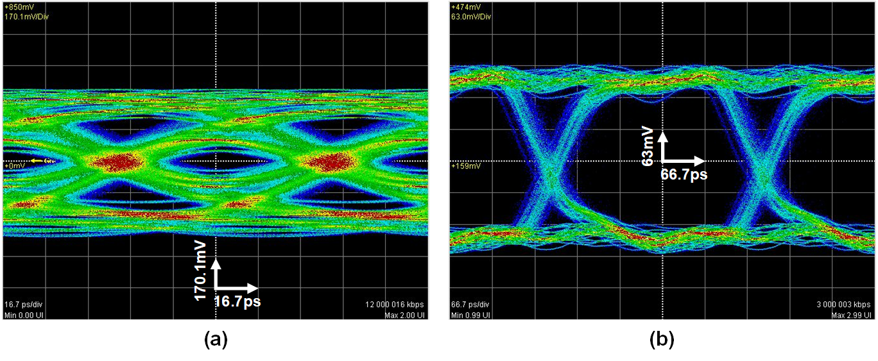
A Low EMI Transceiver for DRAM Interface with Quadrature Clock Corrector and Decision Feedback Equalizer
Hyun-Bin Lee, Dong-Wan Ko, Won-Young Lee
Dept. of Electronic and IT Media Engineering
Seoul National University of Science and Technology
INTORDUCTION
The transmitter (Tx) in the DRAM memory I/O interface has many output drivers which use a lot of current due to communication with other chips through the backplane channel. Using a lot of current at once induces EMI problem.
The receiver (Rx) include decision feedback equalizer (DFE) to equalize the data, which transferred through the backplane channel. The DFE occupies a lot of area and consumes a lot of power, because the DFE is needed per data pins.
Thus, We aim to solve EMI problem in Tx and reduce power in Rx.
PROPOSED TRANSMITTER and RESULT
PROPOSED DFE and RESULT
Proposed Transmitter
  Output drivers transfer data at different times by phase controller circuit which consists of phase interpolator (PI) and transmission gate (TG), and TG is added to turn function on and off.
  Each channel is synchronized by different phase clock.
Proposed DFE in Receiver
  DFE with low supply voltage operation is implemented to reduce the power consumption.
  The DFE calibrates tap weighting by control the output signal common mode.
  It is 2-tap 4 interleaved structure.
  Consist of 4 Integrators, 4 latches and 4 RZ-to-NRZ.
  The RZ-to-NRZ is for quarter rate operation.
  The current consumption used at one time is reduced.
  Quadrature Clock Corrector(QCC) corrects the clock distortion for signal integrity.
  QCC operates to dual loop, thus clock correct time is faster than conventional clock corrector.
  Reducing EMI problem.
< Block diagram
of proposed transmitter >
< Block diagram
of proposed DFE>
< Measured waveform
of corrected clock by QCC >
< Eye-diagram (a) after channel and (b) after DFE >
< Output current profile
of the proposed transmitter >
Proposed DFE
  Power : 3.32 ㎽
  Area : 0.00276 ㎟
  FOM1 : 0.28 pJ/b
  FOM2 : 0.0187 pJ/b/dB
Conventional DFE
  Power : 4.16 ㎽
  Area : 0.0036 ㎟
  FOM1 : 0.35 pJ/b
  FOM2 : 0.0158 pJ/b/dB
23 % reduced Maximum Current Peak
  Normal mode : 163 mA
  Low EMI mode : 126 mA
Performance of QCC
  Duty cycle error : 0.2 %
  phase error : 1.08 ˚
< performance of the proposed DFE and the conventional DFE >
CONCLUSION
The low EMI and low power transceiver for DRAM I/O interface is designed. The proposed transmitter is operated in max. 3.2Gb/s and DFE is operated in max. 12Gb/s. In transmitter, max. current peak is reduced by 23% and QCC corrects the clock in 58 cycles. And max. phase and duty error is 3.75ps and 0.2% in measured results. The proposed DFE compensates for the FR4 PCB channel loss of -15 dB at 12 Gb/s and consumes 3.32 ㎽ achieving 0.28 pJ/bit for PRBS-7 input.
ACKNOWLEDGMENT
The chip fabrication and EDA tool were supported by the IC Design Education Center(IDEC), Korea.

