Slide 1
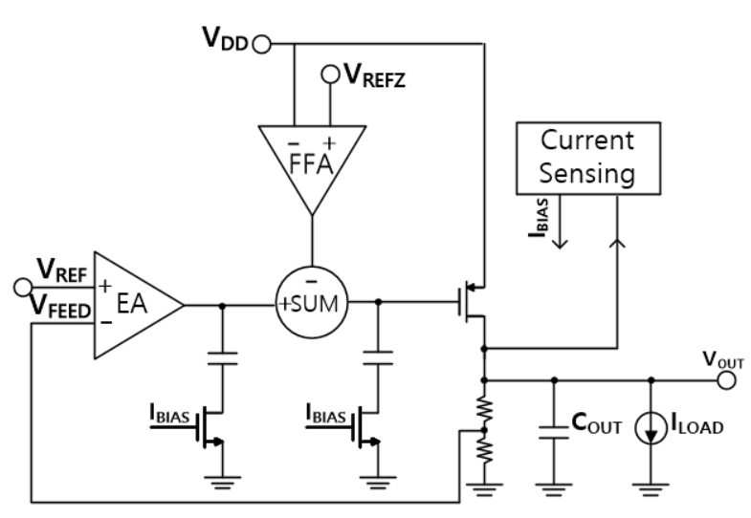
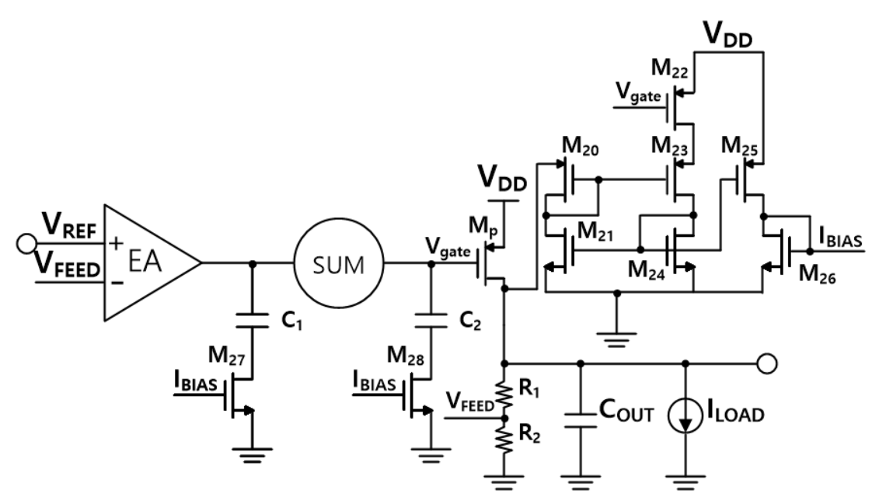
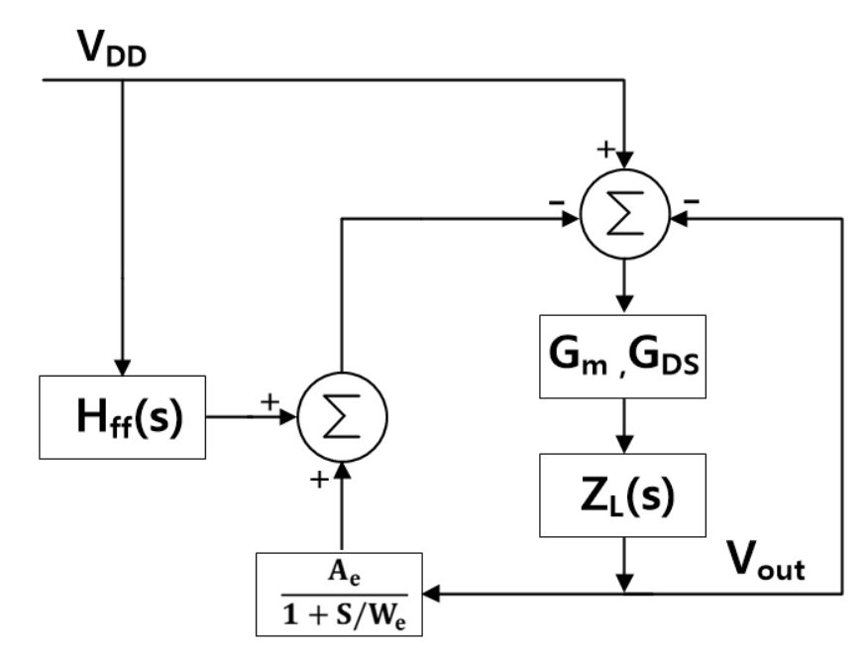
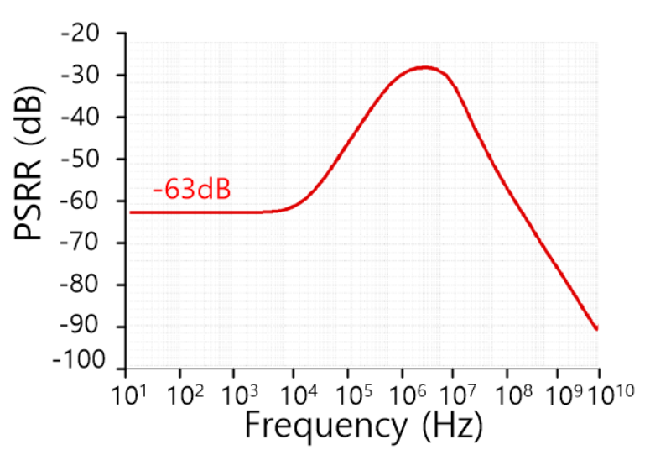
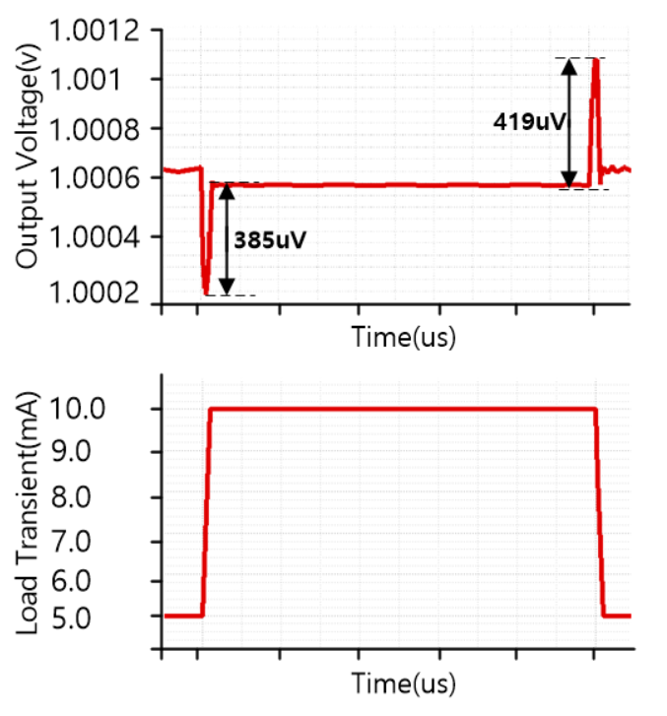
A 28-nm CMOS High PSRR and Stability Low Dropout Regulator Using Feed-Forward with Current Sensing
Bongsu Kim and Junyoung Song
Dept. of Electronics Engineering, Incheon National University, Incheon, South Korea
1. Background
2. Proposed Design
■ LDO regulators are preferred for low output voltage, low dropout voltage, and low output noise application.
■ PSRR is a critical performance parameter that measures their ability to maintain stable output voltage.
■ Conventional LDO structures rely on passive filtering techniques that have limited effectiveness at higher frequencies.
■ Using feedforward, a
high PSRR was a achieved.
■ To regulate overall
stability, generate zero
using the current sensing
Block.
3. System Architecture & Simulation Results
Fig. 1. Proposed feedforward LDO block diagram
Fig. 2. Schematic of the proposed feedforward LDO
Fig. 3. Schematic of the current sensing
Fig. 4. Mathematical model of the LDO
Fig. 5. Simulation measured PSRR (I_{LOAD} = 10mA)
Fig. 6. Simulation measured load transient response
(5mA → 10mA → 5mA )
4. Conclusion
■ When there are fluctuations between 5mA and 10mA, the overshoot and undershoot are 419uV and 385uV, respectively.
■ A stable PM for the overall stability of LDO is established by creating a zero generator using current sensing.
■ Results shows a -63dB at 10kHz and performs well at all frequency.
Acknowledgement The chip fabrication was supported by the IC Design Education Center(IDEC), Korea.
Reference [1] J. Jiang, W. Shu and J. S. Chang, "A 65-nm CMOS Low Dropout Regulator Featuring >60- dB PSRR Over 10-MHz Frequency Range and 100-mA Load Current
Range," in IEEE Journal of Solid-State Circuits, vol. 53, no. 8, pp. 2331- 2342, Aug. 2018.
[2] K. Joshi, S. Manandhar and B. Bakkaloglu, "A 5.6 μ A Wide Bandwidth, High Power Supply Rejection Linear Low-Dropout Regulator With 68 dB of PSR Up To
2 MHz," in IEEE Journal of Solid-State Circuits, vol. 55, no. 8, pp. 2151- 2160, Aug. 2020.
[3] M. El-Nozahi, A. Amer, J. Torres, K. Entesari and E. Sanchez-Sinencio, "High PSR Low Drop-Out Regulator With Feed-Forward Ripple Cancellation Technique," in
IEEE Journal of Solid-State Circuits, vol. 45, no. 3, pp. 565-577, March 2010.

