Slide 1
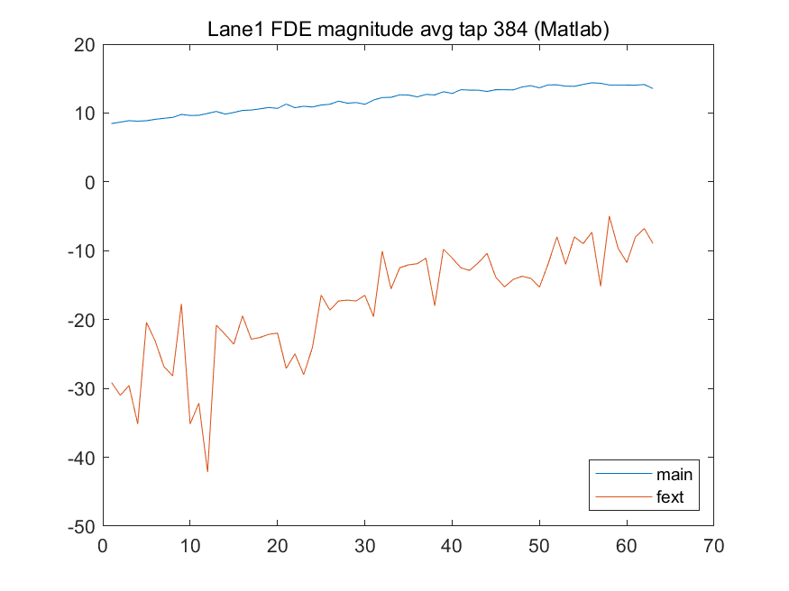
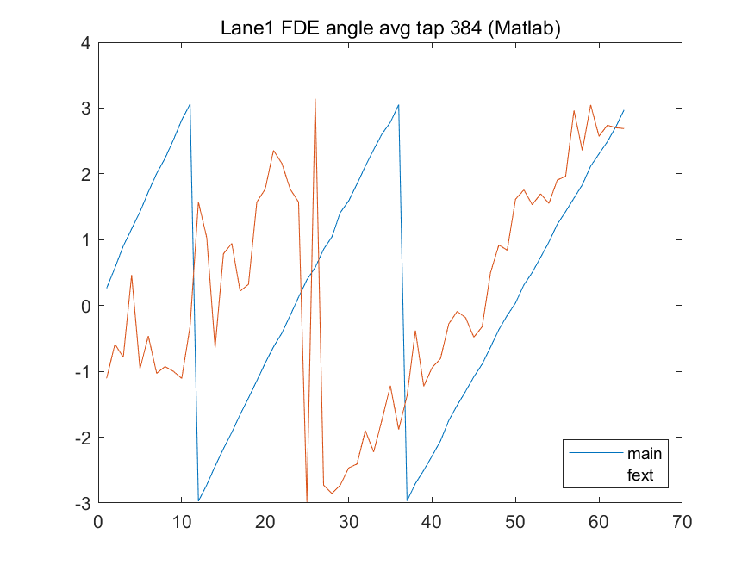
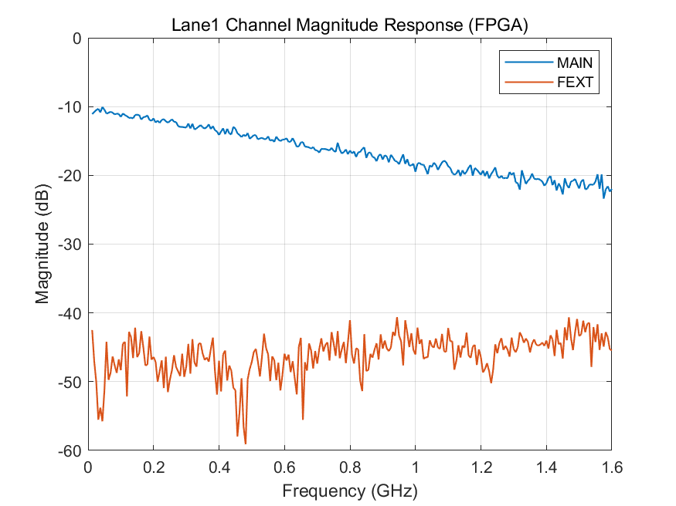
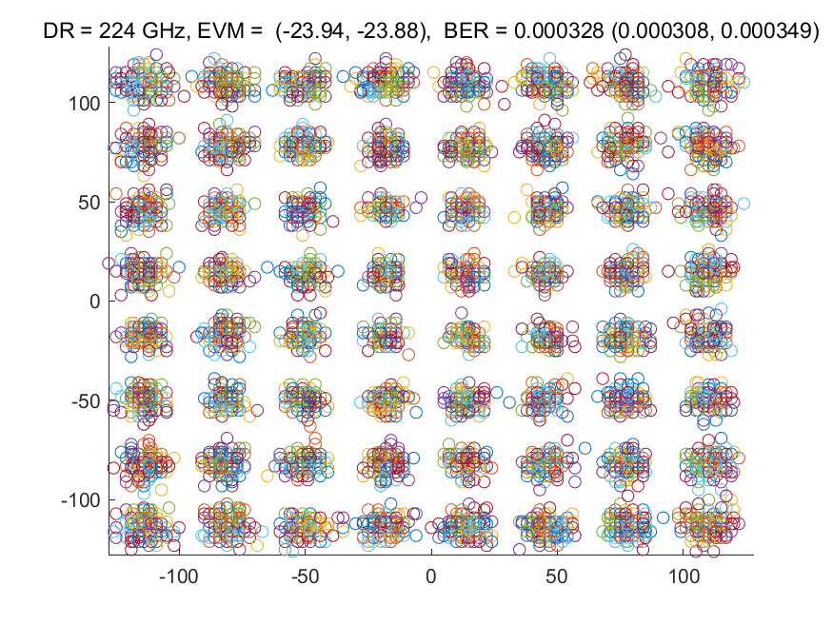
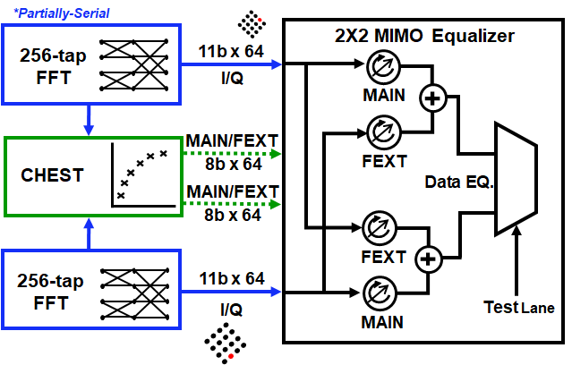
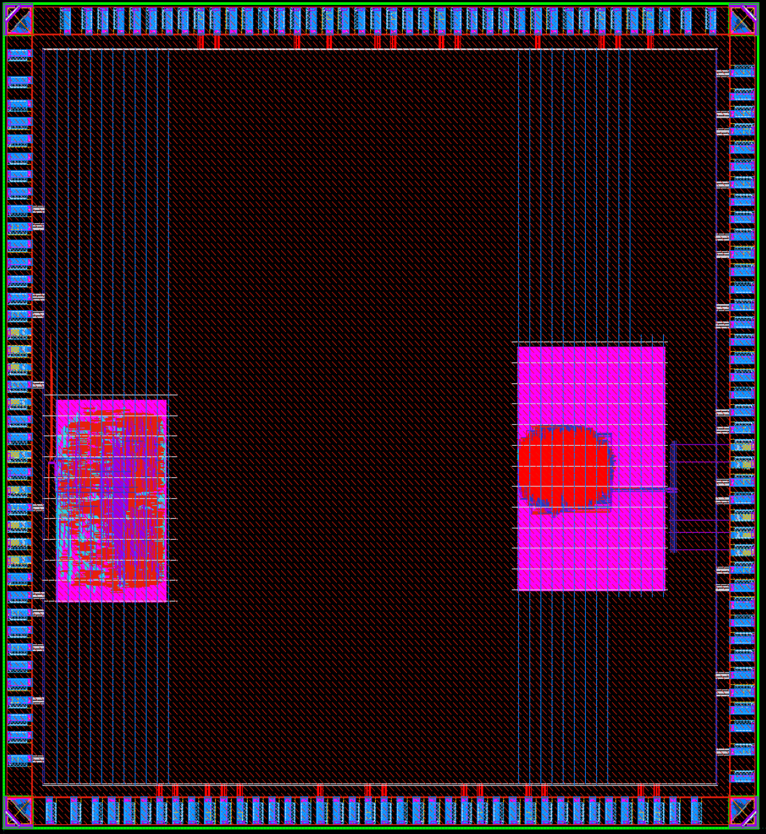
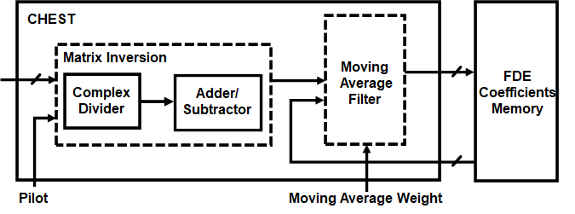
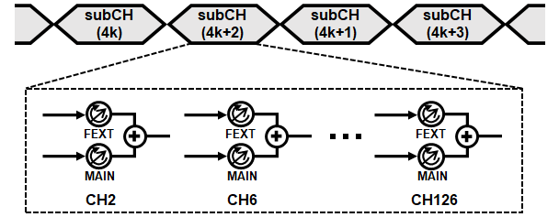
Chip Design for Performance Evaluation of Digital Equalizer for >224Gb/s ADC-Based Serial Links
대구경북과학기술원 전기전자컴퓨터공학과
장서영, 이재원, 김가인
jang119jsy@dgist.ac.kr, ljw3136@dgist.ac.kr, gain.kim@dgist.ac.kr
Introduction
Results
Simulation
FEXT decreases SNR and increases BER
However, PAM4 is vulnerable to FEXT
Chip-to-chip connectivity requires ever-higher wireline transceiver bandwidth
High-order modulation is needed for better bandwidth efficiency
Method
Estimated FDE coefs. Blue(main),Orange(FEXT)
RX Datapath
Measured channel(left), Constellation(right)
Layout
Left: 64-tap
(1000um x 600um)
Right: 256-tap
(1200um x 700um)
BIDI is used for chip configuration
and readout of measured results
partially-serial FFT
2x2 MIMO cross equalization
On-chip channel adapdations
Channel estimation
Comparsion
 | 1-lane 56G DMT | 2-lane 224G DMT
Synchronization | Off-chip | 128-tap sign-sign
FFT | 32-tap / Parallel | 128-tap / Serial
Cylic-Prefix | 4-tap / Exact | $≥$8 / Approx
FDE | SISO FDE | 2x2 MIMO FDE
CHEST | Off-chip | 2x2 MIMO
Operating Freq | 1.2GHz | 200MHz
Area/lane (um2) * | 200k | 620k
Support up to 1024-tap moving average window
2x2 MIMO cross equalizer
*:Area @ 500MHz within ss 28nm rvt
Conclusion
FEXT cancellation with OFDM requires small amount of additional resource
Proposed FEXT-cancellation OFDM is promising to achieve > 224Gbps
On-chip CHEST is area-efficient for slow-fading channel
Only one addional complex multiplexer per sub-channel for each aggressor

