Slide 1
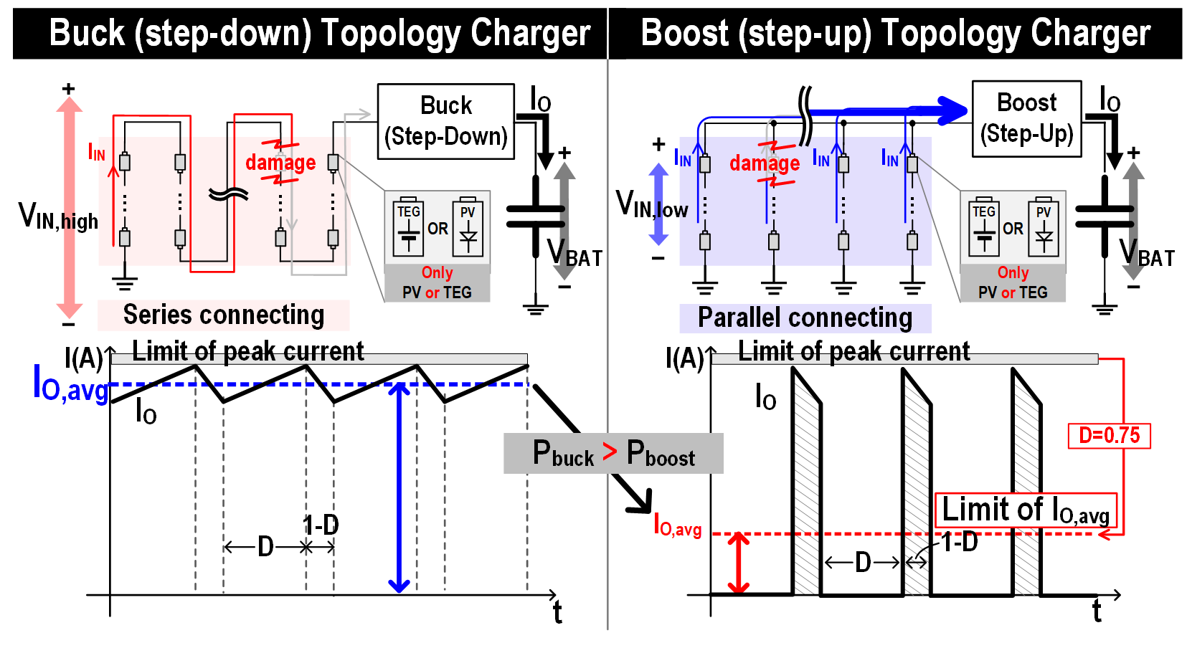
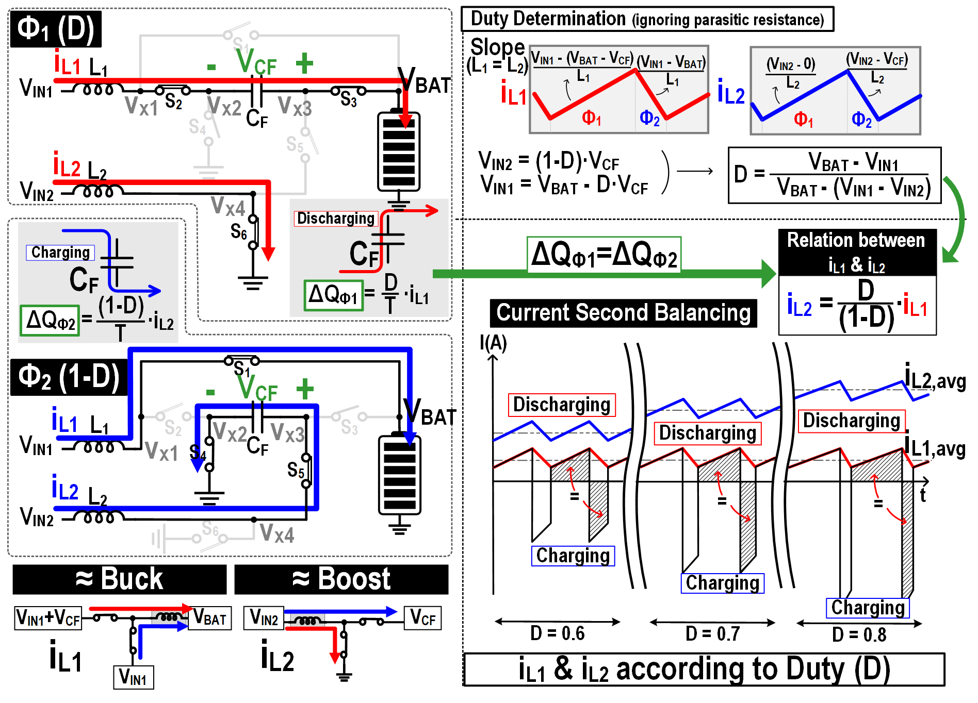
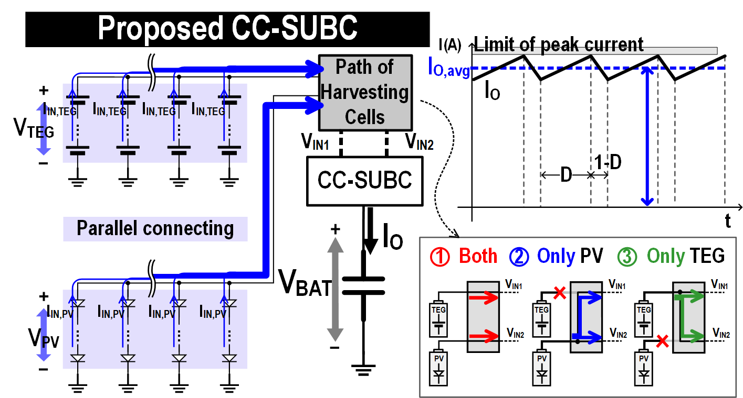
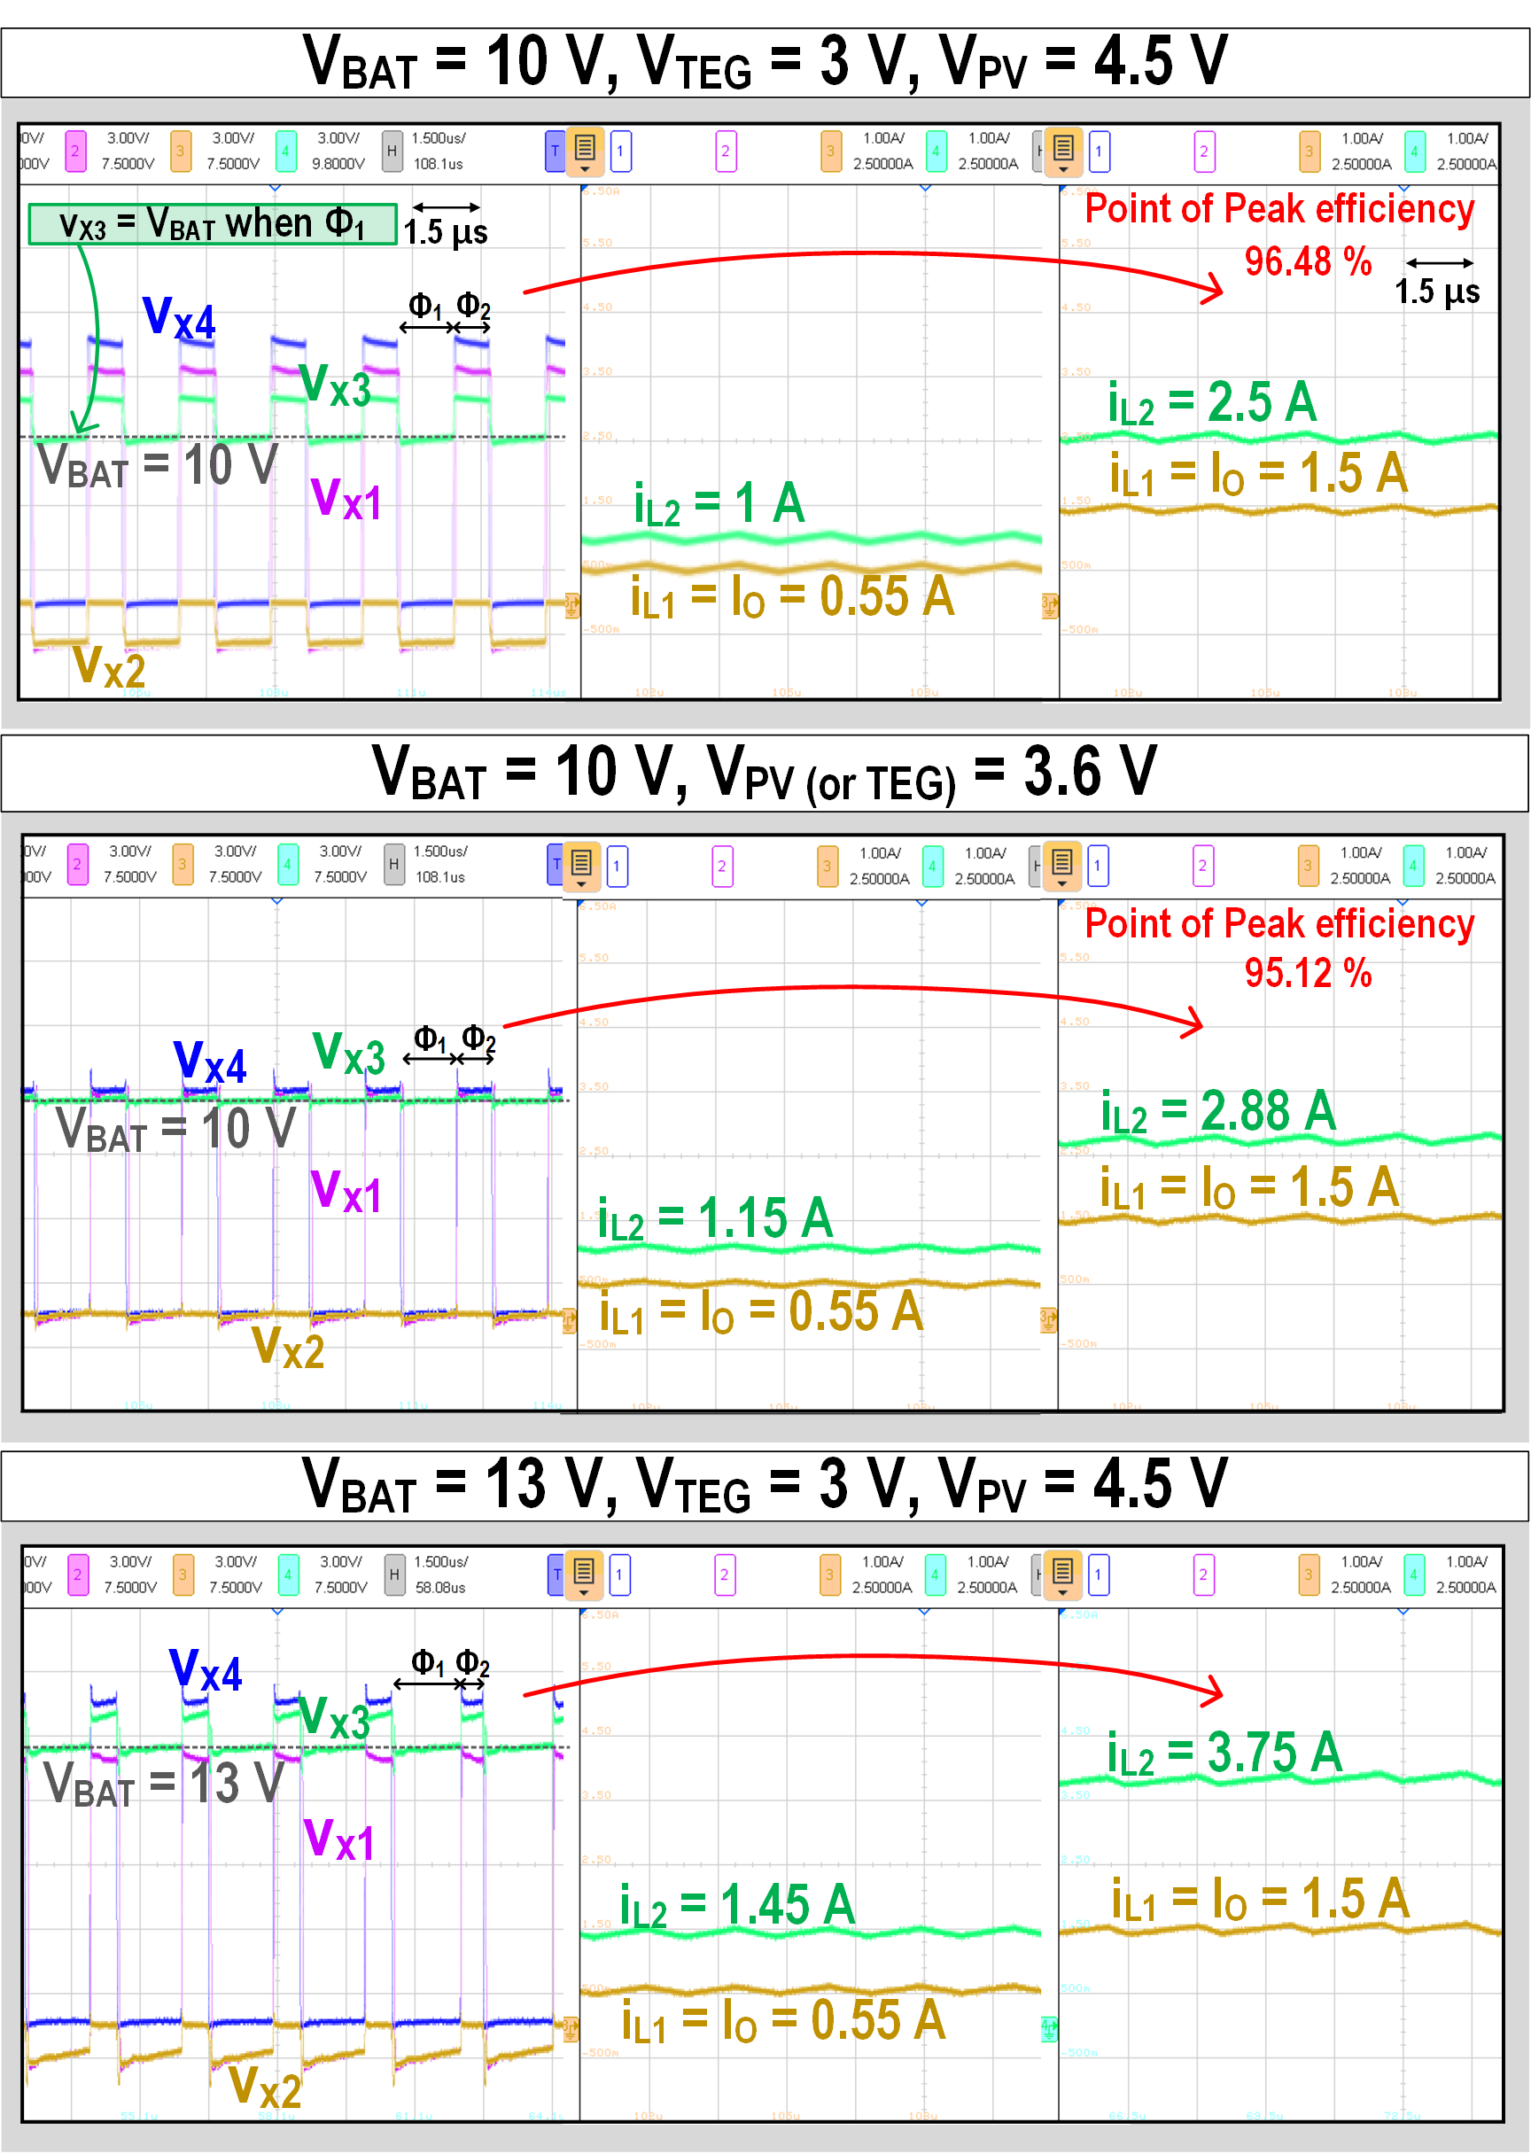
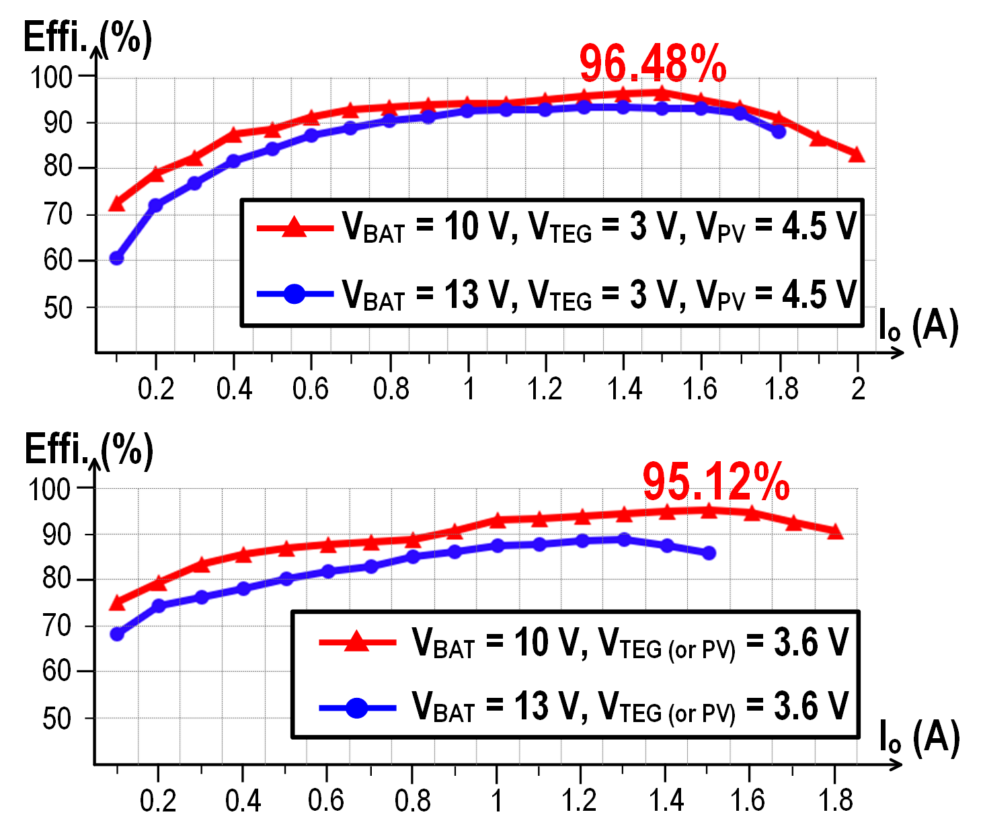
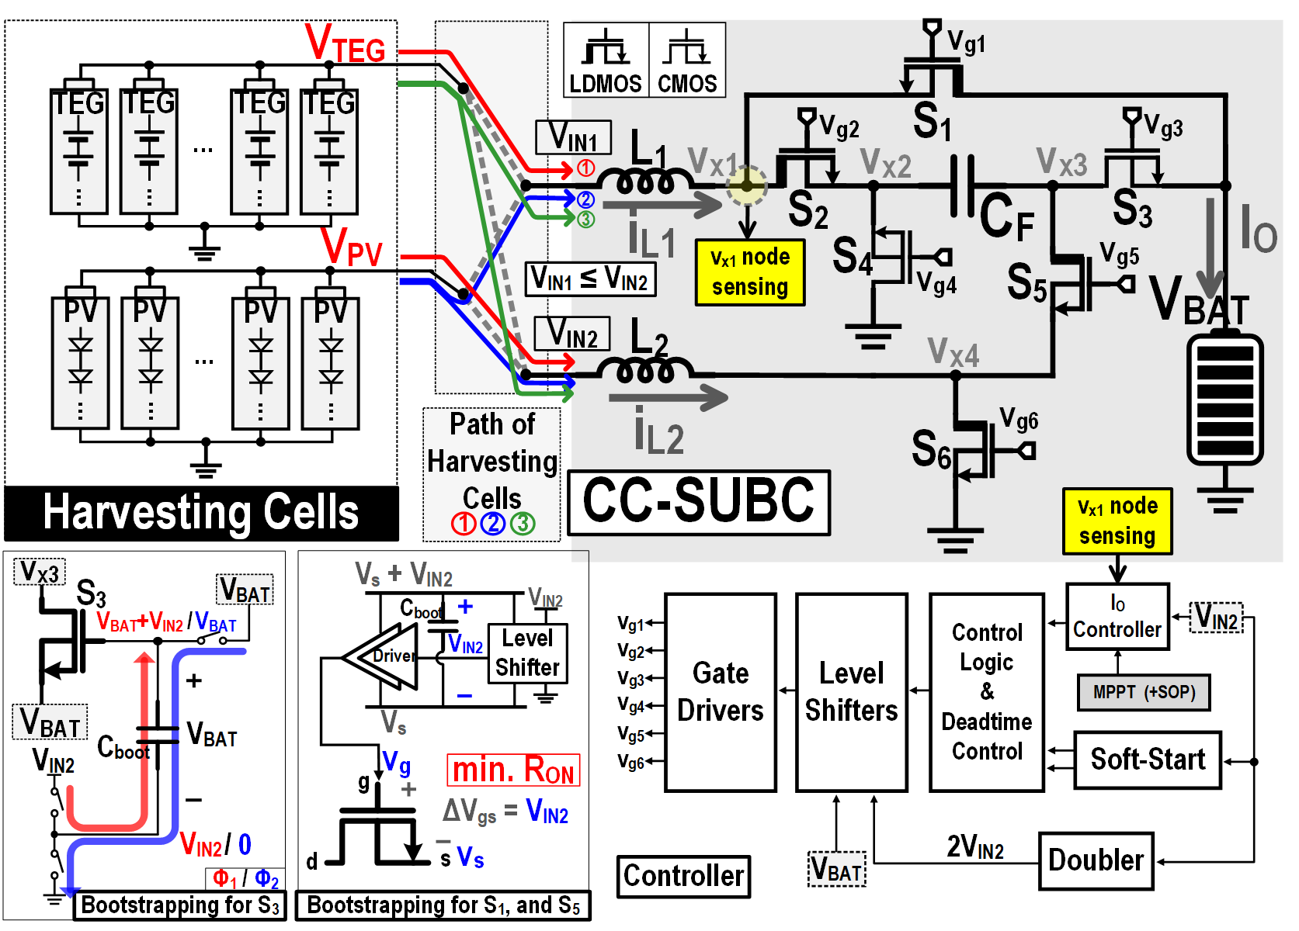
96.48% Peak-Efficiency Continuous-Current Step-Up Battery Charger (CC-SUBC) with Dual Energy-Harvesting Sources for Automotive Application
Hyo-Jin Park, Young-Jun Jeon, Young-Ju Oh, and Sung-Wan Hong
School of Electronics Engineering, Sogang University
Design Procedure
Circuit Explanation
Buck charger
- Continuous output current
- Inefficient use of harvesting cells
Boost charger
- Discontinuous output current
- Efficient use of harvesting cells
Positive Feedback Loops
Adaptively increase bias current
Possible to improve slew-rate
Keep static power consumption small
☺
☹
☺
☹
- Operation of the CC-SUBC
- Duty determination and relationship between i_{L1} and i_{L2}
Result
Continuous-Current Step-up battery charger (CC-SUBC)
Continuous output current
Efficient use of harvesting cells
Dual harvesting sources
☺
☺
☺
Circuit Architecture
Peak efficiency was 96.48% (V_{BAT}=10V, V_{TEG}=3V and V_{PV}=4.5V )
→
→ Operation of the proposed charger with a single & dual input source
Conclusion
CC-SUBC has the largest maximum output power among the step-up converters.
Among the converters, CC-SUBC is the sole converter having two input sources.
Among the step-up converters, only CC-SUBC has a continuous I_{O}.
2 input, 1 Flying capacitor, 2 inductors, and 6 switches
Reduce the power loss by making the minimum R_{ON} of switches
<Acknowledgement>
The EDA tools were supported by the IC Design Education Center (IDEC), South Korea.

