Slide 1
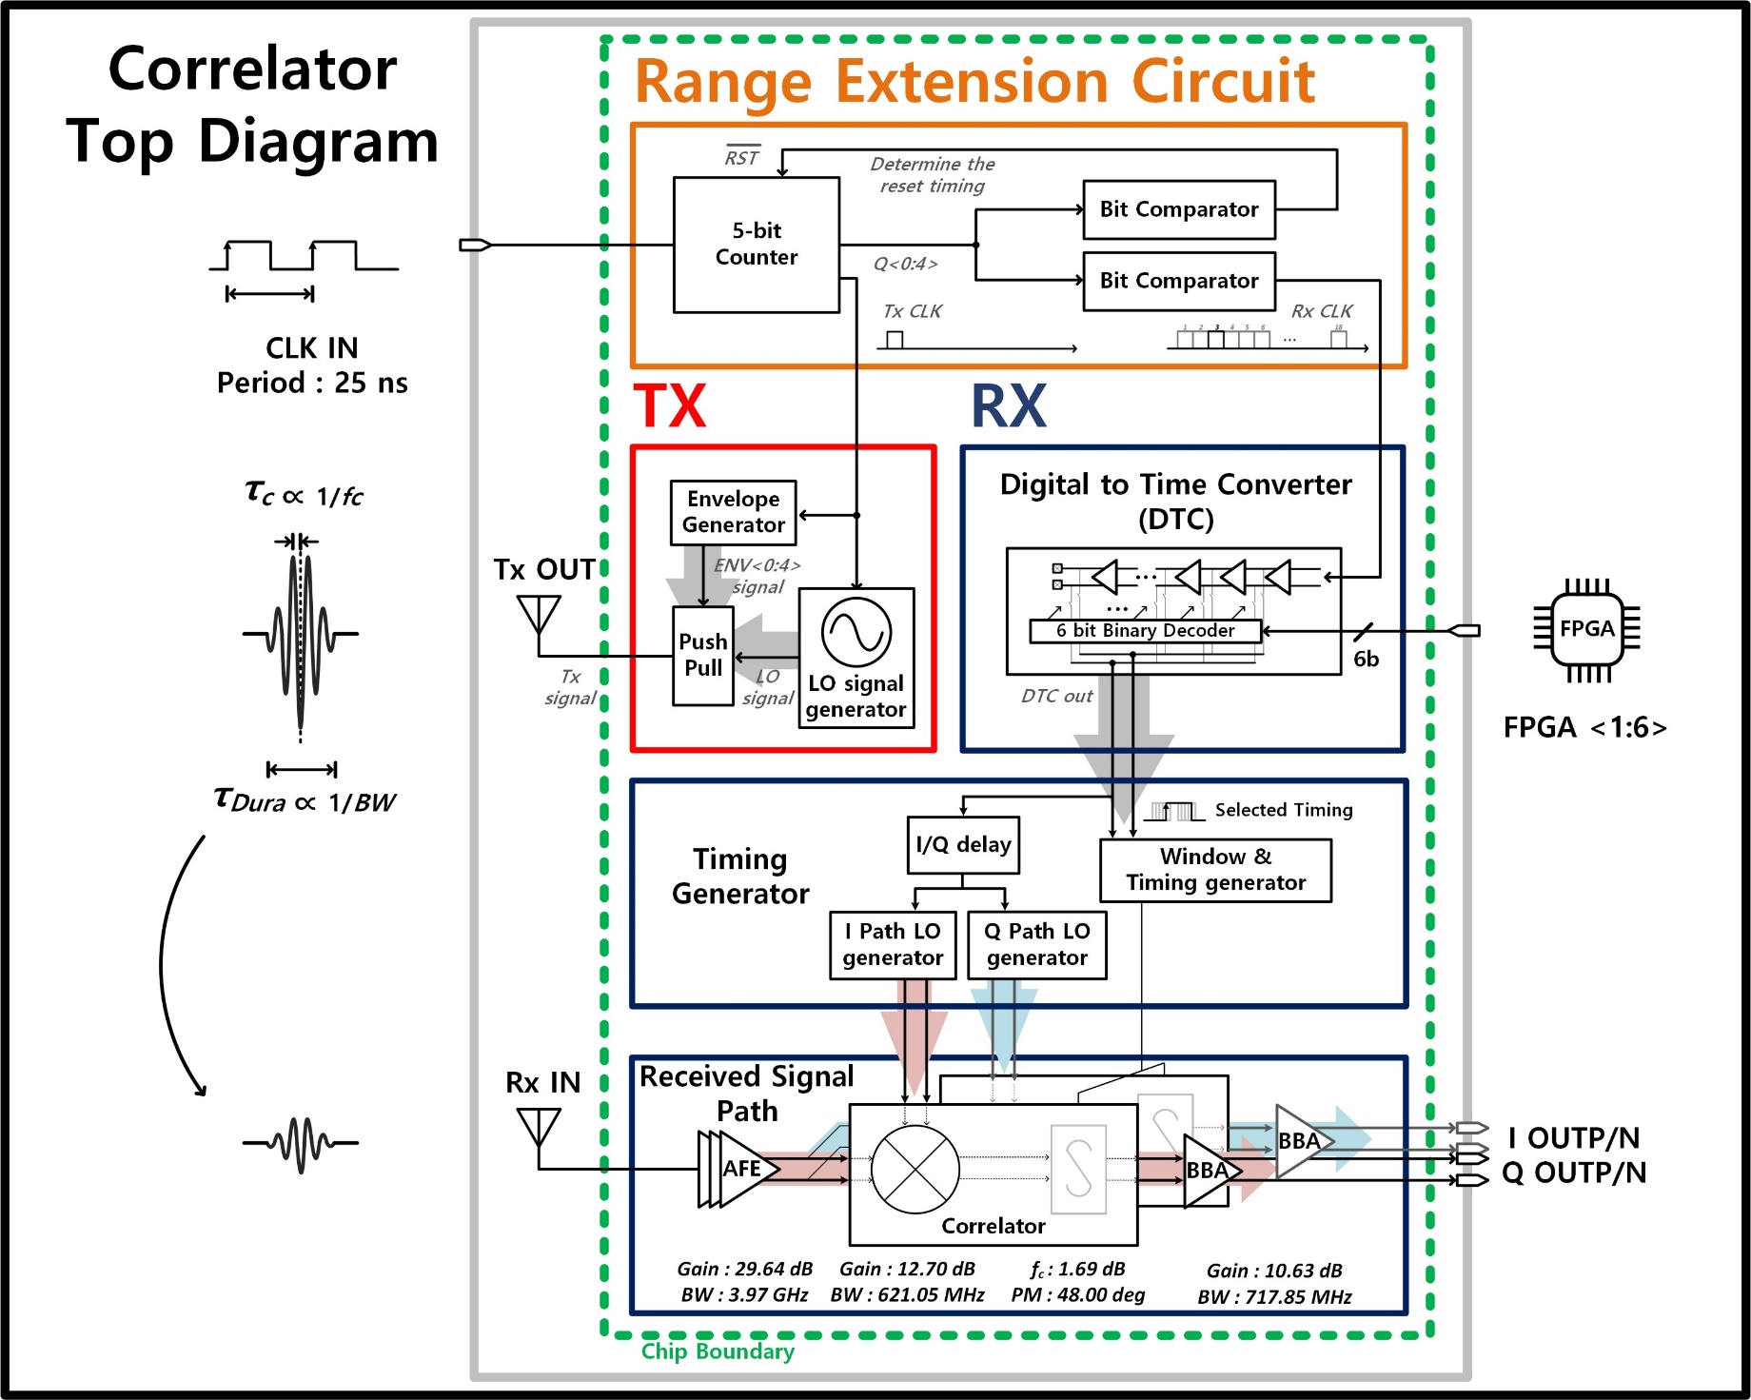
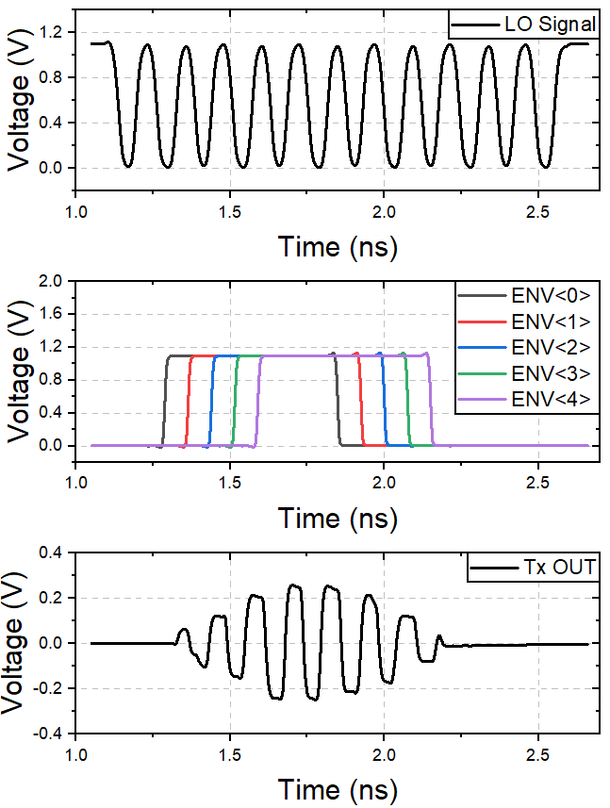
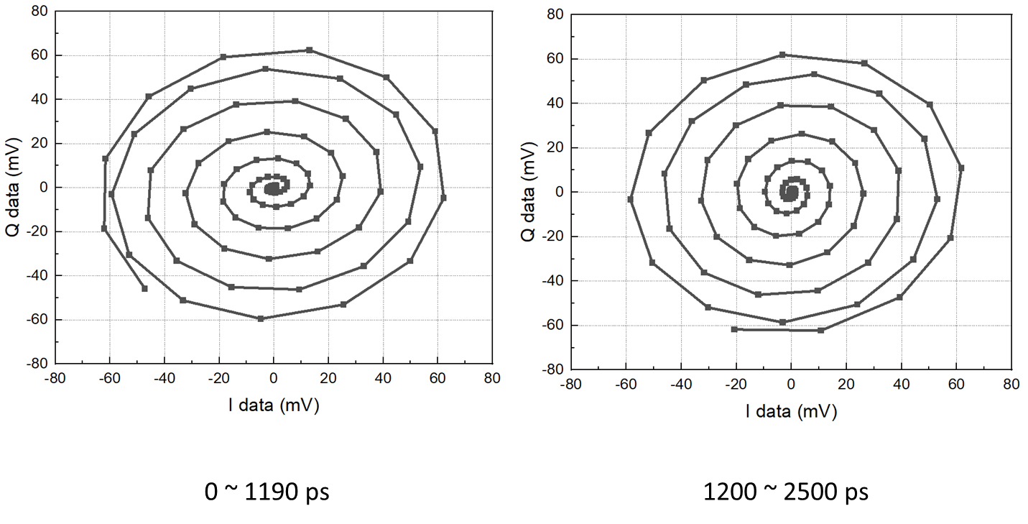
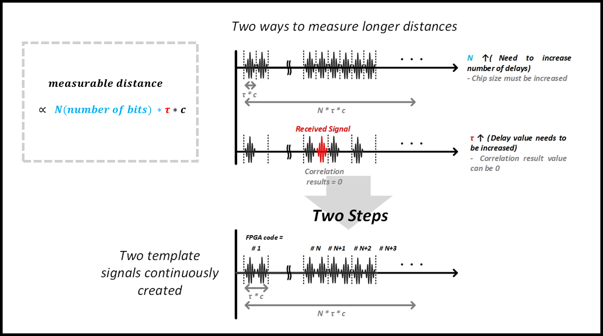
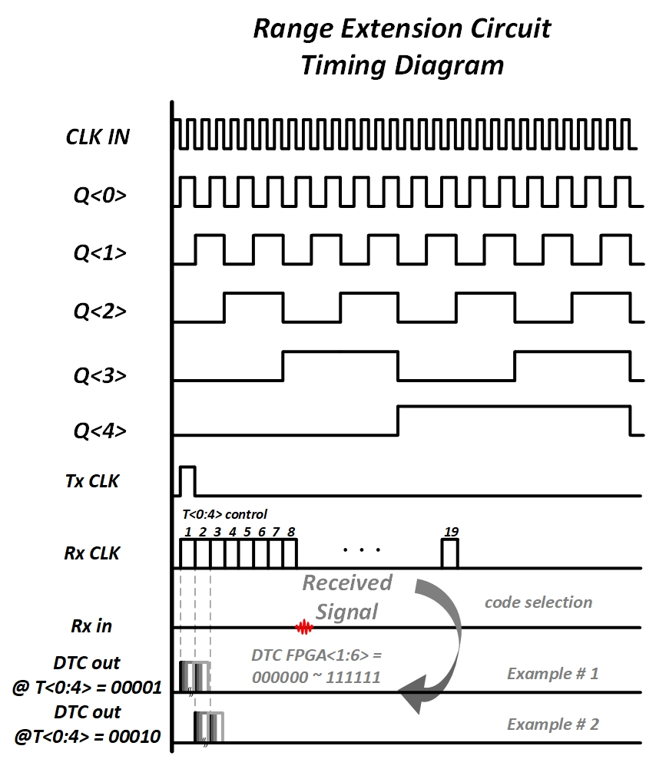
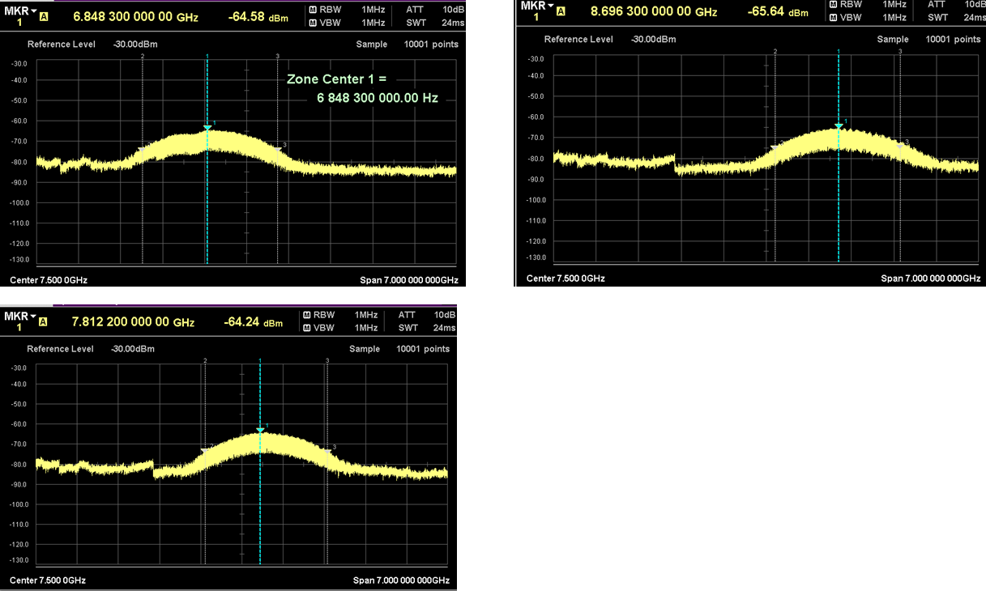
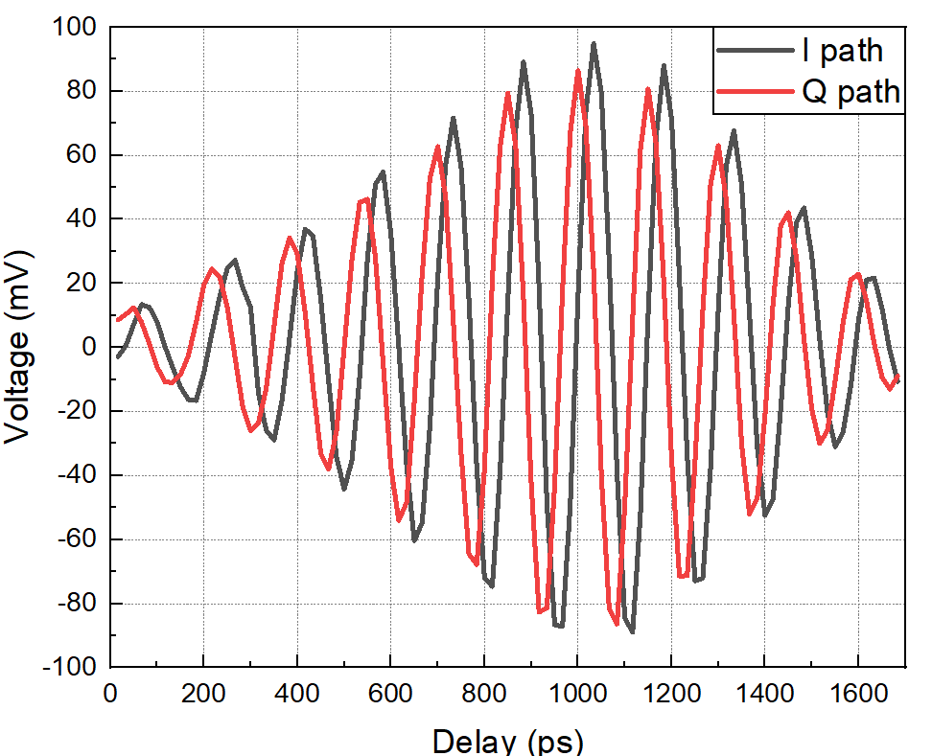
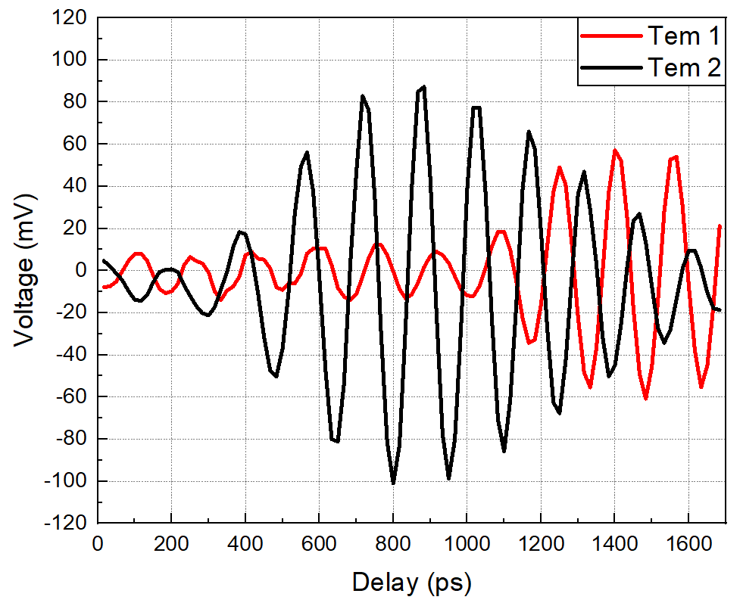
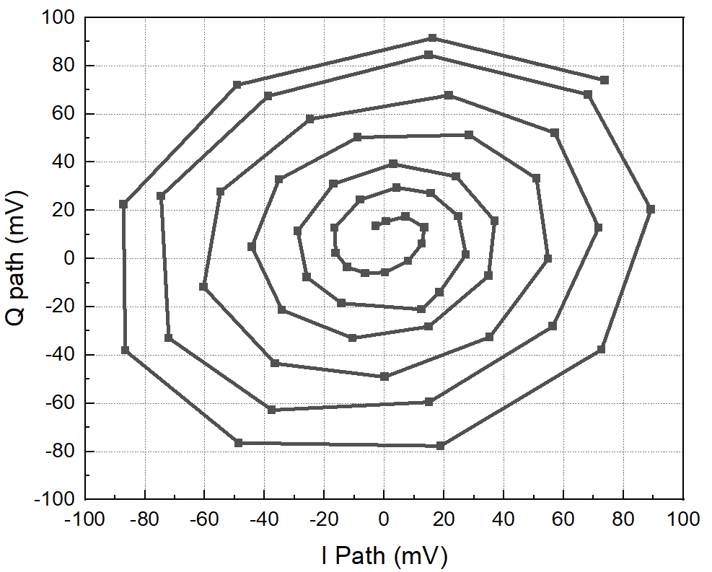
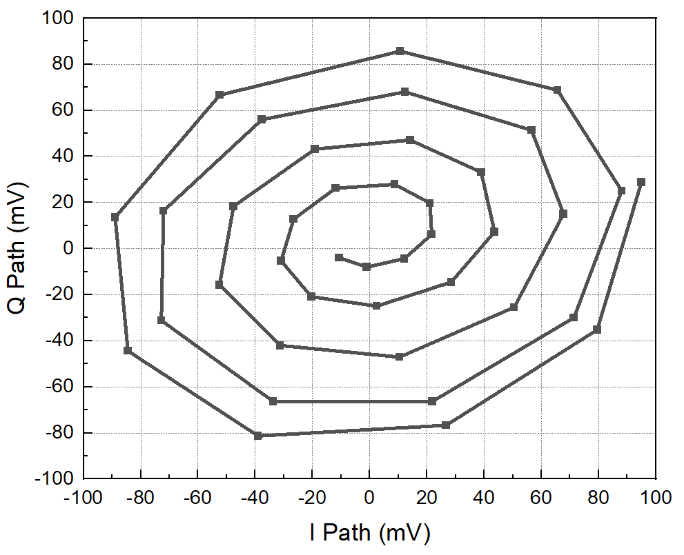
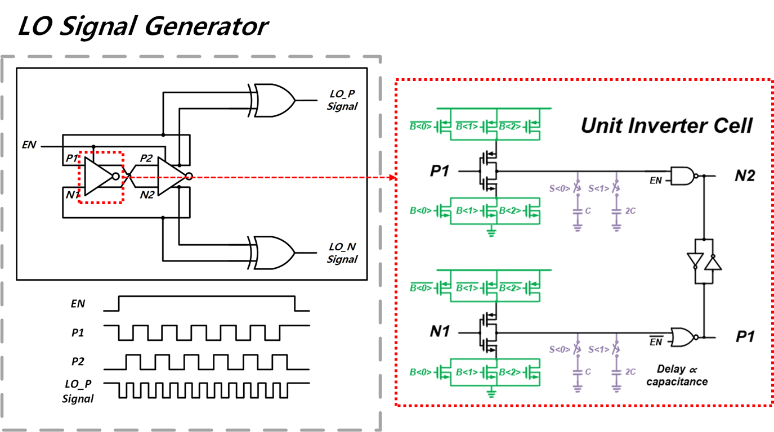
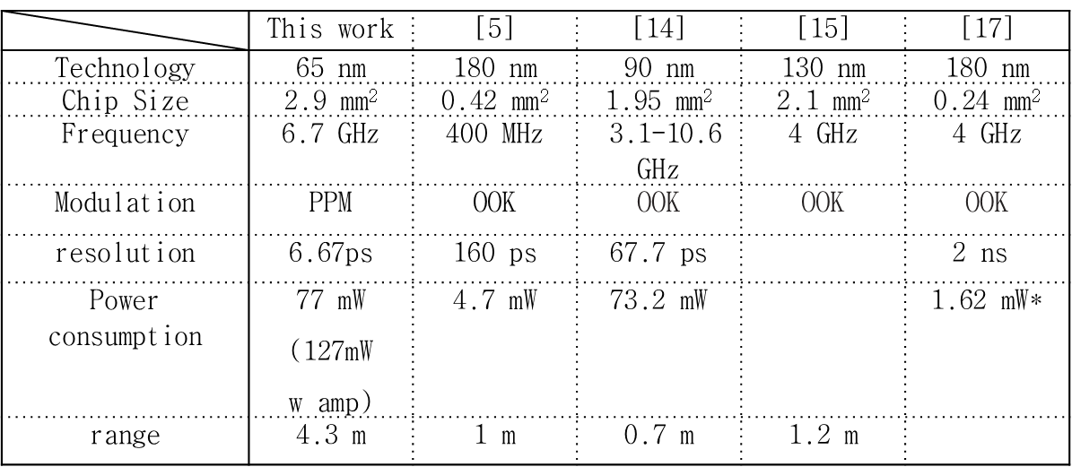
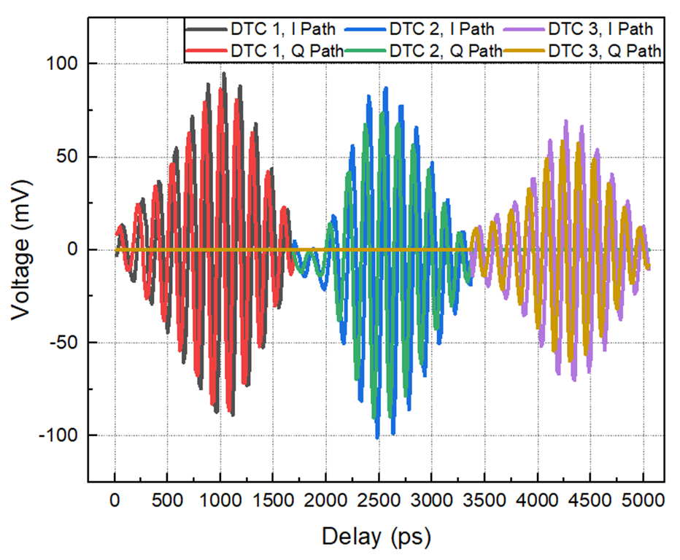
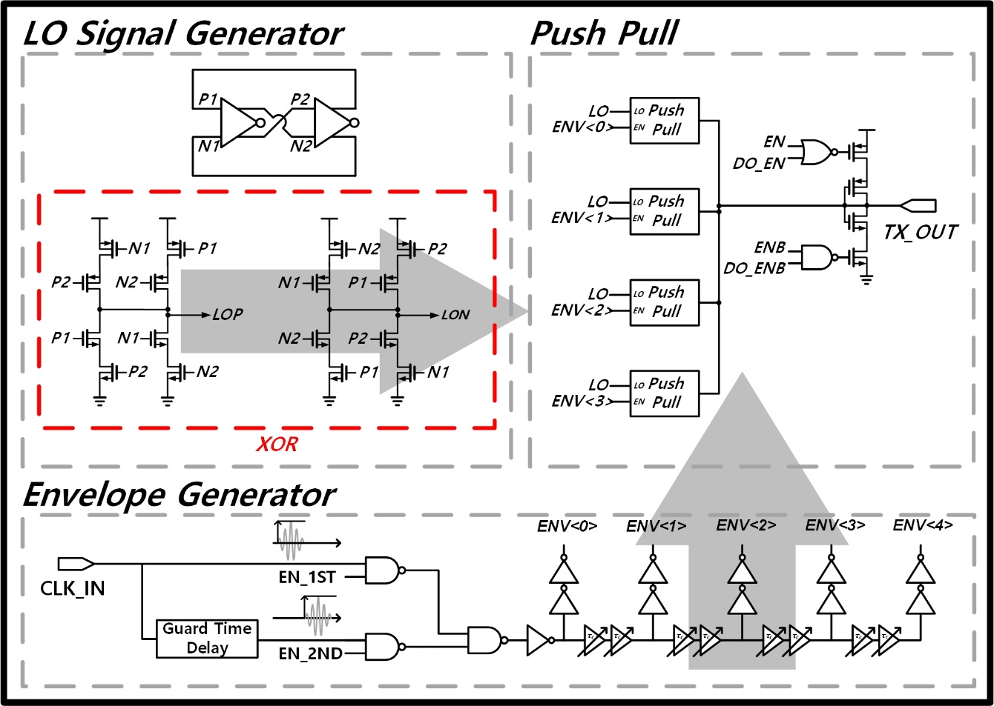
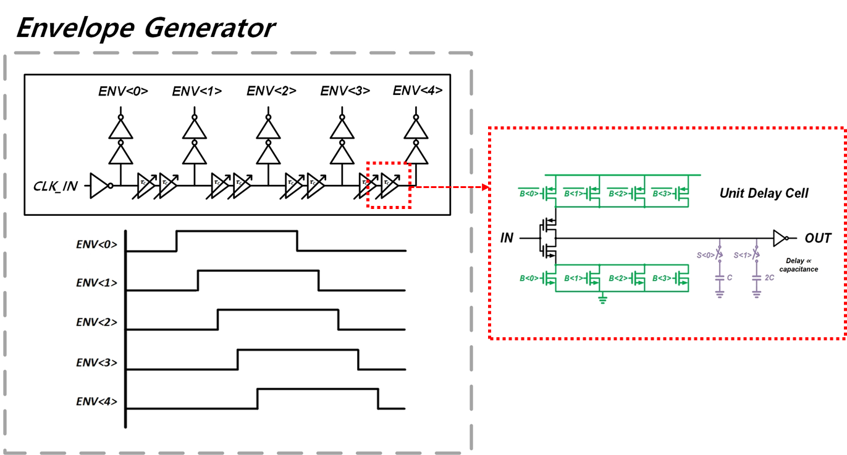
IR-UWB precision distance measurement system based on correlation technique capable of long-distance measurement
한유현, 연세대학교
In the case of a radar using a RF signal, it can measure a long distance and is insensitive to illumination or weather, so the radar has characteristics that can be used in any surrounding environment. In particular, since IR-UWB has a short signal length due to its broadband, a system using it is advantageous for precise distance measurement, and this study proposes a precision distance measurement system based on IR-UWB technology. In particular, by implementing a correlation-based precise distance measurement system using IR-UWB, we propose an impulse radar capable of long-range location measurement with high resolution.
Top Diagram
Simulation Results
✓ A block diagram of the correlation-based measurement system
✓ It can be confirmed that Gaussian-shaped UWB pulses are being created through the gate ring-based Tx/template generator.
✓ From 0-1190ps, ​​the signal reflected from the object and the template signal are approaching, and conversely, from 1200-2500ps, ​​they are moving away.
✓ As the two signals get closer, the correlation result value gradually increases and rotates, and as the two signals move away, the result value gradually decreases and rotates.
Key Idea
✓ Introduction of two-step technique for measuring long distances
Measurement Results
✓ Suggests the possibility of using a long-distance measurement using a range extension circuit
✓ Confirm that the Tx frequency has approximately 6.85, 7.81, 8.70 GHz depending on the digital bit
✓ It consumes 77mW (127mW w Amp) of power and is measured at approximately 5 mm intervals.
✓ A Tx/Template signal generator based on a gated ring oscillator is proposed. This circuit can control the center frequency and envelope shape with digital bits.
[5] TERADA, Takahide, et al. A CMOS ultra-wideband impulse radio transceiver for 1-mb/s data communications and/spl plusmn/2.5-cm range finding. IEEE Journal of Solid-State Circuits, 2006, 41.4: 891-898.
[14] ZITO, Domenico, et al. A 90nm CMOS SoC UWB pulse radar for respiratory rate monitoring. In: 2011 IEEE International Solid-State Circuits Conference. IEEE, 2011. p. 40-41.
[15] SHIM, Yuna, et al. A 520 pJ/pulse IR-UWB radar for short range object detection. In: 2011 IEEE Radio Frequency Integrated Circuits Symposium. IEEE, 2011. p. 1-4.
[17] PHAN, Anh Tuan, et al. Low-power sliding correlation cmos uwb pulsed radar receiver for motion detection. In: 2009 IEEE International Symposium on Circuits and Systems. IEEE, 2009. p. 1541-1544.
✓ We implemented a system that can measure long distances very precisely through two-step (Coarse, Fine) operation.
✓ It is designed to extend the measurement distance and implements a Tx/Template Generator that can control center frequency and envelope shape with digital bits.

