Slide 1

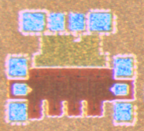
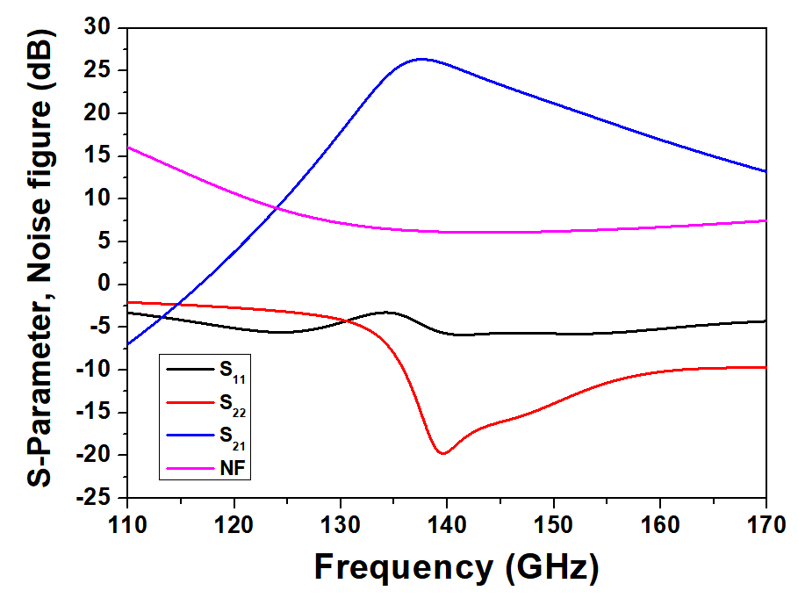
A 140-GHz Low Noise Amplifier in 28-nm CMOS
Jaeman Lee, Wooyong Keum, and Jae-Sung Rieh
High Speed Integrated System Lab.
Korea University, Anam-ro 145 Seongbuk-gu, Seoul, Korea
Introduction
In THz communication systems, low noise amplifier dominates the overall system noise of the receiver. Especially on sub-terahertz to terahertz band, Signal-to-Noise ratio (SNR) is lower as frequency becomes higher, so the design of LNA is much more important which can amplify signal power with less noise addition. In this work, a 140-GHz low noise amplifier based on Samsung 28-nm CMOS process has been designed.
1. Circuit Design
Fig.1 shows the schematic of unit stage amplifier.
Noise matching for input matching of first stage and 50-ohm matching for the other are implemented with single stub matching.
C₃ ~ C₆ are used for bypass capacitors which can block noise from external supply and also can guarantee and operation and TL₃ and TL₆ as a short stub at the same time.
R₁ and R₂ are placed between bypass capacitor and ground. By placing the resistors, the oscillation due to bypass capacitors and parasitic inductance can be suppressed effectively.
Fig.2 shows the block diagram of entire circuit which is composed of 4-Stage amplifier.
2. Simulation Result
Fig.3 shows the chip photo of fabricated 4-Stage LNA.
The size is 705 um x 621 um and 450 um x 205 um without pad.
4-Stage LNA simulation results are showed in Fig.4. According to this, it has 25-dB peak gain at 138 GHz, and 6-dB minimum noise figure at 140 GHz.
Each of all stages has the same bias voltage (drain voltage for 1V, gate voltage for 0.8V), and total DC power consumption is 31.9 mW.
Fig. 3. Chip photo of fabricated LNA
Fig. 1. Schematic of unit stage
Fig. 2. Block diagram of entire circuit
Fig. 4. Simulation Results
Conclusion
In this work, we designed 140-GHz low noise amplifier based on Samsung 28-nm CMOS process. It has 25-dB peak gain and 6-dB minimum noise figure in simulation. This circuit will be measured with VNA (Vector Network Analyzer) to evaluate the S-parameter. The designed LNA can be applied to D-band wireless communication systems or radar systems.
Acknowledgement
The chip fabrication and EDA tool were supported by the IC Design Education Center(IDEC), Korea.

