Slide 1

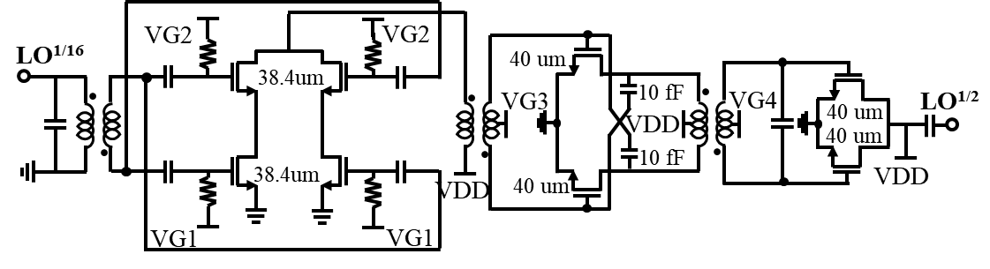


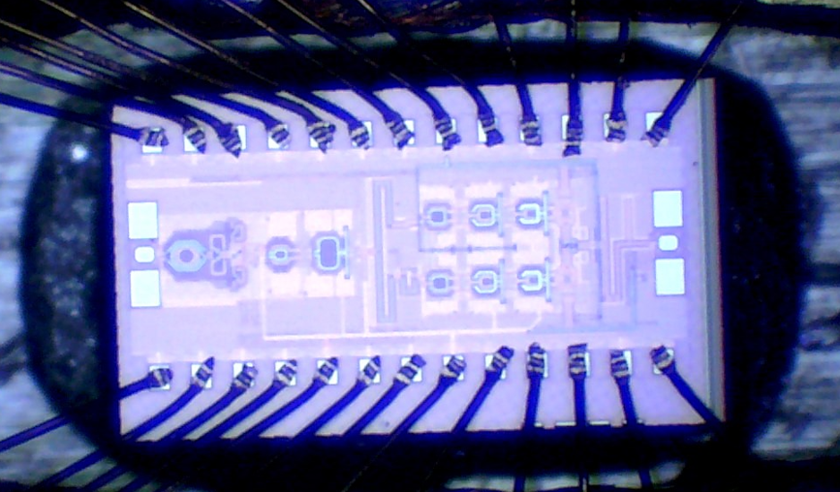
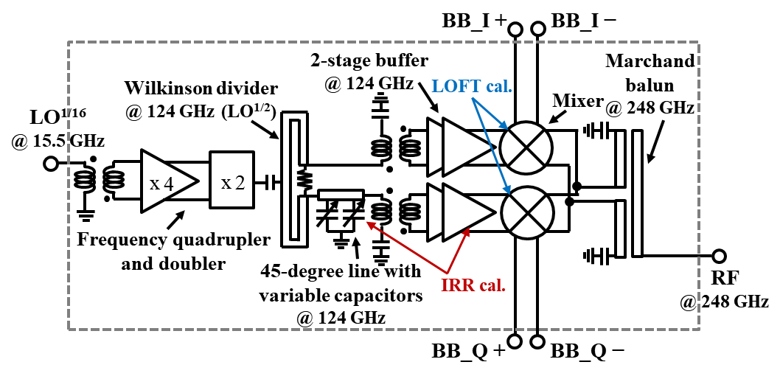
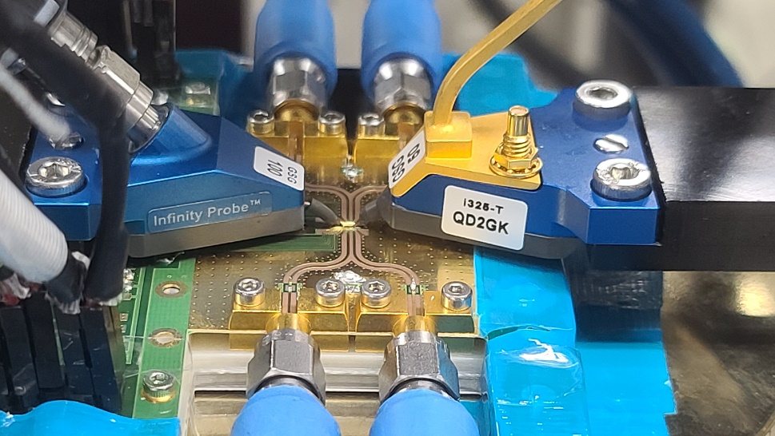

248 GHz Compact Mixer-Last Direct-Conversion Transmitter with I/Q and LO Feedthrough Calibration Capability
Seunghoon Lee, Junhyeong Kim, and Ho-Jin Song
Electrical Engineering, POSTECH, Pohang, Korea
Abstract
- This paper presents a 248 GHz compact direct-conversion transmitter (TX) with IQ imbalance and LO feedthrough (LOFT) calibration capability, which can achieve a data rate of 20-Gb/s with 16-QAM. The measured image rejection ratio (IRR) and LOFT suppression are better than 25 and 28 dB, respectively, within the range of 242–252 GHz.
Introduction
- The sub-terahertz band above 200 GHz has attracted research interest due to its wide frequency bandwidth and compact hardware size [1].
- Extensive research has been conducted on developing TXs operating above f_{max}. There are generally three structures:
IF
RF
IF
x 2
IF
PA
x N
RF
x N
RF
Fig. 5. Schematic of frequency multipliers.
Fig. 6. n^{th} harmonic output power.
LO
x N/2
LO
LO
LO Multipliers (x8)
  Employs x4 and x2 to efficiently produce the eighth harmonic with low power and size.
  The simulated peak output power is -2.46 dBm at 136 GHz with a harmonic suppression greater than 24 dB and a power consumption of 31 mW.
Multiplier-last TX
Cubix mixer-last TX
Mixer-last TX
High output power
Not suitable for high-order constellation
Spectral broaderning
High-performance
High power consumption
Large area
Simple structure
High power consumption
Long LO chain
Measurement
→ In this work, a 248 GHz direct conversion transmitter with a push–push sub-harmonic double-balanced mixers has been developed, which is capable of IQ and LOFT calibration capability. It achieves a maximum data rate of 20-Gb/s with low power consumption and a compact size.
1.34 mm
AWG
(Keysight M8195A)
Signal Generator
(Keysight N5183B)
Signal Generator
(Keysight N5183B)
I+
I-
Q+
Q-
VDI D-band extension module (×12)
Transmitter Design
0.64 mm
LO generation
2-stage
buffer
mixer
+balun
LO^{1/16}
RF
DSO
(Keysight DSOV254A)
TX module
External
sub-harmonic mixer
Fig. 7. A photograph of die chip.
Fig. 8. Measurement setup.
20 dB
20 dB
Fig. 9. Measurment setup photo.
Fig. 10. Measured LOFT, IRR.
Fig. 1. 248 GHz CMOS transmitter architecture.
RF+
RF−
IQ current combiner
LO₀^{1/2} + (f₀/2)
M₂ M₂
M₂ M₂
harmonic mixer
LO₄₅^{1/2} + (f₀/2)
M2 M2
M2 M2
harmonic mixer
Modulation | QPSK | 16 QAM | 32 QAM
Baud rate (Gbaud/s) | 9 | 5 | 2
EVM (dB) | -12.26 | -17.37 | -18.81
LO₀^{1/2} − (f₀/2)
12.4 fF
f₀
f₀
12.4 fF
LC series
LO₄₅^{1/2} − (f₀/2)
12.4 fF
f₀
f₀
12.4 fF
LC series
Fig. 11. Output power, conversion gain
Fig. 12. Constellation measurement
60Ω
VG1
130um
VG1
60Ω
LOFT calibration
60Ω
VG1
130um
VG1
60Ω
Chip/core size : 1.34 × 0.64 mm², 0.4 mm²; consumped DC power : 96.3 mW.
LOFT and IRR after calibration were improved by approximately 20 dB at 245 GHz and maintained above 28 dB and 25 dB in the range of 242 GHz to 252 GHz.
The conversion gain and output P1dB of the DCT were 14.78 dB and -19.81 dBm, respectively.
The 3-dB bandwidth was 10 GHz from 243 GHz to 253 GHz including PCB, cable loss.
A peak data rate of 20 Gb/s was measured at 248 GHz using the 16-QAM.
I+
M1
M1
I−
M₁ : $1um∗$30/40nm
M₂ : 1$.4μm∗$14/40nm
Q+
M1
M1
Q−
Fig. 2. Schematic of push push sub-harmonic double-balanced mixers.
70Ω, 90º@LO^{1/2}
50Ω, 19º
LO₀^{1/2} (2)
Varactor VG ↑ (0.1-0.9 V)
LO^{1/2} (1)
100Ω
 | [2] JSSC 2018 | [3] JSSC 2015 | [4] ISSCC 2017 | [5] IMS 2020 | [6] JSSC 2022 | This work
Technology | 130nm SiGe | 65nm CMOS | 40nm CMOS | 65nm CMOS | 65nm CMOS | 40nm CMOS
Frequency (GHz) | 240 | 240 | 300 | 288 | 256 | 248
TX architecture | Direct-conversion TX | Multiplier last | Cubic mixer last | Mixer last | Mixer last | Mixer last
Integrated TX circuit blocks | LO mult. (×8), LO amp., IQ gen., BB amp., IQ mixer, PA. | LO mult. (×2), ILFM, IQ gen., IQ mixer, PA, Frequency multiplier (×3), On-chip antenna. | LO mult. (×3), SSB mixer, Amplifiers, Square mixers. | LO mult. (×3), LO amp., IF amp., Sub-harmonic mixer. | LO mult. (x4), LO amp., PS, IF amp., sub-harmonic mixer. | LO mult. (×8), LO amp., IQ gen., IQ sub-harmonic mixer.
I/Q calibration | - | - | - | - | Yes | Yes
LOFT calibration | - | - | - | - | Yes | Yes
Conversion gain (dB) | 10.5 | - | -8** | 8** | - | -14.78
Data Rate (Gb/s) | 25 | 16 | 105 | 34 | 52 | 20
P_{DC} (mW) | 375 | 220 | 1400 | 270 | 750 | 96.3
Area (mm²) | 1.25 | 2 | 5.2 | 1.9 | 4.17*** | 0.86
70Ω, 90º@LO^{1/2}
70Ω, 40º
LO₄₅^{1/2} (3)
C ↓ (VG 0.1−0.9 V)
Fig. 3. Schematic of 0/45-degree generator.
Fig. 4. Simulated phase difference; Simulated gain.
Push-Push Sub-Harmonic Double-Balanced Mixers
  The conversion gain is improved by 3 dB through the reduction of the body voltage in quad-transistors and the addition of an LC series circuit.
  Reduces size by requiring LO frequency that is half of RF frequency.
Low-Loss 0/45º Generator with Phase Controllability
  employs a Wilkinson power divider and a transmission line terminated with capacitive loads for low loss and phase controllability, which can necessitate only a 2-stage LO buffer amplifiers, as opposed to a 3-stage configuration.
Reference [1] H.-J. Song et al., IEEE TTST, 2022. [2] M. H. Eissa et al., IEEE JSSC, 2018. [3] S. V. Thyagarajan et al., IEEE JSSC, 2015. [4] K. Takano et al., ISSCC, 2017. [5] I. Abdo et al., IMS, 2020.
[6] I. Abdo et al., IEEE JSSC, 2022.
Acknowlegement Chip fabrication was supported by the IC Design Education Center.

