Slide 1
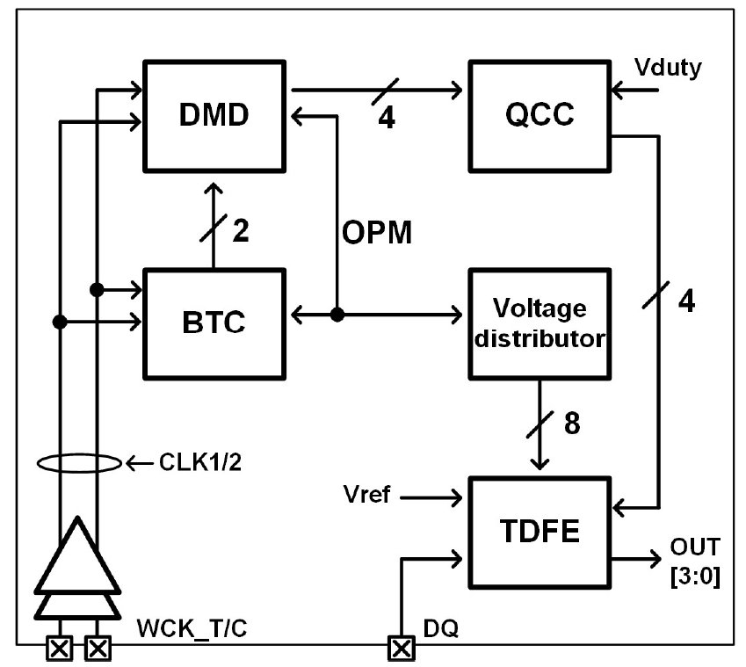
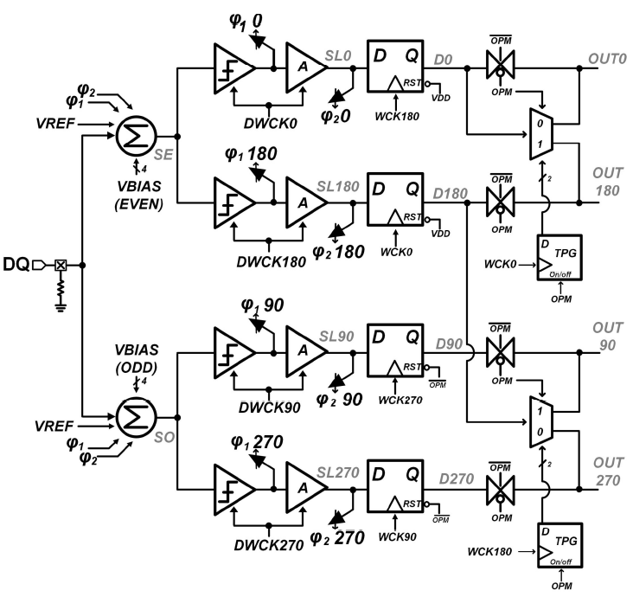
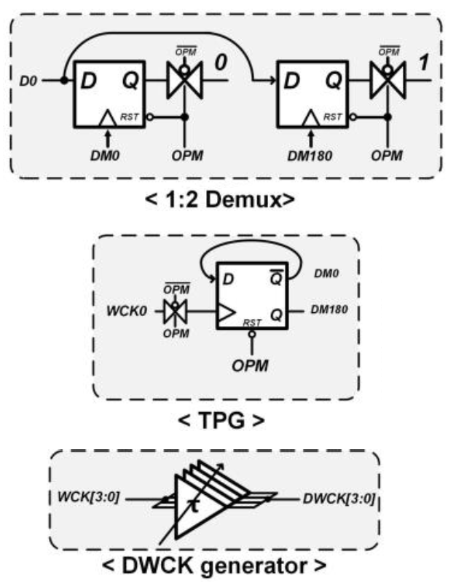
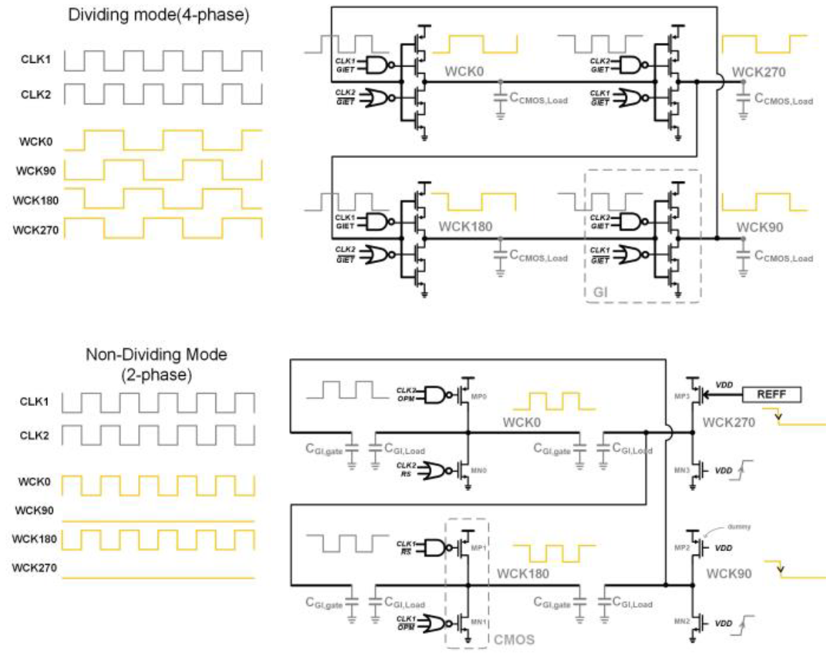
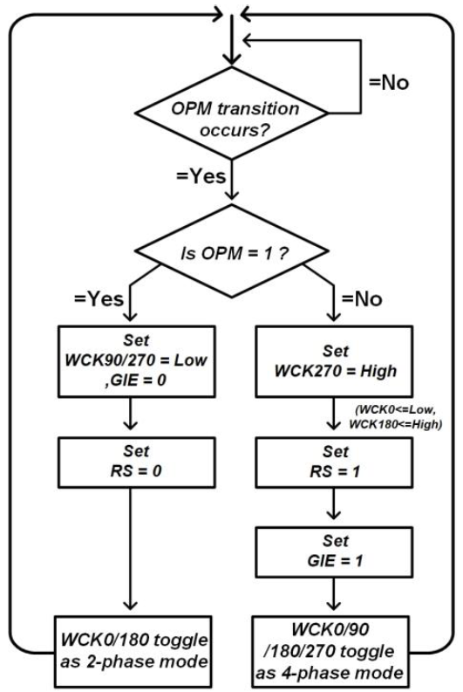
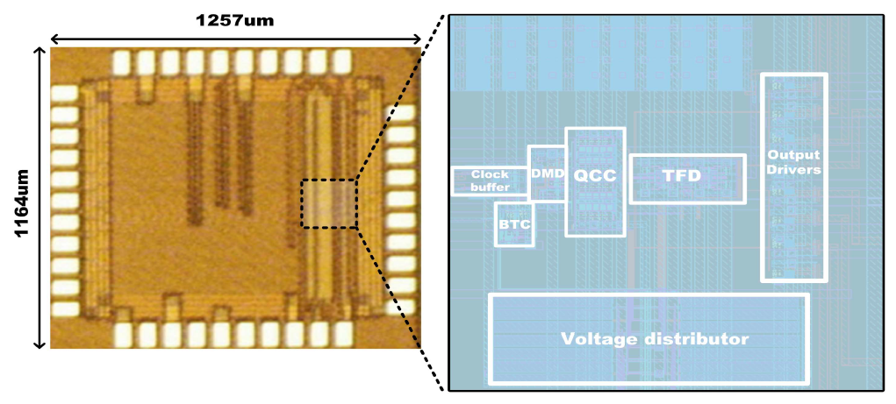
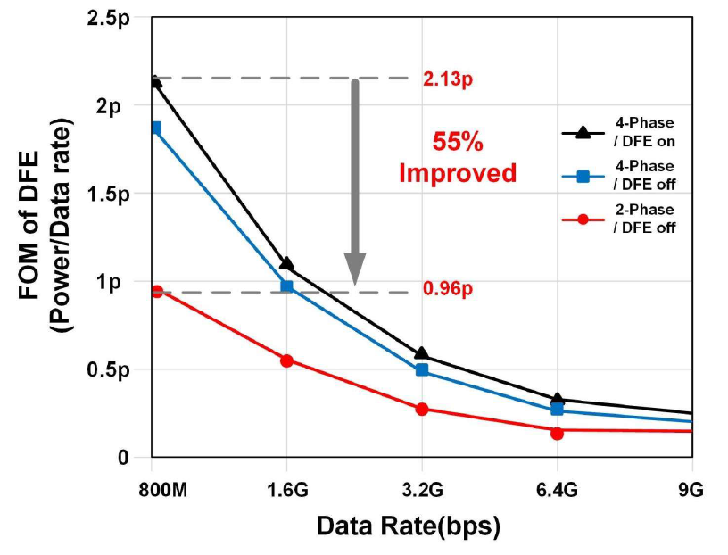
A Transformable DFE with Dual-Mode Divider for Low Power DDR Memory
Young-Min Lee, Giryong Lee, Won-Young Lee
Dept. of Smart ICT Convergence Engineering
Seoul National University of Science and Technology
INTORDUCTION
Decision Feedback Equalizer (DFE) is widely adopted in DRAM interfaces to equalize Inter Symbol Interference (ISI) derived from the transmission channel.
The CML summer is relatively less sensitive to noise but consumes a lot of static power.
In DFE, to address bandwidth issues, adopting more than two Summers is common, however, the problem of static power consumption of CML summer degrades energy efficiency in low-speed operations.
In low-speed operations, since ISI is mitigated, equalization can be omitted, and the timing constraints are relaxed, reducing the need for circuits designed for high-speed operations.
For high speeds, a transformable receiver design is proposed that operates the DFE at a quarter-speed to compensate for channel loss, and at low speeds, operates at half-speed while omitting Equalization to improve energy efficiency.
A dual-mode Divider (DMD) is proposed to perform these operations.
PROPOSED TRANSFORMABLE RECEIVER
TDFE (TRANSFORMABLE DFE)
The Rx consists of a clock buffer, QCC, DMD, a Bidirectional Transition Controller (BTC) for stable mode switching of the DMD, a voltage divider, and a Transformable DFE (TDFE).
Block Diagram of the Transformable Receiver
Block Diagram of TDFE
DMD (DUAL-MODE DIVIDER)
When the OPM is low, the TDFE operates in equalization mode. Both summers of the TDFE are active, and the DMD divides the input WCK into a quarter-rate clock.
When the OPM is high, the TDFE transitions to an amplification mode that does not remove the ISI of the DQ. In this mode, the voltage divider sets all bias voltages for the summer odd (SO) to GND. The TDFE only performs signal amplification without decision feedback. The DMD outputs a half-rate clock through WCK.
MEASUREMENT RESULT
Flow Chart of the DMD with the BTC
Amplifying Mode
Equalizing Mode
Active area: 0.0052 mm²
Equivalent Circuit of the DMD
Equalizing Mode
Data rate : 9 Gb/s
Power : 10.68 mW
EQ : 2 FIR
FOM1 : 0.252 pJ/b
Die Micrograph
When the OPM is low, the DMD outputs a quarter-rate clock through four gated inverters (GI)
When the OPM is high, GI90,270 of the DMD are fixed to low, and a half-rate clock synchronized with WCK is output through GI0,180.
Since the timing of the OPM transition can occur arbitrarily, it can cause unstable timing issues in the DMD, necessitating logic to synchronize with WCK.
Amplifying Mode
Data rate : 800 Mb/s
Power : 4.35 mW
EQ : No
FOM1 : 0.96 pJ/b
Performance of the Proposed Receiver
CONCLUSION
A transformable Rx has been proposed to improve energy efficiency in low-speed operations. To implement a dual sampling method, a Dual-Mode Divider (DMD) and a TDFE capable of quarter/half-rate sampling have been suggested. PRBS7 data with 18 dB of channel loss at 9 Gb/s is input to the test chip, and the input data is demultiplexed 1:4 through an FIR 2-tap and outputted. On the other hand, low-speed PRBS7 at 800Mb/s is simply amplified and sampled at half-rate without equalization. At 800Mb/s, the energy efficiency of the TDFE improved by about 55% from 2.13 pJ/b to 0.96 pJ/b through the proposed dual-mode sampling. The total power consumption in equalization mode at 9 Gb/s and in amplification mode at 800 Mb/s are 10.68 mW and 4.35 mW, respectively. The implemented Rx circuit occupies 0.0052 mm2. The test chip is manufactured in a 28nm process, and the supply voltage is 1.0 V.
ACKNOWLEDGMENT
The chip fabrication and EDA tool were supported by the IC Design Education Center(IDEC), Korea.

