Slide 1

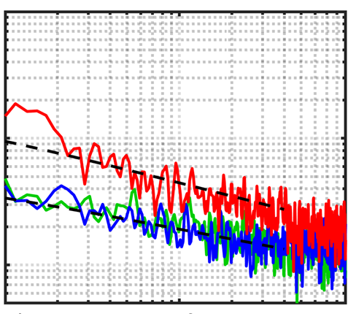
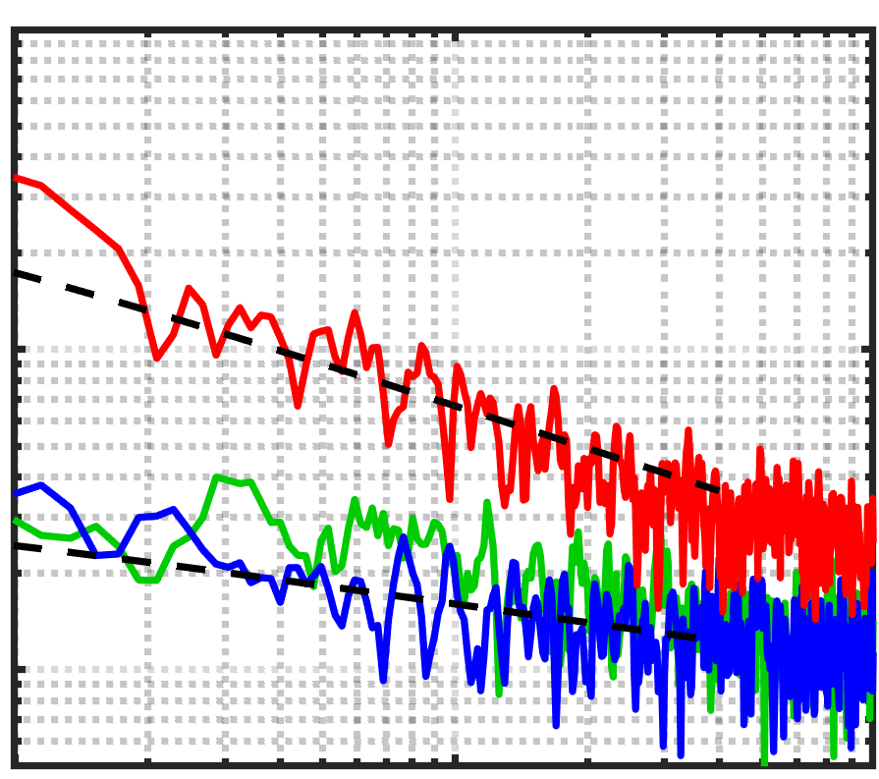
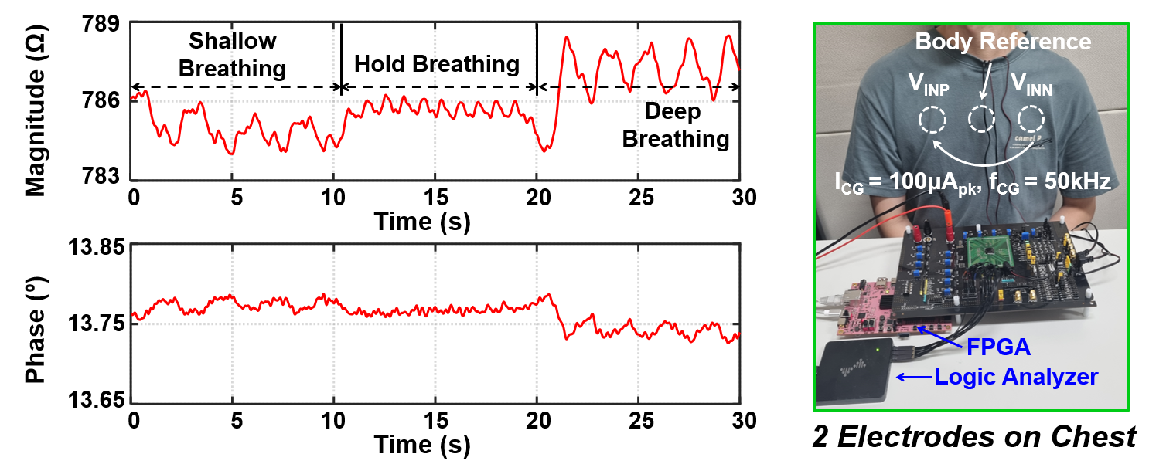
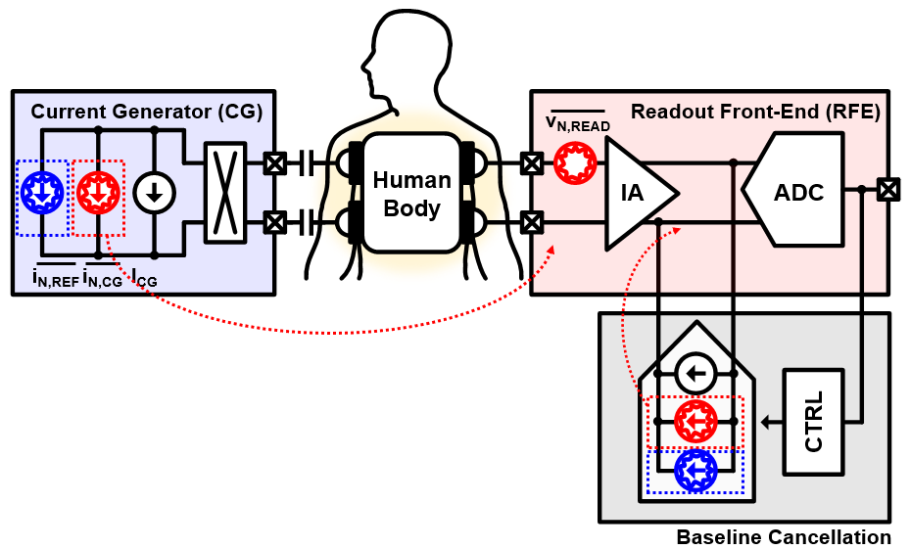
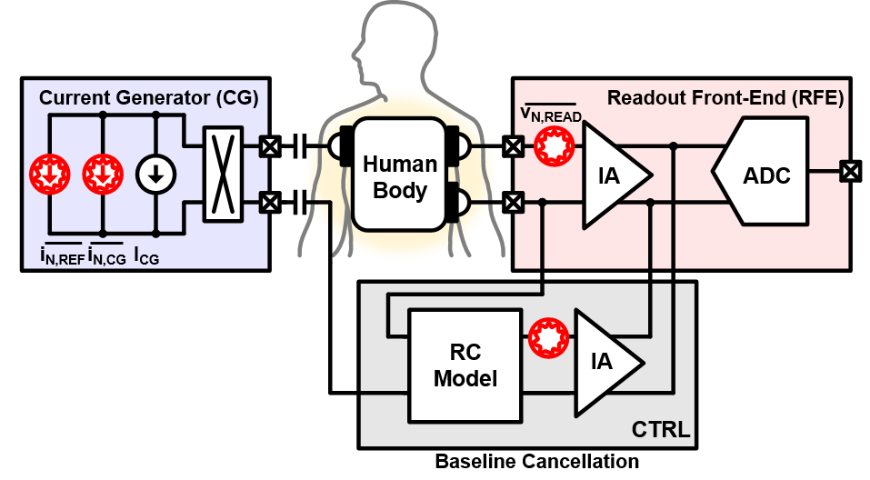

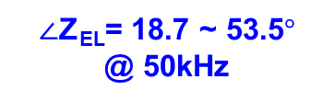
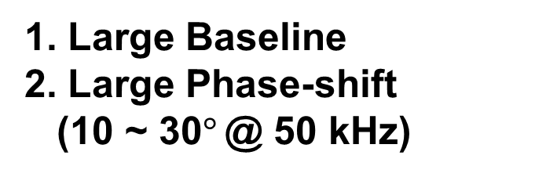
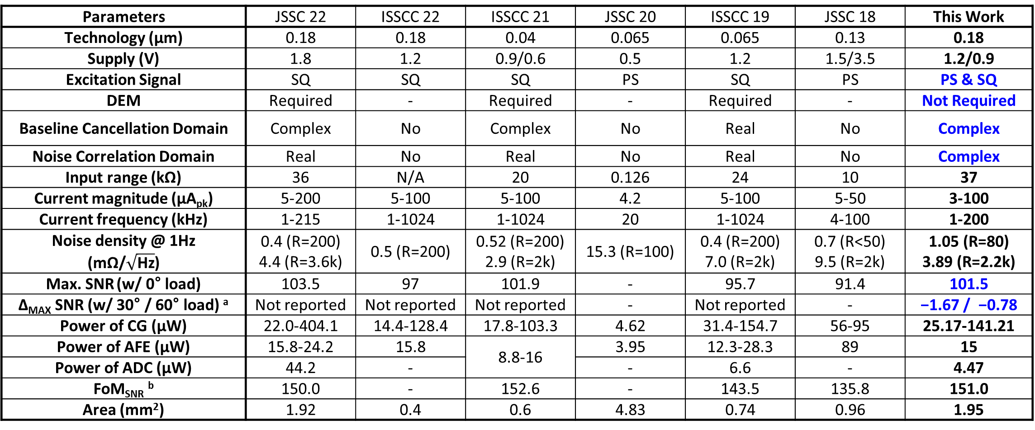

A Two-Electrode Bio-Impedance Readout IC with
Complex-Domain Noise-Correlated Baseline Cancellation
Song-I Cheon†, Haidam Choi†, and Minkyu Je
School of Electrical Engineering, Korea Advanced Institute of Science and Technology (KAIST), †Equally Credited Authors
E-mail: 1000thd2@kaist.ac.kr
Introduction
Measurement Results
Impedance in
2-Electrode System
Prior Work : IDAC Based Resistive
Noise-Correlated Baselince Cancellation ^{[1]-[3]}
Measurement Setup for Noise Comparison
Z_{EL}
V_{IN}
Baseline level
V_{IN}
V_{n,in}
(1) Resistive Model
Z_{test}
Pseudo-sine / Square-wave Gen.
Proposed
BioZ Readout IC
Total Impedance
= 2 x Z_{EL}
+BioZ
ADC
5b
D_{out,I}
BioZ
Z_{EL}
V_{cancel}
Noise Delayed
V_{n,cancel}
TRI
D_{CNT,R}
9b
Impedance
Tuner
D_{out,Q}
V_{OUT}
t
V_{OUT}
t
(2) Complex model
D_{CNT,C}
I-CH
Q-CH
Measurement Issue
t
t
(I) TRI Configuration
: Real-Domain
Noise-Correlated BC
R₂
(II) TRI Configuration
: Complex-Domain
Noise-Correlated BC
R₂
1. Large Baseline
2. Large Phase-shift
(10 ~ 30$°$ @ 50 kHz)
Square Signal
Pseudo-sine Signal
R_{DAC}
C_{DAC}
R_{DAC}
C_{DAC}
Resistive BioZ
Complex BioZ
R₂
R₂
Proposed Bio-Impedance Readout IC
10⁻⁵
10⁻⁵
Noise Density (V/√Hz)
w/ Real-domain BC (I-CH)
Noise Density (V/√Hz)
w/ Real-domain BC (I-CH)
w/ Complex-domain BC (I-CH)
w/ Complex-domain BC (I-CH)
w/ Complex-domain BC (Q-CH)
w/ Complex-domain BC (Q-CH)
51kΩ
Look-up Table
Current
Generator
10⁻⁶
Z_{test}= 500$\text{∠}\text{3}\text{0}\text{⁰}$
10⁻⁶
Z_{test}= 500$\text{∠}\text{6}\text{0}\text{⁰}$
47nF
50~200Ω
Pseudo-sine/ Square-wave Gen.
Current Reference
$∠$Z_{EL}= 18.7 ~ 53.5$°$
@ 50kHz
Differential Difference CBIA
w/ Quiet Chopping
Q-CH
10⁻⁷
x2.47 Noise
Improvement
10⁻⁷
x4.88 Noise
Improvement
I-CH
D_{out,Q}
10⁻¹
10⁰
10⁻¹
10⁰
Z_{BioZ,DC}
Tunable
Reference
Impedance
2nd-order
NS-SAR
ADC
D_{out,I}
Frequency (Hz)
Frequency (Hz)
Human Body
f_{CG}
f_{IF}
∆Z_{BioZ}
R
C
Complex-domain
Noise-correlated BC
e_{I}
e_{Q}
9b’
Impedance
Tuner
9b’
Readout IC
Previous BC
Proposed BC
Conclusion
Cannot cannel out BGR & IDAC noise
➔ DEM Required
Cancel out whole TX noise
➔ DEM is not required
Enable 2-Electrode configuration w/ pseudo-sine excitation
DD-CBIA w/ quiet chopping enables substraction using pseudo-sine
Tunable Reference Impedance w/ 9b resolution for each magnitude and phase
Improve noise performance by 2.5x and 4.9x for BioZ with phases of 30° and 60°
Difficult to apply for pseudo-sine signal injection
Pseudo-sine signal injection is available
Cannot delay the noise of TX
Same delay for BioZ noise and BC noise
JSSC 2022
Prior CBIA
Differential Difference CBIA
w/ Quiet Chopping
Parameters | JSSC 22 | ISSCC 22 | ISSCC 21 | JSSC 20 | ISSCC 19 | JSSC 18 | This Work
Technology (μm) | 0.18 | 0.18 | 0.04 | 0.065 | 0.065 | 0.13 | 0.18
Supply (V) | 1.8 | 1.2 | 0.9/0.6 | 0.5 | 1.2 | 1.5/3.5 | 1.2/0.9
Excitation Signal | SQ | SQ | SQ | PS | SQ | PS | PS & SQ
DEM | Required | - | Required | - | Required | - | Not Required
Baseline Cancellation Domain | Complex | No | Complex | No | Real | No | Complex
Noise Correlation Domain | Real | No | Real | No | Real | No | Complex
Input range (kΩ) | 36 | N/A | 20 | 0.126 | 24 | 10 | 37
Current magnitude (μA_{pk}) | 5-200 | 5-100 | 5-100 | 4.2 | 5-100 | 5-50 | 3-100
Current frequency (kHz) | 1-215 | 1-1024 | 1-1024 | 20 | 1-1024 | 4-100 | 1-200
Noise density @ 1Hz (mΩ/$\sqrt{\text{Hz}}$) | 0.4 (R=200) 4.4 (R=3.6k) | 0.5 (R=200) | 0.52 (R=200) 2.9 (R=2k) | 15.3 (R=100) | 0.4 (R=200) 7.0 (R=2k) | 0.7 (R<50) 9.5 (R=2k) | 1.05 (R=80) 3.89 (R=2.2k)
Max. SNR (w/ 0° load) | 103.5 | 97 | 101.9 | - | 95.7 | 91.4 | 101.5
∆_{MAX} SNR (w/ 30° / 60° load) ª | Not reported | Not reported | Not reported | - | Not reported | - | −1.67 / −0.78
Power of CG (μW) | 22.0-404.1 | 14.4-128.4 | 17.8-103.3 | 4.62 | 31.4-154.7 | 56-95 | 25.17-141.21
Power of AFE (μW) | 15.8-24.2 | 15.8 | 8.8-16 | 3.95 | 12.3-28.3 | 89 | 15
Power of ADC (μW) | 44.2 | - |  | - | 6.6 | - | 4.47
FoM_{SNR} ^{b} | 150.0 | - | 152.6 | - | 143.5 | 135.8 | 151.0
Area (mm²) | 1.92 | 0.4 | 0.6 | 4.83 | 0.74 | 0.96 | 1.95
TC
TI
Input Range
Quiet
Chopping
V_{IN}-V_{REF}
Input-dependent Noise
V_{BioZ}
V_{IN,P}
TC1
TI
V_{OUT}
Digital
IDAC
Pseudo-sine
Noise Cancellation
V_{IN,N}
f_{IF}
ISSCC 2022
V_{TRI}
V_{REF,P}
TC2
G_{m1}
G_{m3}
Input Range
V_{REF,N}
D-TC
Input-dependent Noise
f_{IF}
DD-CBIA
G_{m2}
Pseudo-sine
Noise Cancellation
Input Range
Input-dependent Noise
Pseudo-sine
Noise Cancellation
ª SNR = MAX(20$×$log(R/(2$\sqrt{\text{2}}×$R_{RMS}))), R_{RMS}=R_{N}$×\sqrt{\text{BW}}$ or R_{pp}/6.6
^{b} FoM_{SNR} = SNR_{max}+10$×$log(BW/Power)
where Power is the sum of the max. power of readout, ADC, and the min. power of CG
References
[1] C. S. Park et al., A Baseline-Tracking Single-Channel I/Q Impedance Plethysmogram IC for Neckband-Based Blood Pressure and Cardiovascular Monitoring, ISSCC, Feb. 2022
[2] T. Zhang et al., A 0.6V/0.9V 26.6-to-119.3$μ$W ∆Σ-Bbased Bbio-Iimpedance Rreadout IC with 101.9dB SNR and <0.1Hz 1/f corner, ISSCC, Feb. 2021
[3] H. Ha et al., A Bbio-Iimpedance Rreadout IC with Ddigital-Aassisted Bbaseline Ccancellation for Ttwo-Eelectrode Mmeasurement, ISSCC, Feb. 2019

