Slide 1
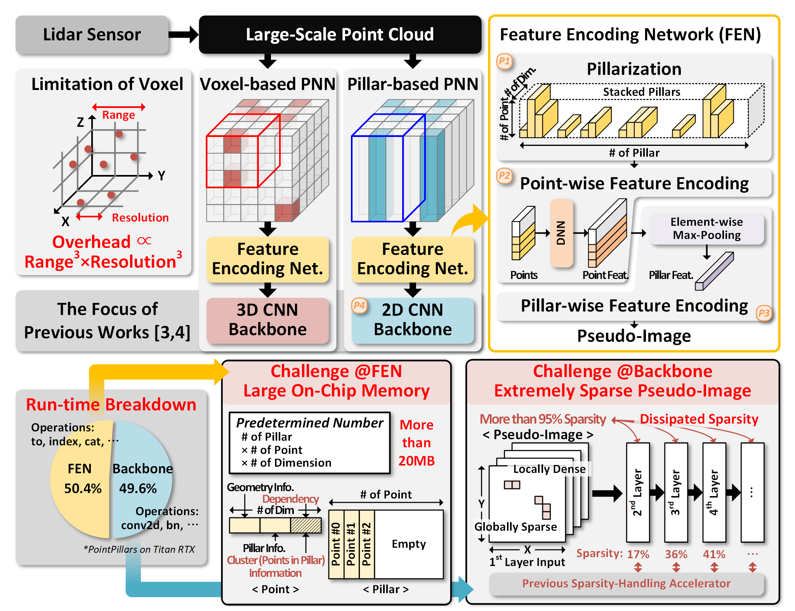
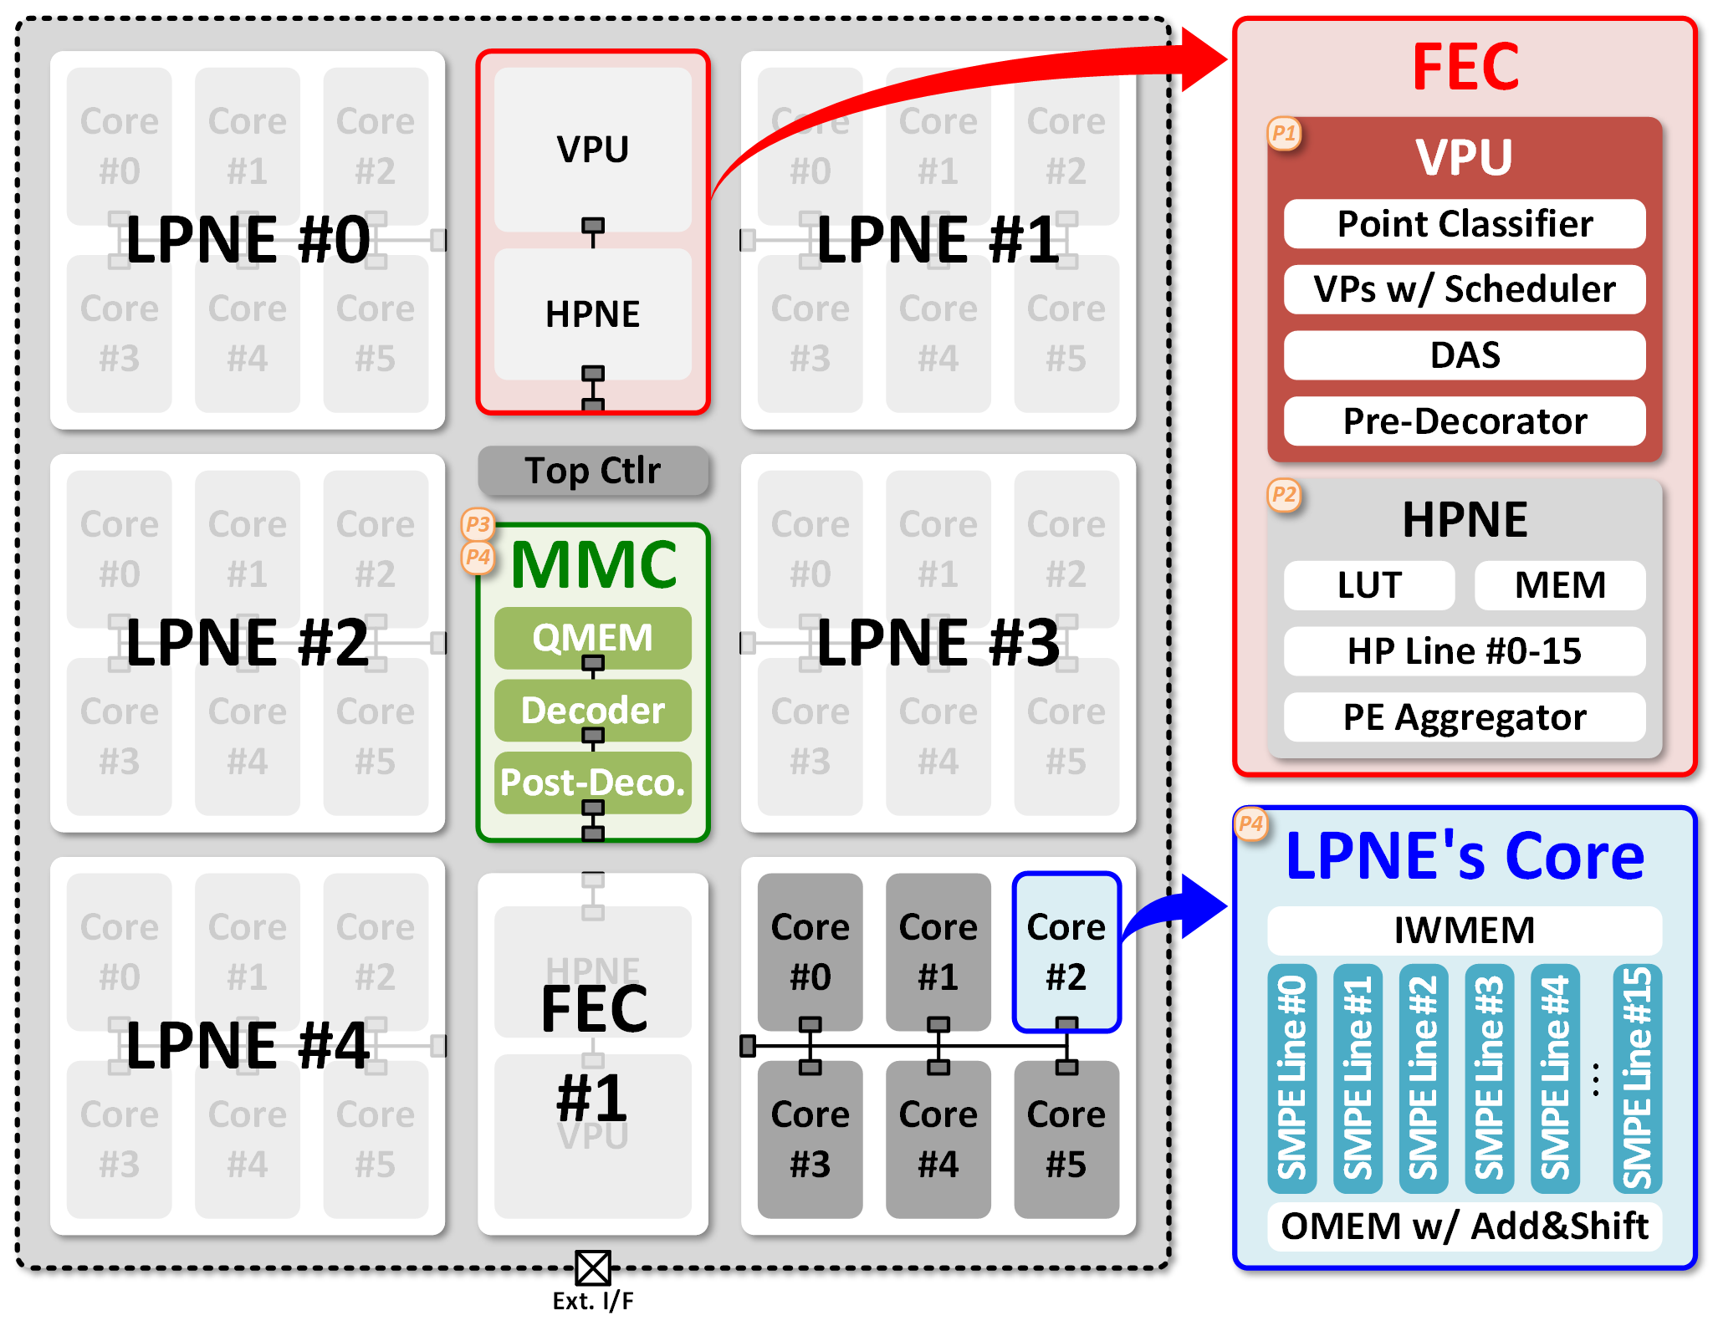
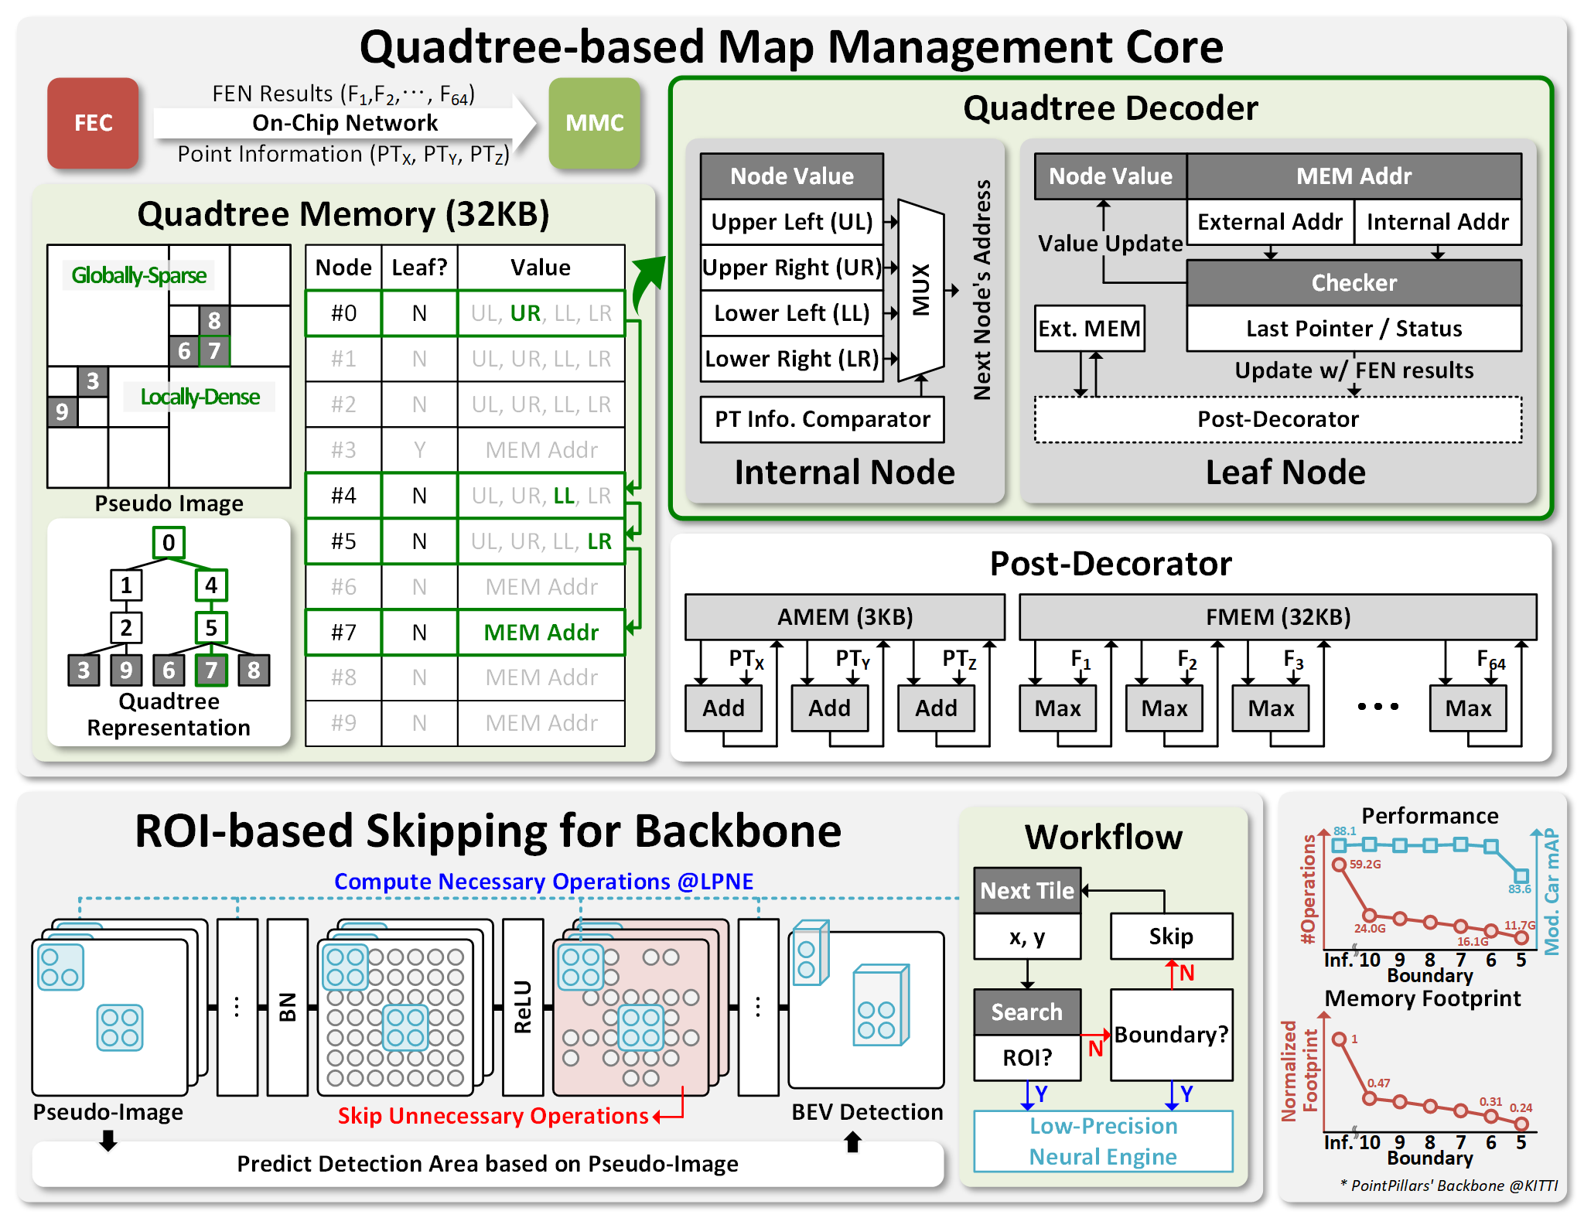
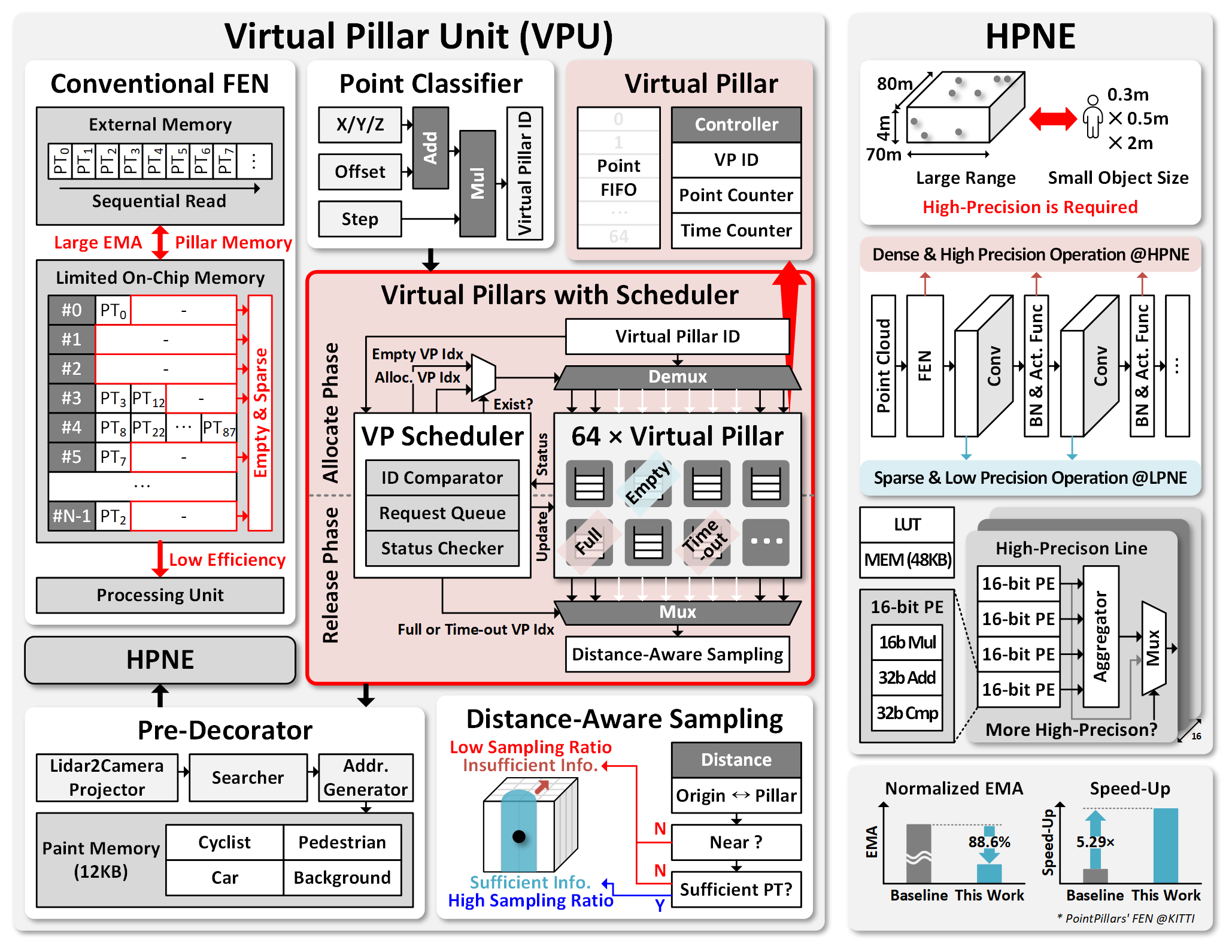
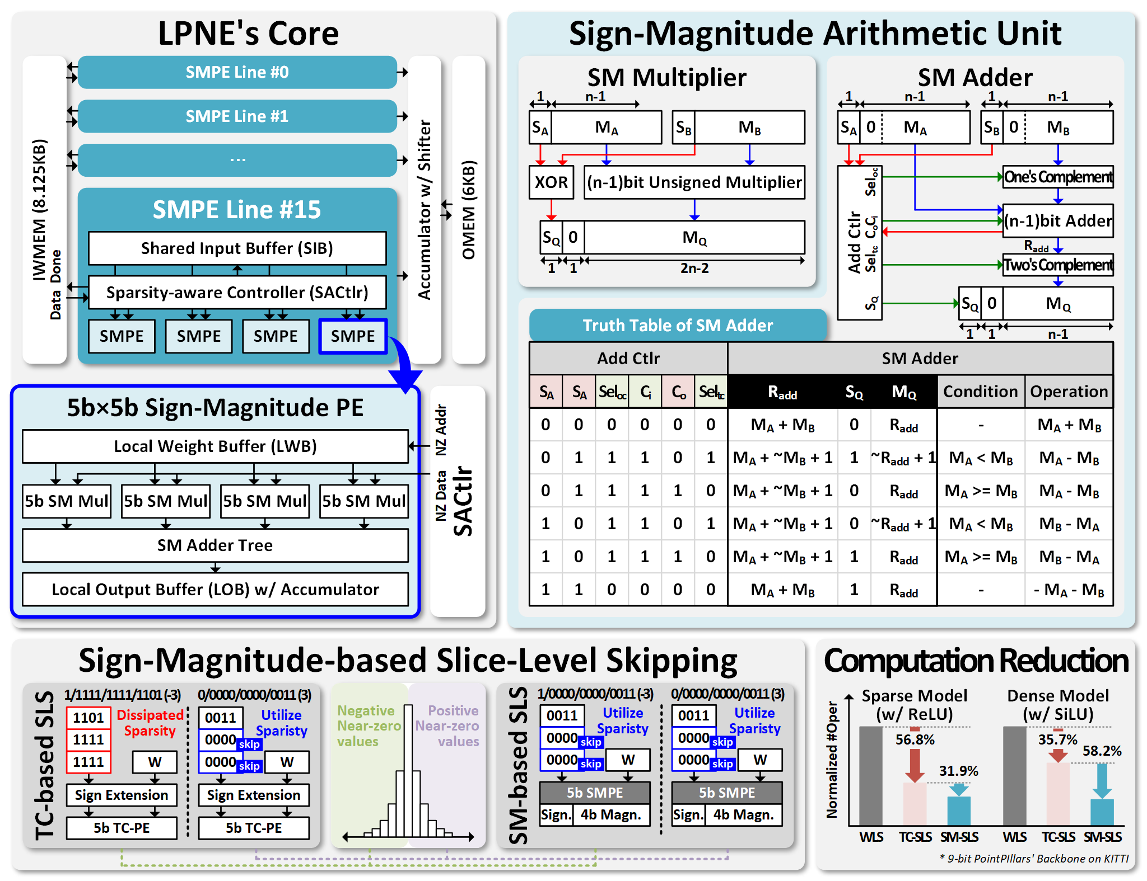
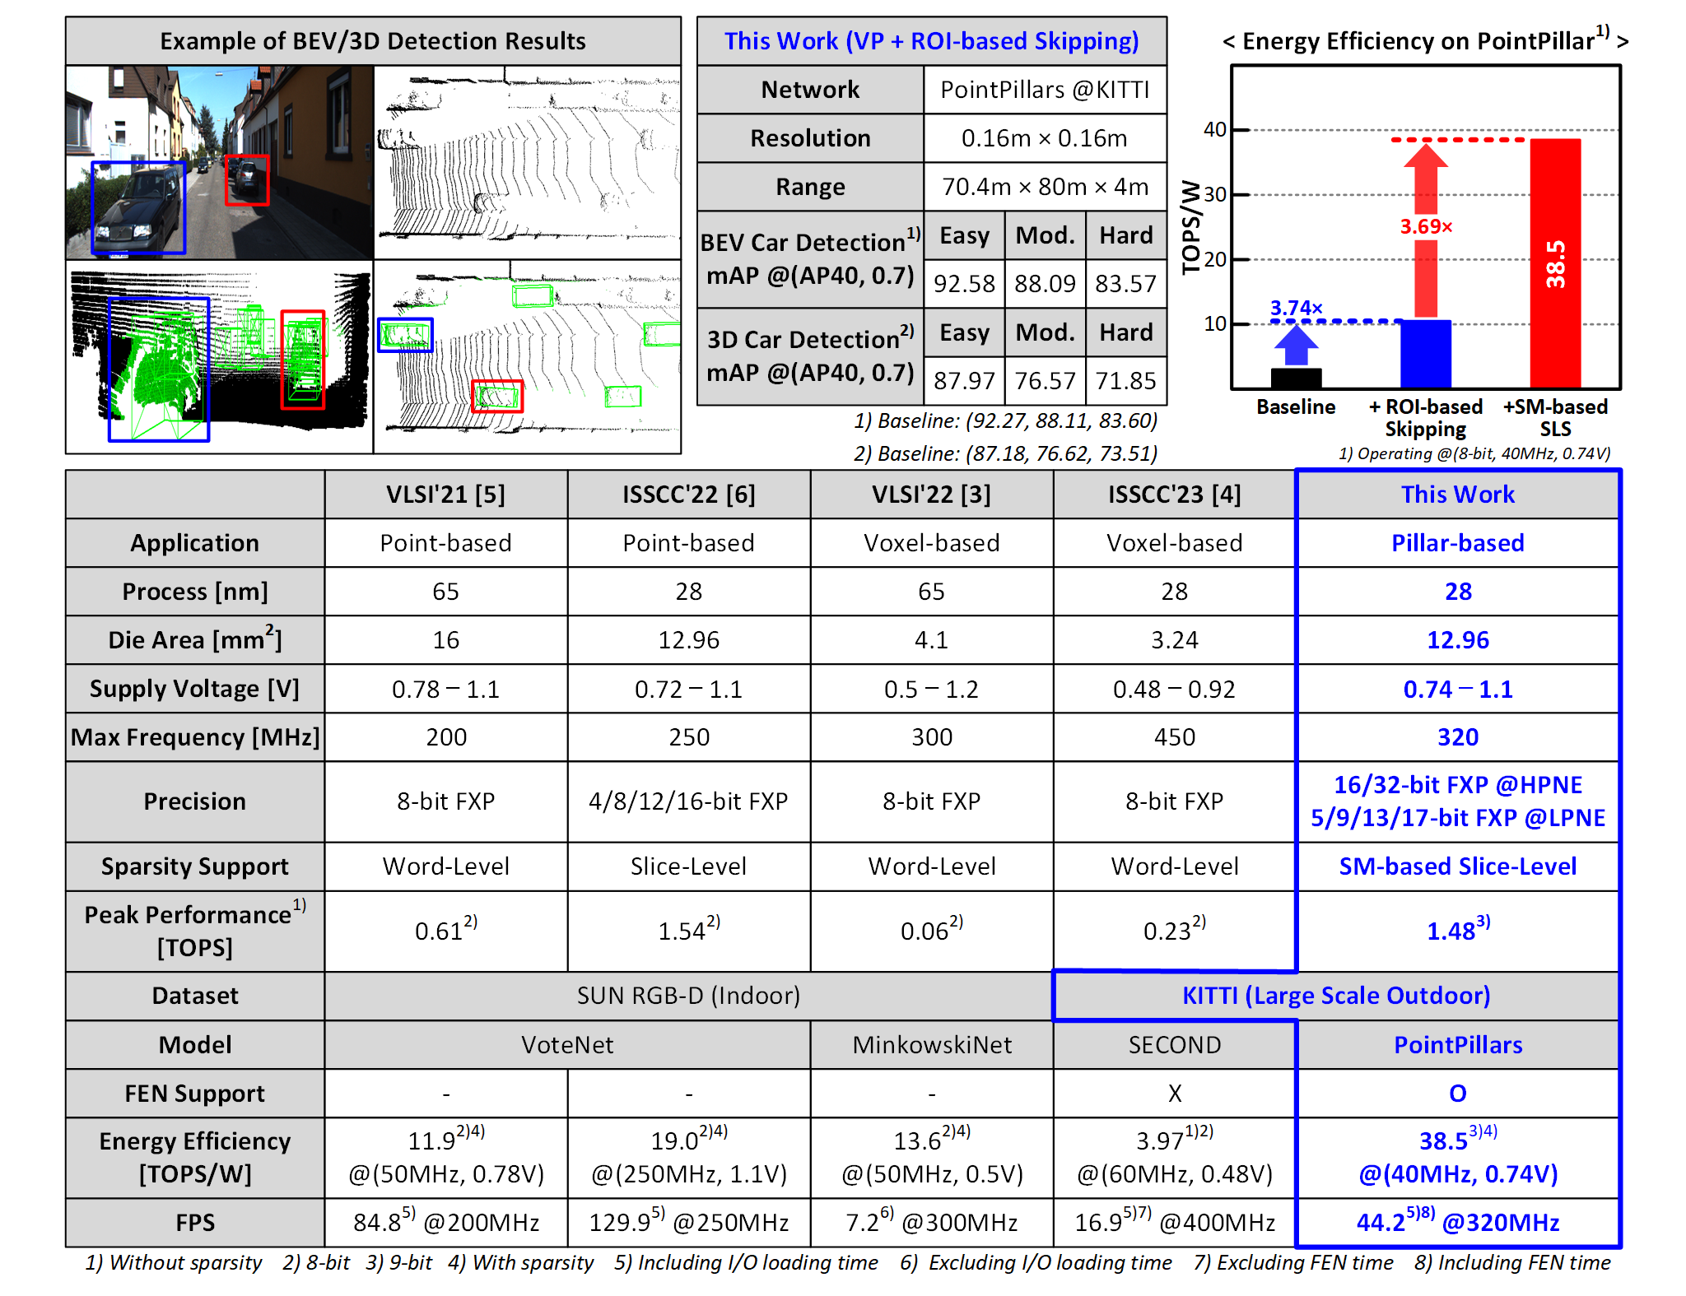
A 38.5TOPS/W Point Cloud Neural Network Processor with Virtual Pillar and Quadtree-based Workload Management for Real-Time Outdoor BEV Detection
Sukbin Lim, Jaehoon Heo, Jinho Yang, and Joo-Young Kim
Korea Advanced Institute of Science and Technology (KAIST)

