Slide 1

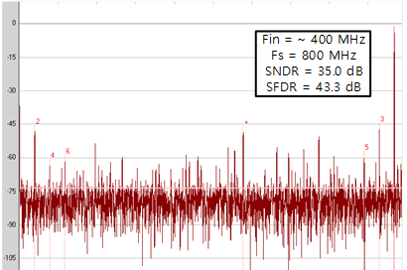


Calibration free Loop Unrolled SAR based Two-Step ADC
with Time-Domain Backend
Hyun-Woo Shin and Seung-Tak Ryu
Korea Advanced Institute of Science and Technology (KAIST), Daejeon, Korea
Mixed-Signal Integrated Circuits Laboratory (MSICL), shin6223@kaist.ac.kr
Abstract
This work proposes a Loop-Unrolled SAR ADC with replica structure of VTC(Voltage-to-Time Converter) and TDC(Time-to-Digital Converter). The proposed VTC operates as a pre-amplifier for multiple latches in the coarse stage of Loop-Unrolled SAR. The mentioned VTC is reused for converting residue voltage into time signal between coarse stage Loop-Unrolled SAR ADC and fine stage Vernier TDC. Thanks to the reusability of single shared VTC, it is possible to alleviate offset mismatch error between multiple latches and inter-stage offset error. In addition, replica VTC/TDC structure is able to achieve calibration free inter-stage gain and inherent PVT robustness. The proposed ADC is fabricated in 28nm CMOS process occupying an active area of 0.0054 mm². Near Nyquist input frequency, this ADC achieves 35.9-dB SNDR and 45.1-dB SFDR at 800 MS/s.
Proposed Architecture
Overall Concept
Overall Architecture
Shared VTC
VTC operates as pre-amplifier @ coarse conversion
VTC operates as V2T converter @ fine conversion
Shared VTC relieves inter-stage offset
Replica structure between VTC&TDC
Current Starved Inverter(CSI) structure is applied to both VTC&TDC
Replica structure achieves gain accuracy with PVT robustness
Replica structure of VTC&TDC
Measurement Result
Layout
Area : 0.0054 mm²
FFT plot
(D_{P1} – D_{N1})
= α〮(2C/I)〮ΔV_{IN}
* ΔV_{IN}/ΔV_{REF} ≤1
(L₀ – E₀)
= α〮(C/I)〮ΔV_{REF}
DNL/INL
Power Breakdown
F_{S} : 800 MHz
Total : 3.1 mW
V2T CSI
Stacked TR → 2X boost gain
1-stage gain : α〮(2C/I)〮ΔV_{IN}
Total gain : 4α〮(2C/I)〮ΔV_{IN}
VTC&TDC FS according to PVT
T2D Vernier CSI
Time-domain 1 LSB : α〮(C/I)〮ΔV_{REF}
Total gain : 8α〮(C/I)〮ΔV_{IN}
Conclusion
The proposed work is designed for eliminating calibration burden of offset and gain calibration in SAR based TDC architecture. Replica structure between VTC&TDC can achieve quite good full-scale alignment according to PVT variation. However, inter-stage offset error seems to be causing linearity issue. Even if, shared VTC structure relieve inter-stage offset, cascaded VTC and Early/Late selection circuit generates inter-stage offset between coarse and fine stage. And this error is not able to be cancelled by redundancy due to inherent folding structure of Vernier TDC. Thus, it is required to carefully calibrate inter-stage offset in next design. This design has not yet been published as a paper.
Mixed-Signal
Integrated
Circuits
Laboratory
Since 2007

