Slide 1

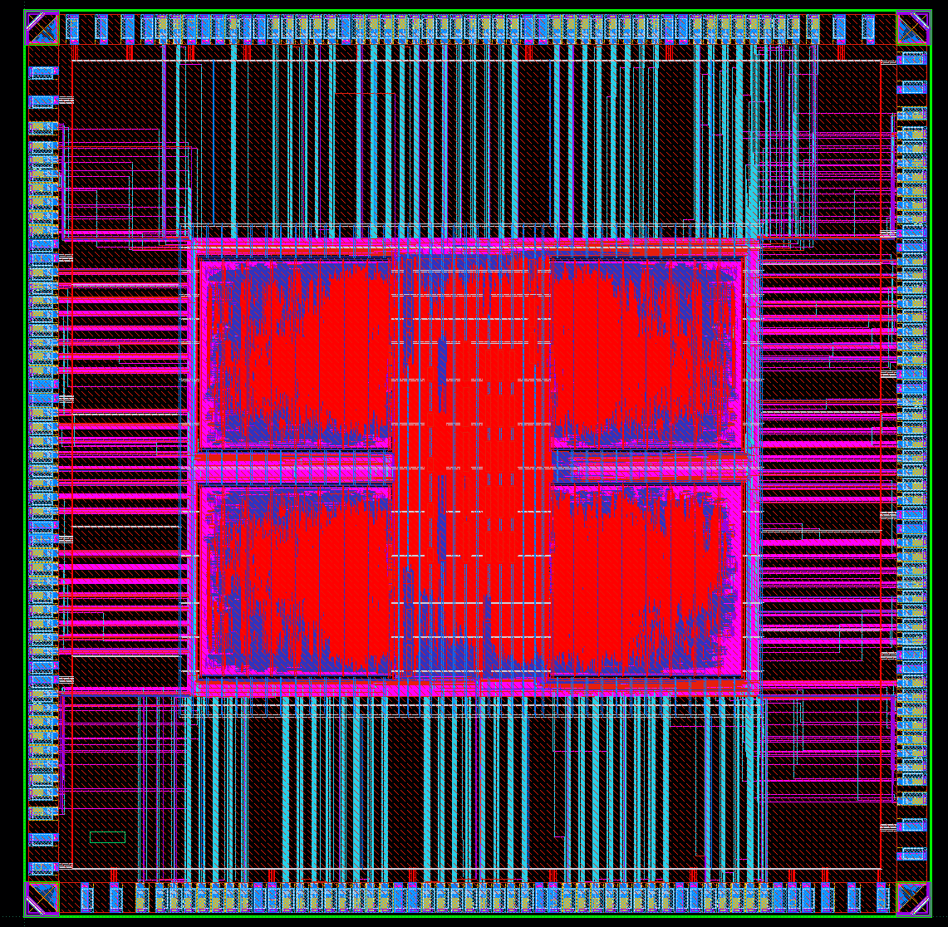
An Energy-Efficient Image Super-Resolution Processor
Byeungseok Yoo, Dongsuk Jeon
Seoul National University, Seoul, Korea
Abstract
We propose an energy-efficient image super-resolution processor specifically designed for lightweight downsampling networks without information loss. The proposed processor can perform arithmetic operations on each sub-feature map simultaneously. Our approach involves a co-design of hardware and software to enable parallel computations of feature maps indexed spatially and reduce network complexity. Our proposed method achieves a 98% reduction in hardware resources compared to the baseline network. The processor was fabricated using Samsung 28nm technology and is expected to operate at over 200 MHz for real-time image processing with 60 frame rates.
Super Resolution Network
Utilizes multi-scale image pyramids
Simultaneous processing of sub-sampled feature maps
Figure 1. Overview of the proposed network.
Figure 2. Performance comparison with baseline network
Chip Architecture
Core supports various CNNs (depth-wise, point-wise, dilated convolutions)
Depth-first direction inference
Layer fusion technique
Tile-based processing
Global buffer for data injection into DRAM
Intermediate buffer in each processing unit for storing activations
Figure 3. Overall chip architecture.
Figure 4. Layout of our design.
Result
We present a hardware accelerator design for super-resolution tasks with self-attention in image signal processing (ISP) pipelines. Our proposed design efficiently supports various CNN modules. It is hierarchically arranged with processor units, PE arrays, and off-chip memory to allocate data flexibly according to target throughput and core usage. The design was fully verified in simulations, but it still has some issues in measurements. We plan to continue measurements and try to identify and resolve the underlying issues.
[1] Y. Zhang et al., "Image super-resolution using very deep residual channel attention networks," ECCV, 2018
[2] M. Alwani et al., "Fused-layer CNN accelerators," MICRO, 2016
[3] K. Goetschalckx et al., "DepFiN: A 12nm, 3.8TOPs depth-first CNN processor for high res. image processing," Symposium on VLSI Circuits, 2021

