Slide 1

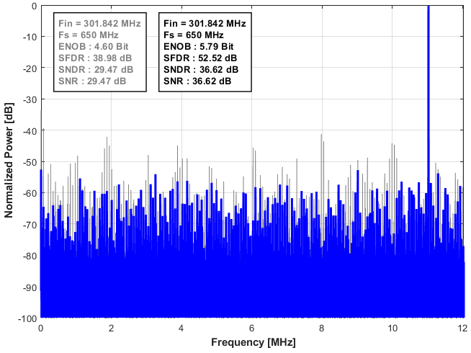
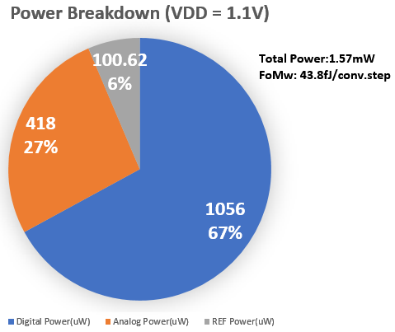
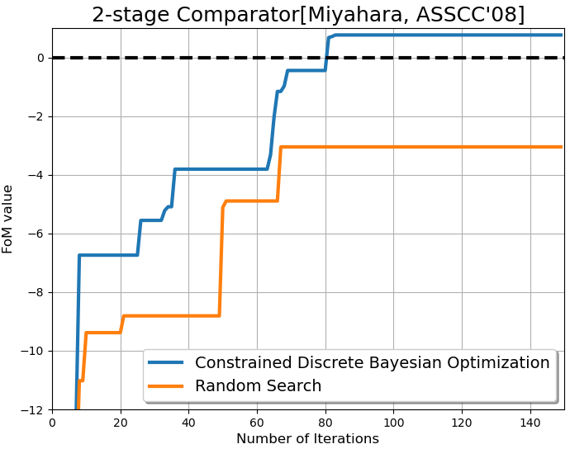
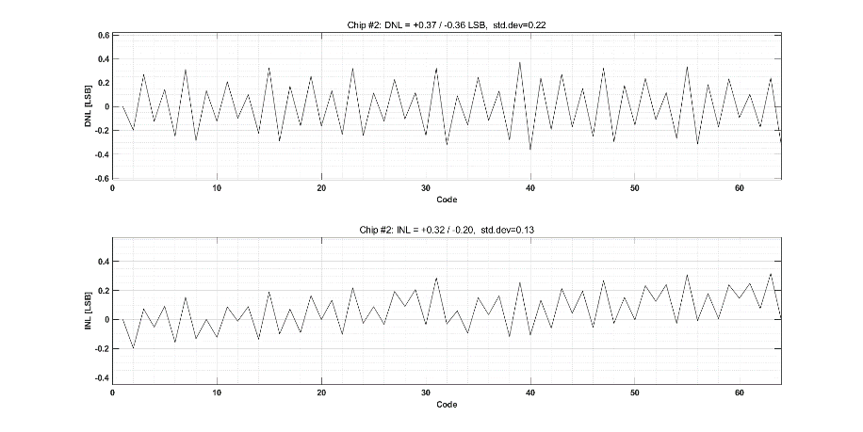
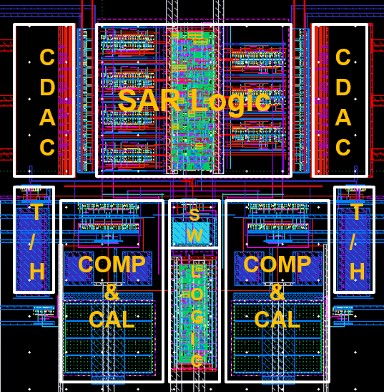
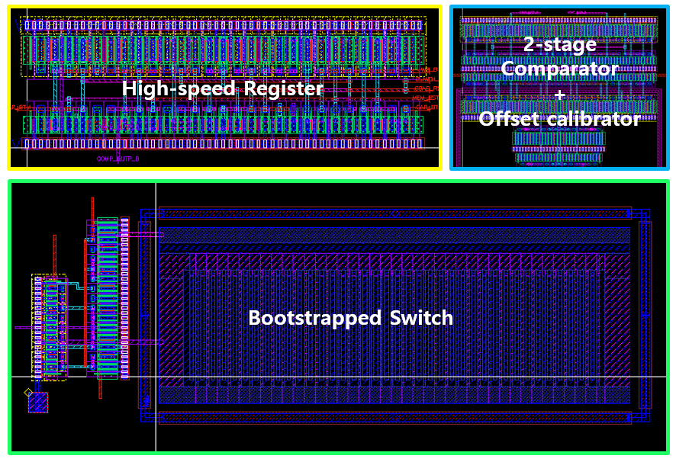
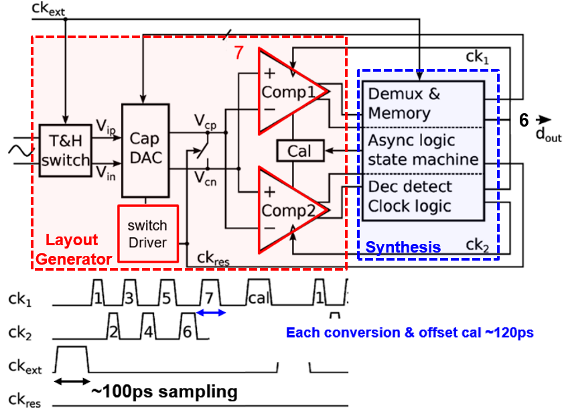



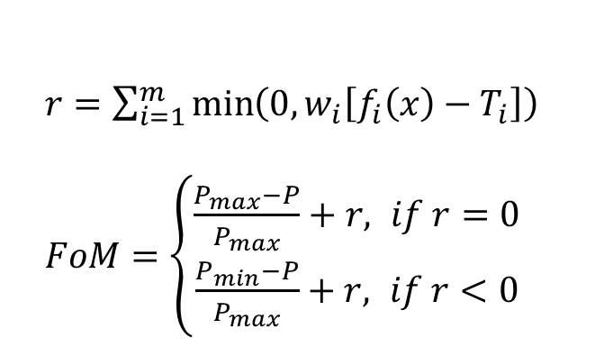
Design Automation of High-Speed ADC using Template-optimization-hybrid Layout Generator and Constrained Discrete Bayesian Optimization
Hyeongjin Kim and Seung-Tak Ryu
Korea Advanced Institute of Science and Technology (KAIST), Daejeon, Korea
Mixed-Signal Integrated Circuits Laboratory (MSICL), gudwls2525@kaist.ac.kr
Abstract
This work presents a framework to automate the design of analog circuits. The framework includes a layout generator and a device sizing algorithm, facilitating automatic circuit design up to the layout stage. Our proposed template-optimization-hybrid layout generator merges the advantages of both template-based and optimization-based approaches. This integration alleviates the need to extensively codify templates thanks to the routing algorithm. Concurrently, it secures a compact layout with minimal routing parasitics via template-driven placement that supports fingering-style layouts. Enhanced by the sizing algorithm, this framework efficiently produces layouts that meet design targets. While the sub-blocks of the ADCs are automatically generated, only the top layout is implemented manually. With this framework, a 6-bit SAR ADC is generated which achieves a 36.62 dB SNDR at 650MS/s with a 1.1V supply.
Proposed Framework & Measurement Results
Overall Framework
Automatic design flow
  Automate essential design routines
  Controls each EDA tool from the Python environment
Template-based placer
  Primitive cells are placed by index in a row
  S/D sharing reduces the routing parasitics
  Generate pins for routing after placement
Optimization-based router
  Generate the routing grid based on the pin locations
  A* algorithm to perform shortest path finding
  Optimize the routing by cost function minimization
Device sizing algorithm
  Optimize device parameters based on post-layout
  simulation results
  Manipulate conventional Bayesian optimization to control discrete device parameters
Circuit Implementation
Chip Layout & Measurement Results
Device parameters optimization of the comparator
  Utilize constrained Bayesian optimization (CBO) [Lyu, TCAS-I18’] to satisfy constraints
  CBO is modified to handle integer parameters, as it generates real-valued samples.
  The layout generator and simulator use rounded integer parameters paired with real-valued simulation results, while the Gaussian Process
  uses real-valued pairs.
  Found device parameters that satisfy the design
  targets of the comparator such as latching time
  within 100 iterations
*Decimated by 27
  $r=\sum_{i=1}^{m}{\min\left(0, w_{i}\left[f_{i}\left(x\right)−T_{i}\right]\right)}$
  $FoM=\left\{\begin{aligned}\frac{P_{max}−P}{P_{max}}+r, if r=0 \\ \frac{P_{min}−P}{P_{max}}+r, if r<0\end{aligned}\right.$
  $m$: the number of target specs
  $T_{i}$: the target spec
  $f_{i}$: the circuit performance
  $P$: the current power
  $P_{max}$: max boundary of power
  $P_{max}$: min boundary of power
Circuit topology & Sub-block layout design
  [Kull, JSSC13] architecture is adopted to demonstrate the proposed framework
Conclusion
Building on prior research in layout generation, the proposed hybrid layout generator significantly lessens designers’ burden and effectively supports fingering-style layouts. Additionally, it integrates a discrete constrained Bayesian optimization algorithm for device sizing with the layout generator to facilitate a fully automated, no-human-in-loop design process. By constructing and testing these designs with actual circuits, we establish a strong foundation for the viability of automated design. This approach is anticipated to not only alleviate the workload on designers but also address the issue of human resource scarcity in the circuit design area.
Mixed-Signal
Integrated
Circuits
Laboratory
Since 2007

