Slide 1
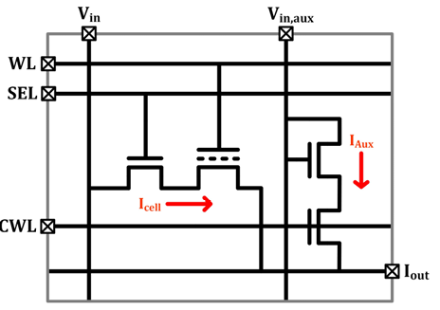
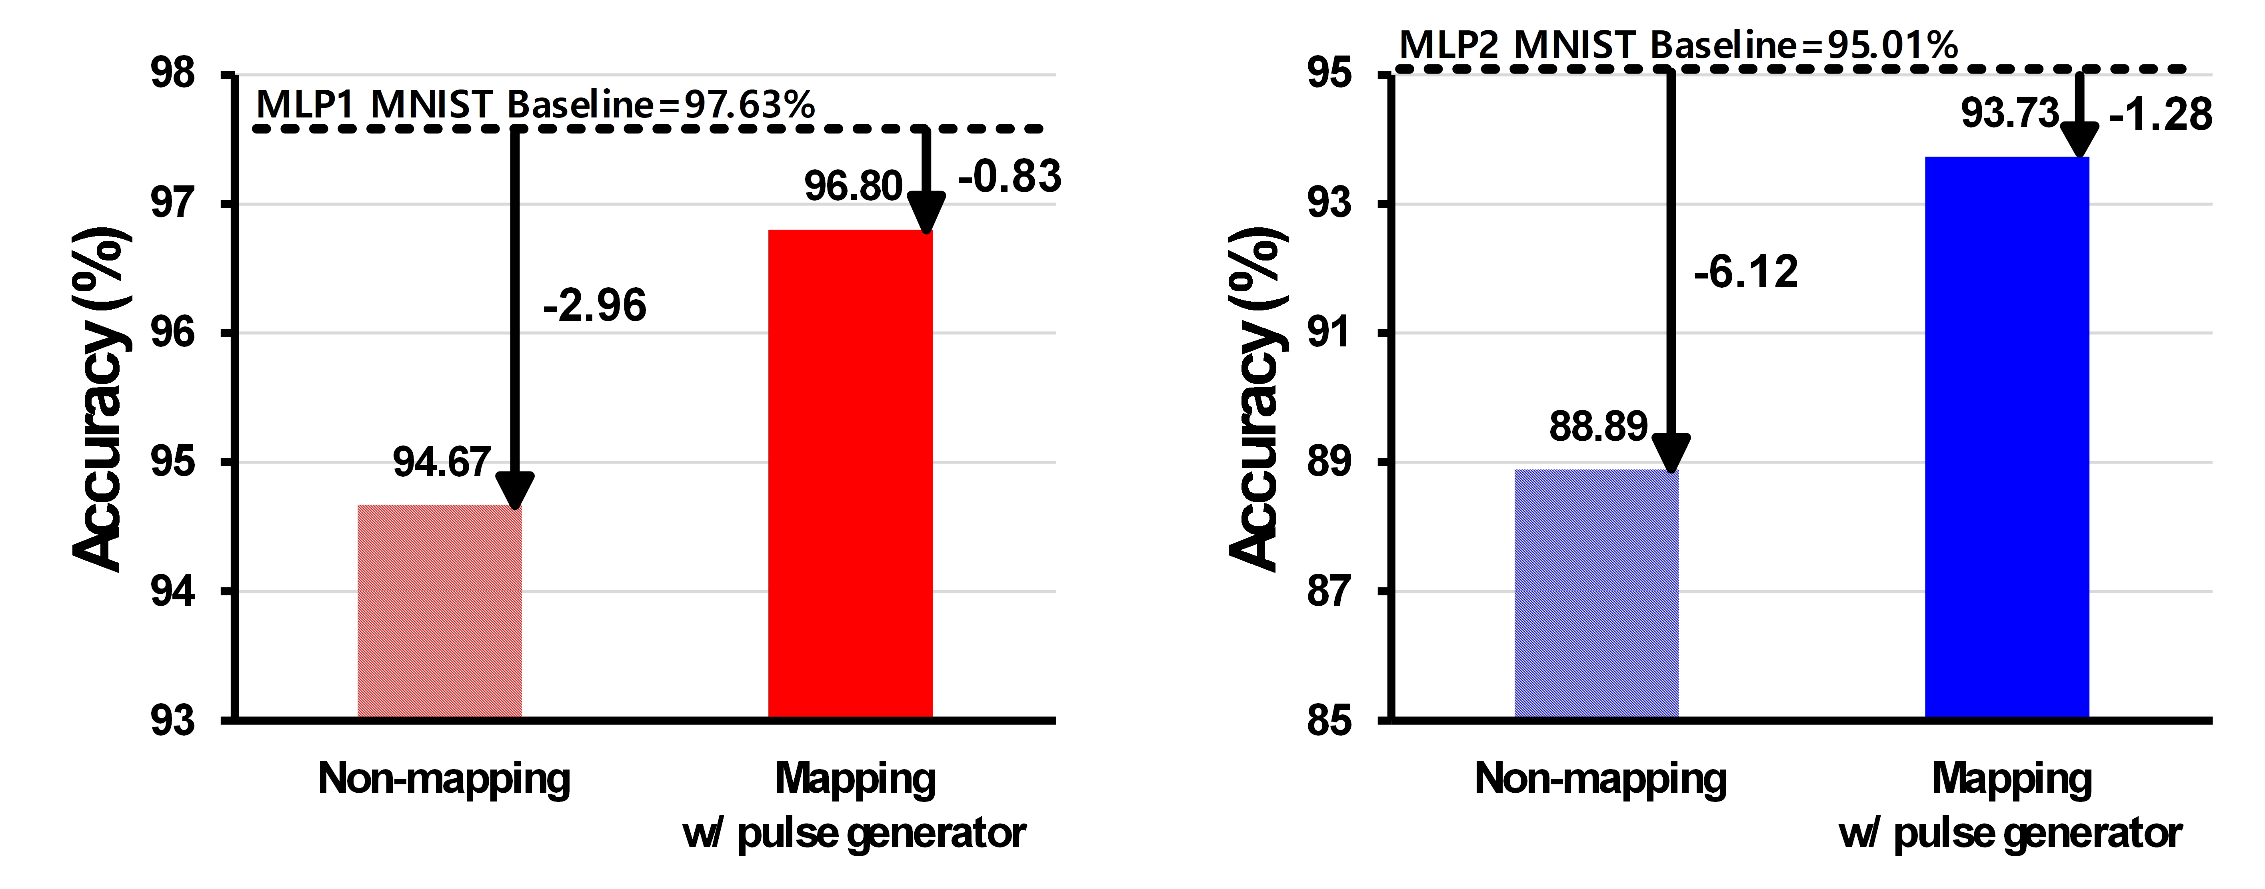
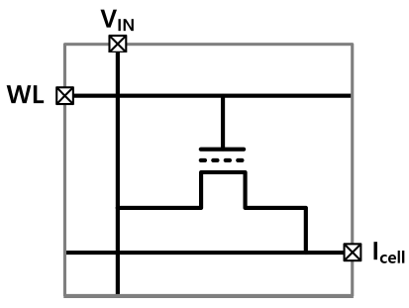
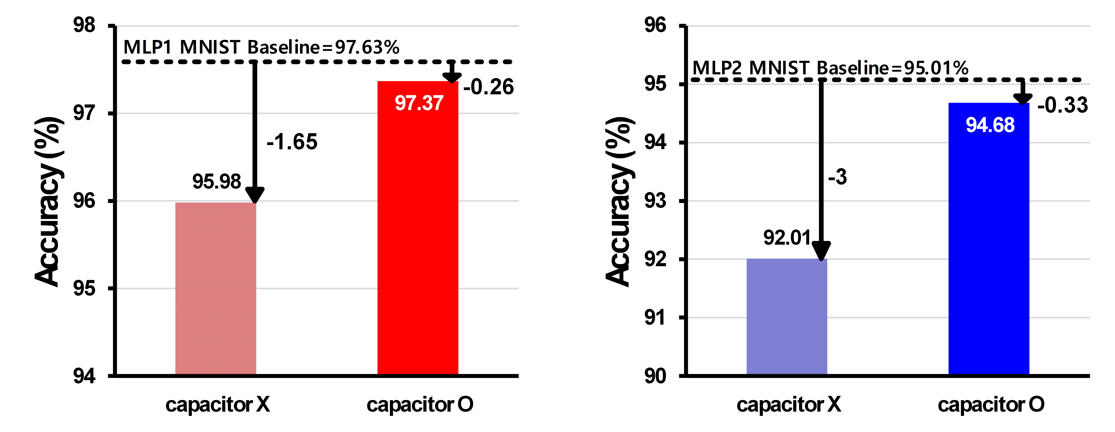
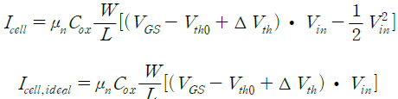
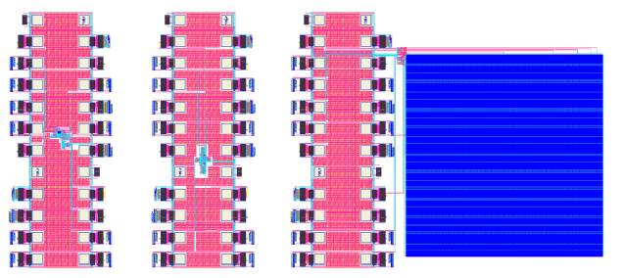
Highly Linear VMM Based on Charge Trap Device
Using Bootstrapping and Non-Linear Weight Programming
Jeongin Choi¹, Hojin Lee¹, Kee-Won Kwon²
¹Department of Electrical and Computer Engineering Sungkyunkwan University, Suwon, South Korea
²Department of Semiconductor and Display Engineering Sungkyunkwan University, Suwon, South Kore
Email: keewkwon@skku.edu
ABSTRACT
TEBL(Tailored Electronics & Betterment Lab) SKKU
To improve the linearity between the input voltage and output current by adding an auxiliary current to the cell current.
This study proposes a highly linear Vector-Matrix Multiplier (VMM) using a charge trap device. To achieve a high recognition accuracy, sufficient linearity between inputs and outputs, as well as weights and outputs, must be ensured in Multiply and Accumulation (MAC) operations. In this study, we propose a 4T-1C VMM cell structure employing a bootstrapping to mitigate the non-linearity between the input and output of the charge trap device. This structure reduces non-linearity between the input and output by 20-65%, demonstrating an effective number of bits of 5.21 across the entire weight range. Additionally, to enhance the linearity between weights and outputs, we propose a weight mapping and write pulse generator, which decrease the variation in conductance differences between adjacent states by 34%.
CTF based VMM cell with auxiliary current path
Charge Trap Device
F
Structure of Proposed 4T-1C VMM Cell
Waveform of the read operation for proposed cell
Auxiliary path makes it impossible to achieve zero current, increasing the burden of post-processing. To address these issues and simultaneously improve the cell’s linearity, a VMM cell incorporating a bootstrapping with separate trapping and boosting nodes is proposed.
Simulation Results
Structure of (a) floating gate FET and (b) charge trap FET
Both devices store data by utilizing the change in the gate voltage required for channel formation (threshold voltage), which varies depending on the amount of charge trapped in the trapping layer.
Proposed Circuits
Comparison of MNIST recognition accuracy with and without weight mapping in (a) MLP1 and (b) MLP2
Assuming the transistor operates in the linear region, the cell current can be expressed as shown in equation.
Comparison of MNIST recognition accuracy with and without bootstrapping in (a) MLP1 and (b) MLP2
Traditional Structure of a charge storage-based analog VMM Cell
DB 180nm BCDMOS
5mmX5mm
측정 장비 셋업 중
Charge Trap Device stores multi-level weights in the form of conductance by controlling the amount of trapped electrons.
When an input voltage (Vin) is applied, it is multiplied by the cell conductance, resulting in an output current.
Layout of TEG and large array for proposed VMM cell
ACKNOWLEDGMENT
CONCLUSION
This work was supported by Samsung Electronics Co. ,Ltd (IO201222-08253-01) The EDA tool was supported by the IC Design Education Center(IDEC), Korea.
The application of bootstrapping reduced the SSR values by 20-65%. Proposed cell demonstrated an excellent ENOB of 5.21 bits.
Evaluated using MNIST Dataset, a reduction of 72% and 79% compared to case without bootstrapping.

