Slide 1
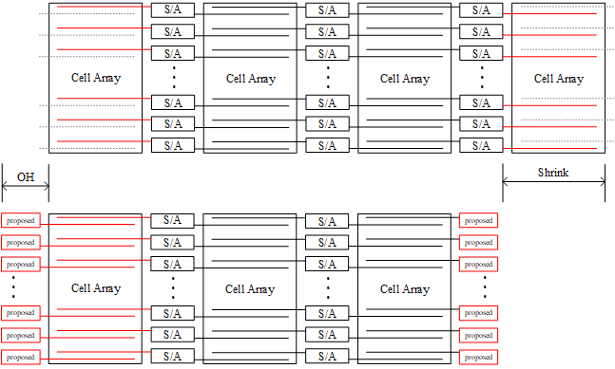
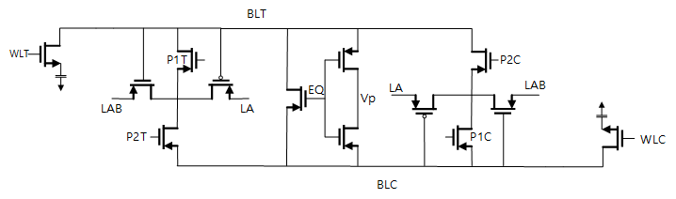
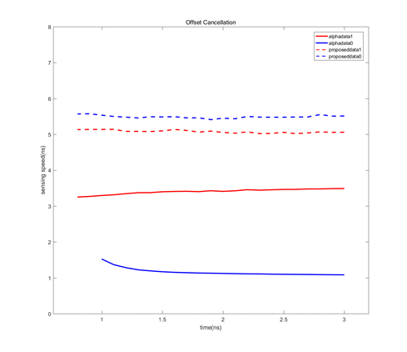
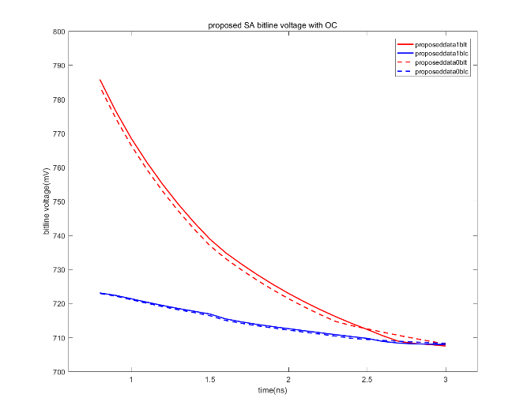
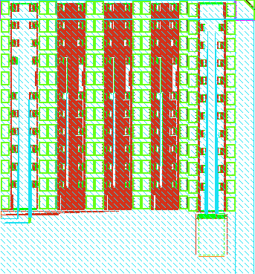
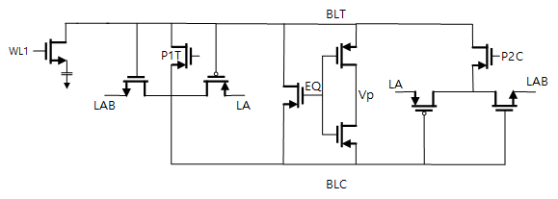
Design and Validation of Single-ended Sense Amplifier Utilizing Dummy Bit Line in Edge Block
Hyun-Jin Kim¹, Chae-Bin Kim¹, Kee-Won Kwon²
¹Department of Electrical and Computer Engineering Sungkyunkwan University, Suwon, South Korea
²Department of Semiconductor and Display Engineering Sungkyunkwan University, Suwon, South Kore
Email: keewkwon@skku.edu
Abstract
TEBL(Tailored Electronics & Betterment Lab) SKKU
This study proposes a sense amplifier with a single-ended structure that can be used in edge blocks. Since semiconductor miniaturization is rapidly progressing, the use of dummy bit lines that are not used in edge blocks will greatly help reduce the area of DRAM cell arrays. In addition, the role of the sensing bit line inside the sense amplifier is fixed due to the nature of using only one bit line of the cell array, thereby ensuring fast sensing speed and low power depletion.
Introduction
Open bit line configuration method including proposed sense amplifier
Since the dummy bit line that was being consumed due to structural limitations can be used in the edge block, instead of using one less cell array block, a sense amplifier that senses the dummy bit line is added.
Simulation Results
Schematic of alpha sense amplifier
The operation of the alpha-type sense amplifier is divided into four stages: (1) Precharge (2), Offset Cancellation (3), Charge Sharing (4), Sensing.
Precharge - the voltage of BLT and BLC is adjusted to the same value
Offset Cancellation - the amplitude function of each inverter is activated, and the P1 signal is turned on to connect the input/output terminal of the inverter. When the input and output terminals are connected, the two voltages will gradually turn to a metastable voltage.
Charge Sharing - charge sharing occurs between the Cell Cap (VDD or VSS) and the BL Cap (VDD/2)
Sensing - the P2 signal is turned on while the ISO signal is turned on, and the voltage is amplified through the inverter chain
Proposed Circuit
Sensing time graph of two sense amplifiers
according to OC time
bit line voltage graph of two sense amplifiers
according to OC time
 | alpha SA | proposed SA
Number of TRs used | 11 TR | 9 TR
OC time limit | no limit | 1ns
Data 1 sensing speed | 5.1ns | 3.2~3.5ns
Data 0 sensing speed | 5.5ns | 1.0~1.5ns
DRAM cell array area | - | 2% decrease
Schematic of proposed sense amplifier
Single-ended structure: both data are received from one sensing line, so the unused side must be separated from the signal
2 fewer transistors used: if only one bit line is sensed at the edge block of the cell array, the sense amplifier can be operated without using the isolation TR
layout of proposed sense amplifier
The sensing time of the alpha sense amplifier is 5.0 to 5.5ns, the sensing time of 1.0 to 1.5ns for data 0 and 3.2 to 3.5ns for data 1 was measured, and it has a less sensing time of about 1.5ns or more based on the worst case. Even considering that sensing becomes unstable from the time the OC time is 1.5ns, it can be confirmed that the value of OC time + sensing time is more than 1ns faster than the alpha sense amplifier.
설계 오류로 측정 불가
ACKNOWLEDGMENT
CONCLUSION
The proposed sense amplifier at the edge block uses two less TRs than the alpha sense amplifier using 11 TRs and utilizes discarded dummy bit lines, so an area reduction of 2-3% can be expected from the DRAM cell array perspective. In addition, it can cause sensing errors when having a short OC time of less than 1ns, but it shows that the overall main sensing speed is sensing at a much faster speed than the alpha sense amplifier.
This work was supported by Samsung Electronics Co. ,Ltd (IO201222-08253-01) The EDA tool was supported by the IC Design Education Center(IDEC), Korea.

