Slide 1


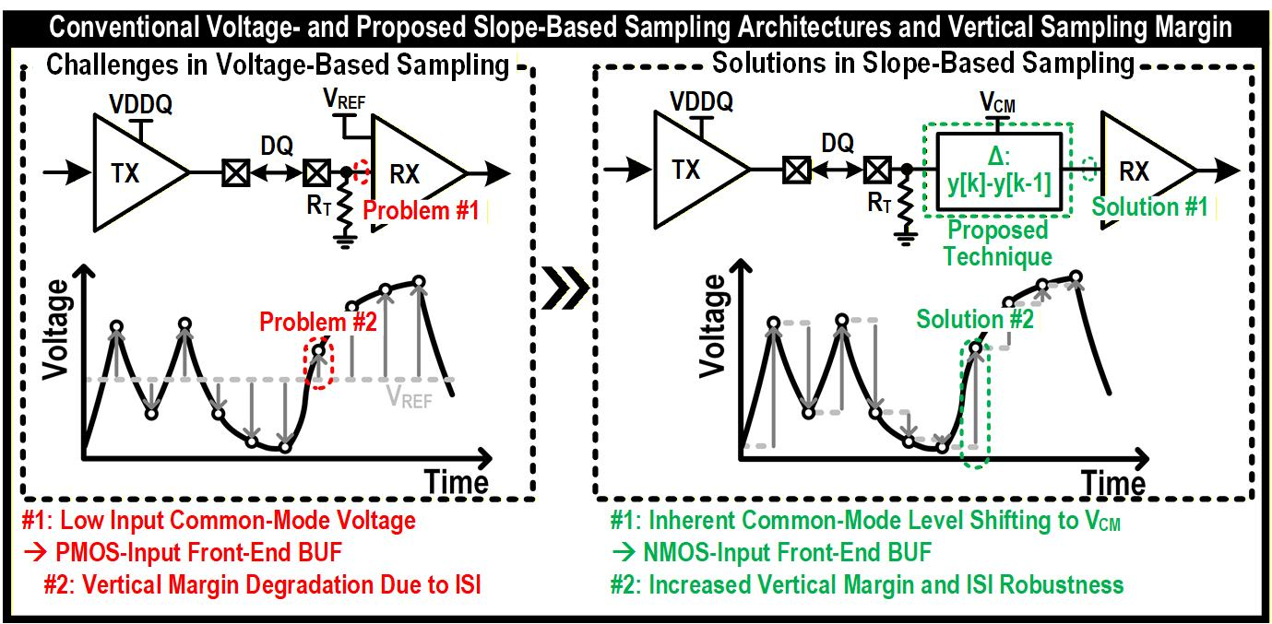
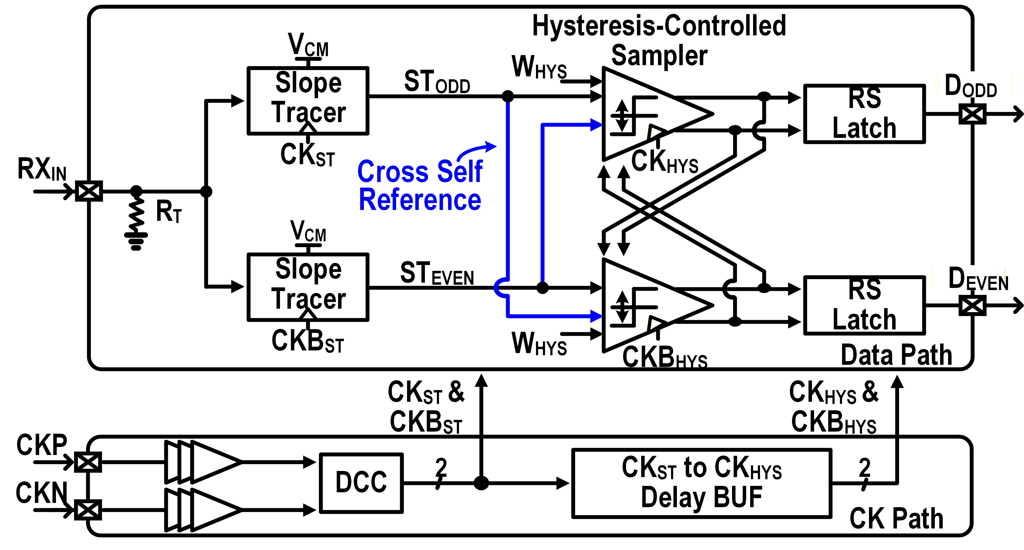
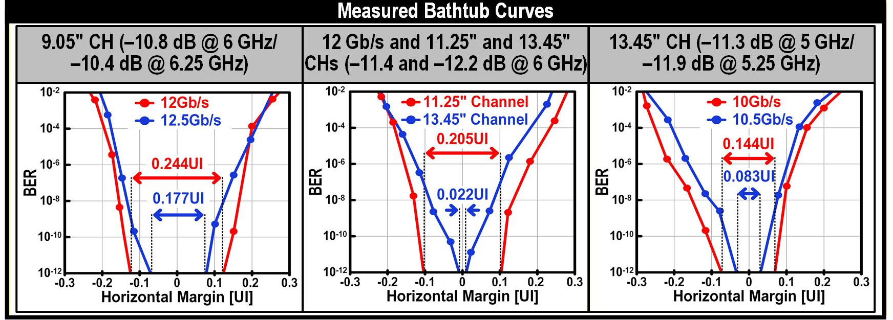
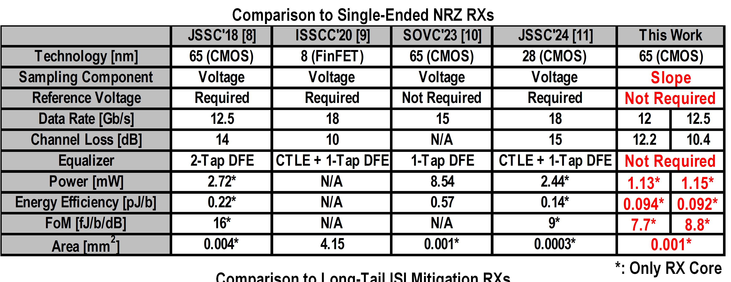
A 0.092-pJ/bit and 7.7-fJ/bit/dB Cross-Self-Referenced Slope-Sampling Receiver with Long-Tail ISI Robustness for Next-Generation Low-Power Memory Interfaces
Ki-Soo Lee*, Chanheum Han*, and Joo-Hyung Chae (*Equally-contibuted Authors)
Electronics and Communications Engineering, Kwangwoon University
Introduction
Severe channel loss in high-speed memory interfaces causes long-tail ISI and degrades sampling margin.
Voltage-based sampling suffers from low common-mode operation and ISI accumulation.
This work employs slope-based sampling to enhance vertical margin and robustness to ISI without any equalization.
Proposed Scheme: Slope-Based Sampling for Long-Tail ISI Robustness
In voltage-based sampling, post-cursor ISI components are directly accumulated, leading to degraded signal integrity as the number of post-cursors increases.
In contrast, slope-based sampling utilizes the differences between adjacent coefficients, enabling partial cancellation of post-cursor ISI components.
As shown in the analysis, voltage-based sampling exhibits increasing mean and variation of accumulated ISI, whereas slope-based sampling maintains lower and more stable values.
Implementation
Measurement
A cross-self-referenced architecture with a hysteresis-controlled sampler is adopted to improve ISI robustness.
Conclusions
The proposed slope-based sampling receiver achieves robust operation under severe long-tail ISI conditions.
By employing a cross-self-referenced hysteresis-controlled sampler, it enhances the vertical margin without requiring complex equalization.
The proposed receiver achieves robust horizontal margin across various channel conditions with severe long-tail ISI (up to 0.545).
Measured BER bathtub curves demonstrate stable operation under high channel loss.
Acknowledgement The chip fabrication and EDA tool were supported by the
IC Design Education Center(IDEC), Korea.

