Slide 1

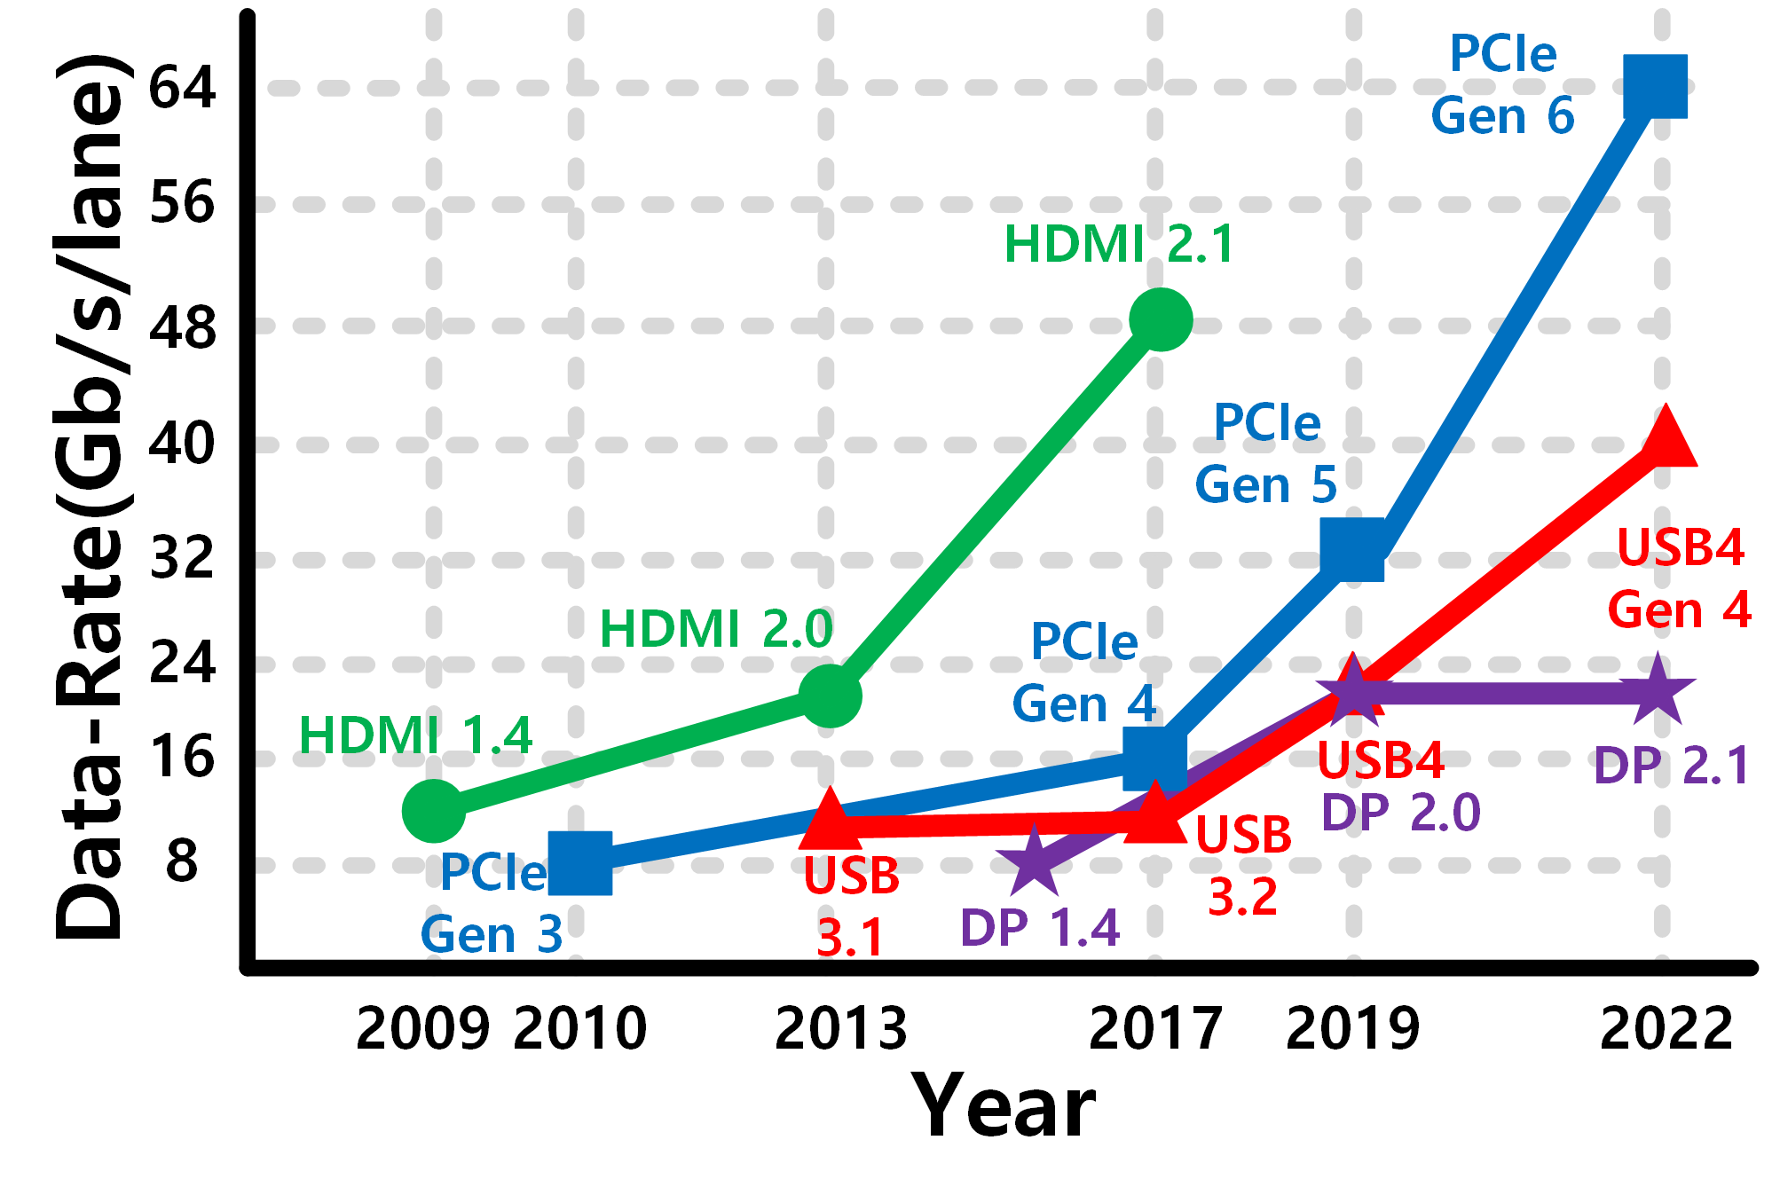
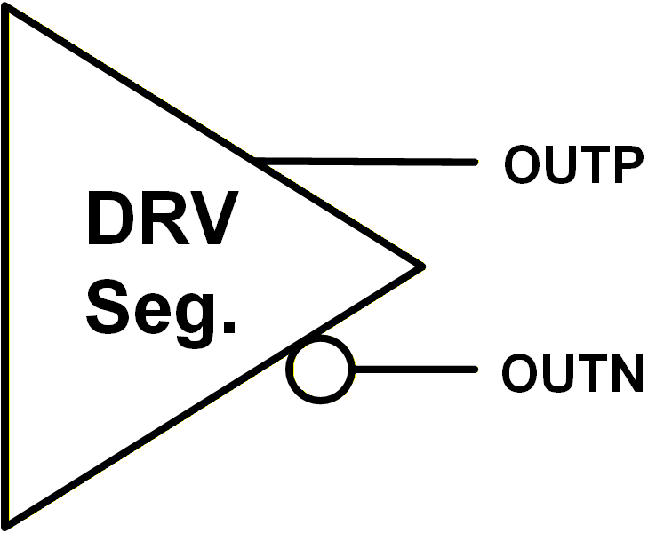
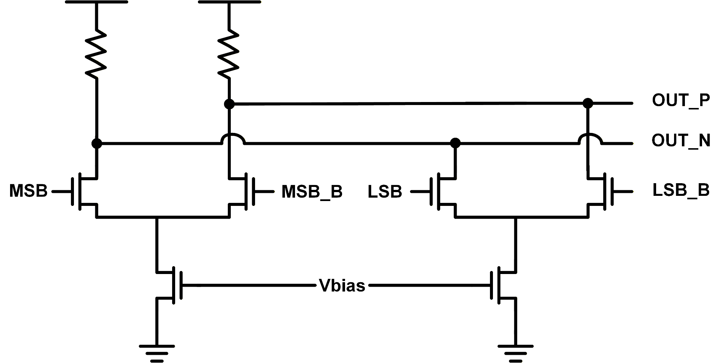
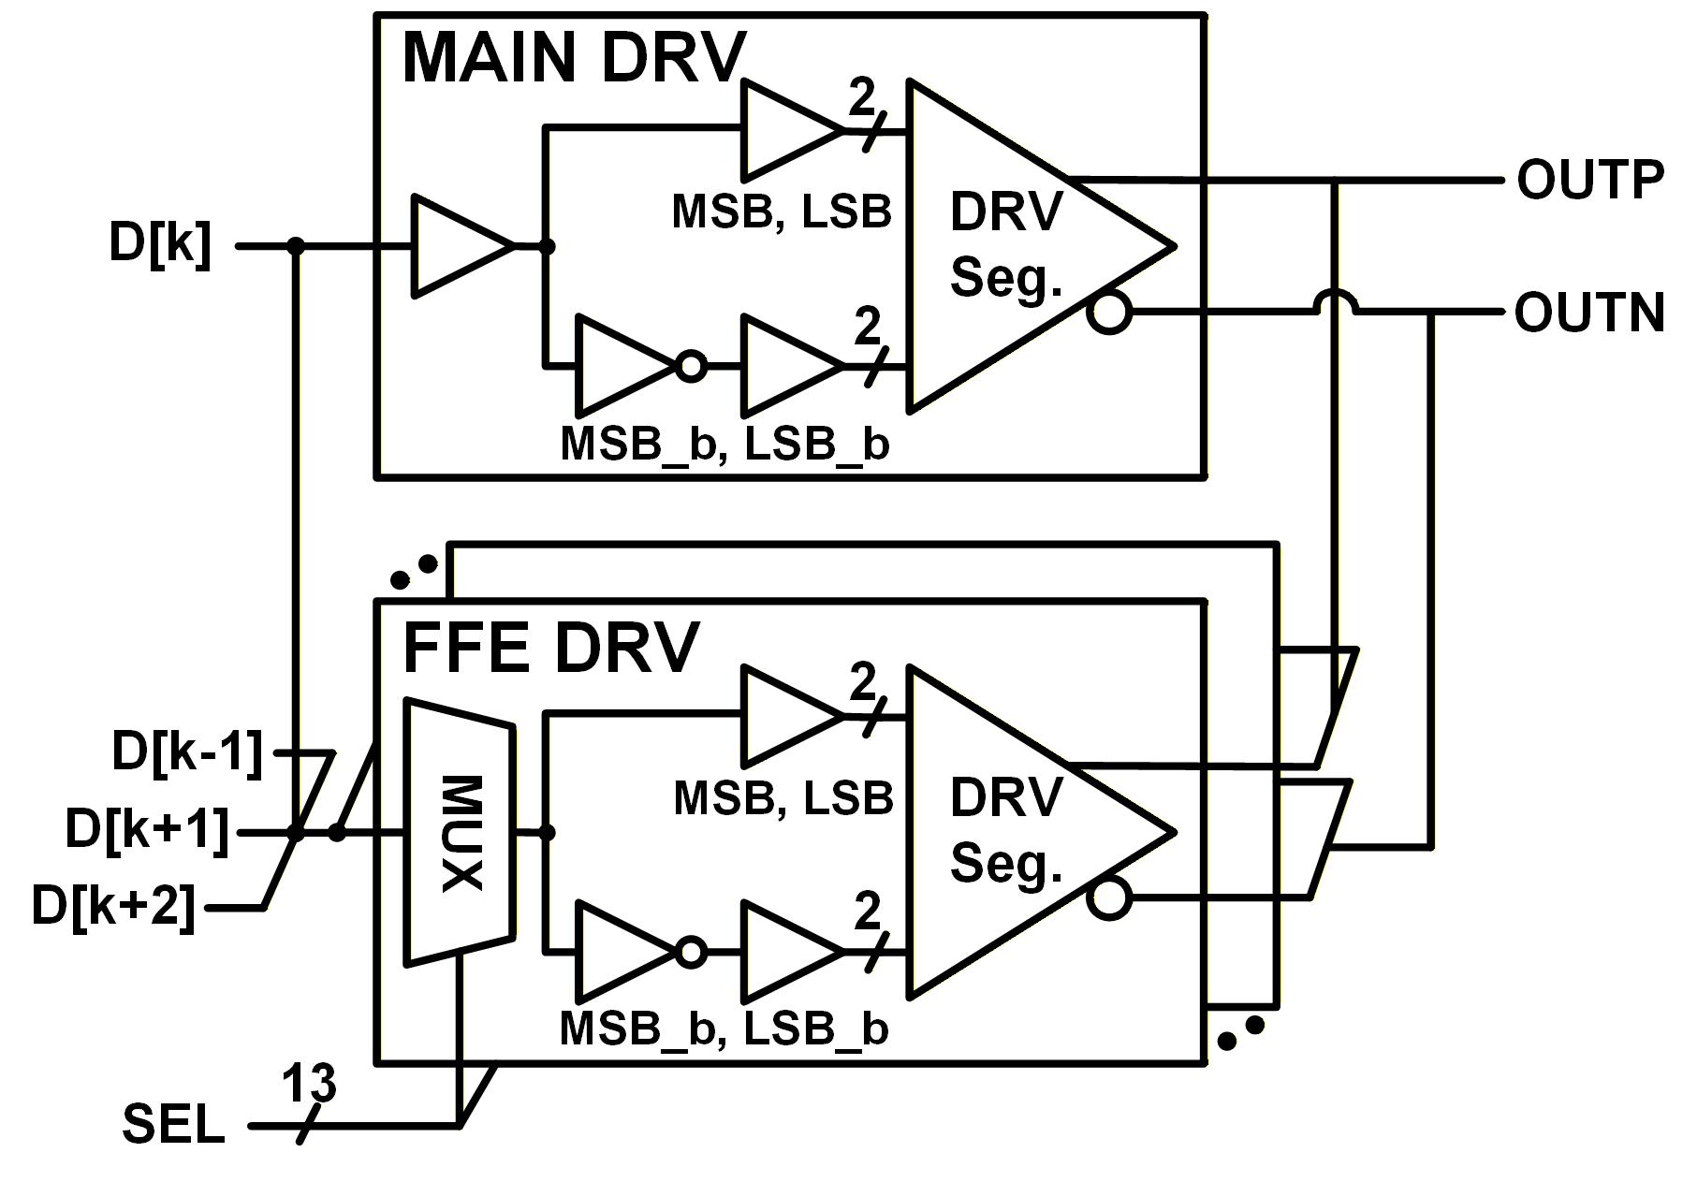
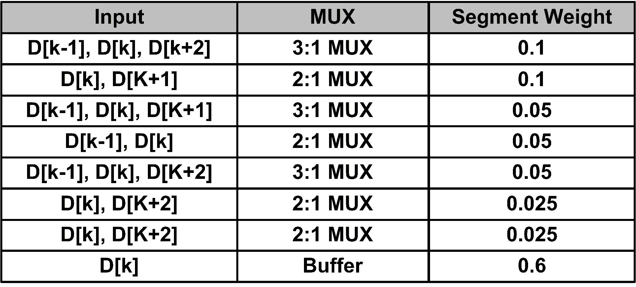
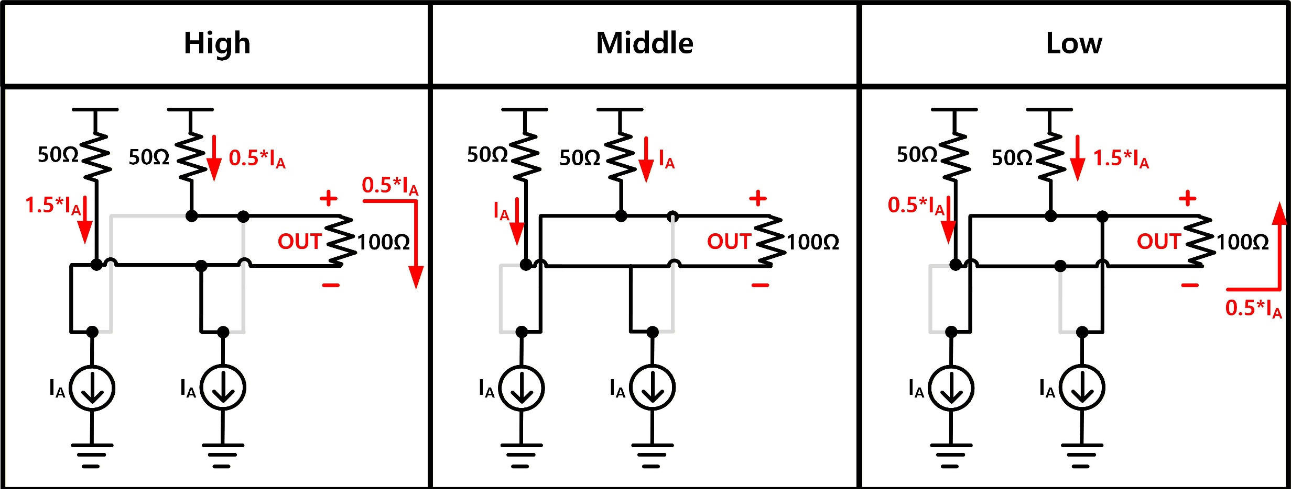
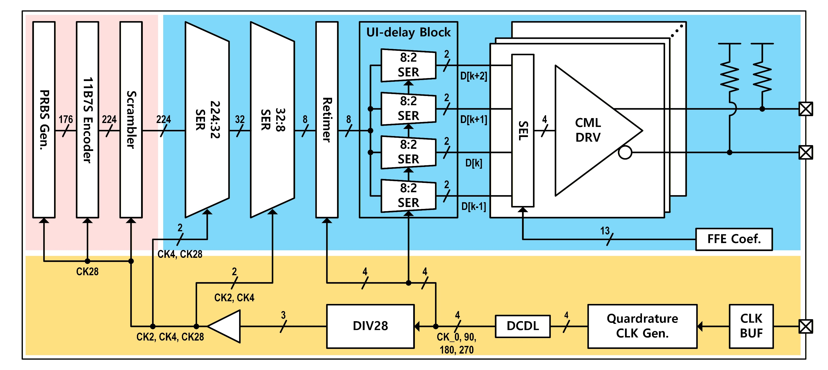
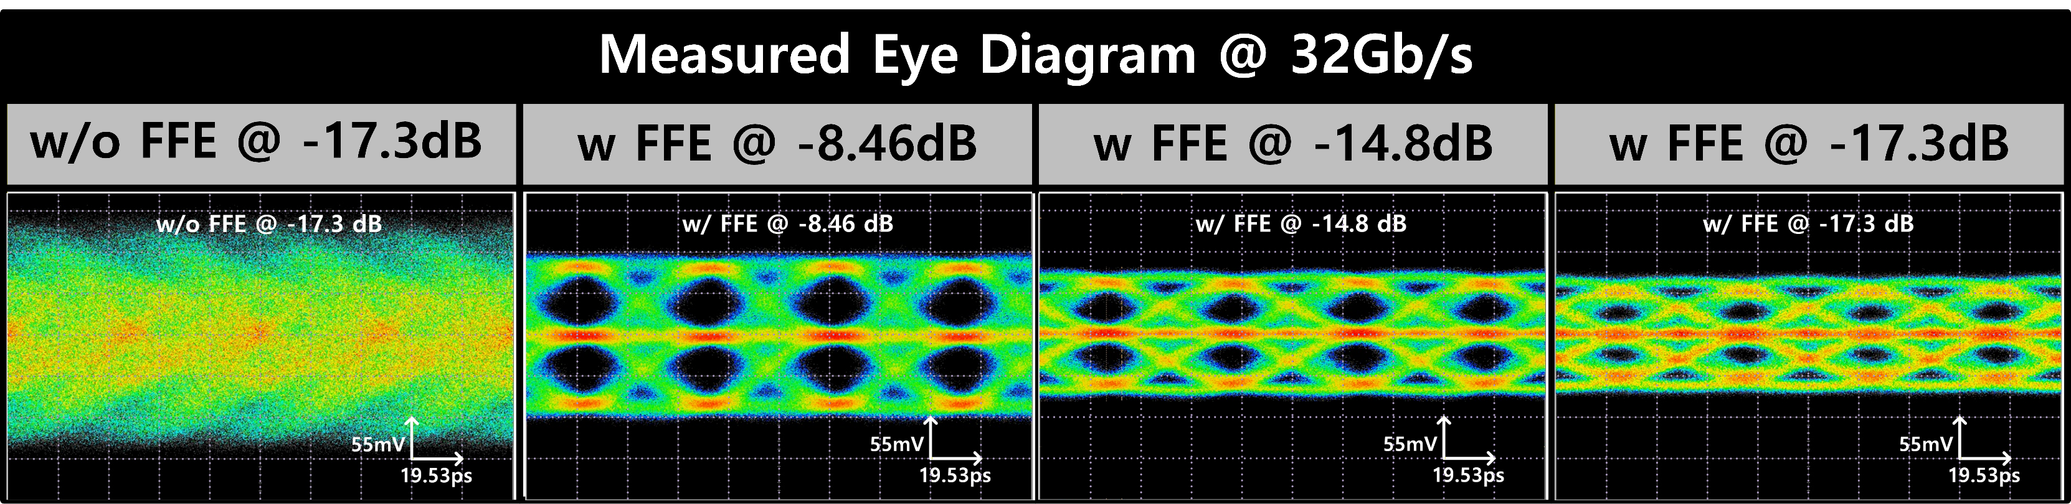
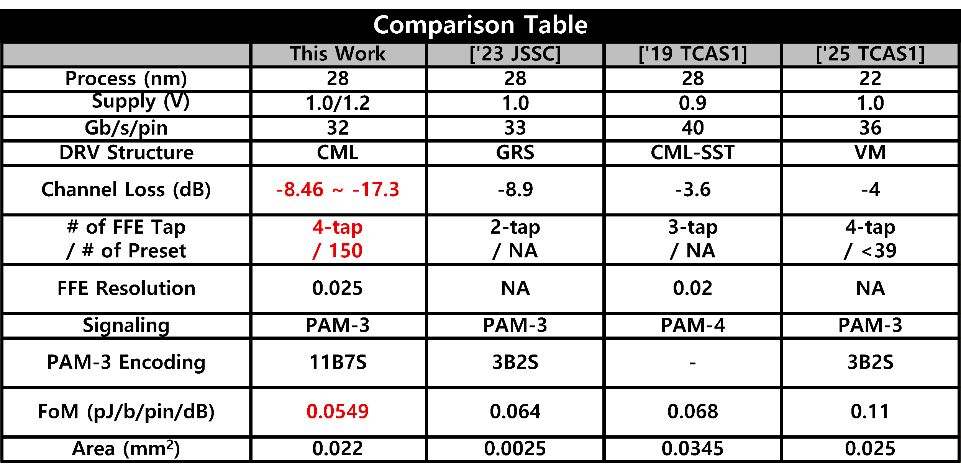
A 0.0549 pJ/bit/pin/dB PAM-3 Current Mode Transmitter with 4-Tap FFE
for Various Channel Environment.
YongGyu Yu*, Chaehyeon Lim*, Ju-Hyeong Yun*, and Joo-Hyung Chae (*Equally-contibuted Authors)
Electronics and Communications Engineering, Kwangwoon University
Introduction
Modern computing platforms require high-speed interfaces to support large bandwidth across diverse peripherals.
To ensure robust data transmission, these standards must provide reliable interoperability across various channel environments.
PAM-3 CML Driver
Reconfigurable FFE
The FFE consists of seven segments with three different weights, which can be reconfigured as either a main-tap or an FFE-tap.
By utilizing 13-bit select signals, it can generate 150 unique presets.
This architecture implements a 4-tap de-emphasis FFE.
By sharing segment units between MAIN and FFE taps, this design minimizes hardware overhead.
The proposed architecture utilizes two identical current sources to generate three-level signals.
Top Architecture
Measurement Result
The proposed TX integrates a logical layer, including 11b7s encoder and scrambler, and electrical layer to PAM-3 signal.
Conclusion
The proposed TX achieves a 32 Gb/s using PAM-3 signaling, resulting in a Figure of Merit (FoM) of 0.0549 pJ/bit/pin/dB.
The measured eye height and width for the upper eye are 21.16 mV and 11.19 ps, respectively, while the lower eye achieves 19.8 mV and 11.67 ps with an RLM of 0.967 under a -17.3 dB at 10.24 GHz.
Fabricated in 28-nm CMOS, the proposed PAM-3 TX achieves a 32 Gb/s data rate with a 0.0549 pJ/bit/pin/dB, successfully compensating for up to -17.3 dB at 10.24 GHz channel loss.
Acknowledgement The chip fabrication and EDA tool were supported by the
IC Design Education Center(IDEC), Korea.

