Slide 1

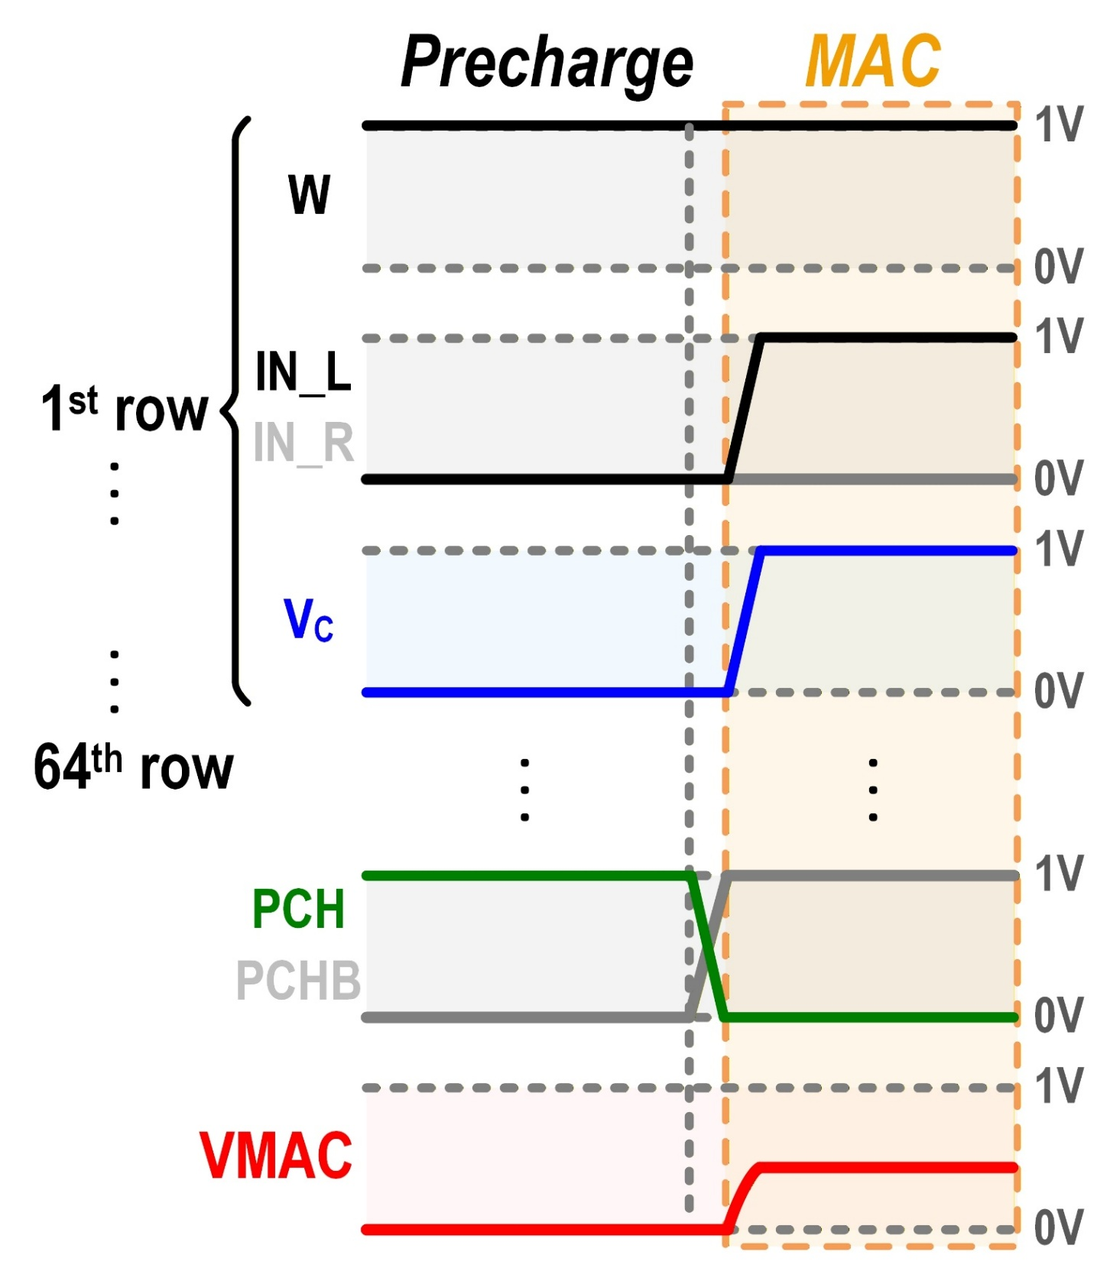
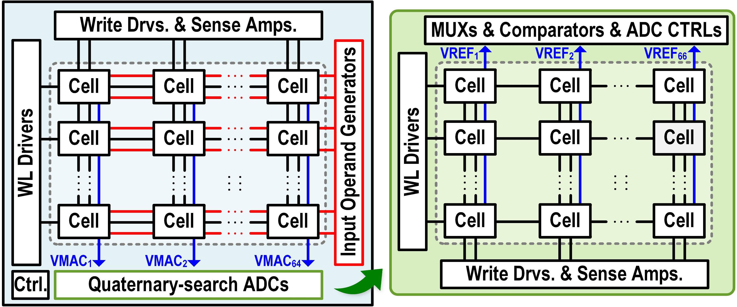
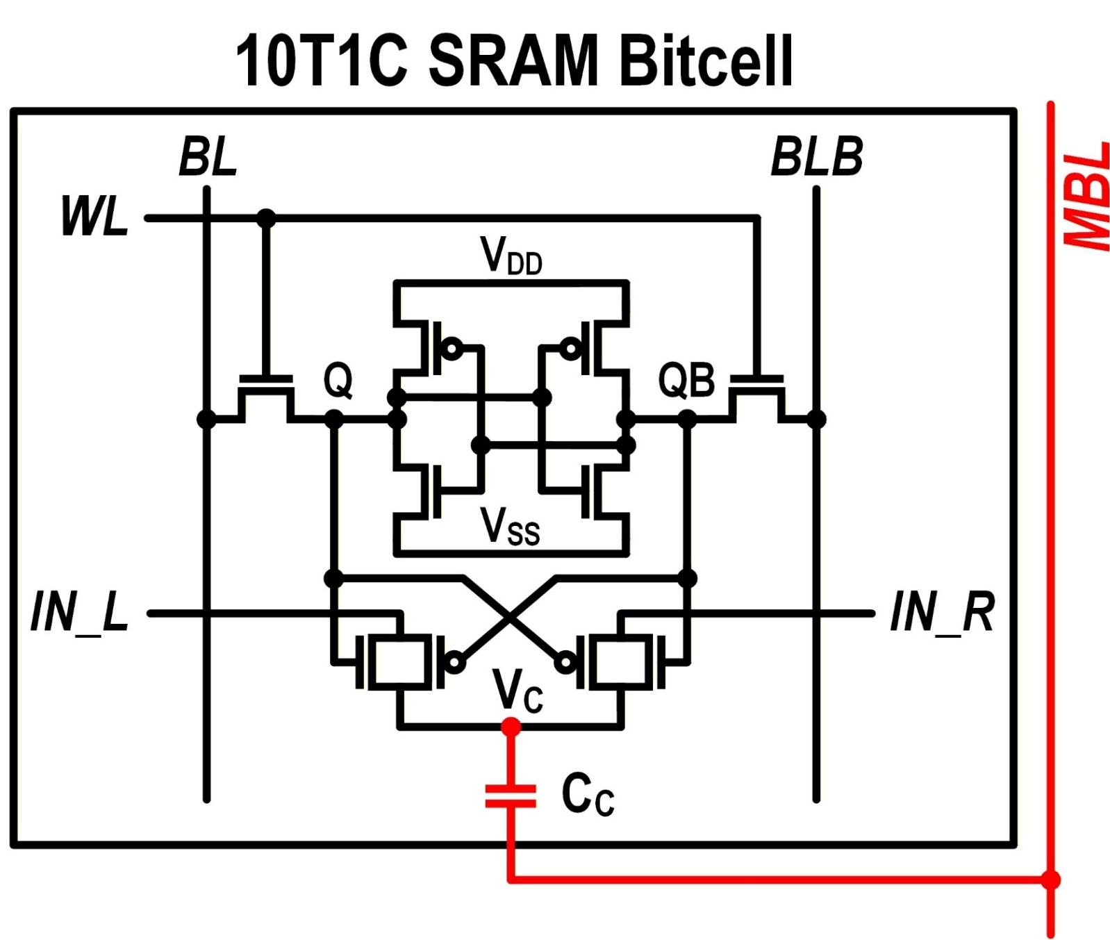
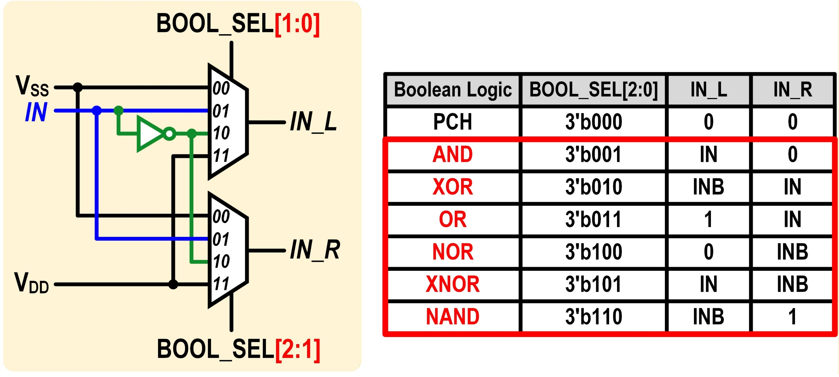
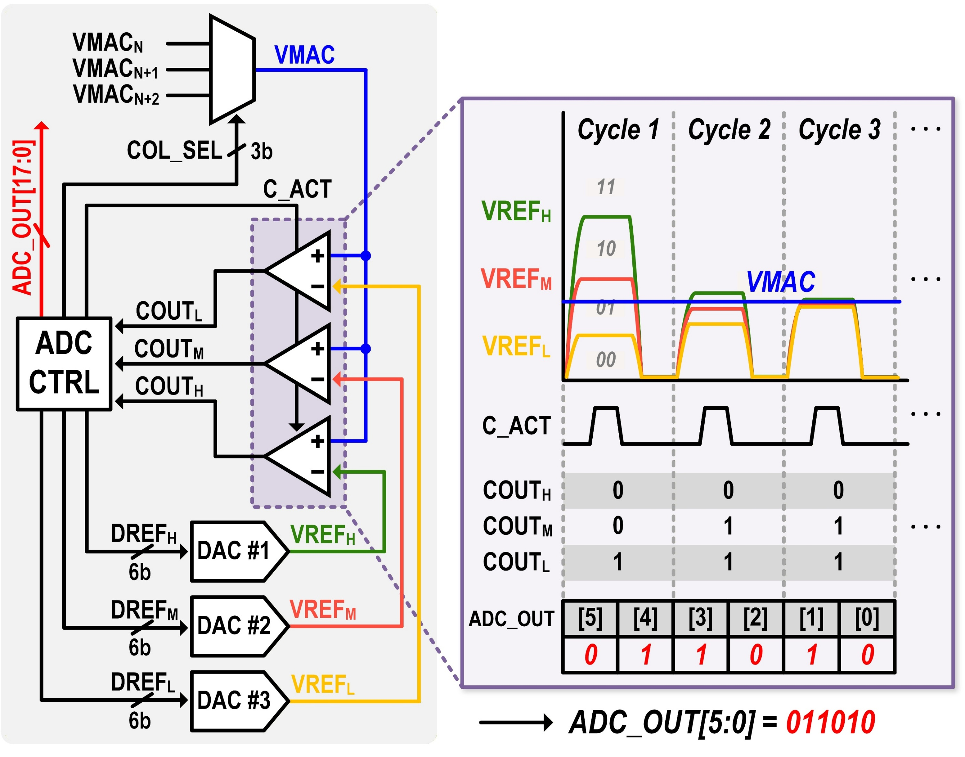
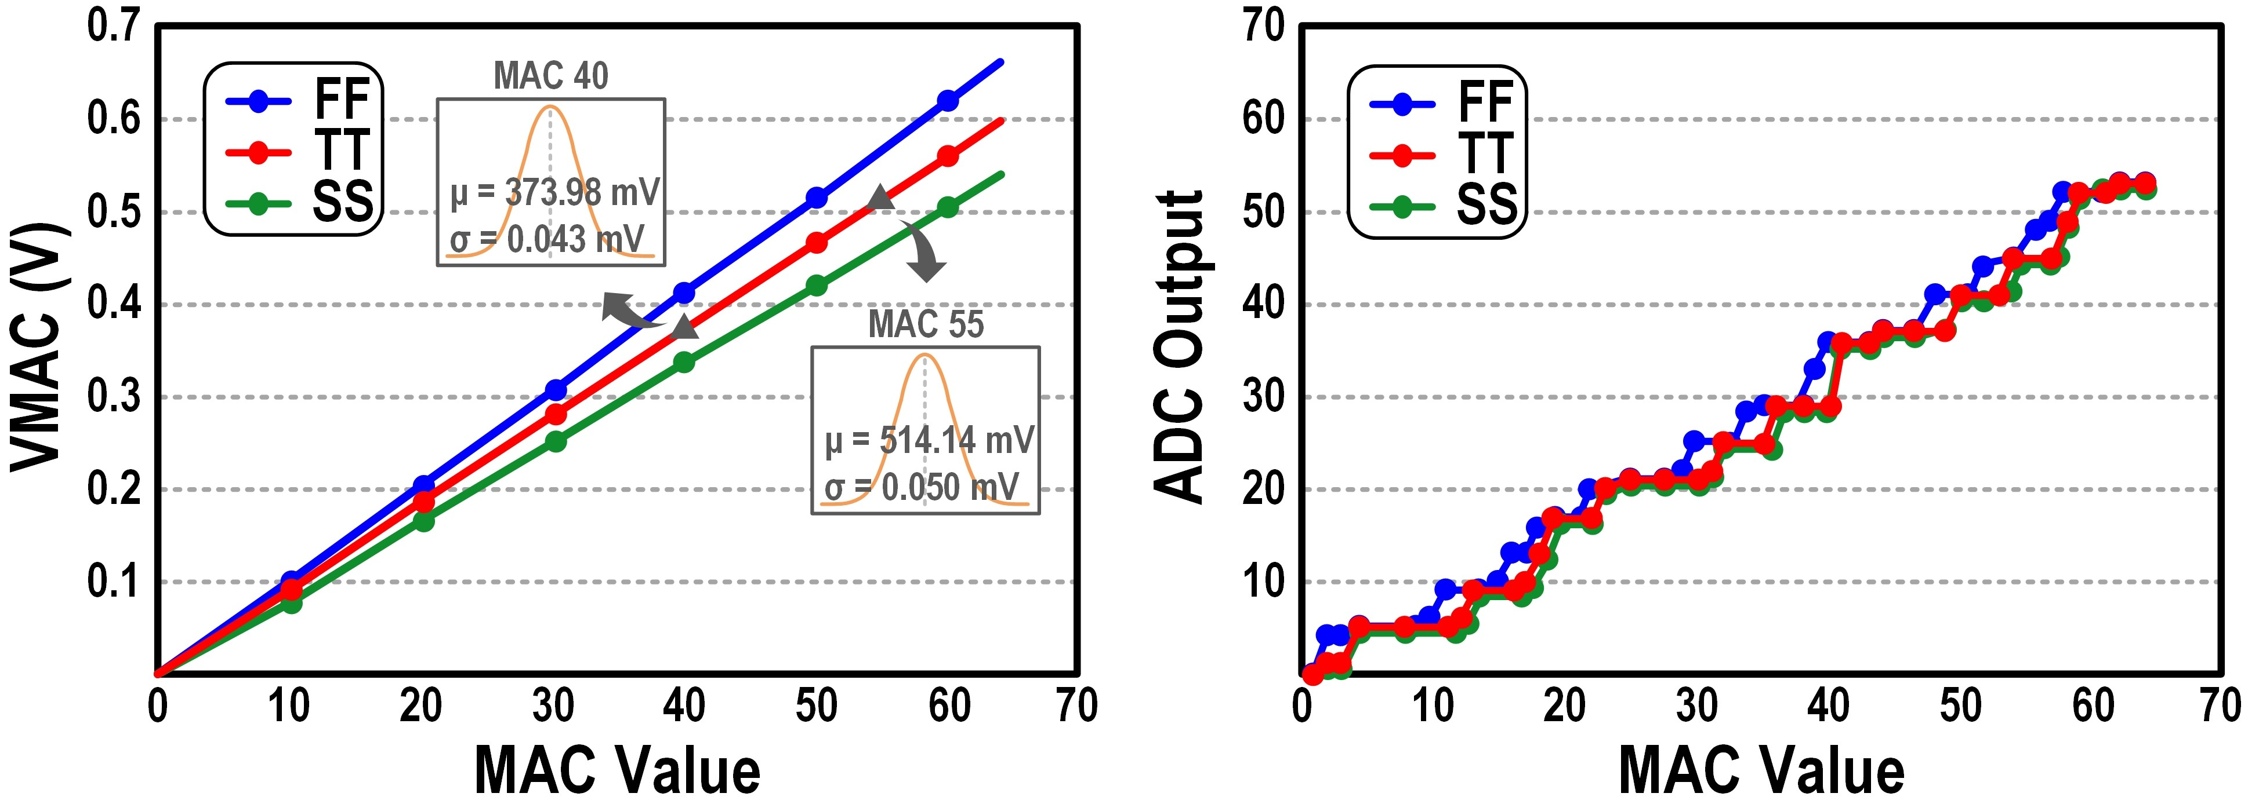
A 0.58 Ops/Trans Analog Compute-in-Memory Macro With Input Operand Generator Supporting Wide Boolean Operations for Enhanced Versatility
Eun-Bi Koh, Jeong-Eun Ko, and Joo-Hyung Chae
Department of Electronics and Communications Engineering, Kwangwoon University
Introduction
Compute-in-memory (CIM) reduces data movement and improves energy efficiency for data-intensive applications.
However, most prior CIM macros are optimized for multiply-and-accumulate (MAC) operations, limiting their applicability.
To support a wider range of tasks, recent applications require both MAC and Boolean operations.
This work proposes an analog CIM (ACIM) macro that supports both MAC and multiple Boolean operations, while reusing the memory array structure in the analog-to-digital converter (ADC) to improve area–latency efficiency.
Proposed Architecture and Key Ideas
Overall Architecture
① 10T1C SRAM Bitcell
The proposed architecture is based on three key ideas:
① 10T1C SRAM Bitcell with Capacitive Coupling
→ Enables charge-domain MAC with high linearity and no
threshold voltage loss.
② Input Operand Generator
→ Generates dual inputs (IN_L, IN_R) to support six Boolean
operations.
→ Achieves high versatility with minimal peripheral overhead.
③ Quaternary-Search 6-bit ADC
→ Performs 2-bit/cycle conversion to reduce latency.
→ Shares one ADC across three columns to minimize area
overhead.
② Input Operand Generator
③ Quaternary-Search ADC
Simulation Results
VMAC exhibits highly linear behavior across MAC values under FF/TT/SS corners.
ADC outputs accurately match MAC values, validating correct conversion.
33.8 TOPS/W (energy efficiency)
0.58 Ops/Trans (Boolean operations per transistor)
89.81% inference accuracy for AND-based MAC operations (ResNet-18, CIFAR-10)
Conclusion
The proposed ACIM macro supports both MAC and six Boolean logic operations.
The row-shared IOG and quaternary-search ADC reduce peripheral overhead and improve area–latency efficiency.
Compared with recent CIM designs, this work achieves competitive energy efficiency of 33.8 TOPS/W.
Acknowledgement The chip fabrication and EDA tool were supported by the
IC Design Education Center(IDEC), Korea.

