Slide 1

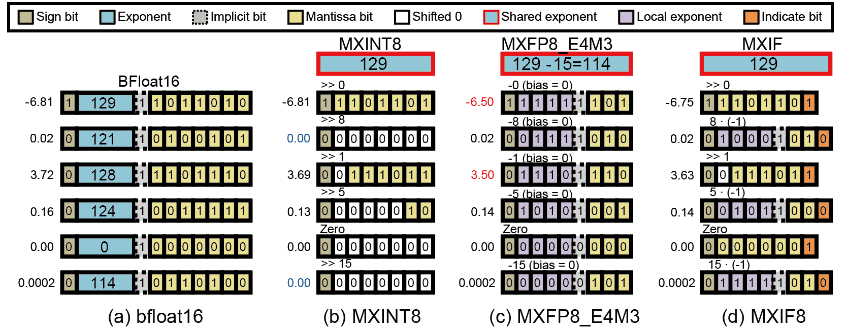
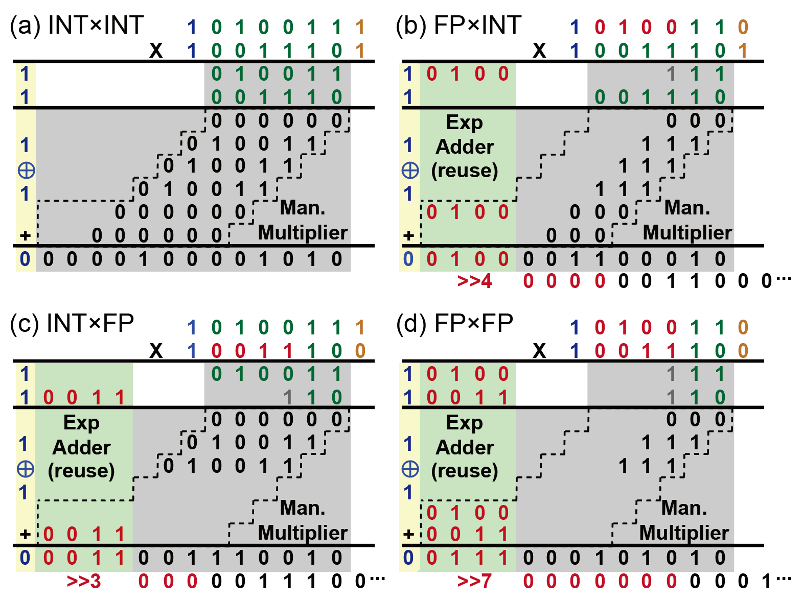
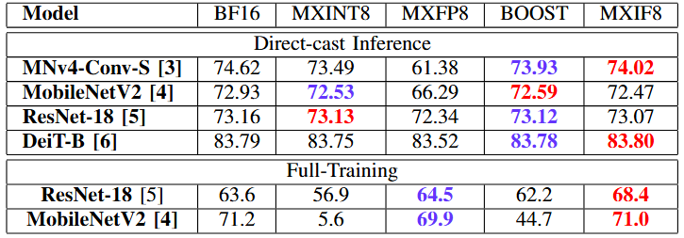
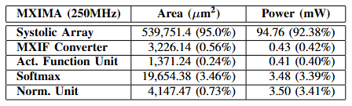
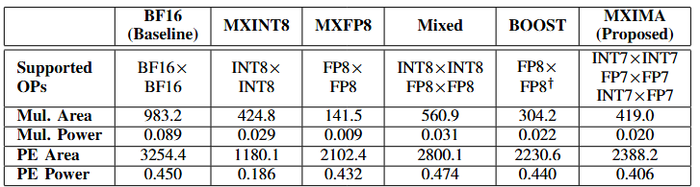
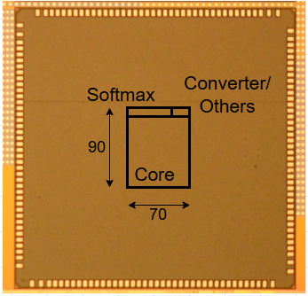
MXIMA: Mixing INT- and FP-based Microscaling Formats for Designing Accurate and Efficient Training-Inference Accelerator
Jahyun Koo†, Dahoon Park∗ and Jaeha Kung∗
∗ School of Electrical Engineering, Korea University, South Korea
† School of Electrical Engineering and Computer Science, DGIST, South Korea
I. Introduction
The MX format can be categorized into two types
(i) MXINT which focuses on a high precision consisting only of mantissa bits.
(ii) MXFP which focuses on a wider dynamic range by allowing local exponent bits.
We proposed a novel hybrid MX format (MXIF), that combines the advantages of both MXINT and MXFP.
II. Basic Idea
MXINT causes underflow (Blue value)
MXFP hurts outliers
(Red value)
MXIF mixed format
INT7 ( =1) + FP7 ( =0)
III. MXIMA Multiplier
Ⅳ. Results
MXIF8 can support training/inference simultaneously
MXIMA Multiplier: Reusing INT7 Multiplier
We fabricated a chip in a 200 MHz environment.
(Samsung FD-SOI, 28nm)
The physical area is 1200×800 μm²
Compared Multiplier and PE Unit
Ⅴ. Conclusion
We proposed MXIF, a hybrid MX format that incorporates both MXINT and MXFP, boosting accuracy for both training and inference.
Our MXIMA multiplier modifies the existing INT7 multiplier to perform both mantissa multiplication and exponent addition to switch between four operation modes, i.e., INT×INT, INT×FP, FP×INT, and FP×FP.
The MXIMA PEs achieve similar performance to BF16 PEs while reducing area and power consumption by 26.6% and 9.8%.

