Slide 1


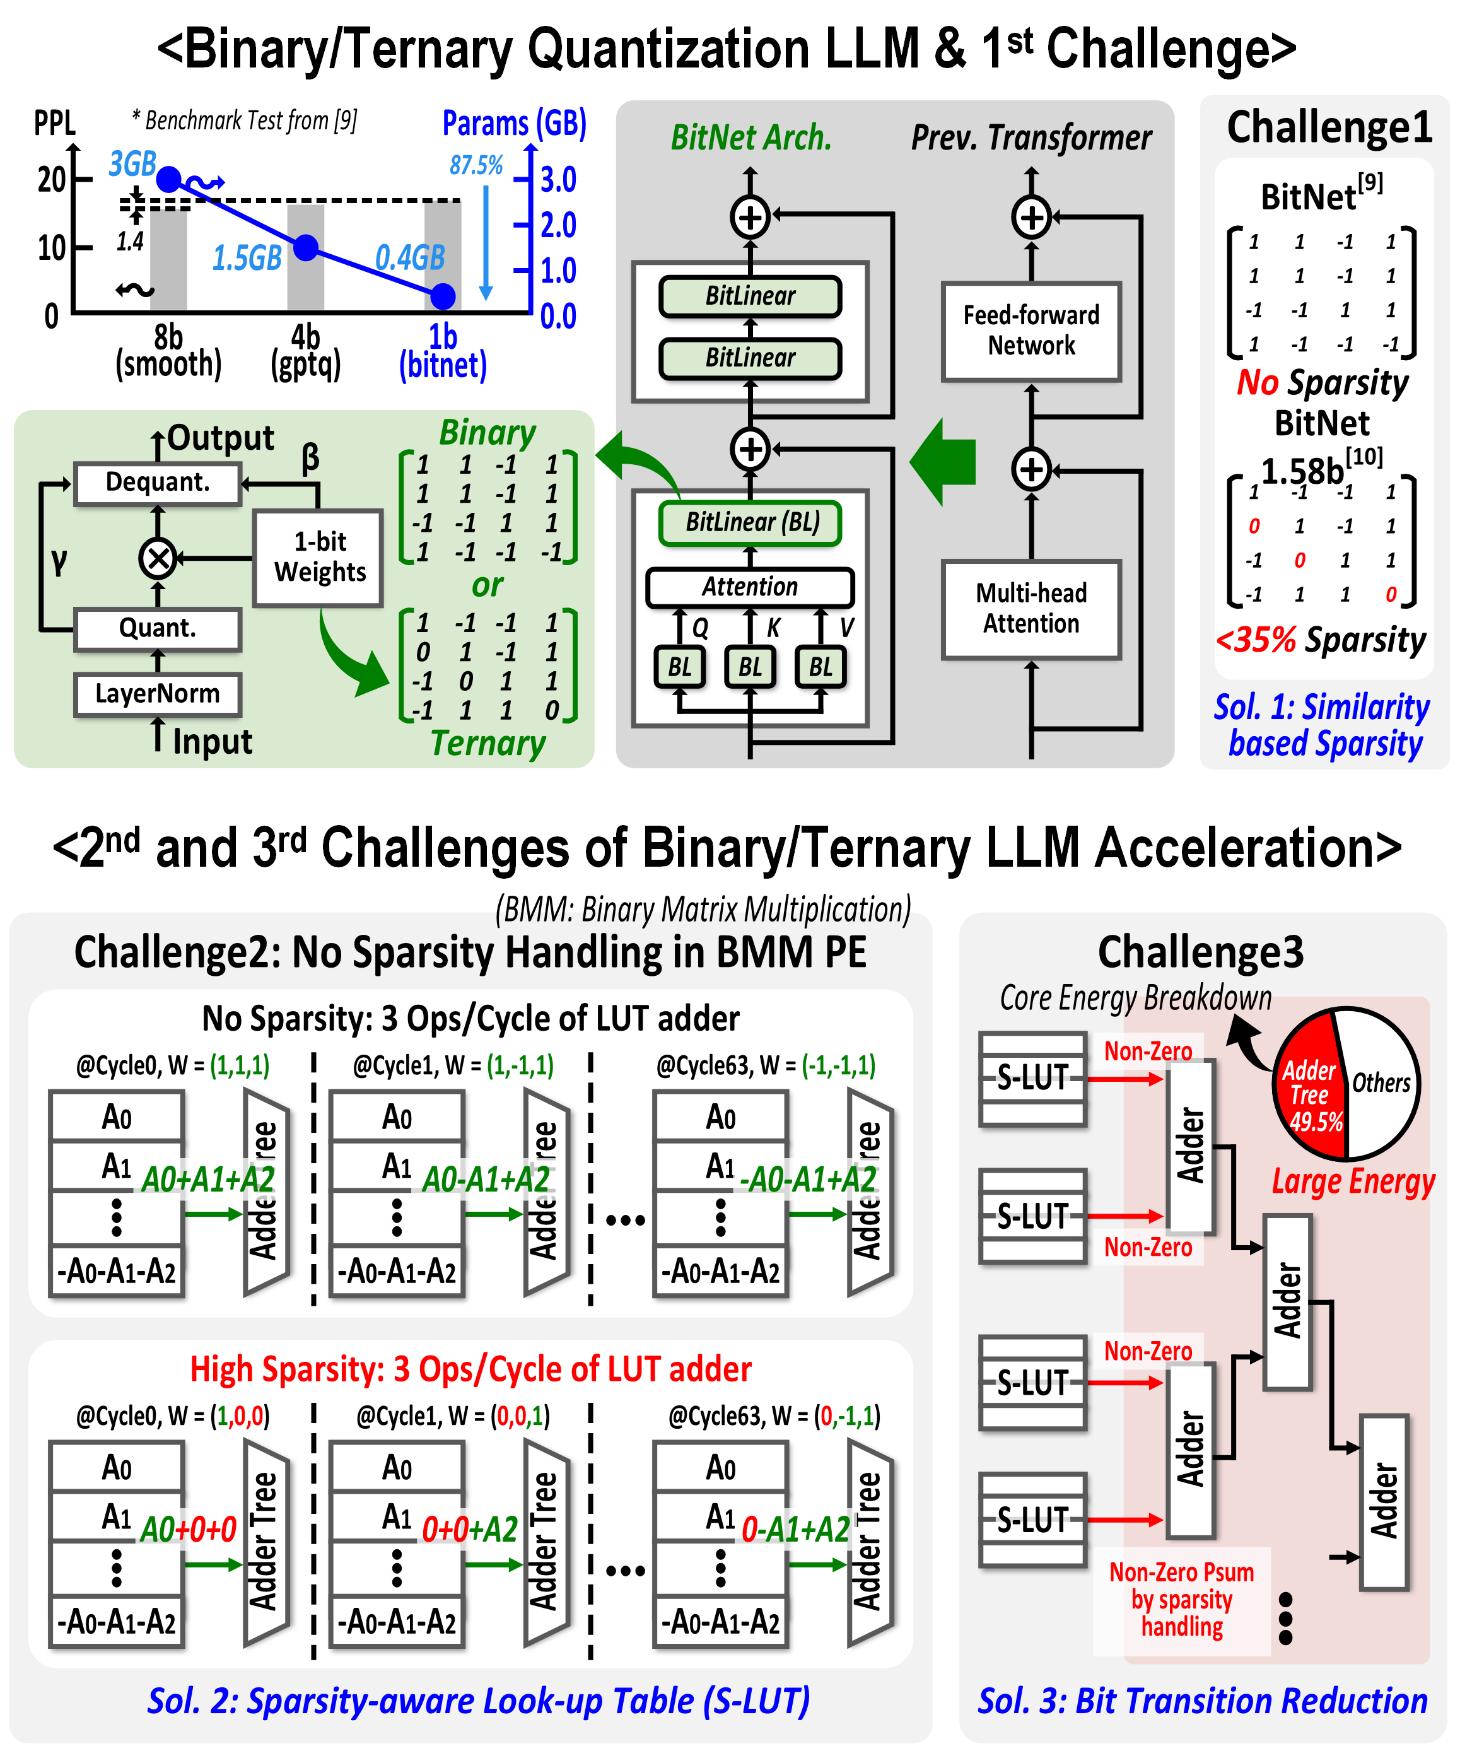
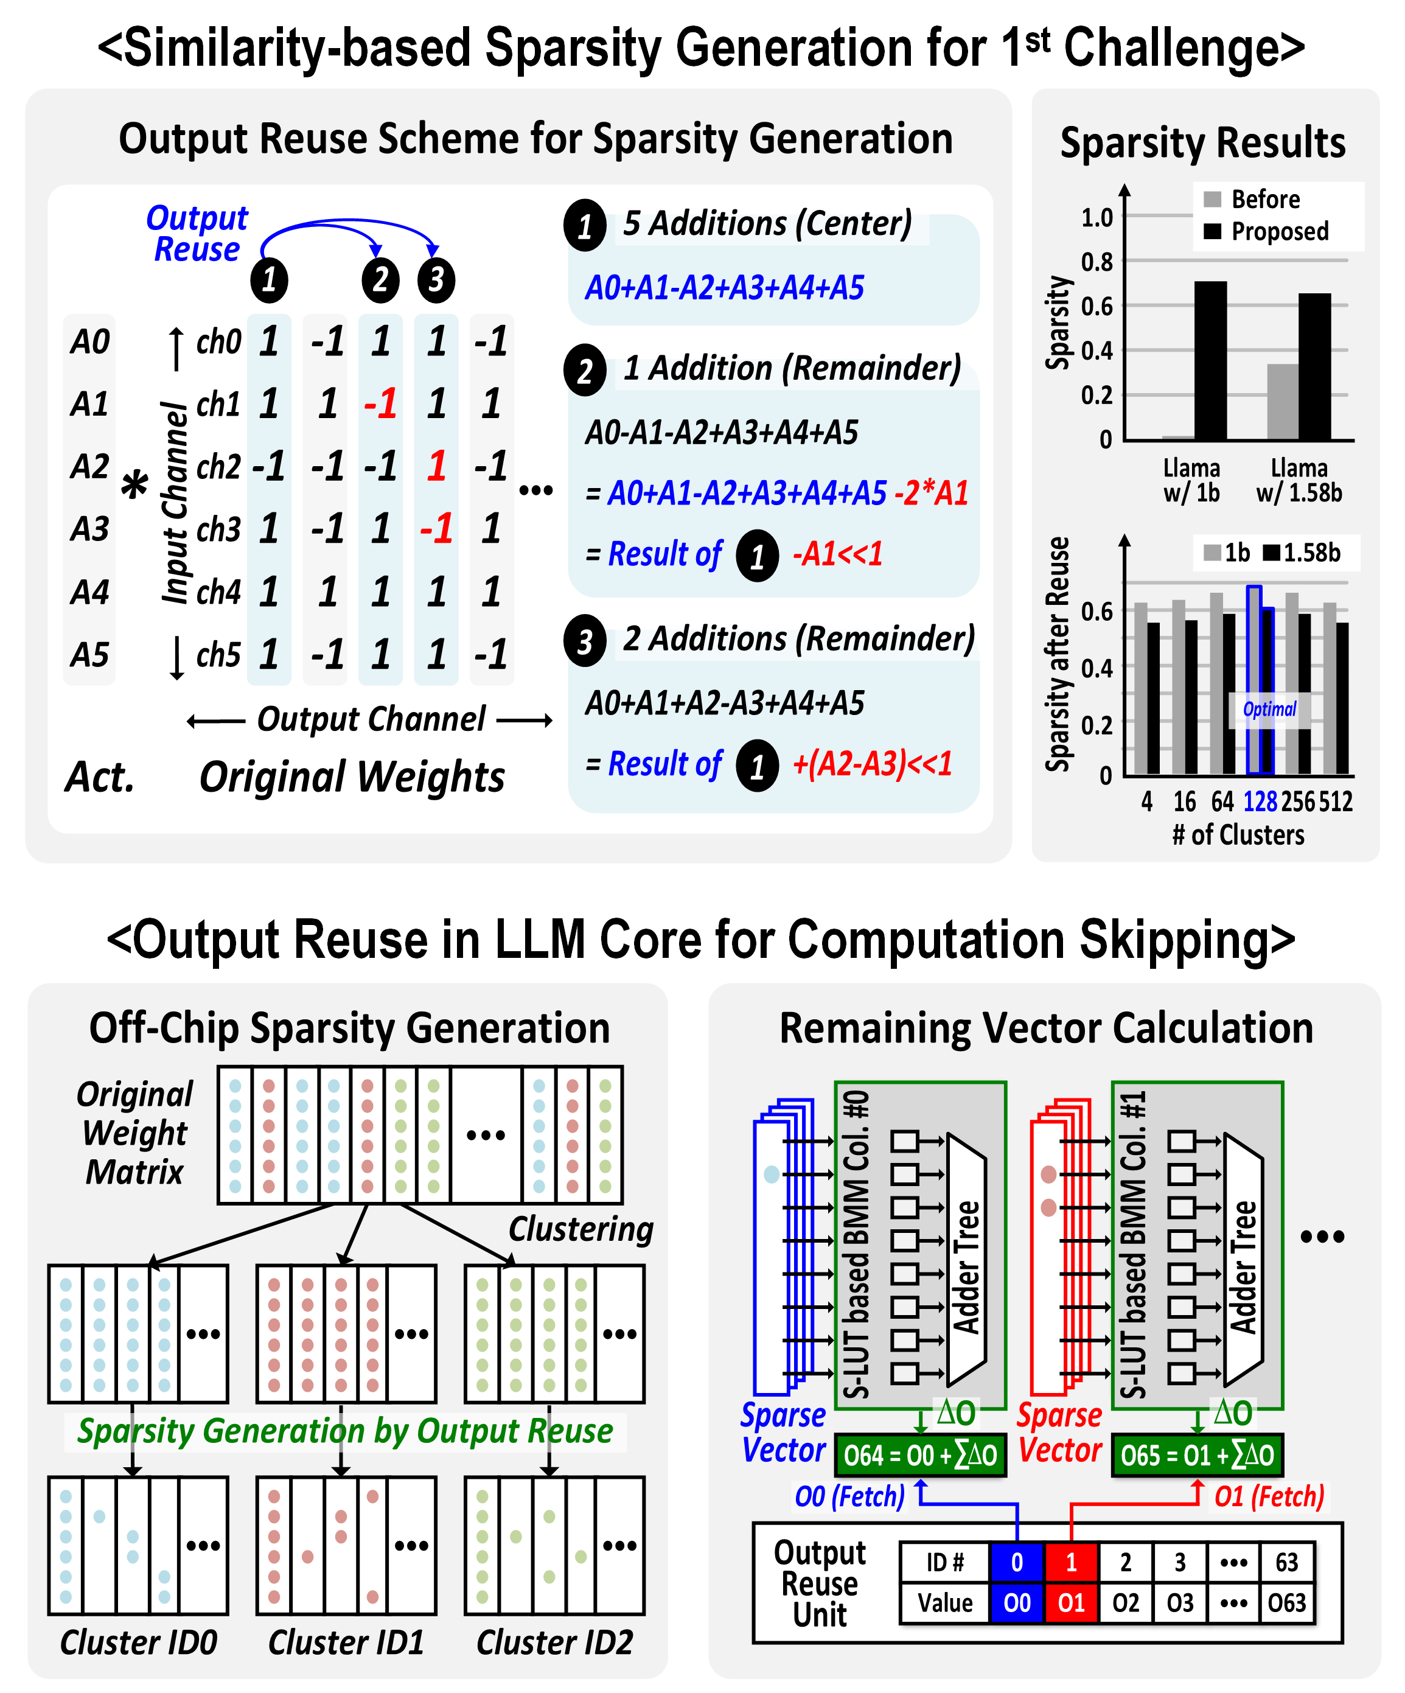
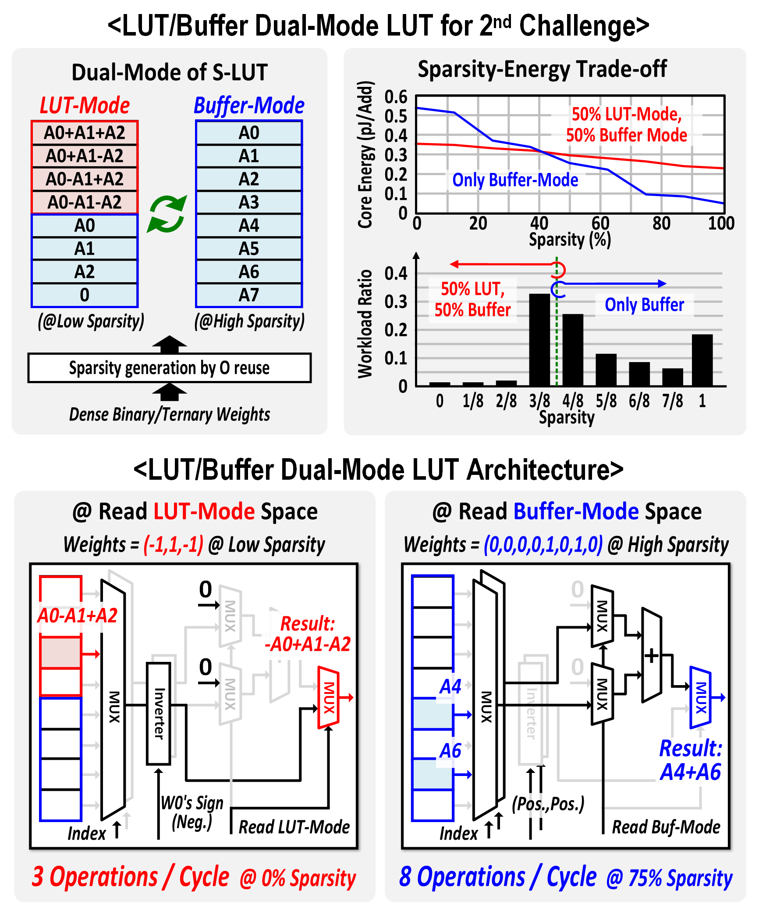
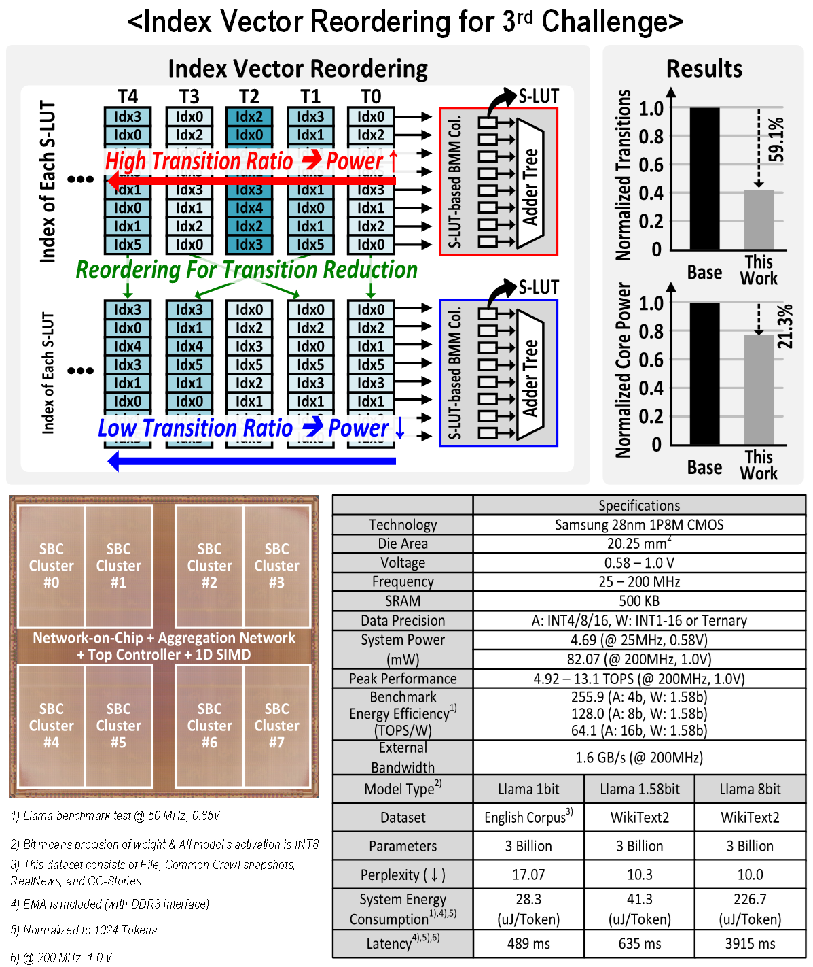
Slim-Llama: A 4.69mW Large-Language-Model Processor
with Binary/Ternary Weights for Billion-Parameter Llama Model
Sangyeob Kim, Jungwan Lee, and Hoi-Jun Yoo
KAIST, Daejeon, Korea
Motivation
Feature 1
Feature 2
Feature3 & Measurement Results

