Slide 1
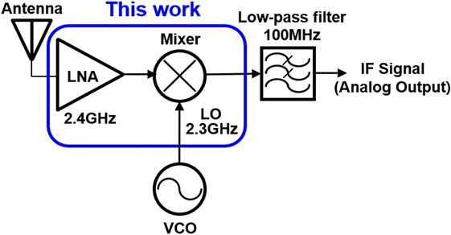
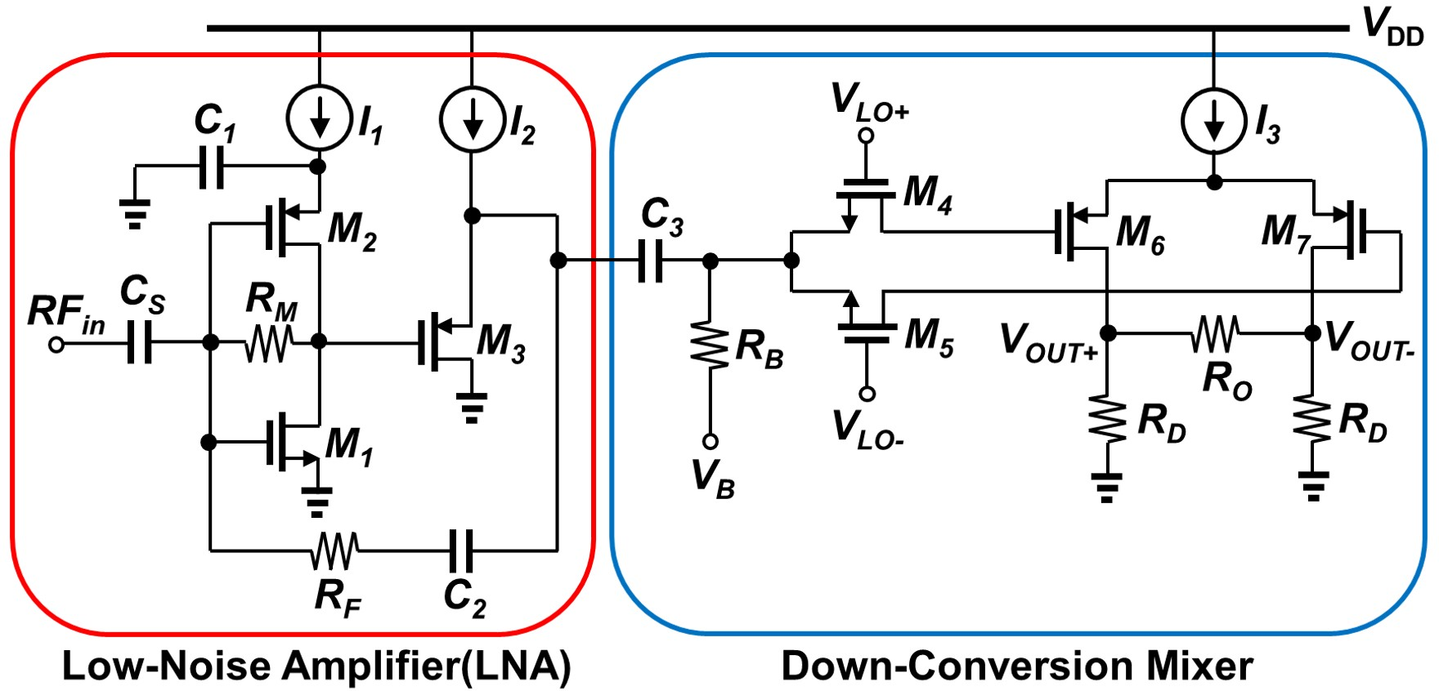
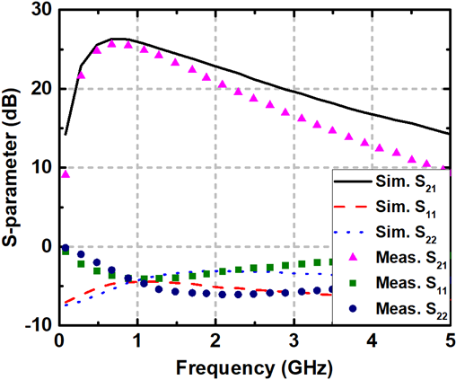
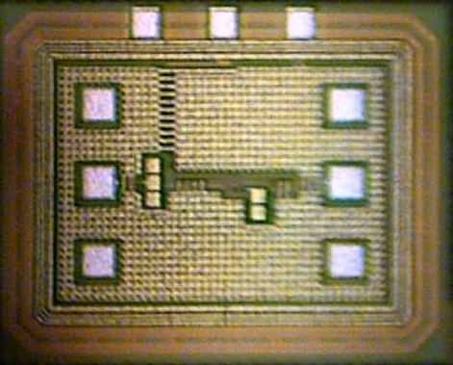
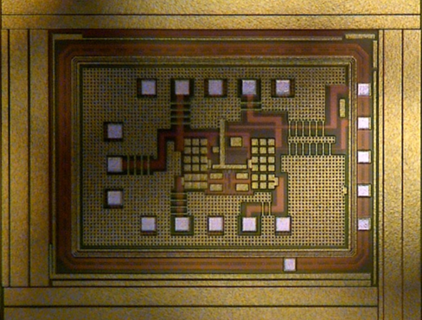
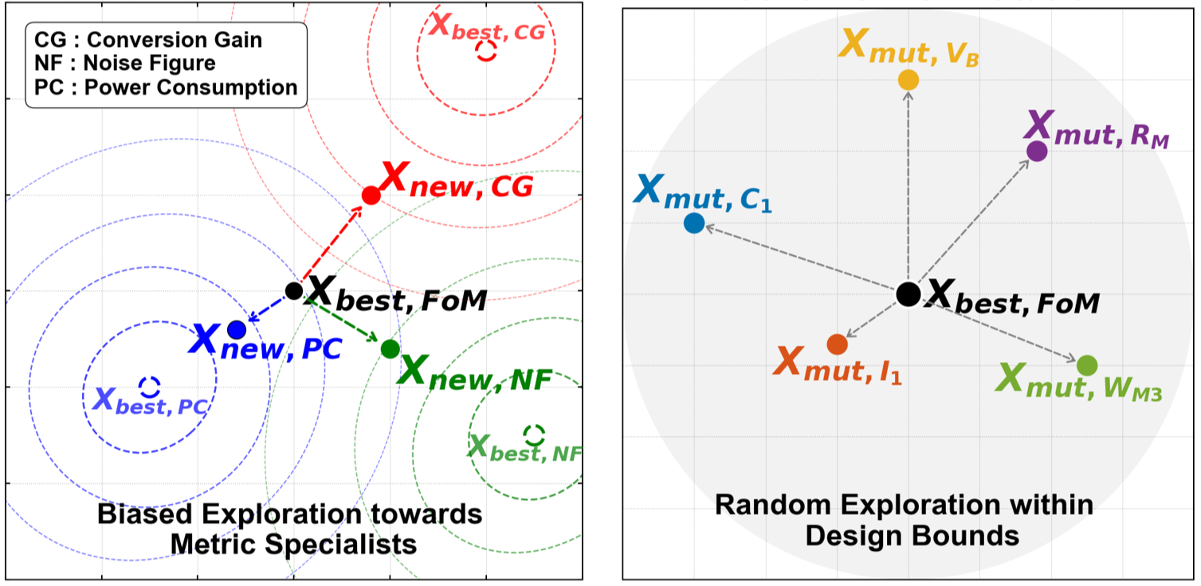

Design and Optimization of Radio-Frequency Receiver
with Modified Genetic Algorithm
Hoyeon Shin, Yeonggi Kim, Jongho Lee, Myunghyun Shim, Junhwa Jeong, Seonho Shin,
Kyubeom Kang, Taeyeong Kim, Jiyong Chung and Ickhyun Song (Sonic Lab)
Department of Artificial Intelligence Semiconductor Engineering, Hanyang University
Division of Nanoscale Semiconductor Engineering, Hanyang University
Automation Difficulty: Prior methods often computationally expensive (PSO/ACO) or ineffective (Std. GA crossover issues) for complex RF circuits.
s, and RFID systems.
I. Introduction
RF Receiver (RX) Overview:
Core front-end: Amplifies signals (LNA) & converts frequency (Mixer)
Critical for extracting weak signals reliably from noisy environments
Needs Optimization: To meet stringent, simultaneous goals
Key Challenges:
High Sensitivity: Performance heavily depends on circuit parameter values
Trade-off: Conflicting metrics (PC, CG, NF) and strong interdependencies s
Automation Difficulty: Prior methods often computationally expensive
(PSO/ACO) or ineffective (Std. GA) for complex RF circuits
Block diagram of a typical radio-frequency receiver
II. Circuit Design
III. Result
Pre and post S-parameter responses of the reference LNA
Unified LNA-Mixer Design
Target circuit combines LNA & Mixer
Optimizes blocks together to capture inter-stage effects for best system performance
Chip micrographs of the (a) LNA and (b) mixer blocks
Block | Metric | Pre-layout (manual) | Pre-layout (CGA) | Post-layout
LNA | Peak S21 | 20.05 dB | 21.62 dB | 19.13 dB
LNA | NF | 2.23 dB | 1.75 dB | 3.52 dB
Mixer | CG | 13.21 dB | 12.65 dB | 10.3 dB
Mixer | NF | 12.79 dB | 12.85 dB | 14.5 dB
Optimization Process
Pre-layout and post-layout characteristics.
Circuit-Centric GA (CGA):
Proposed method for efficient RF circuit optimization.
Focuses on: Mutation, Metric-Guidance, & Preservation (No Crossover)
IV. Acknowledgement
The chip fabrication and EDA tool were supported by the IC Design Education Center(IDEC), Korea. In addition, this work was supported in part by the National Research Foundation of Korea (NRF) grant funded by the Korea government (MSIT) (No. RS-2024-00409492).

