Slide 1
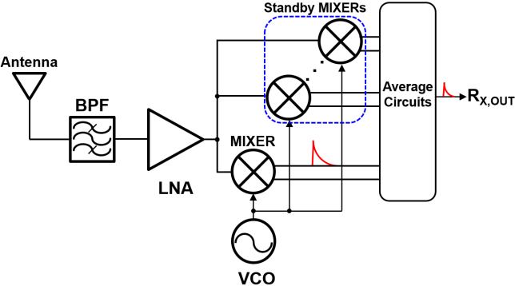
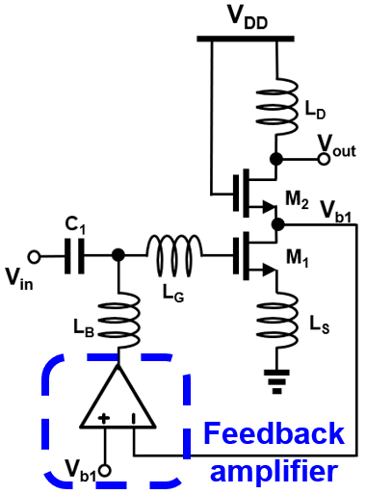
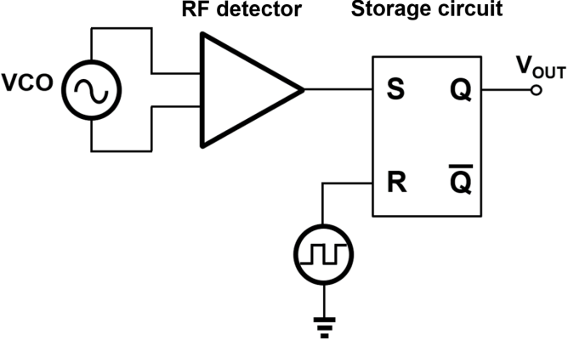
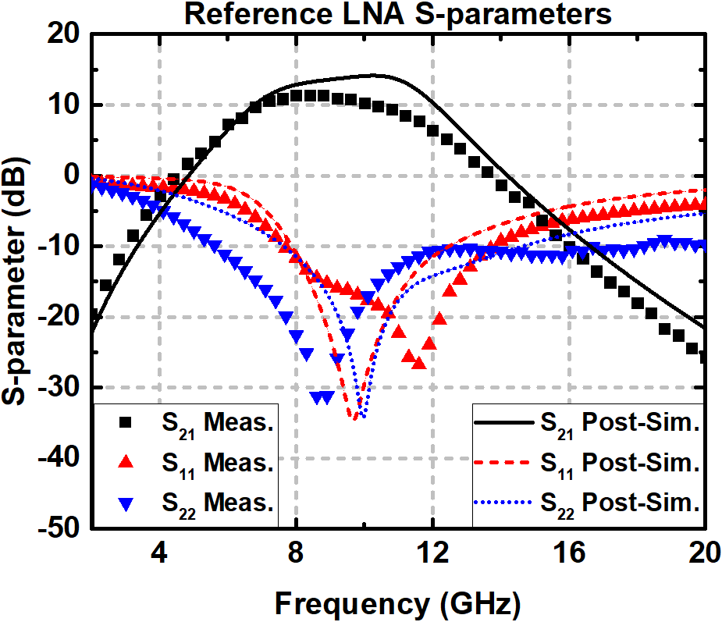
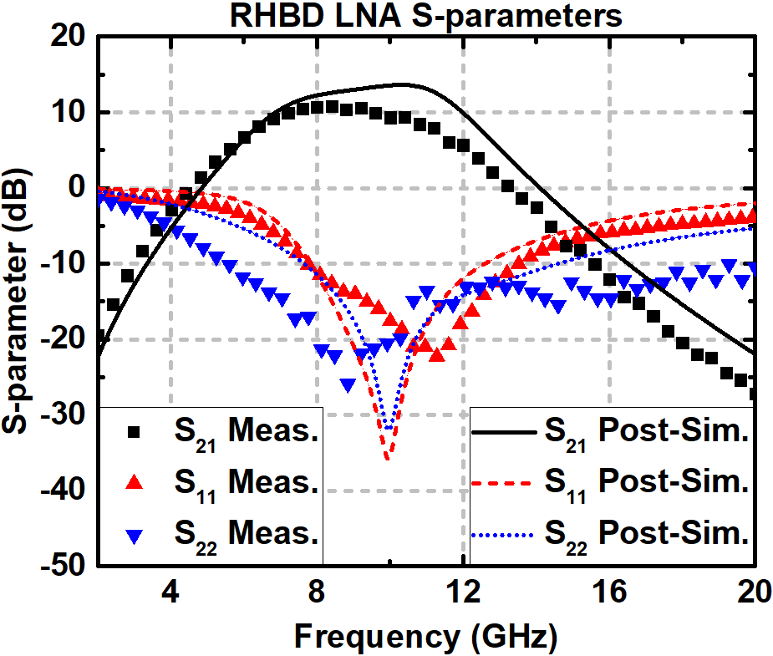
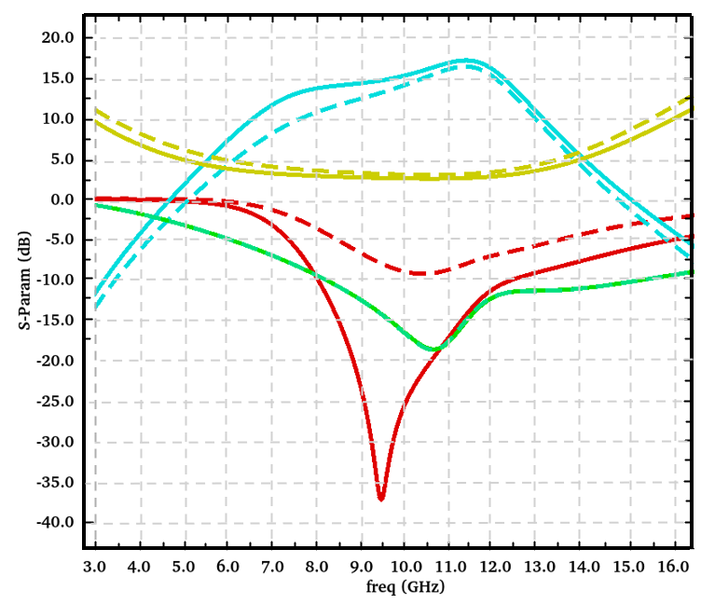
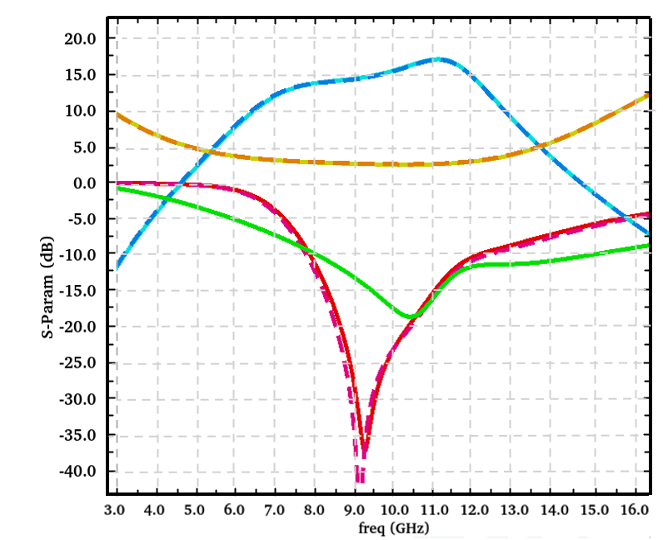
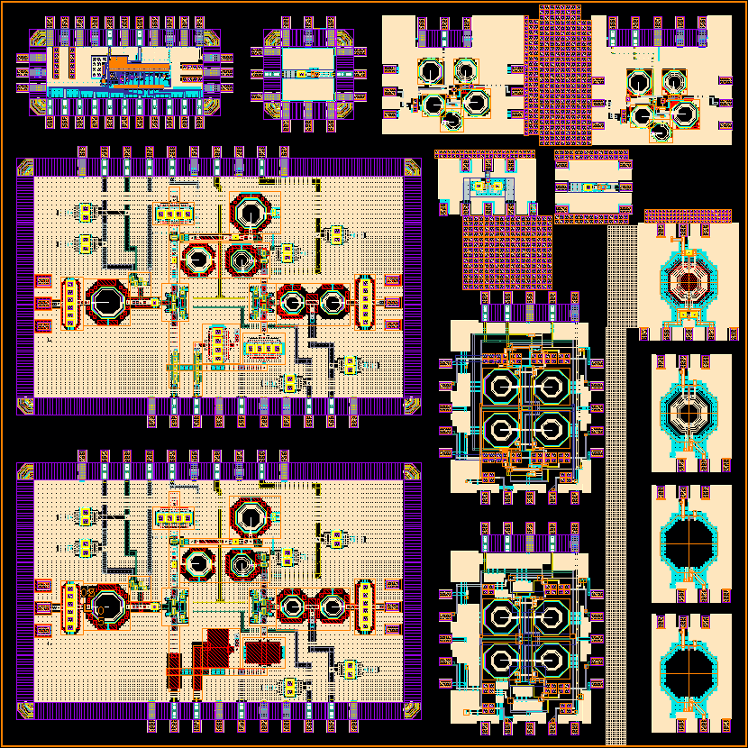
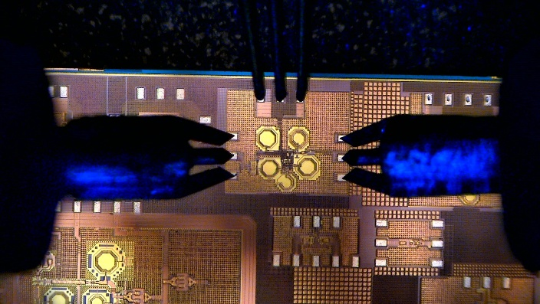
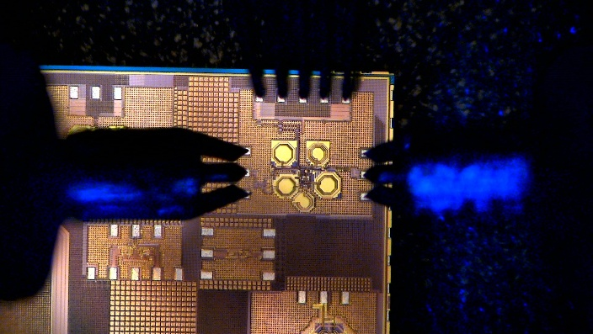
Design of Radiation-Hardened Circuit Blocks in RF Receiver
Jongho Lee¹, Junhwa Jeong¹, Taeyeong Kim¹, Euijin Jang¹, Yonghee Kim², Kyubeom Kang²,
Hoyeon Shin¹, Sungwoo Lee³, Mieun Choi³, and Ickhyun Song³ (Sonic Lab)
¹Department of Artificial Intelligence Semiconductor Engineering, Hanyang University
²Division of Nanoscale Semiconductor Engineering, Hanyang University
³Department of Electronic Engineering, Hanyang University
Automation Difficulty: Prior methods often computationally expensive (PSO/ACO) or ineffective (Std. GA crossover issues) for complex RF circuits.
s, and RFID systems.
I. Introduction
RF Receiver (RX) Overview:
Space environments cause TID and SEE, degrading RF circuit performance
X-band receivers are important for satellite communication systems
LNA: impedance mismatch & gain degradation
VCO/Mixer: frequency shift & signal distortion
Proposed dual RHBD strategy: feedback-based LNA + SEE-detection-assisted standby mixer
Goal: radiation-tolerant X-band receiver design validated at chip level
Key Challenges:
TID → Vth shift → bias, gain, and matching degradation
SEE → transient current → VCO/mixer output distortion
RF circuits are highly sensitive to bias and impedance matching
Fig. 1. Block diagram of a radiation-hardened receiver.
II. Circuit Design
III. Result
(a)
(b)
(a)
(b)
Fig. 5. Post-layout simulation and measurement results of S-parameter for
(a) the reference LNA and (b) the proposed LNA
Fig.2 (a) OTA feedback LNA schematic and (b) proposed SEE Detector System of VCO.
LNA for TID Mitigation
TID induces Vth shift → bias & gm variation
Negative feedback automatically restores bias current
Maintains gain and input matching under radiation
➔ Feedback stabilizes LNA operation against TID-induced degradation
SEE Detection and Compensation
SEE causes imbalance in VCO differential outputs
RF detector + SR latch detects transient events
Standby mixers are activated for compensation
➔ Output distortion is reduced to 1/N via signal averaging
(a)
(b)
Fig. 6. (a) reference and (b) proposed LNAs; dashed lines denote TID-effect emulation.
Chip Implementation
Fully integrated RF receiver in
TSMC 180-nm CMOS
Includes LNA, mixer, and RHBD circuits
Chip area: 25 mm² including all RF and RHBD blocks
Includes fully integrated receiver front-end with on-chip RF signal paths
➔ Design validated at chip level with full integration
Measurement Results
On-wafer measurements were carried out using GSG probes, a VNA, DC power supply, and source meter (Fig. 4).
The reference LNA showed a measured peak gain of 11.39 dB and a 3-dB bandwidth of 6.44–11.28 GHz.
The proposed RHBD LNA achieved a measured peak gain of 10.79 dB and a 3-dB bandwidth of 6.3–11.1 GHz.
Despite frequency shifts from simulation, the proposed design maintained stable S-parameter characteristics after fabrication.
Simulation results show that the proposed circuit maintains its original performance even after TID exposure (Fig. 6).
The mixer and bidirectional blocks were also verified through DC bias and current monitoring.
Fig. 3. Layout of a process of the HM-2501
IV. Acknowledgement
The chip fabrication and EDA tool were supported by the IC Design Education Center(IDEC), Korea. In addition, this work was supported in part by the National Research Foundation of Korea (NRF) grant funded by the Korea government (MSIT) (No. RS-2024-00409492).
(a)
(b)
Fig. 4. On-chip measurement of a (a) Reference and (b) Proposed LNA

