Slide 1

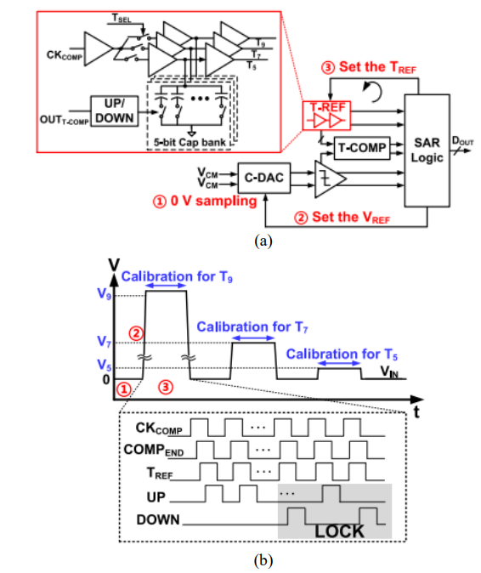
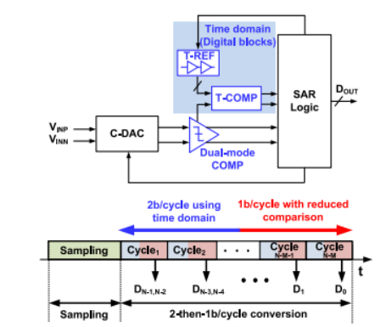
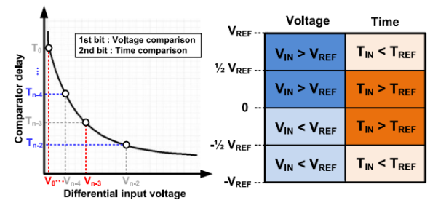
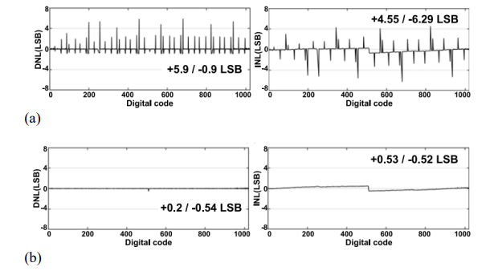
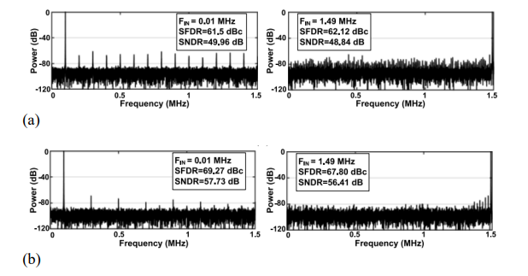
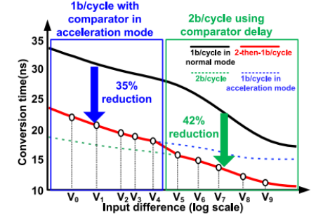
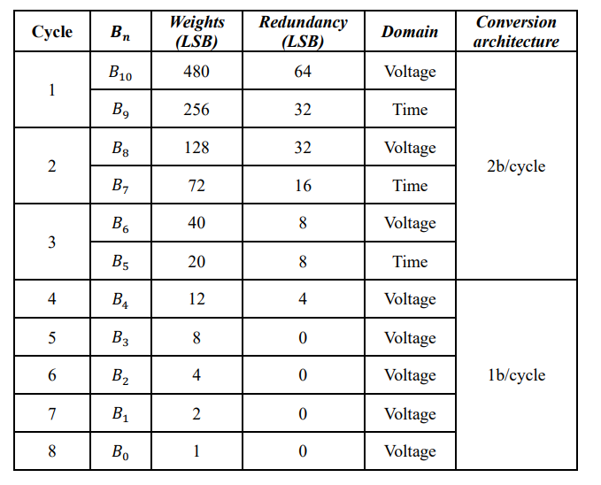
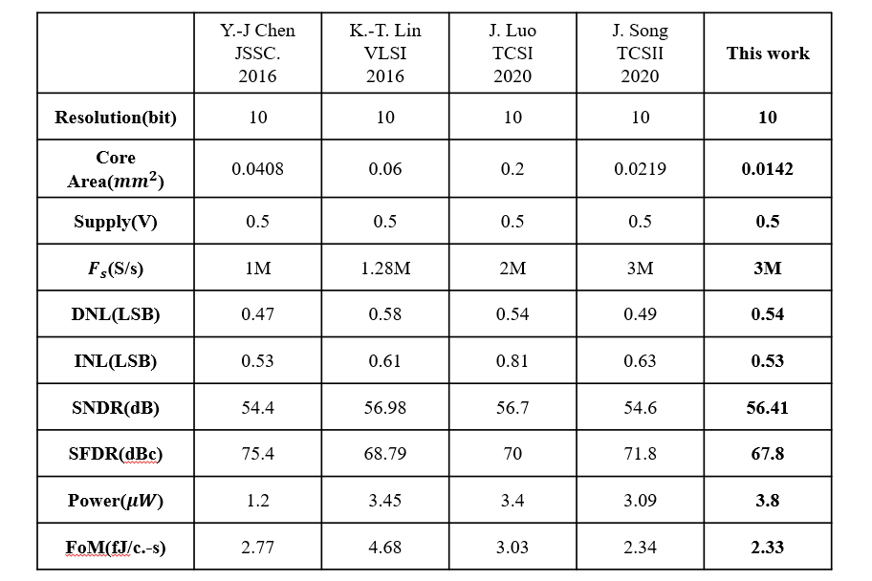
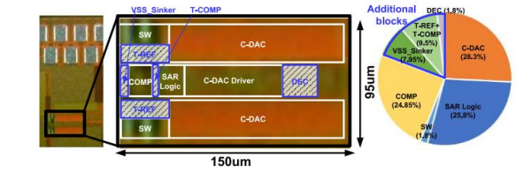
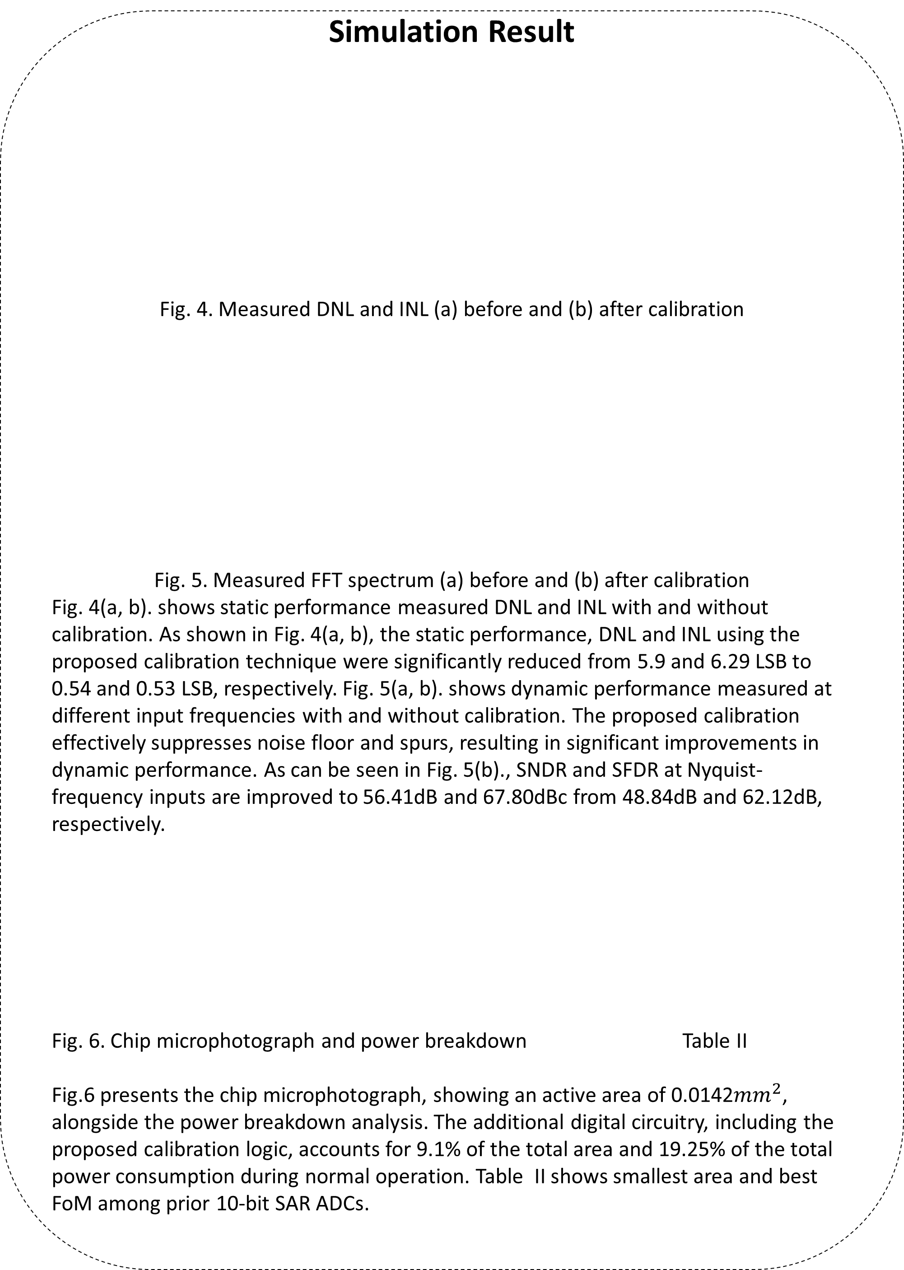
A Dual-Mode Comparator and Digital Time-Domain Reference in 2-Then-1b/Step SAR ADC Design
Jeetaeck Seo¹, JongHyeon Seo², Dong-Hyun Shin³, Chunghee Jang⁴, Jaesoub Han⁵, Jeonghun Lee⁶,and Tae-hyun Kim⁷
¹Department of Intelligent Semiconductor Engineering, Chung-Ang University, Seoul, Korea
²Department of Intelligent Semiconductor Engineering, Chung-Ang University, Seoul, Korea
³School of Electrical and Electronics Engineering, Chung-Ang University, Seoul, Korea
Abstract
This proposal suggests a low-power asynchronous 10bit 2-then-1b/cycle successive approximation register(SAR) analog-to-digital converter(ADC) architecture. By partially applying the 2b/cycle mode to only the higher-order bit conversions, the design aims to reduce both area and power consumption while sustaining a high conversion rate. Unlike conventional 2b/cycle conversion approaches that require two capacitive digital-to-analog converters(C-DACs) and multiple analog comparators, the proposed architecture leverages a digital-based time-domain reference to implement the 2-then-1b/cycle operation with only a single C-DAC and one analog comparator. Furthermore, the speed of 1b/cycle conversion for lower-order bits is enhanced through the integration of a dual-mode comparator, ensuring faster and more efficient conversion.
Fig. 3. (a) Block diagram of the proposed architecture
(b) timing diagram for the calibration mode
To compensate for PVT-induced delay mismatch, we proposed an on-chip foreground calibration scheme. Fig. 3(a) illustrates the block diagram of the proposed architecture, highlighting the T-REF unit and its associated calibration circuitry that sequentially tunes T9, T7, and T5 until the generated TREF matches the comparator delay. The calibration procedure is executed sequentially from T9 to T5 to compensate for the delay offset in each path. A 5-bit capacitor bank, controlled by and UP/DOWN counter, is utilized to fine-tune the delay of each path. The calibration sequence is indicated by the circled numbers in the figure.
Introduction
This work proposes an asynchronous 2-then-1b/cycle SAR ADC designed for low-voltage IoT applications. By integrating time-domain reference and a dual-mode comparator, the proposed architecture achieves a high conversion rate and area efficiency without the hardware overhead typically found in multi-bit-per-cycle designs.
Proposed TI SAR ADC with WD
(a) (b)
Fig. 1. (a) Architecture and timing diagrams proposed 2-then-1b/cycle
(b) Concept of 2b/cycle using comparator delay
Fig. 1(a) shows the proposed 2-then-1b/cycle SAR ADC, which improves conversion speed while reducing the area and power overhead of conventional 2b/cycle architectures. Unlike conventional 2b/cycle SAR ADCs that require additional analog blocks such as extra comparators and C-DACs, the proposed architecture performs 2b/cycle conversion for the higher-order bits using a digital time-domain reference (T-REF) and a time comparator, significantly reducing hardware complexity. For the remaining lower-order bits, a dual-mode comparator with an acceleration mode is employed to shorten comparison delay and enhance conversion speed. As a result, the proposed architecture achieves high-speed and energy-efficient operation with minimal analog overhead.
Fig.2 Table I
Fig. 2. Background window width control for window detector
Table I. Summary of conversion at different phase
The proposed architecture partitions the conversion sequence into 2b/cycle and 1b/cycle regions, applying 2b/cycle to the first three cycles and 1b/cycle to the remaining five cycles for an efficient speed-overhead tradeoff. Fig. 2. shows the reduction in conversion time achieved by the proposed 2-then-1b/cycle scheme(red) relative to the conventional 1b/cycle mode(black). The higher-order bit region operating in 2b/cycle mode(dashed green)-calculated as half the sum of the conventional 1b/cycle conversion time and the 2b/cycle logic delay-and the lower-order bit region utilizing 1b/cycle conversion with the comparator acceleration mode(dashed blue). A 1-bit redundancy scheme is introduced to tolerate TREF variations, and the redundant 11-bit output is converted into a binary-weighted 10-bit code through digital error correction logic. Table I details the weights, redundancy ranges, comparison domains, and conversion methodologies for each successive cycle.
Simulation Result
Fig. 4. Measured DNL and INL (a) before and (b) after calibration
Fig. 5. Measured FFT spectrum (a) before and (b) after calibration
Fig. 4(a, b). shows static performance measured DNL and INL with and without calibration. As shown in Fig. 4(a, b), the static performance, DNL and INL using the proposed calibration technique were significantly reduced from 5.9 and 6.29 LSB to 0.54 and 0.53 LSB, respectively. Fig. 5(a, b). shows dynamic performance measured at different input frequencies with and without calibration. The proposed calibration effectively suppresses noise floor and spurs, resulting in significant improvements in dynamic performance. As can be seen in Fig. 5(b)., SNDR and SFDR at Nyquist-frequency inputs are improved to 56.41dB and 67.80dBc from 48.84dB and 62.12dB, respectively.
Fig. 6. Chip microphotograph and power breakdown Table II
Fig.6 presents the chip microphotograph, showing an active area of 0.0142${mm}^{2}$, alongside the power breakdown analysis. The additional digital circuitry, including the proposed calibration logic, accounts for 9.1% of the total area and 19.25% of the total power consumption during normal operation. Table II shows smallest area and best FoM among prior 10-bit SAR ADCs.
Conclusions
This work proposes a low-power and area-efficient 10-bit 2-then-1b/cycle SAR ADC. By applying 2b/cycle conversion only to higher-order bits and switching to 1b/cycle conversion for lower-order bits, the proposed architecture achieves high conversion speed with reduced hardware overhead. A digital time-domain reference (T-REF) and on-chip calibration scheme improve area efficiency and robustness against PVT variations, while a dual-mode comparator accelerates lower-bit conversions. As a result, the proposed ADC achieves both high-speed and energy-efficient operation.
Acknowledgement
The chip fabrication and EDA tool were supported by the IC Design Education Center(IDEC), Korea. This (paper/research/work/...) was supported by Korea Institute for Advancement of Technology(KIAT) grant funded by the Korea Government(MOTIE)

