Slide 1

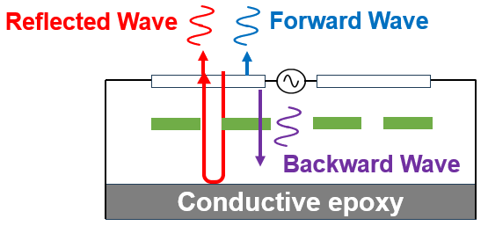
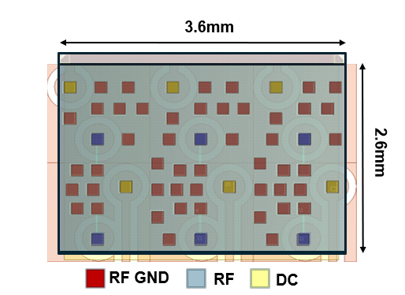
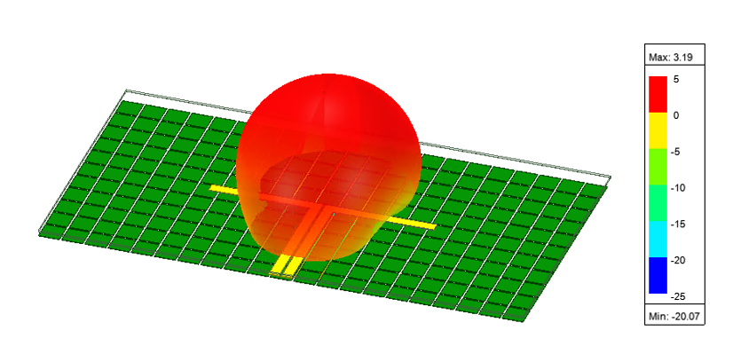
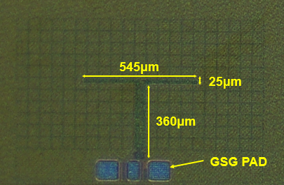
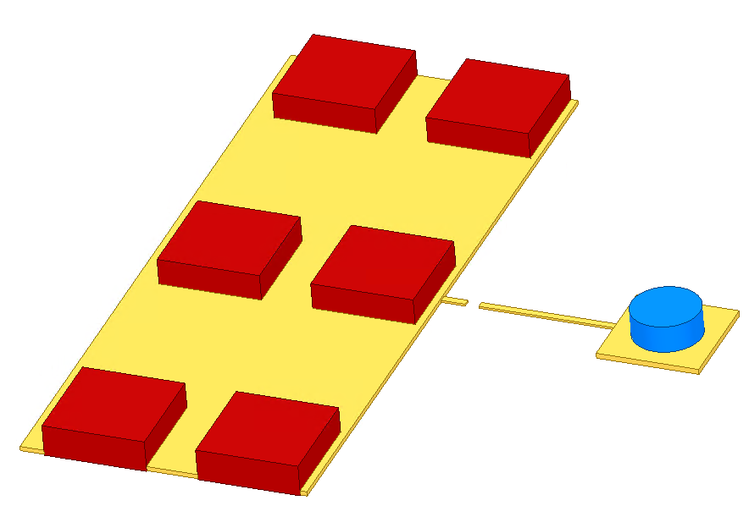
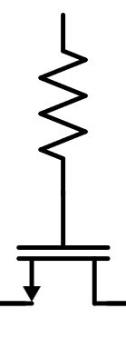
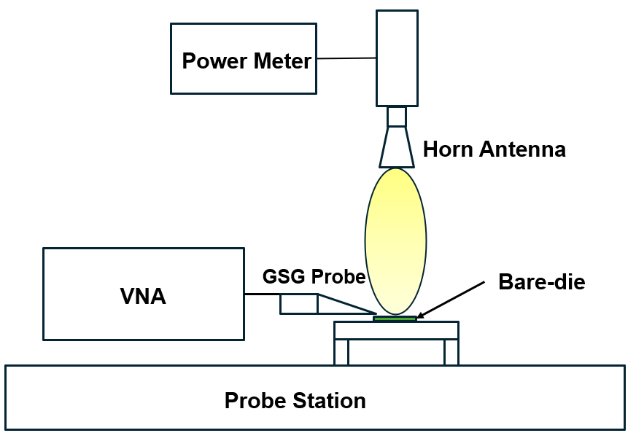
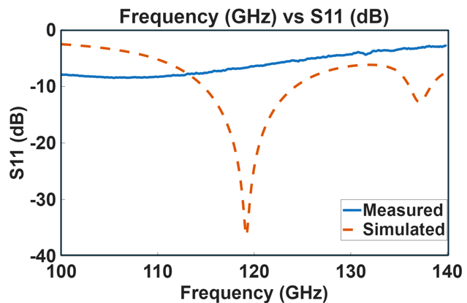
Design of D-band on-chip antennas and switches
for B5G communication and radar systems
JIMIN YANG, KYUNGBIN YOO, SEHOON PARK
Electronic Engineering, Kyungpook National University
Introduction
The importance of D-band frequencies in B5G (Beyond 5G) communications and radar systems is increasing, necessitating designs that minimize loss and parasitic components.
Implementation of a D-band on-chip antenna operating at 120GHz.
Implementation of an IC-PCB co-integration-based switching IC that provides 1-bit impedance control for 140GHz-band RIS (Reconfigurable Intelligent Surface) antennas.
Design 1
Design 2
- 120GHz On-Chip Antenna
- 140GHz Switch with Packaging Consideration
V_{switch}
Z_{in}
Transmission line
Transmission line
Fig. 1. Principle of Antenna
IC
GND on PCB
Z_{in}
V_{switch}
Fig. 2. Simulated Radiation Gain
Fig. 3. Chip photo of Antenna
PCB
<PCB + IC Bump Map>
Fig. 6. IC-PCB Co-integration Structure
Switching IC for 1-bit impedance control of 140GHz band RIS antennas.
Proposed a low-parasitic structure using stud bumps instead of wire bonding, which suffers from difficult parasitic control in IC-PCB co-integration.
Minimizing parasitic effects by utilizing high-performance Top Metals(LB,OI,IA,IB) as Ground layers
Achieved Z_{in} =86.7-14.3j at V_{switch} High, Z_{in} =127.3+145.6j at V_{switch} Low.
Fig. 4. Antenna Measurement setup
Fig. 5. Antenna S11 Result
Antenna structure utilizing constructive interference.
Patch AMC (Artificial Magnetic Conductor) structure + Backside metal dipole antenna.
Simulated Radiation Gain = 3.19dBi.
Conclusion
Discrepancies in S11 results due to EM simulations conducted without accurate loss data for 120GHz on-chip silicon materials.
Antenna radiation gain could not be measured due to link budget constraints of the detection equipment.
Measurements are currently on hold as the PCB fabrication for the RIS antenna is not yet complete.
Acknowledgement
The chip fabrication and EDA tool were supported by the IC Design Education Center(IDEC), Korea.

