Slide 1
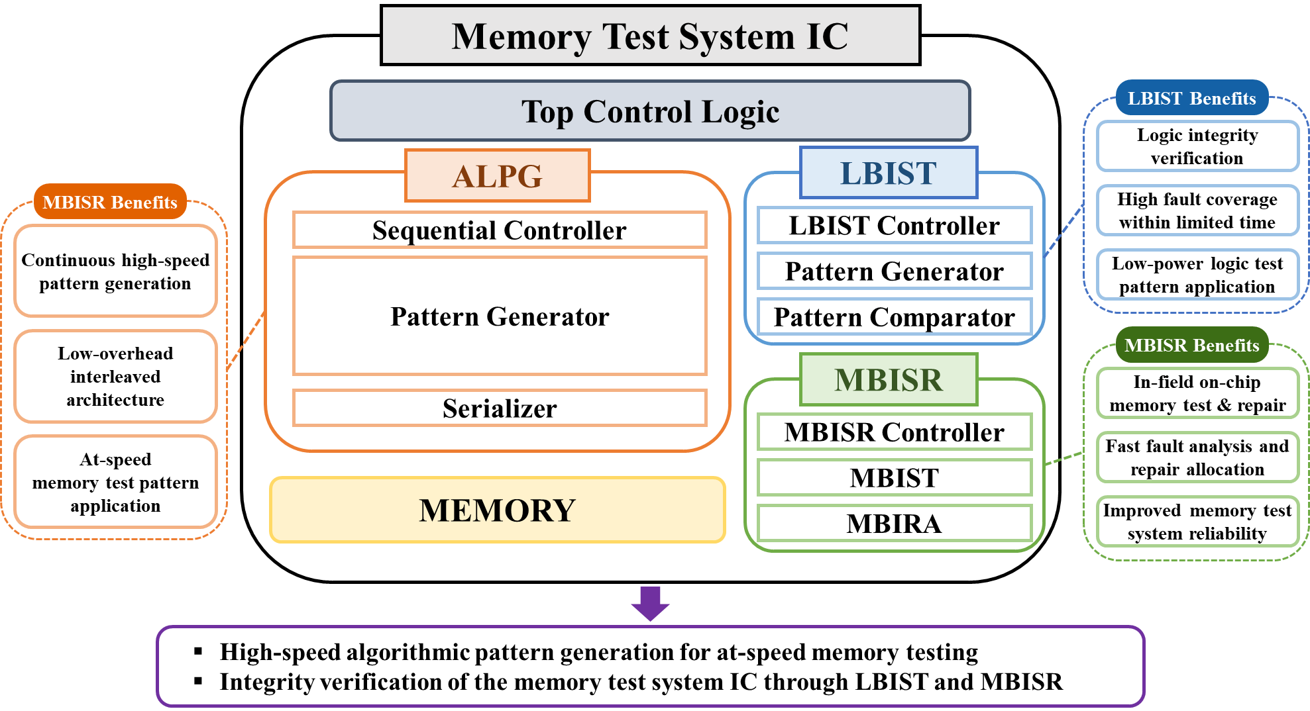
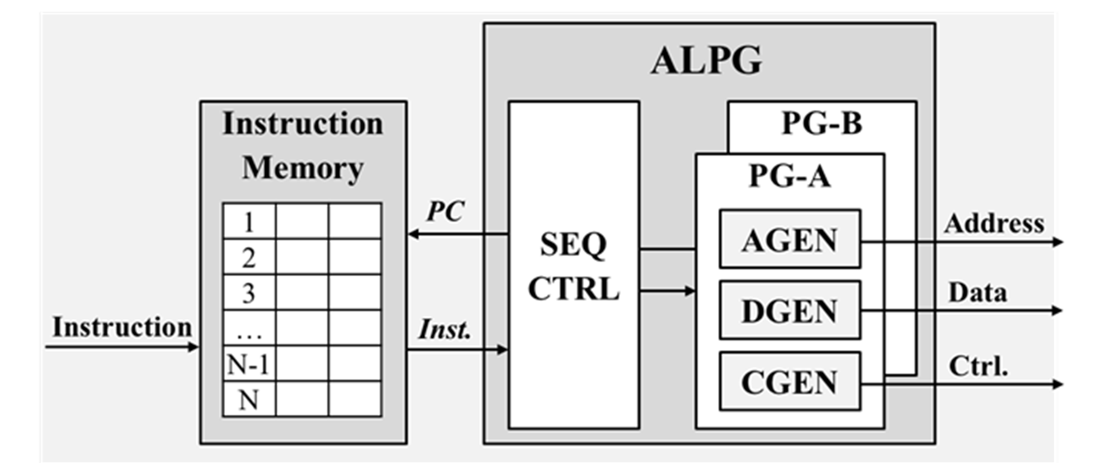
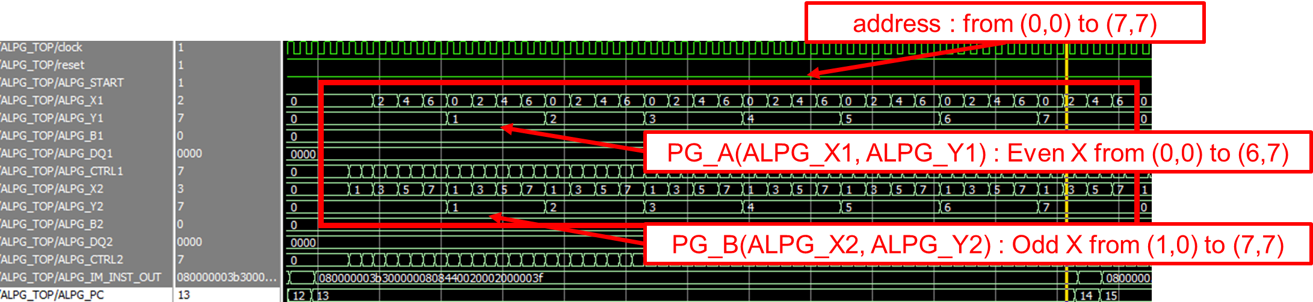
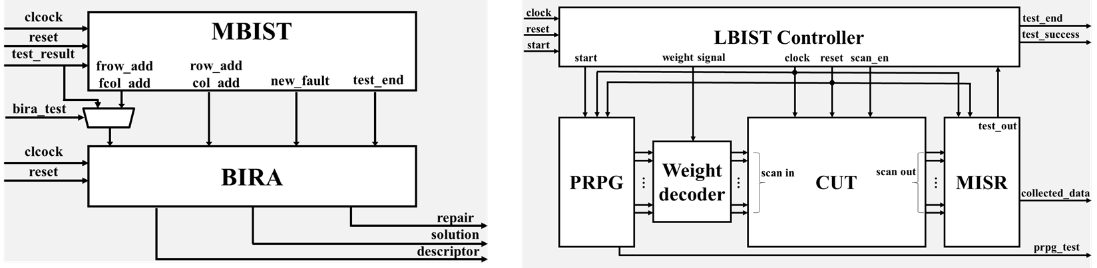
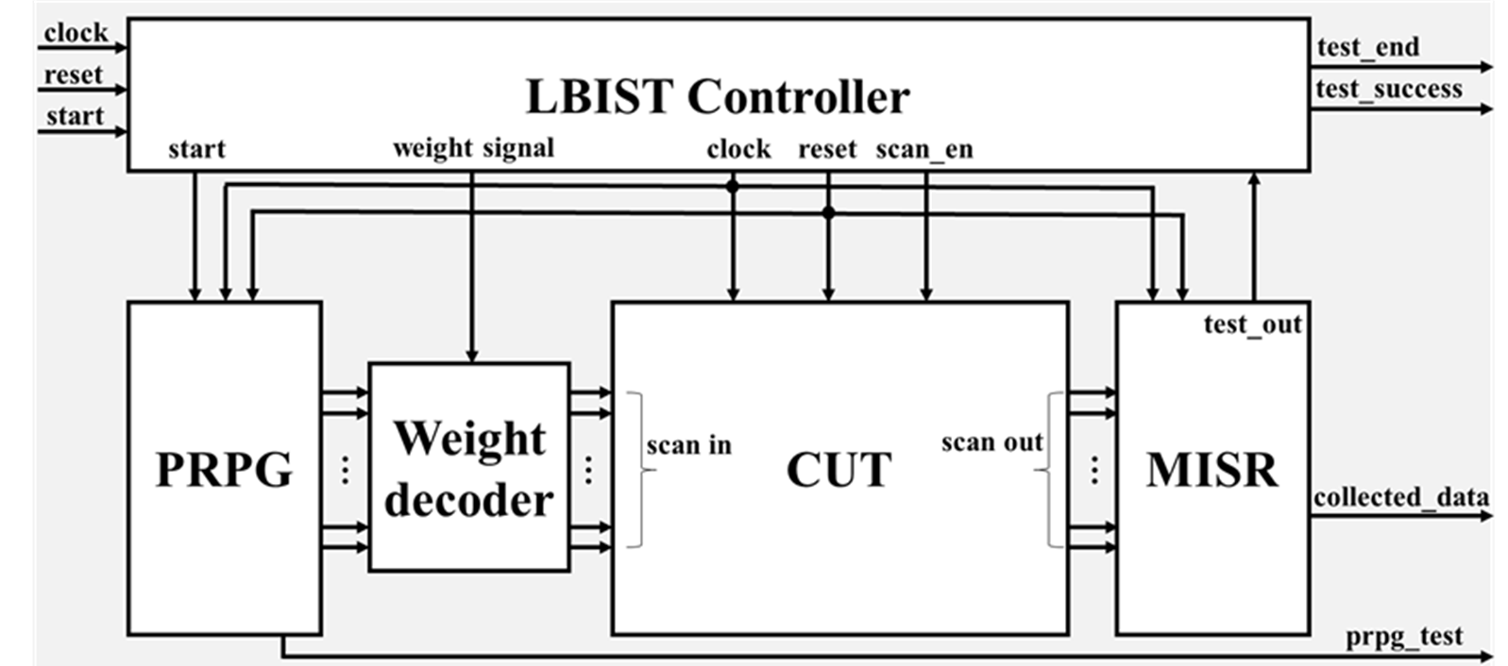
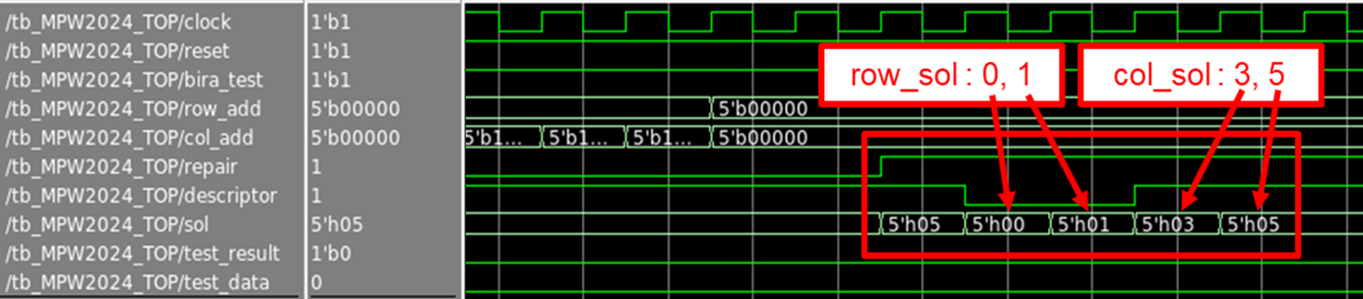
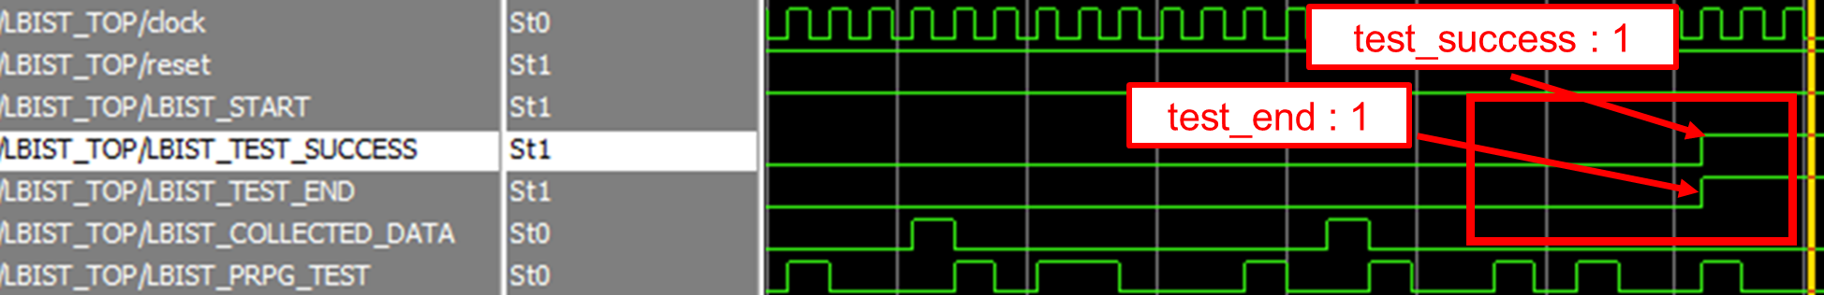
Memory Test System IC and its Built-In Self-Test Architecture
Jongho Park, Hyojun Yun, Sooryeong Lee, Juyong Lee, Jaehyun Kim, Doohyun Yoon,
and Sungho Kang
Department of Electrical and Electronic Engineering, Yonsei University
Abstract & Introduction
A unified memory test system IC integrating a high-speed ALPG, MBISR, and LBIST
The demand for high-speed and high-bandwidth memory has rapidly increased, making fast and reliable memory testing increasingly important.
However, conventional algorithmic pattern generators (ALPGs) exhibit limitations in operating speed and hardware complexity during at-speed testing.
To address these limitations, a high-speed ALPG architecture is proposed to improve test-vector generation throughput with low hardware overhead.
In addition, memory built-in self-repair (MBISR) and logic built-in self-test (LBIST) modules are integrated to ensure reliable operation of the memory test system IC through both logic and memory integrity verification.
A. Overview of the Proposed design
Proposed Design and Results
B. ALPG Module
Proposed architecture of the ALPG module
Continuous test-vector generation through PG-A and PG-B interleaving
The ALPG consists of a sequence controller and a pattern generator composed of address, data, and control generators.
Test vectors are generated by fetching and decoding compact instructions stored in the instruction memory.
Two independent pattern generators, PG-A and PG-B, are used to overcome the speed limitation of conventional ALPG architectures.
By interleaving their outputs, test vectors are continuously generated without duplicating the entire ALPG structure.
Block diagram of the proposed design
Unified on-chip integration of memory-test generation, memory repair, and logic verification
The proposed design integrates a high-speed ALPG, an MBISR module, and an LBIST module into a unified on-chip memory test system.
The ALPG module generates memory-test vectors with high throughput to support fast at-speed testing.
The MBISR module detects faults in the on-chip memory and determines repair solutions using the available row and column redundancies.
The LBIST module verifies the integrity of the ALPG logic to maintain reliable test operation during in-field use.
C. MBISR Module
Waveform of the ALPG module
D. LBIST Module
Proposed architecture of the MBISR module
Proposed architecture of the LBIST module
Dynamic repair analysis using row and column redundancies
The MBISR module consists of a memory built-in self-test (MBIST) block and a built-in redundancy analysis (BIRA).
The MBIST block detects memory faults using the March C- algorithm.
The BIRA block dynamically allocates row and column redundancies according to the detected fault distribution.
Simulation results confirmed that the expected repair solution was generated immediately after MBIST completion.
In-field integrity verification using pseudo-random patterns
The LBIST module verifies ALPG logic integrity during in-field operation.
It includes a pseudo-random pattern generator, a weight decoder, a response compactor, and a BIST controller.
Weighted test patterns are selectively applied to scan-chain groups to reduce switching activity while maintaining high fault-detection capability.
The test_end and test_success signals were asserted after 1,000 test patterns were applied, confirming successful logic verification.
Waveform of the MBISR module
Waveform of the LBIST module
Discussion
Post-layout simulation was performed using Synopsys tools, including IC Compiler II, StarRC, and PrimeTime, to verify the intended operation of the proposed modules, followed by chip-level validation using the IDEC Test Board II with the same testbench.
Partial mismatches were observed during chip-level validation, which were considered to be mainly caused by clock-delivery path issues and measurement-environment disturbances.
Conclusion
A high-speed algorithmic pattern generator architecture was designed to improve memory test functionality through accelerated test pattern generation.
Its integrity was verified through on-chip validation, ensuring reliable operation of the pattern generation logic and enhancing overall test reliability.
The chip fabrication and EDA tool were supported by the IC Design Education Center(IDEC), Korea.

