Slide 1

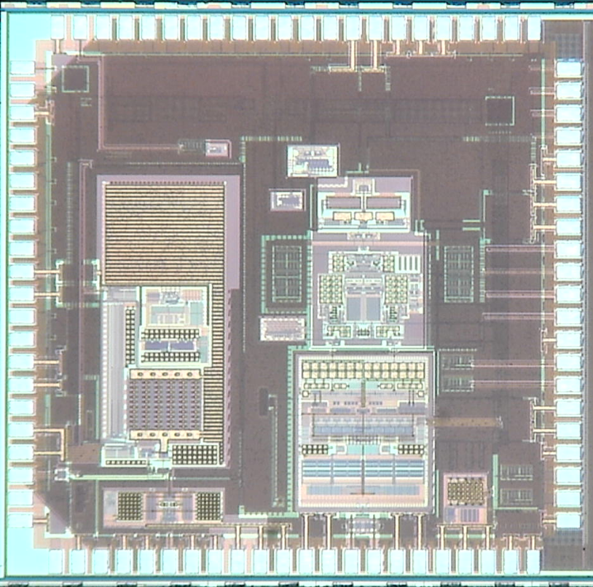
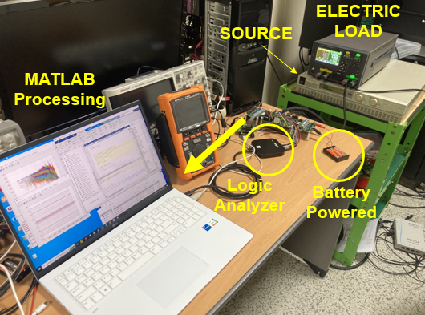
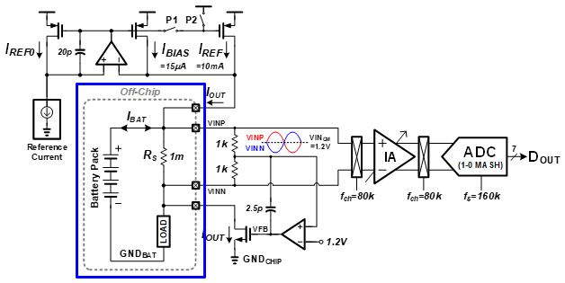
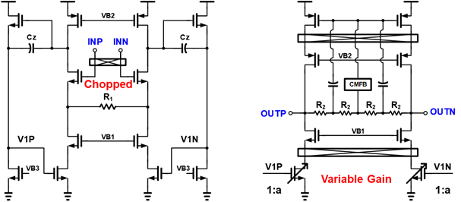
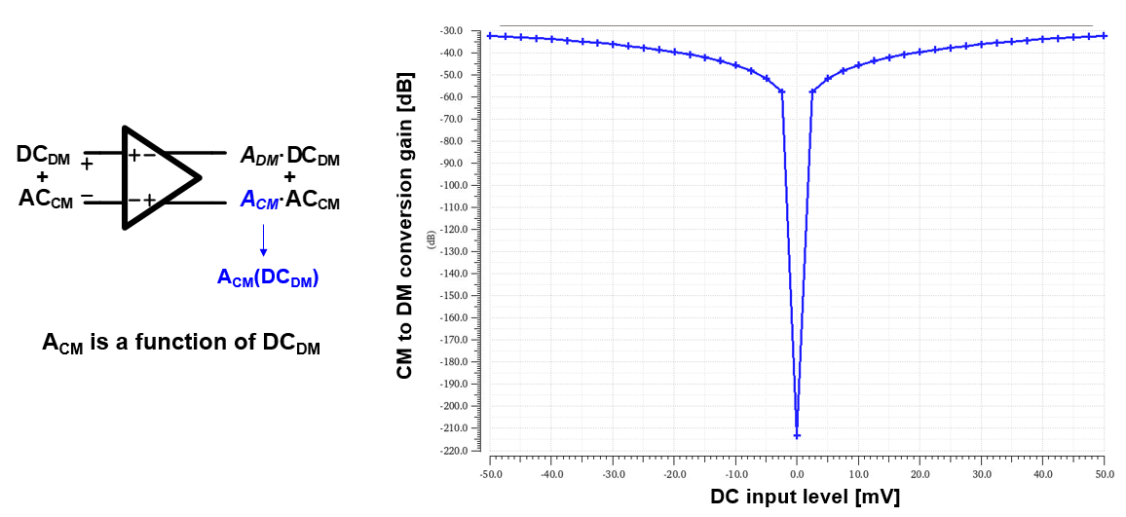
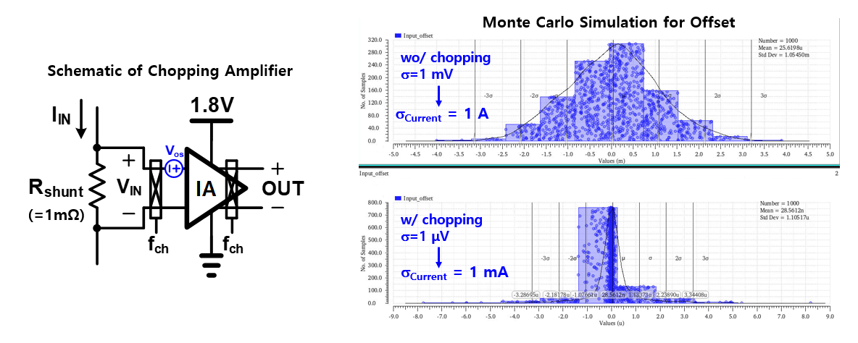
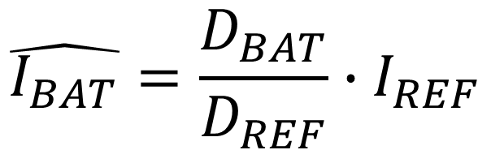
High-Side Current Sensing Interface with Low-Offset
Chopped-CBIA for Battery Management Systems
Pangi Park¹, Dabin Hong¹ and SeongHwan Cho¹
¹Department of Electrical Engineering, KAIST, Daejeon, Korea
Introduction
Chip Photo and Measurement Setup
  Battery Management System (BMS) requires accurate bidirectional current sensing to monitor charge and discharge currents over a wide input range. This work presents an current reference (I_{REF}) based high-side current sensing interface. The front-end employs a low-offset chopped-current balanced instrumentation amplifier (CBIA) with programmable gain and targets a ± 50 mV input range, corresponding to ± 50 A under a 1 mΩ shunt resistor. In the proposed sensing concept, the battery current is estimated from the ratio between the battery-current signal and the reference-current tone, so that common gain-related variations can be reduced. The interface is characterized using simulation and measurement results, and the observed linearity degradation is analyzed in terms of input-dependent common-mode variation and CM-to-DM conversion.
Proposed I_{REF}-based High-Side Current Sensor
▲ Chip Die Photo
▲ Measurement Setup
Estimation of I_{BAT}
Implemented with TSMC 180nm technology (HM-2501).
Effective area : 2.08 mm².
$$\hat{I_{BAT}}=\frac{D_{BAT}}{D_{REF}}∙I_{REF}$$
Measurement Results
Linearity : ± 0.15 % over ± 50 A
Proposed I_{REF}-based high-side current sensor with input bias generator, chopped-CBIA, and ADC readout.
Off-chip 1 mΩ sense resistor generates a small differential input voltage.
Input bias generator sets the input common-mode voltage near 1.2 V.
Low-Offset Chopped-CBIA
Schematic of chopped-CBIA
DC current measurement was performed at the amplifier output.
A 2-point calibration was applied at ± 45 A.
CM-to-DM Conversion Simulation Result (Revision Point)
10k
200k
Offset Monte Carlo Simulation
Input DC current changes the IA input common-mode condition.
CBIA converts this common-mode variation into differential output error.
This CM-to-DM conversion is likely responsible for the input-dependent IREF ton variation.
Acknowledgement
For a 1 mΩ sense resistor, 1 μV offset corresponds to about 1 mA current error.
The chip fabrication and EDA tool were supported by the IC Design Education Center(IDEC), Korea.

