Slide 1

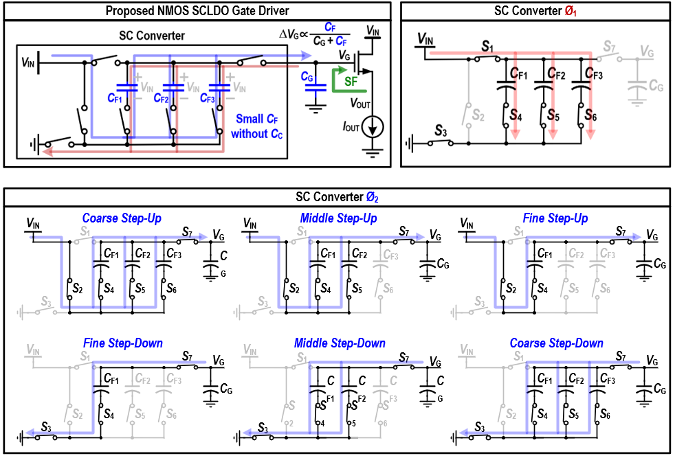
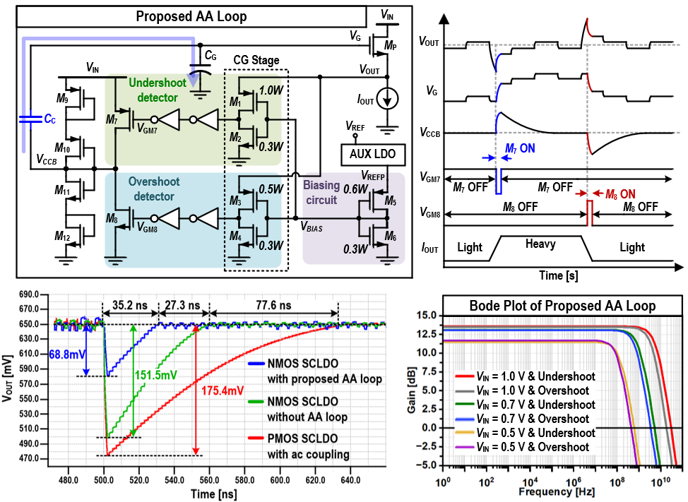
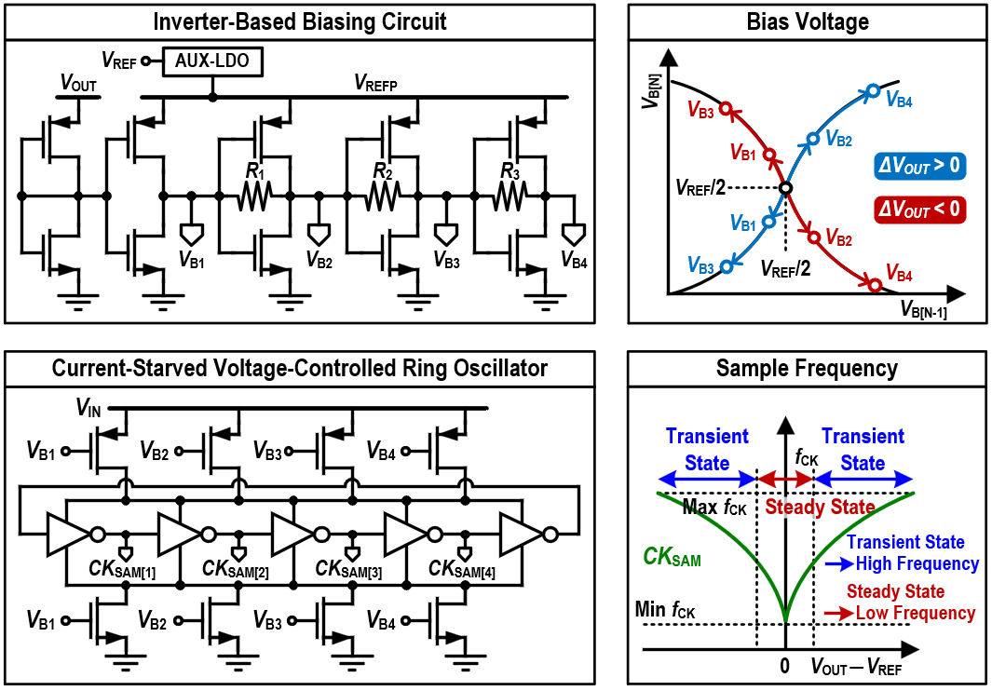
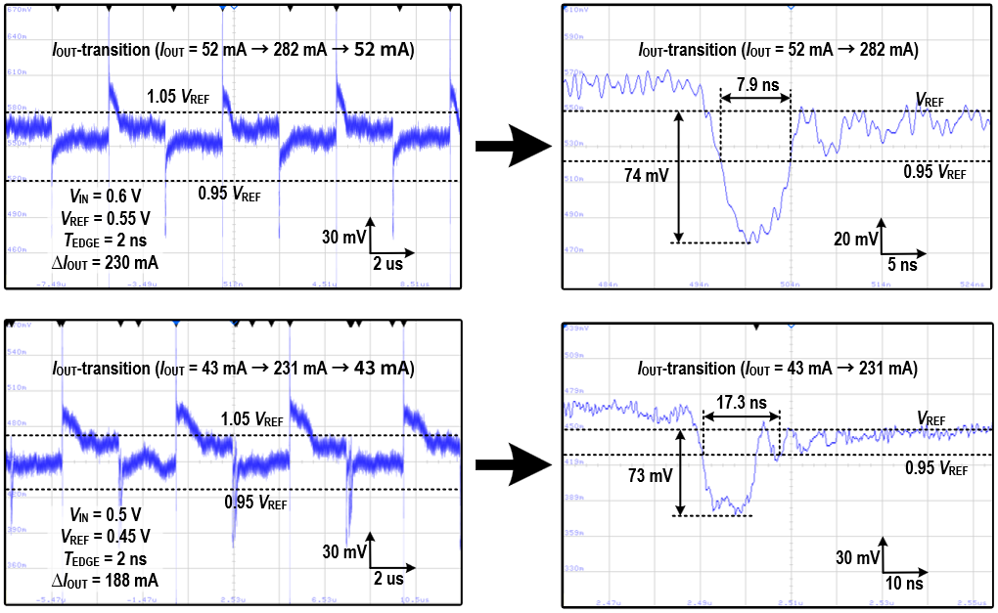
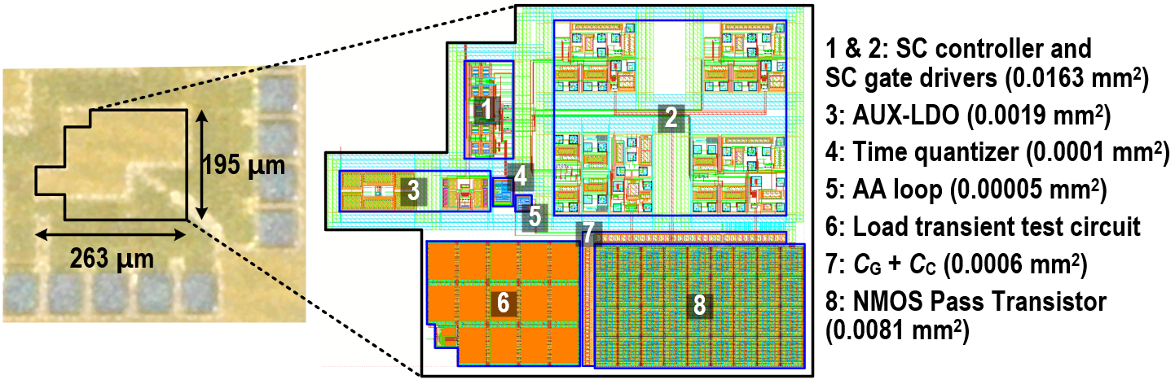
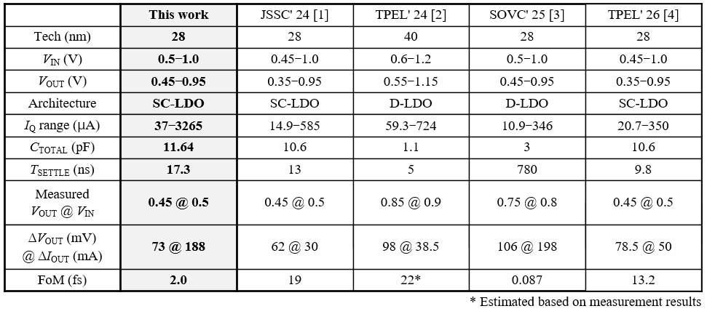
An Output-Capacitor-Free NMOS Switched-Capacitor LDO Using a Time Quantizer and an Inverting-Gain-Assisted Loop
Sungjun Moon, Jonghun Chae, and Inho Park
Department of Electrical and Computer Engineering, Inha University
Introduction
Conventional LDOs suffer from limited transient response due to bandwidth, clock, and power constraints, which degrade voltage regulation under abrupt load changes. In particular, output-capacitor-free and low-voltage designs require significantly faster response to effectively suppress voltage droop and maintain stable operation. This work proposes an NMOS SCLDO with an active AA loop and time quantizer, enabling fast settling, low voltage droop, and efficient transient regulation.
Proposed NMOS SCLDO Gate Driver
Proposed Analog-Assisted Loop
Proposed SC gate driver with small capacitance, eliminating the need for large charge-pump capacitors.
Adaptive gain control enables fast settling and low V_{OUT} ripple
Fast V_{G} recovery under undershoot and overshoot conditions using an analog-assisted loop
Proposed Inverter-Based Time Quantizer
Measured Load Transient Responses
Time quantizer generates a low-frequency sampling clock in steady state and a high frequency clock during transients.
Chip Micrograph and Performance Comparison
Acknowledgments: This work was supported by the National Research Foundation of Korea (NRF) grant funded by the Korea government (MSIT) (RS-2026-25497457).
The chip fabrication and EDA tool were supported by the IC Design Education Center(IDEC), Korea.
[1] H. Kim et al., IEEE JSSC, vol. 59, no. 2, 2024
[2] J. Oh et al., IEEE TPEL, vol. 39, no. 1, 2024
[3] S.-Y. Nam et al., Proc. Symp. VLSI Tech. Circuits, 2025
[4] S. Sim and J. Jun, IEEE TPEL, vol. 41, no. 7, 2026

