Slide 1

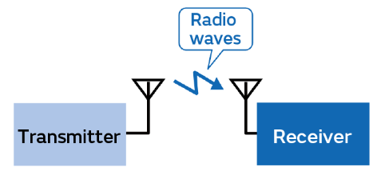
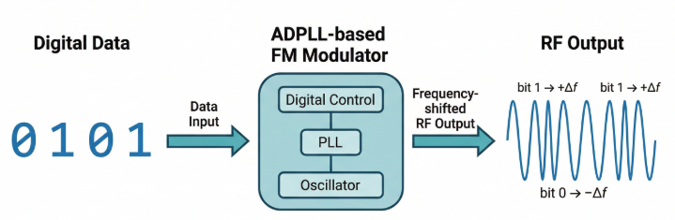
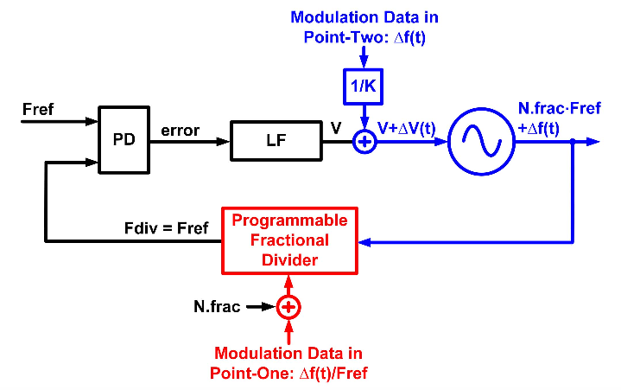
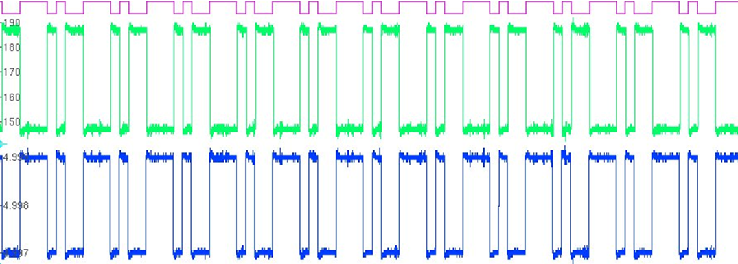
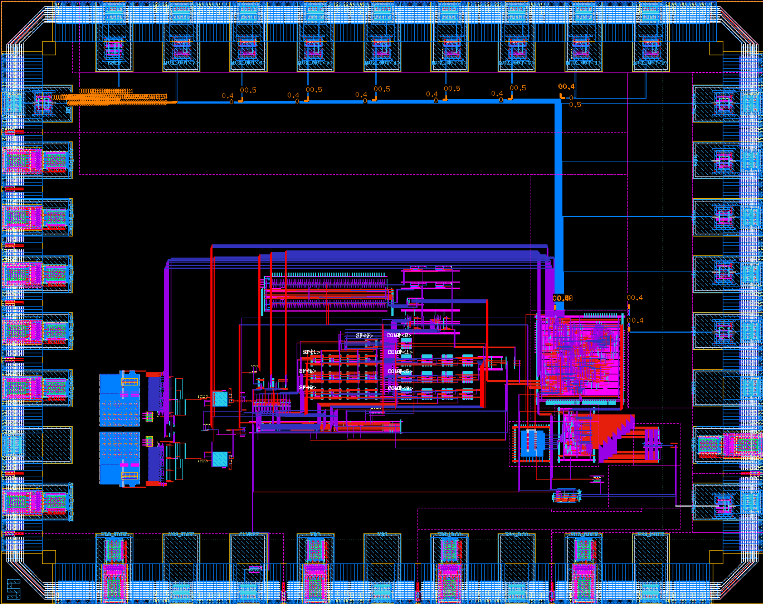
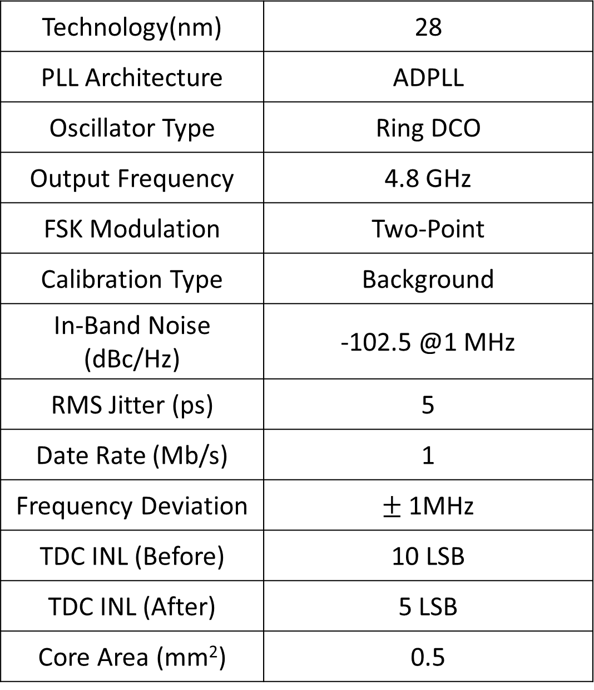
2026 IDEC Congress CDC
ADPLL-based FM Modulator Using Two-Point Modulation
Solmon Shin, Youngsik Kim, and Shinwoong Kim
Department of Computer and Electronic Engineering,
Handong Global University, Pohang, Korea
Introduction
Calibration Techniques
FM Modulator
[https://article.murata.com/ko-kr/article/basics-of-wireless-communication-1]
ADPLL-based FM Modulators are essential for wireless systems
(a)
(b)
Figure 3. (a) TDC gain calibration for DSM quantization noise cancellation, (b) Two-point modulation gain calibration
TDC Gain Calibration for DSM Quantization Noise Cancellation
DSM quantization error (QE) propagates to the TDC output and degrades linearity
The TDC gain is calibrated using sign-sign LMS based on QE
<Conventional Digital PLL>
[N. Marculic, 16’JSSC]
<DPLL using Two-point modulation>
Two-Point Modulation Gain Calibration
Mismatch between slow path and fast path introduces modulation distortion
Sign-sign LMS is employed to align the modulation gains
The calibration compensates delay and gain mismatch between the two paths
The modulation bandwidth is fundamentally limited by the loop bandwidth
To overcome this limitation, two-point modulation is employed
In addition, background calibration of TDC non-linearity is applied within the PLL loop to enhance modulation accuracy
System Architecture
Conclusion
Tx_DATA
DCTRL
DCO
Frequency
Figure 4. Simulated FM modulation with 1 Mbps TX data (1MHz frequency deviation).
The proposed ADPLL achieves accurate FM modulation using Two-point modulation and In-loop TDC Non-Linearity Calibration
Figure 1. Block diagram of the proposed ADPLL
Technology(nm) | 28
PLL Architecture | ADPLL
Oscillator Type | Ring DCO
Output Frequency | 4.8 GHz
FSK Modulation | Two-Point
Calibration Type | Background
In-Band Noise (dBc/Hz) | -102.5 @1 MHz
RMS Jitter (ps) | 5
Date Rate (Mb/s) | 1
Frequency Deviation | $±$1MHz
TDC INL (Before) | 10 LSB
TDC INL (After) | 5 LSB
Core Area (mm²) | 0.5
The proposed ADPLL-based FM Modulator employs:
Fractional-N PLL using DSM
Two-point FM Modulation
ADC-assisted coarse-to-fine TDC
In-loop background TDC Nonlinearity calibration
Figure 5. Simulated Phase noise spectrum
Fast path directly modulates the DCO
Slow path processes low-frequency components through the PLL loop
This architecture overcomes the modulation bandwidth limitation of PLLs
Figure 2. Two-point modulation architecture
Figure 6. Layout view
Table 1. Performance summary

