Slide 1


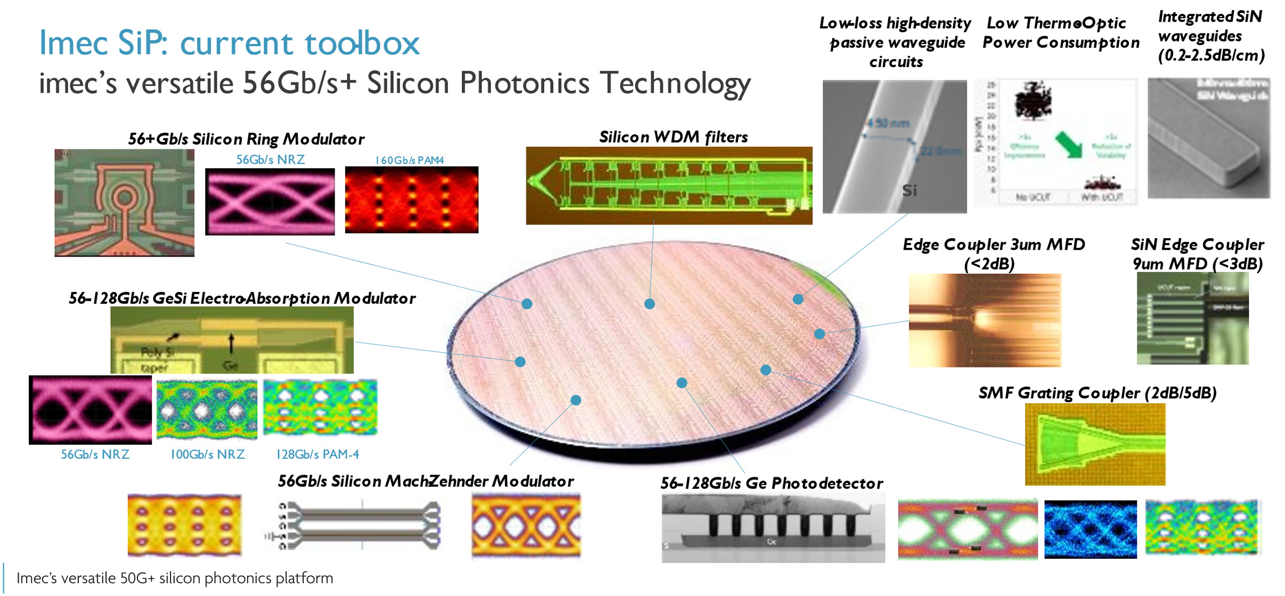
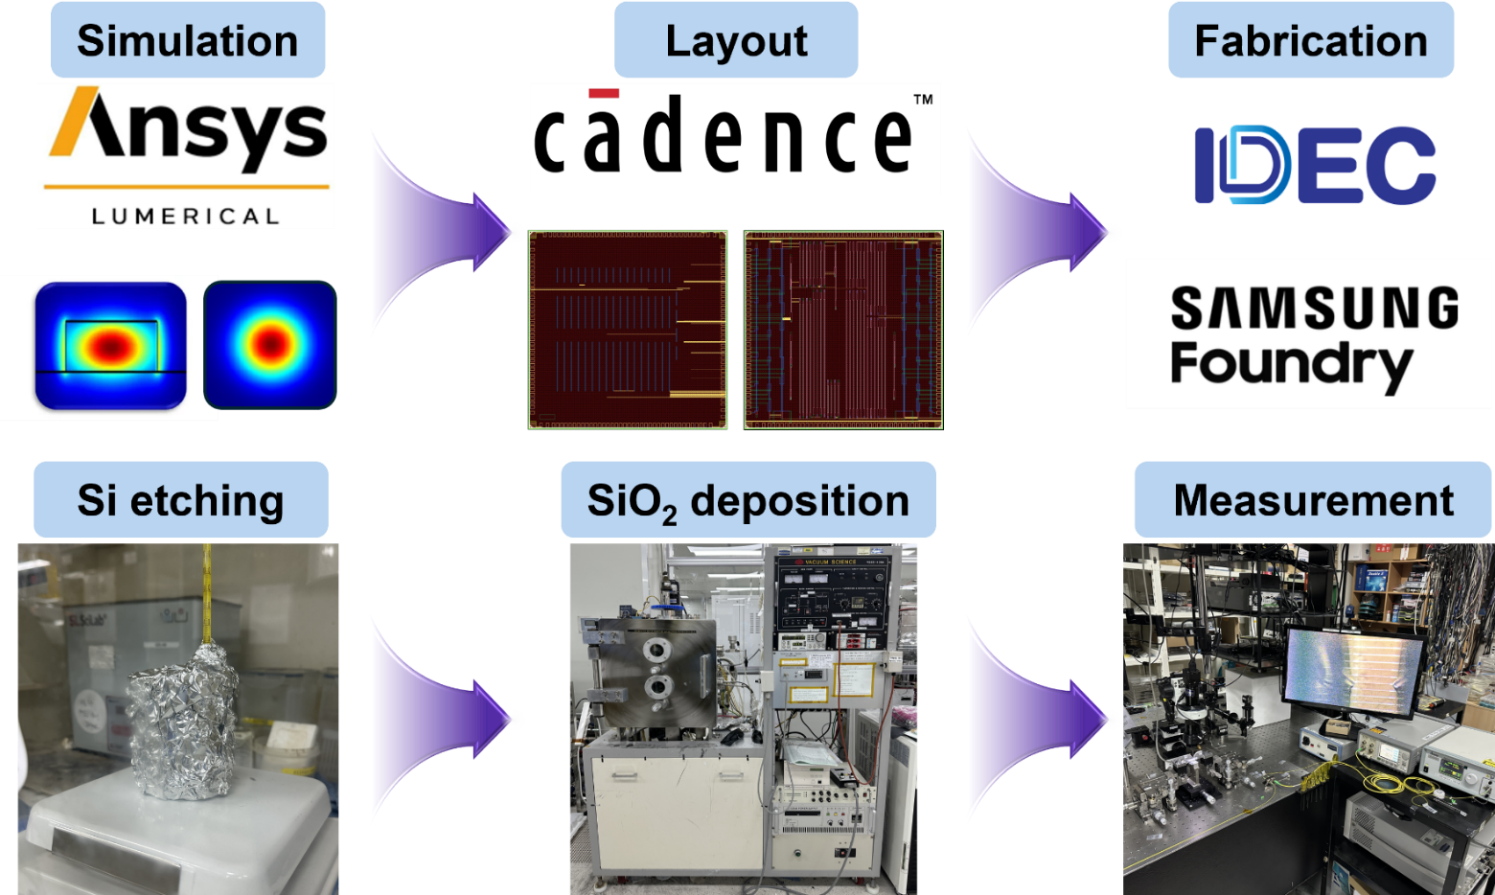
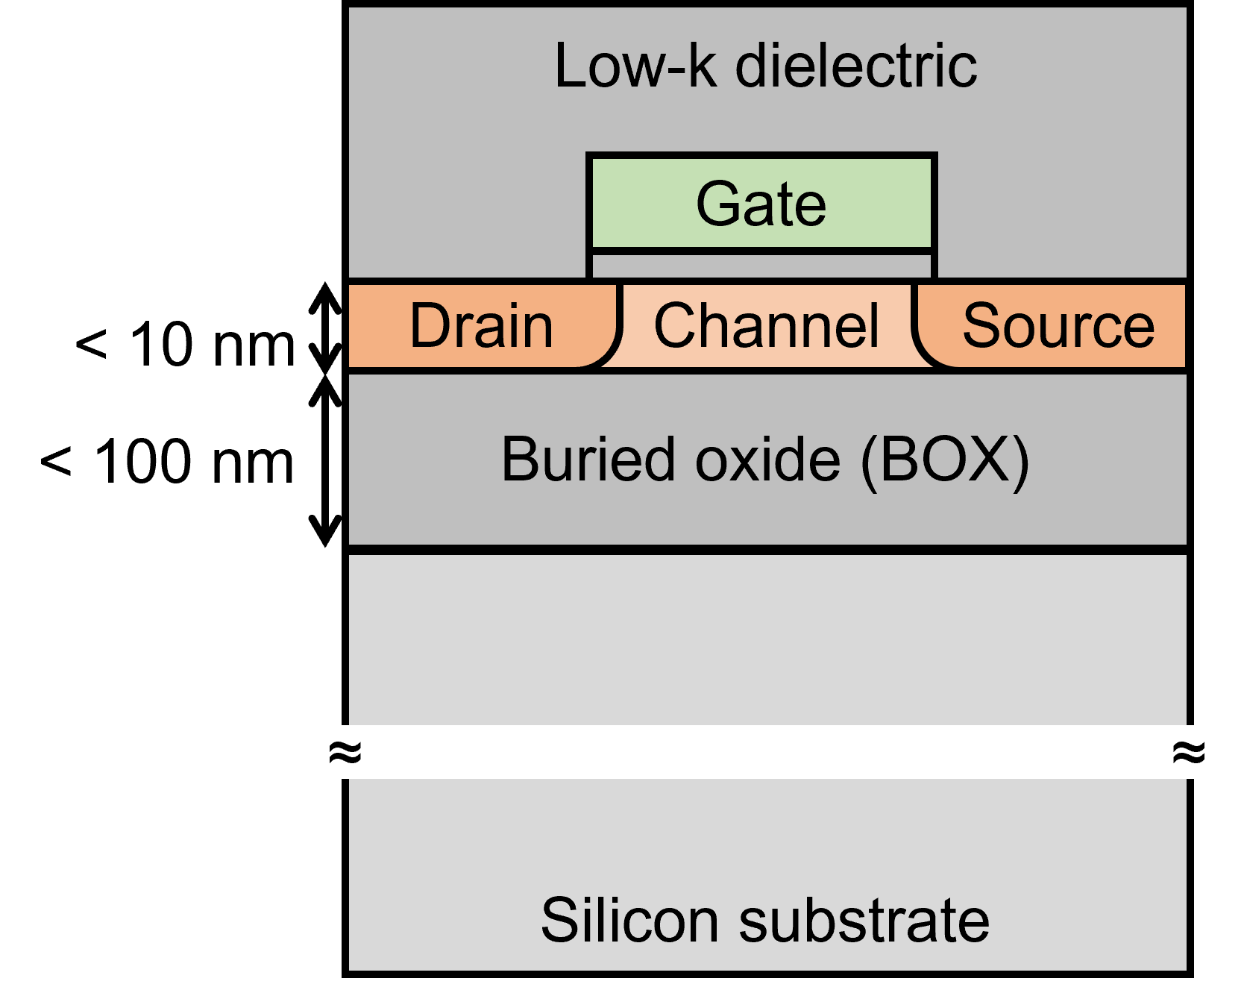
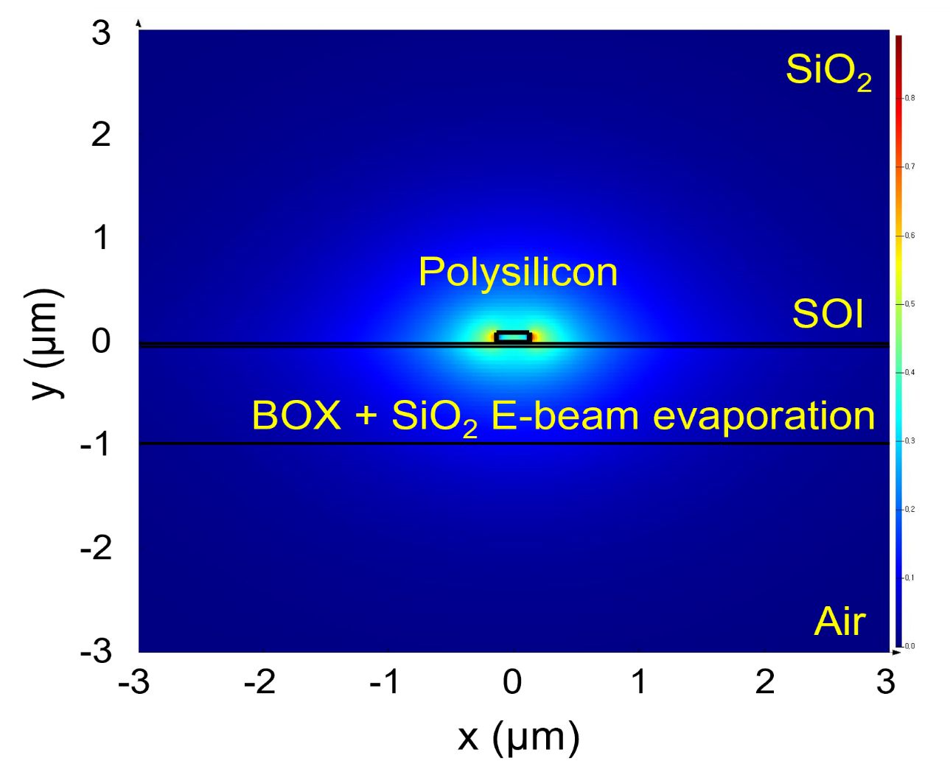
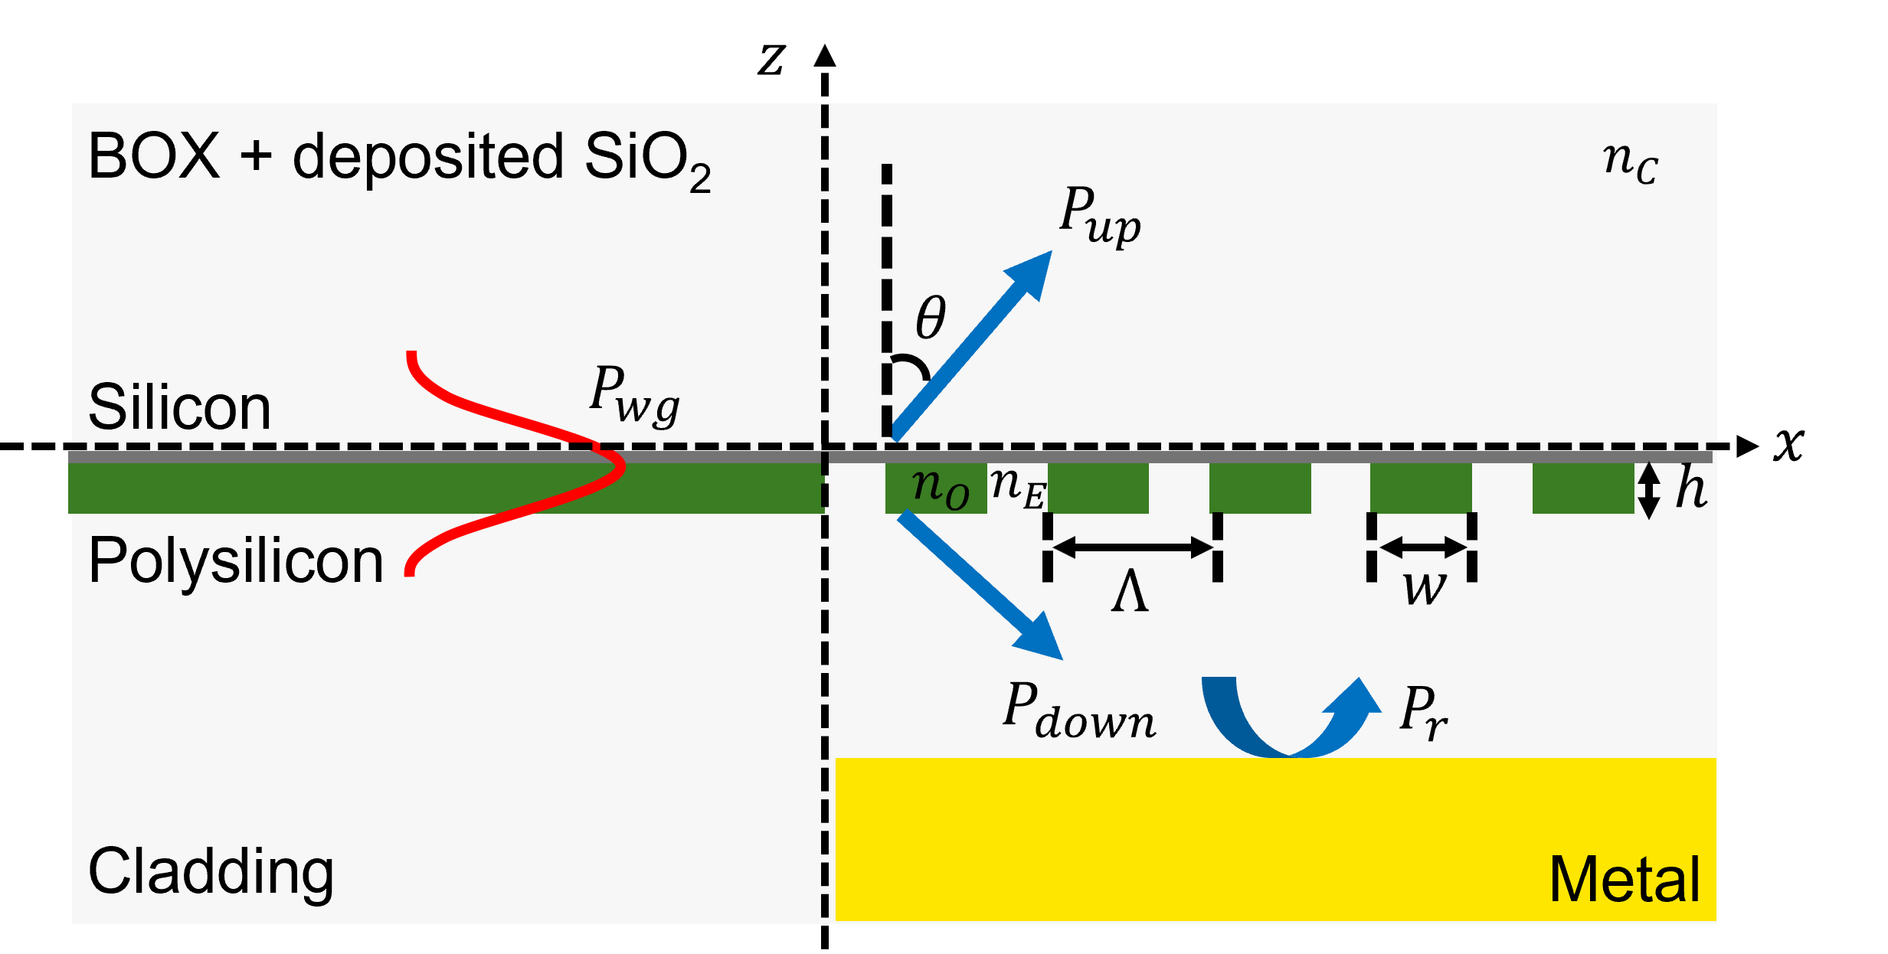
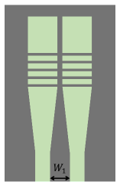
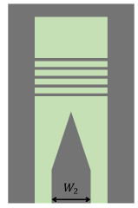
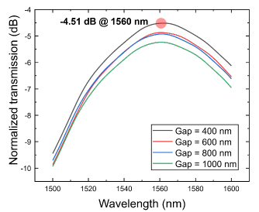
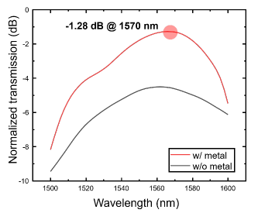
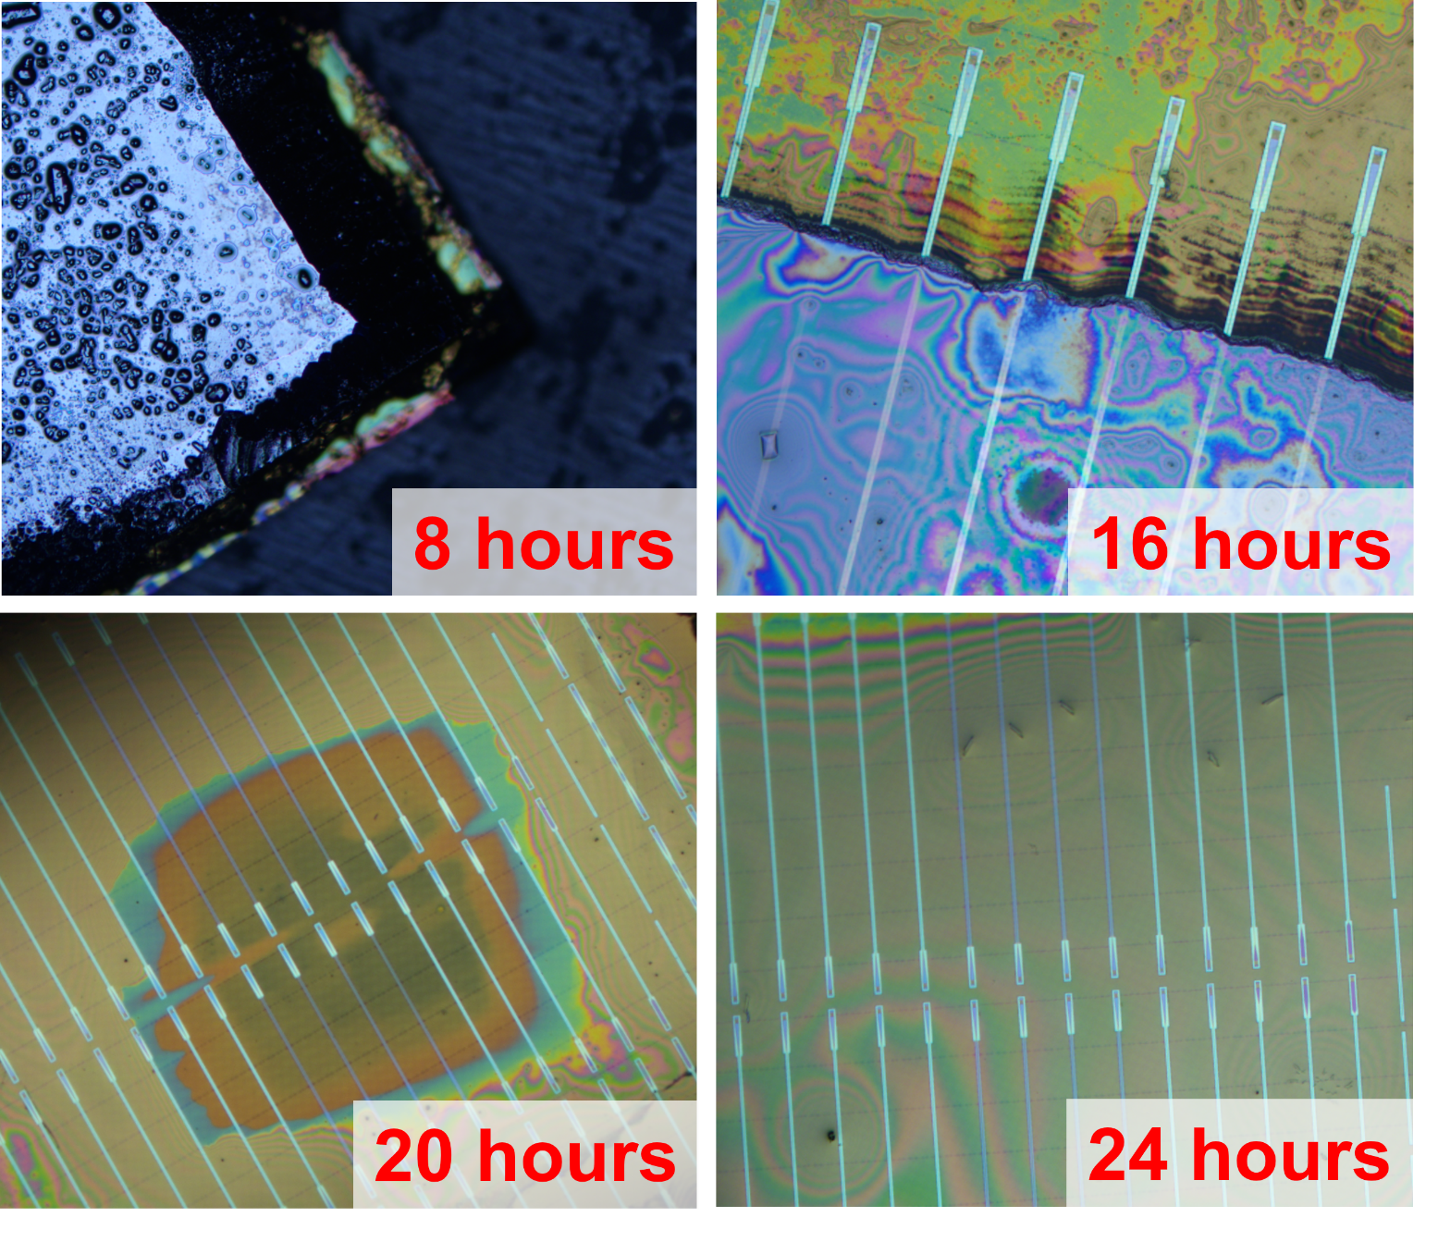
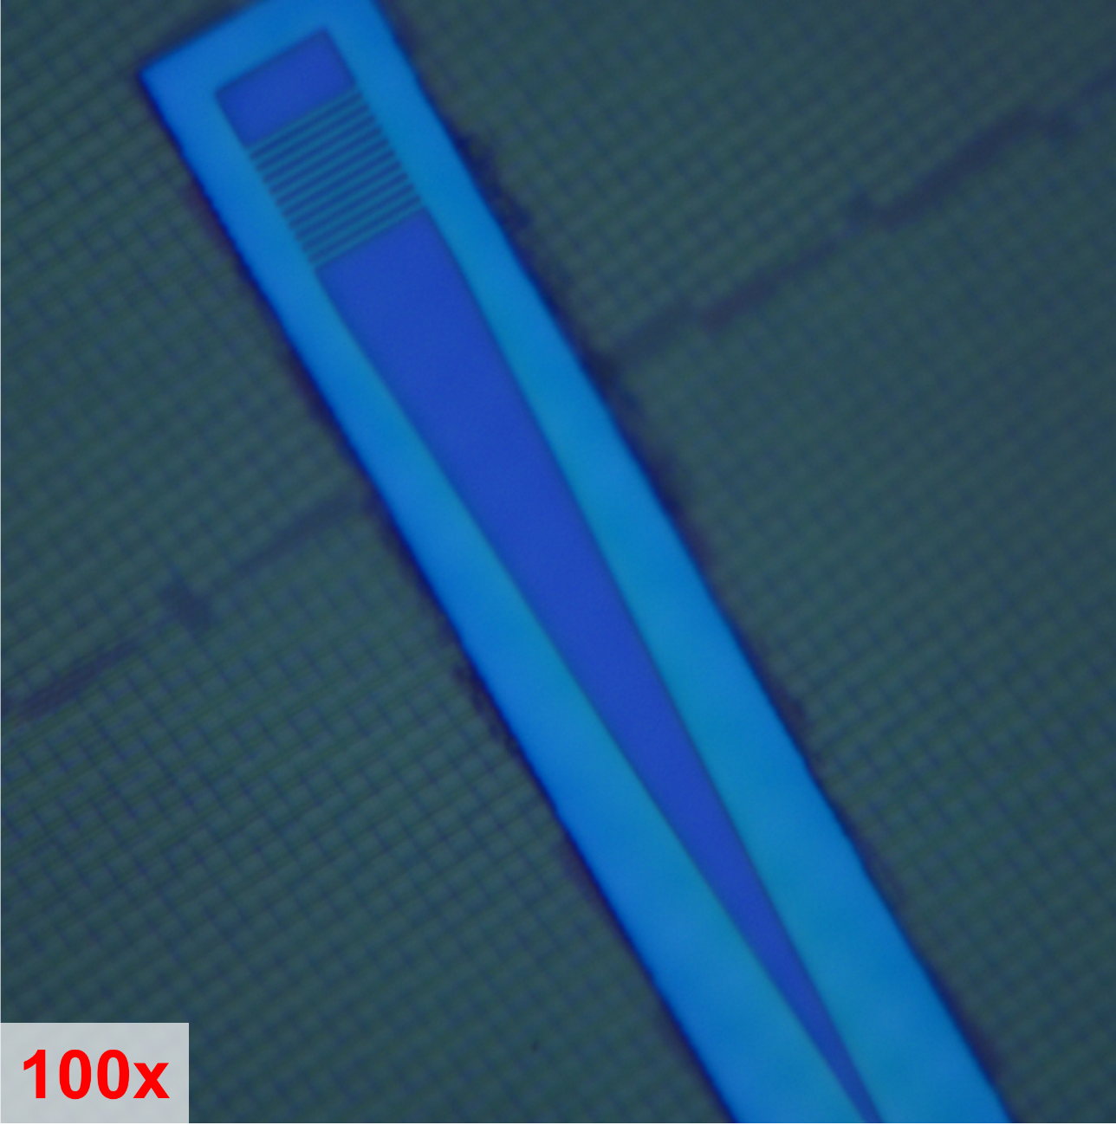
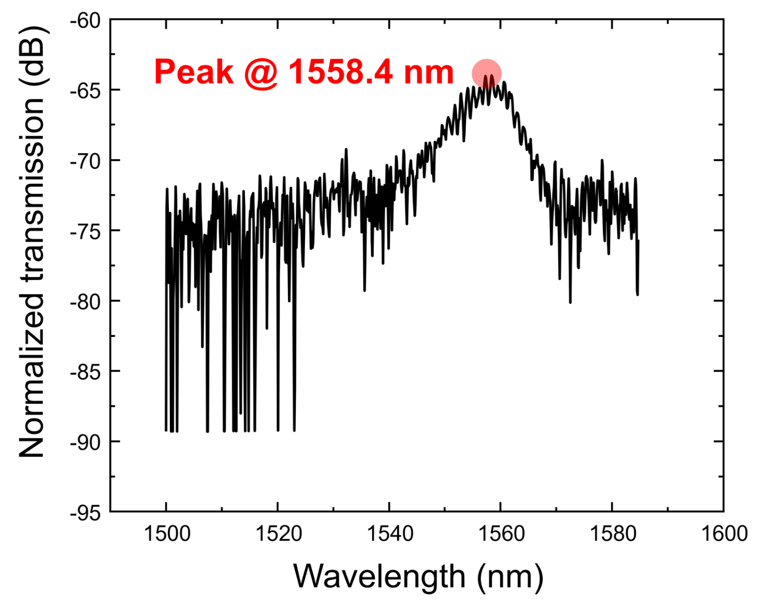
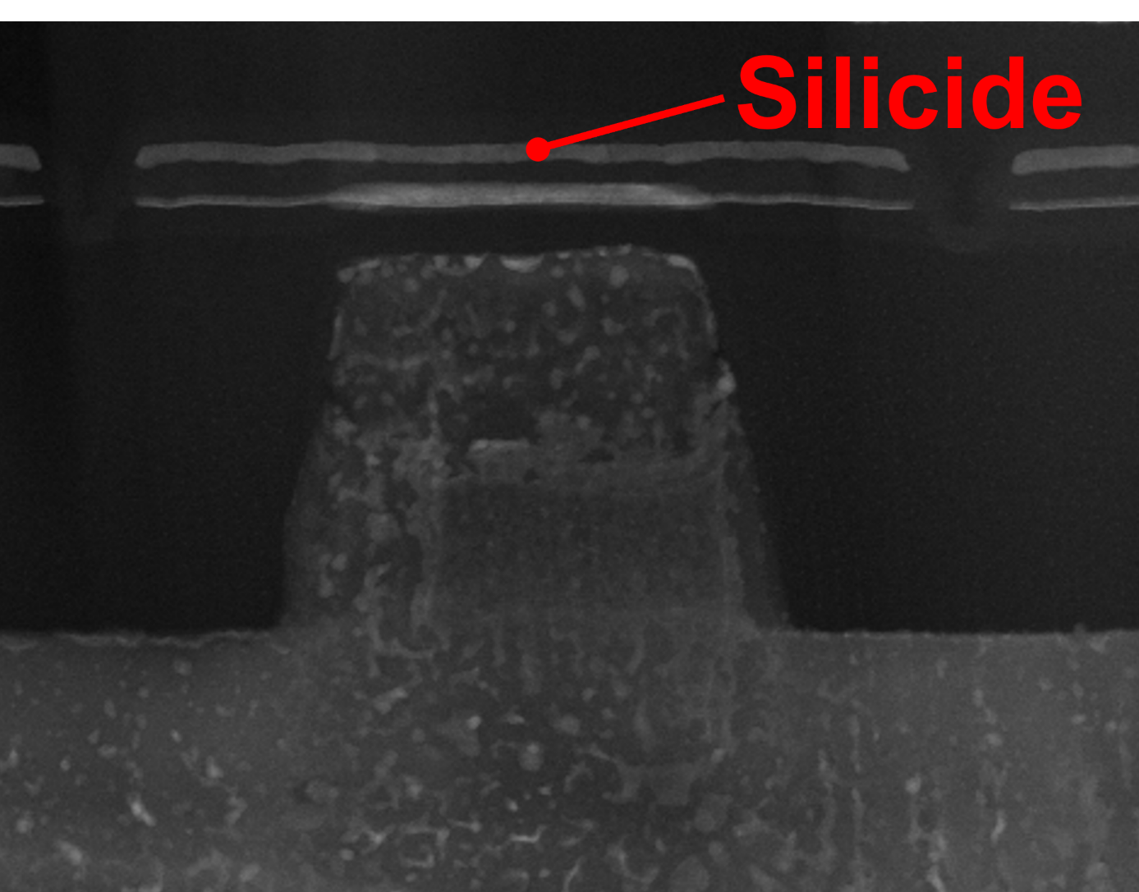
Design of Polysilicon Grating Couplers using Metal Reflector in FD-SOI Platform
Chaewon Jeon, and Kyoungsik Yu*
School of Electrical Engineering, Korea Advanced Institute of Science and Technology (KAIST), Daejeon 34141, Korea
*E-mail: ksyu@kaist.edu
Introduction
Silicon photonics and zero-change integration
FD-SOI Platform
(a)
(b)
(a)
(b)
Silicon photonics exploits silicon as an optical platform to generate, modulate, and detect light, enabling high-bandwidth and energy-efficient data transmission
Zero-change integration leverages this CMOS compatibility to monolithically integrate photonic and electronic circuits on a single chip without modifying standard CMOS flows
A sub-10 nm device layer and a sub-100 nm buried oxide (BOX) layer are not suitable for efficient waveguiding and light coupling
Silicon substrate removal and additional SiO₂ deposition are required to form a symmetric refractive index profile around the waveguide
Grating coupler design
Theoretical backgrounds
Simulation result
(a)
(b)
Type Ⅰ
Type Ⅱ
(a)
(b)
The grating coupler couples light between an optical fiber and on-chip waveguides using a periodic structure
Back-reflection is suppressed by detuning the grating and tilting the fiber at a small angle (𝜃_{c}), with a metal reflector added
Split grating couplers are used to distribute the coupled light into two waveguides under layout constraints
The spacing between parallel grating couplers reduces the coupling efficiency and shifts the peak wavelength to 1560 nm
Introducing a metal reflector improves the coupling efficiency to
−1.28 dB/facet
Post-processing and measurement
Post-processing
Measurement result
(a)
(b)
(a)
(b)
The silicon substrate was removed using a strong alkaline solution,
with the BOX acting as an etch-stop layer
A 1 μm SiO₂ layer was deposited on the BOX to form a symmetric cladding
The measured coupling efficiency of the grating coupler is approximately −32 dB/facet, mainly attributed to silicide-induced optical loss
To address this issue, a silicide blocking layer (SBLK) is introduced to prevent silicide formation
Conclusion
This study presents a grating coupler design methodology on the FD-SOI platform that avoids design rule violations.
The coupling efficiency was predicted to be −1.28 dB per facet in simulation, while the measured value was −32 dB per facet, attributed to silicide-induced optical loss in the polysilicon waveguide. A silicide blocking layer was introduced to mitigate this loss.
* The chip fabrication and EDA tool were supported by the IC Design Education Center(IDEC), Korea.

