Slide 1
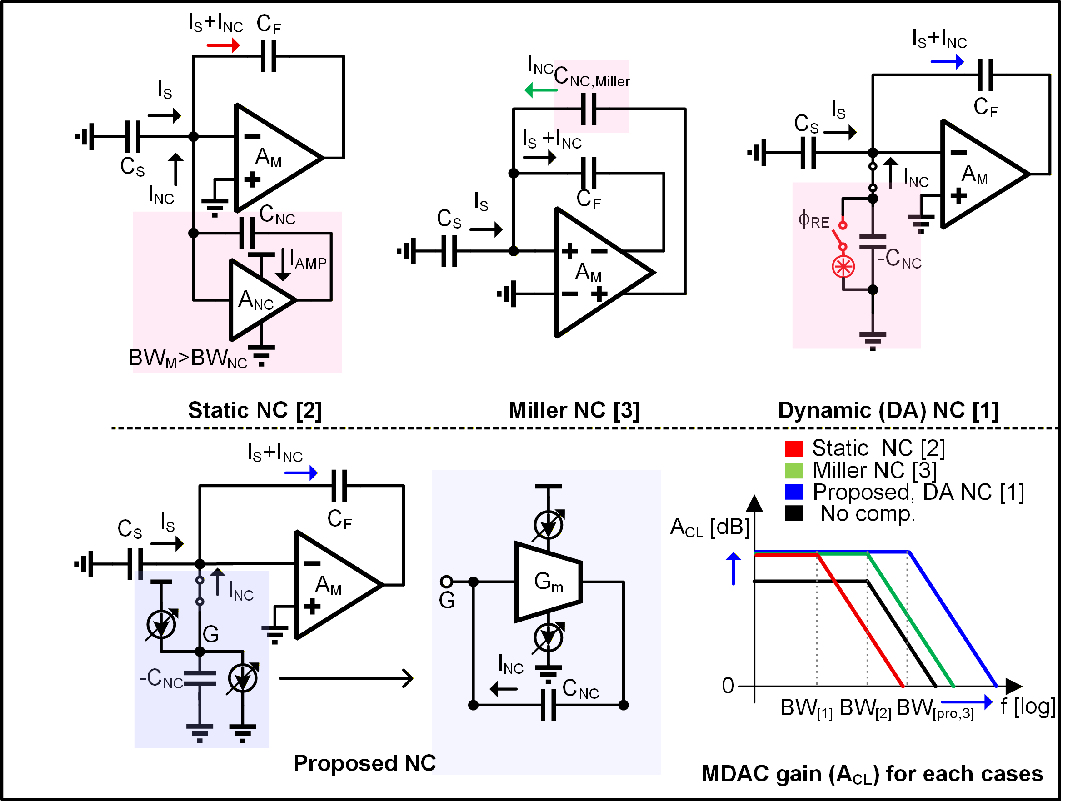
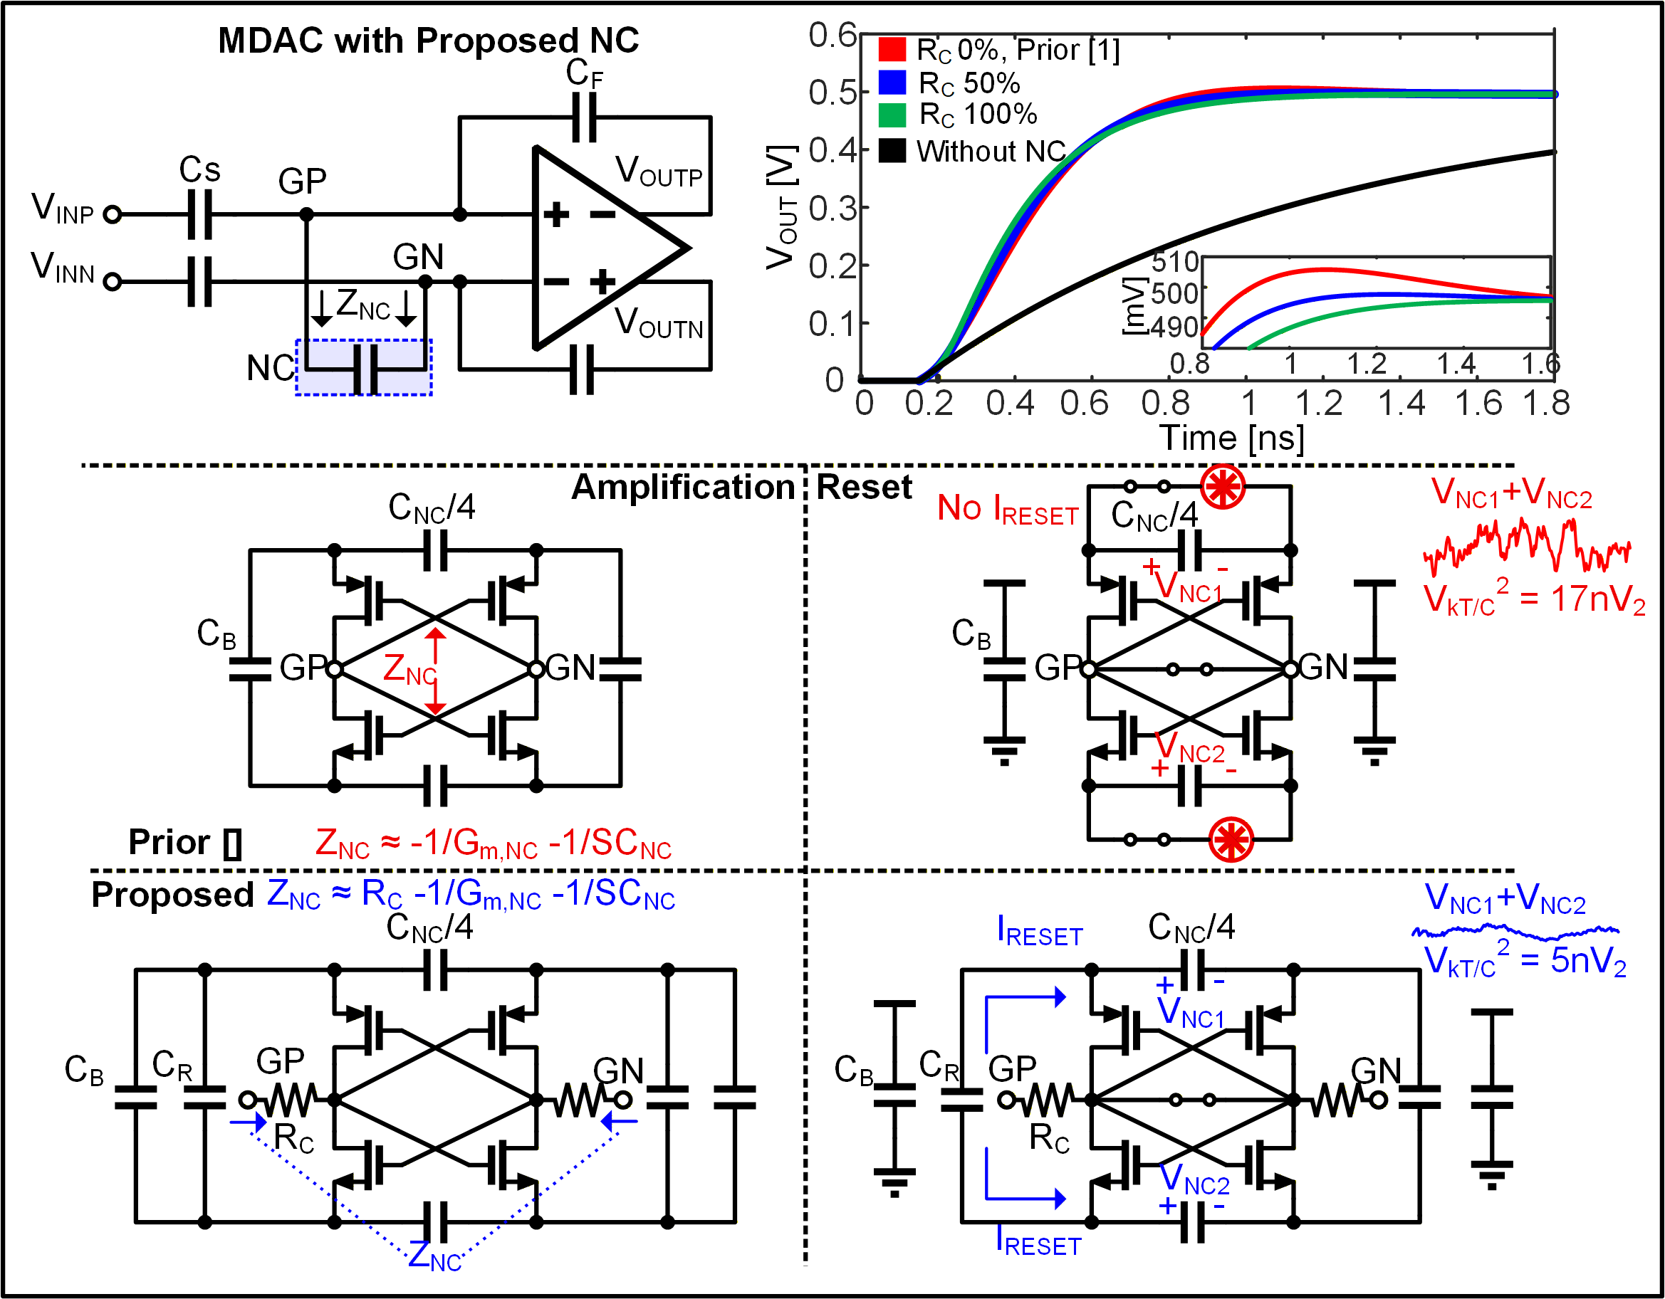
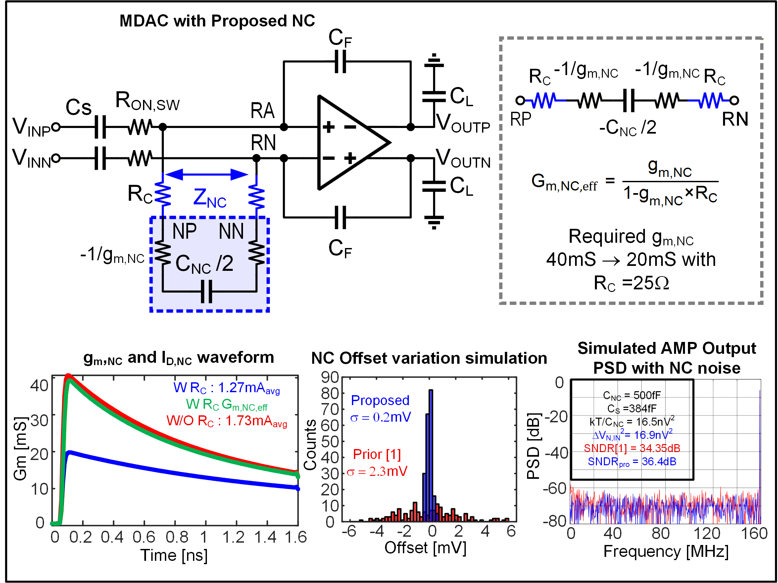
Fs=280MS/S
Fin : low frequency
A 12bits 280MS/s Pipelined-SAR ADC with residue amplifier assisted by reduced kT/C NC
Jongyoon Won, Youngcheol Chae
Yonsei University, Seoul, Korea
Abstract – This paper presents a 280MS/s Pipelined-SAR ADC assisted by reduced kT/C NC, which achieve SNDR of 64.6dB and FoM of 171.7dB. The proposed NC reduces kT/C_{NC} noise by continuously flowing current during reset phase, therefore kT/C_{NC} noise and offset voltage of NC which is induced by TR mismatch is largely reduced. Also, additional compensation resistor is implemented to reduce the requirement of g_{m,NC}.
Figure1. Comparison between previous negative-C (NC) implemented ADC, MDAC bode plot with each NC
Figure2. Transient response with NC and operation principle of the proposed NC compared to previous NC [1]
SNDR : 64dB
LF input
 | This work | VLSI’23, Song [4] | ISSCC’23 Hsieh [5] | T-CAS1’25, Kwon [1] | T-CAS2’25 Kwon[6] | ESSCIRC’22 Jang [3] | ISSCC’24, Lim [7]
Technology | 28nm | 28nm | 7nm FinFET | 28nm | 6nm FinFET | 28nm | 8nm FinFET
Supply Voltage (V) | 1 | 1 | 0.85 / 1 | 0.95 | 0.78 / 0.9 | 1 | 0.9
Architecture | 2-stage PSAR | 2-stage PSAR | TI 2X Pipeline | 2-stage PSAR | 2-stage PSAR | Pipeline | 2-stage PSAR
Sampling rate (1-channel) | 280MS/s | 150MS/s | 900MS/s | 360MS/s | 500MS/s | 320M/s | 400MS/s
Feedback factor compensation | Gain & BW | Gain | Gain & BW | Gain & BW | Gain & BW | Gain | NO comp.
kT/C_{NC} noise free | O | O | X | X | X | X
SNDR @ Nyq (dB) | 64 | 67.9 | 60.2 | 58 | 54.5 | 54.7 | 62.8
SFDR @ Nyq (dB) | 80 | 84.3 | 69.2 | 77.9 | 68.3 | 71.8 | 68.6
Power (mW) | 3.2 | 1.72 | 7.55 | 3.9 | 2.1 | 11.3 | 2.08
FoM_{SH} (dB) | 170.7 | 173 | 170.9 | 164.6 | 165.3 | 156 | 172.6
Figure3. MDAC schematic, Impedance analysis of proposed NC, simulated required Gm without RC with RC and effective Gm, offset cancellation histogram, MDAC output noise PSD.
Figure4. Layout of proposed ADC, SNDR PSD with LF input frequency, and Comparison table with other Pipelined SAR ADCs.
This work is simulated and fabricated in 28nm FDSOI process. Fig.3 shows the simulated PSD for low and high frequency signals with sampling speed of 280MS/s. The simulated SNDR is 64.6dB.
Reference
[1] Y. Kwon, S. Lee, C. Lee, H. Yoon, B. Min, and Y. Chae, “An 11bit 360MS/s pipelined SAR ADC with dynamic negative-C assisted residue amplifier,” in Proc. IEEE Asian Solid-State Circuits Conf. (A-SSCC), Nov. 2023, pp. 1–3.
[2] W. Jang, G.-G. Kang, Y. Lim, and H.-S. Kim, “A pipeline ADC with negativeC-assisted SC amplifier canceling gain error and nonlinearity,” in Proc. IEEE 48th Eur. Solid State Circuits Conf. (ESSCIRC), Sep. 2022, pp. 317–320.
[3] S. Song, T. Kang, S. Lee, and M. P. Flynn, “A 150-MS/s fully dynamic SAR-assisted pipeline ADC using a floating ring amplifier and gainenhancing Miller negative-C,” in Proc. IEEE Symp. VLSI Technol. Circuits, Jun. 2023, pp. 1–2.
[4] H. H. Boo, D. S. Boning and H. -S. Lee, "15.6 12b 250MS/S pipelined ADC with virtual ground reference buffers," 2015 IEEE International Solid-State Circuits Conference - (ISSCC) Digest of Technical Papers, San Francisco, CA, USA, 2015, pp. 1-3.
[5] S. -E. Hsieh, T. -C. Wu and C. -C. Hou, "A 1.8GHz 12b Pre-Sampling Pipelined ADC with Reference Buffer and OP Power Relaxations," 2023 IEEE International Solid-State Circuits Conference (ISSCC), San Francisco, CA, USA, 2023, pp. 166-168.
[6] Y. Lim et al., “9.2 A 2.08 mW 64.4dB SNDR 400MS/s 12b pipelined-SAR ADC using mismatch and PVT variation tolerant dynamically biased ring amplifier in 8nm,” in Proc. IEEE Int. Solid-State Circuits Conf. (ISSCC), Feb. 2024, pp. 170–172.
[7] S. Ye et al., "9.1 A 2mW 70.7dB SNDR 200MS/s Pipelined-SAR ADC with Continuous-Time SAR-Assisted Detect-and-Skip and Open-then-Close Correlated Level Shifting," 2024 IEEE International Solid-State Circuits Conference (ISSCC), San Francisco, CA, USA, 2024, pp. 168-170.

