Slide 1

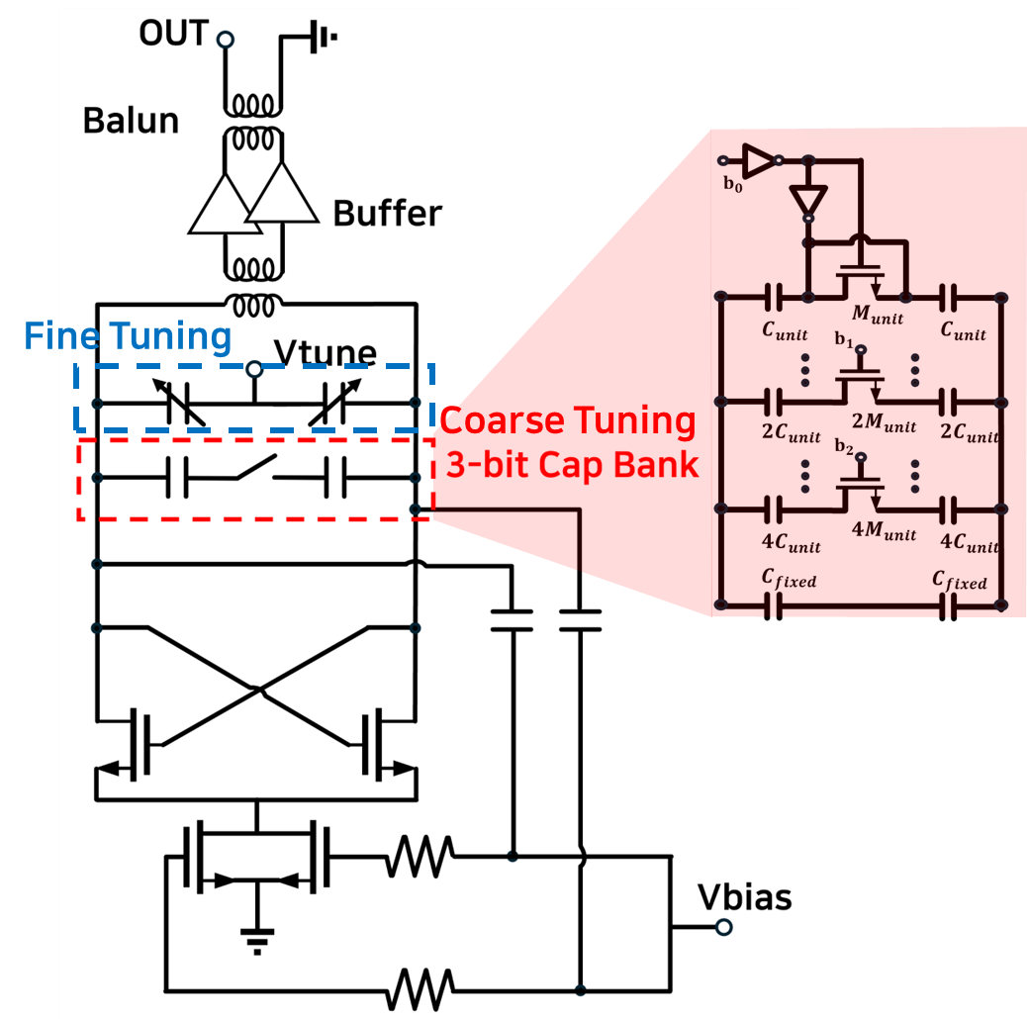
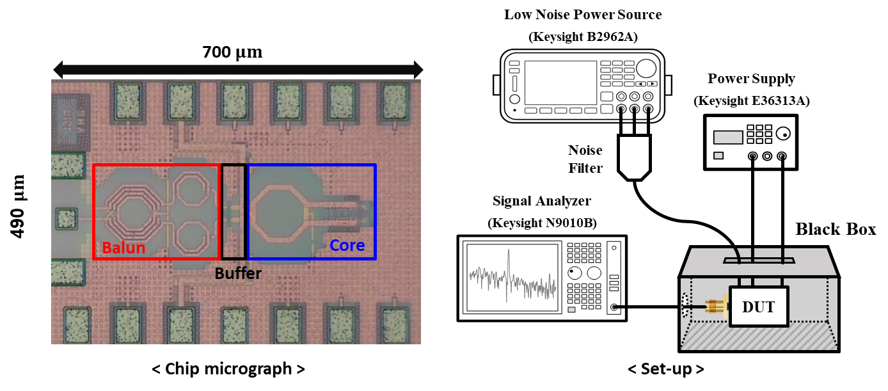
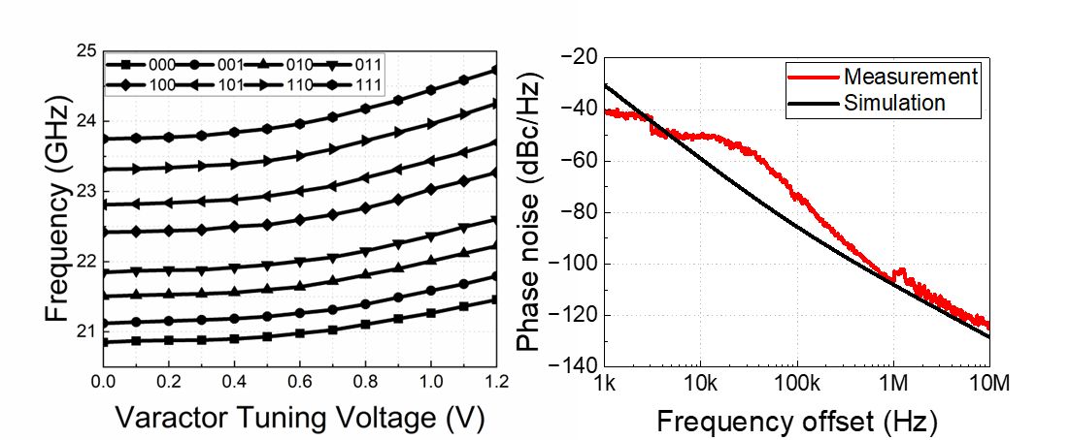
K-band CMOS Voltage-Controlled Oscillator for Millimeter-Wave Signal Generation
Ji-Ho Yoo¹°, Hyeon-Jin Son², Jong-Ryul Yang^{1,2}*
Electrical and electronics engineering, Konkuk University
E-mail: °jhy0502@konkuk.ac.kr , *jryang@konkuk.ac.kr
Background
Millimeter-wave signal sources typically rely on frequency multipliers, making the driving VCO's performance critical for overall system stability
To ensure stable multiplier operation, the VCO must deliver both high output power and low phase noise.
This work proposes a K-band CMOS VCO utilizing switched-biasing and high-Q MOM capacitors to achieve superior phase noise and a wide tuning range.
Methods
Results
A proposed VCO Structure
Chip micrograph & Measurement setup
Measurement Results
The switched biasing technique is a method that reduces flicker noise by modulating the current source.
Coarse tuning was implemented using a 3-bit capacitor bank, while fine tuning was achieved using a differential varactor pair.
Integrates an output buffer and on-chip balun for single-ended measurement and impedance matching.
Conclusion
The proposed CMOS K-band VCO modulates the current source to reduce fliker noise in the phase noise.
A high-Q LC resonator incorporating a MOM capacitor array provides a wide and linear tuning range while maintaining efficiency across the band.
A VCO with high output power and low phase noise is advantageous for configuring transmitter chain above 100 GHz.
A proposed High Q Metal-Oxide-Metal(MOM) capacitor
Edge
Broadside
Reference | AEUE ‘24 | VLSI ’19 | SSC-L’22 | This work
Process | 65-nm CMOS | 65-nm CMOS | 65-nm CMOS | 65-nm CMOS
Tuning range [GHz] | 22 ⎯ 24.61 (11.2%) | 25.7 ⎯ 29.7 (14.44%) | 16.8 to 21.6 (25%) | 20.97 ⎯ 24.93 (17.25%)
V_{DD} [V] | 1.2 | 0.9 | 1 | 1.2
P_{DC} [mW] | 7.48 | 10.8 | 7 | 10.6
Peak P_{out} [dBm] | 0.95 | 1 | -1 | 4.48
Conversion efficiency [%] | 16.65 | 12.95 | 11.35 | 11.1
PN @ 1 MHz (dBc/Hz) | ⎯109.1 | ⎯105.8 | -105.8 | ⎯107.72
FoM @ 1 MHz (dBc/Hz) | ⎯187.4 | -184.12 | -181.86 | ⎯183.11
FoM_{TP} @ 1 MHz (dBc/Hz) | ⎯188.4 | -188.31 | -188.81 | -192.33
<High Q MOM Customized Capaictor cross-section view>
<Comparison of Quality factor & Capacitance with PDK, custom capacitor >
The proposed customized MOM capacitor achieves a higher Q-factor than standard PDKs, ensuring stable and robust oscillation.
Consequently, this high-Q design enables a wide and linear frequency tuning range while maintaining high efficiency.
< Acknowledge >
This work was supported by the National Research Foundation (NRF) grand funded by the Korea government (MSIT)(NO.RS-2023-00219725).
The chip fabrication and EDA tool were partially supported by IDEC, Korea.

