Slide 1


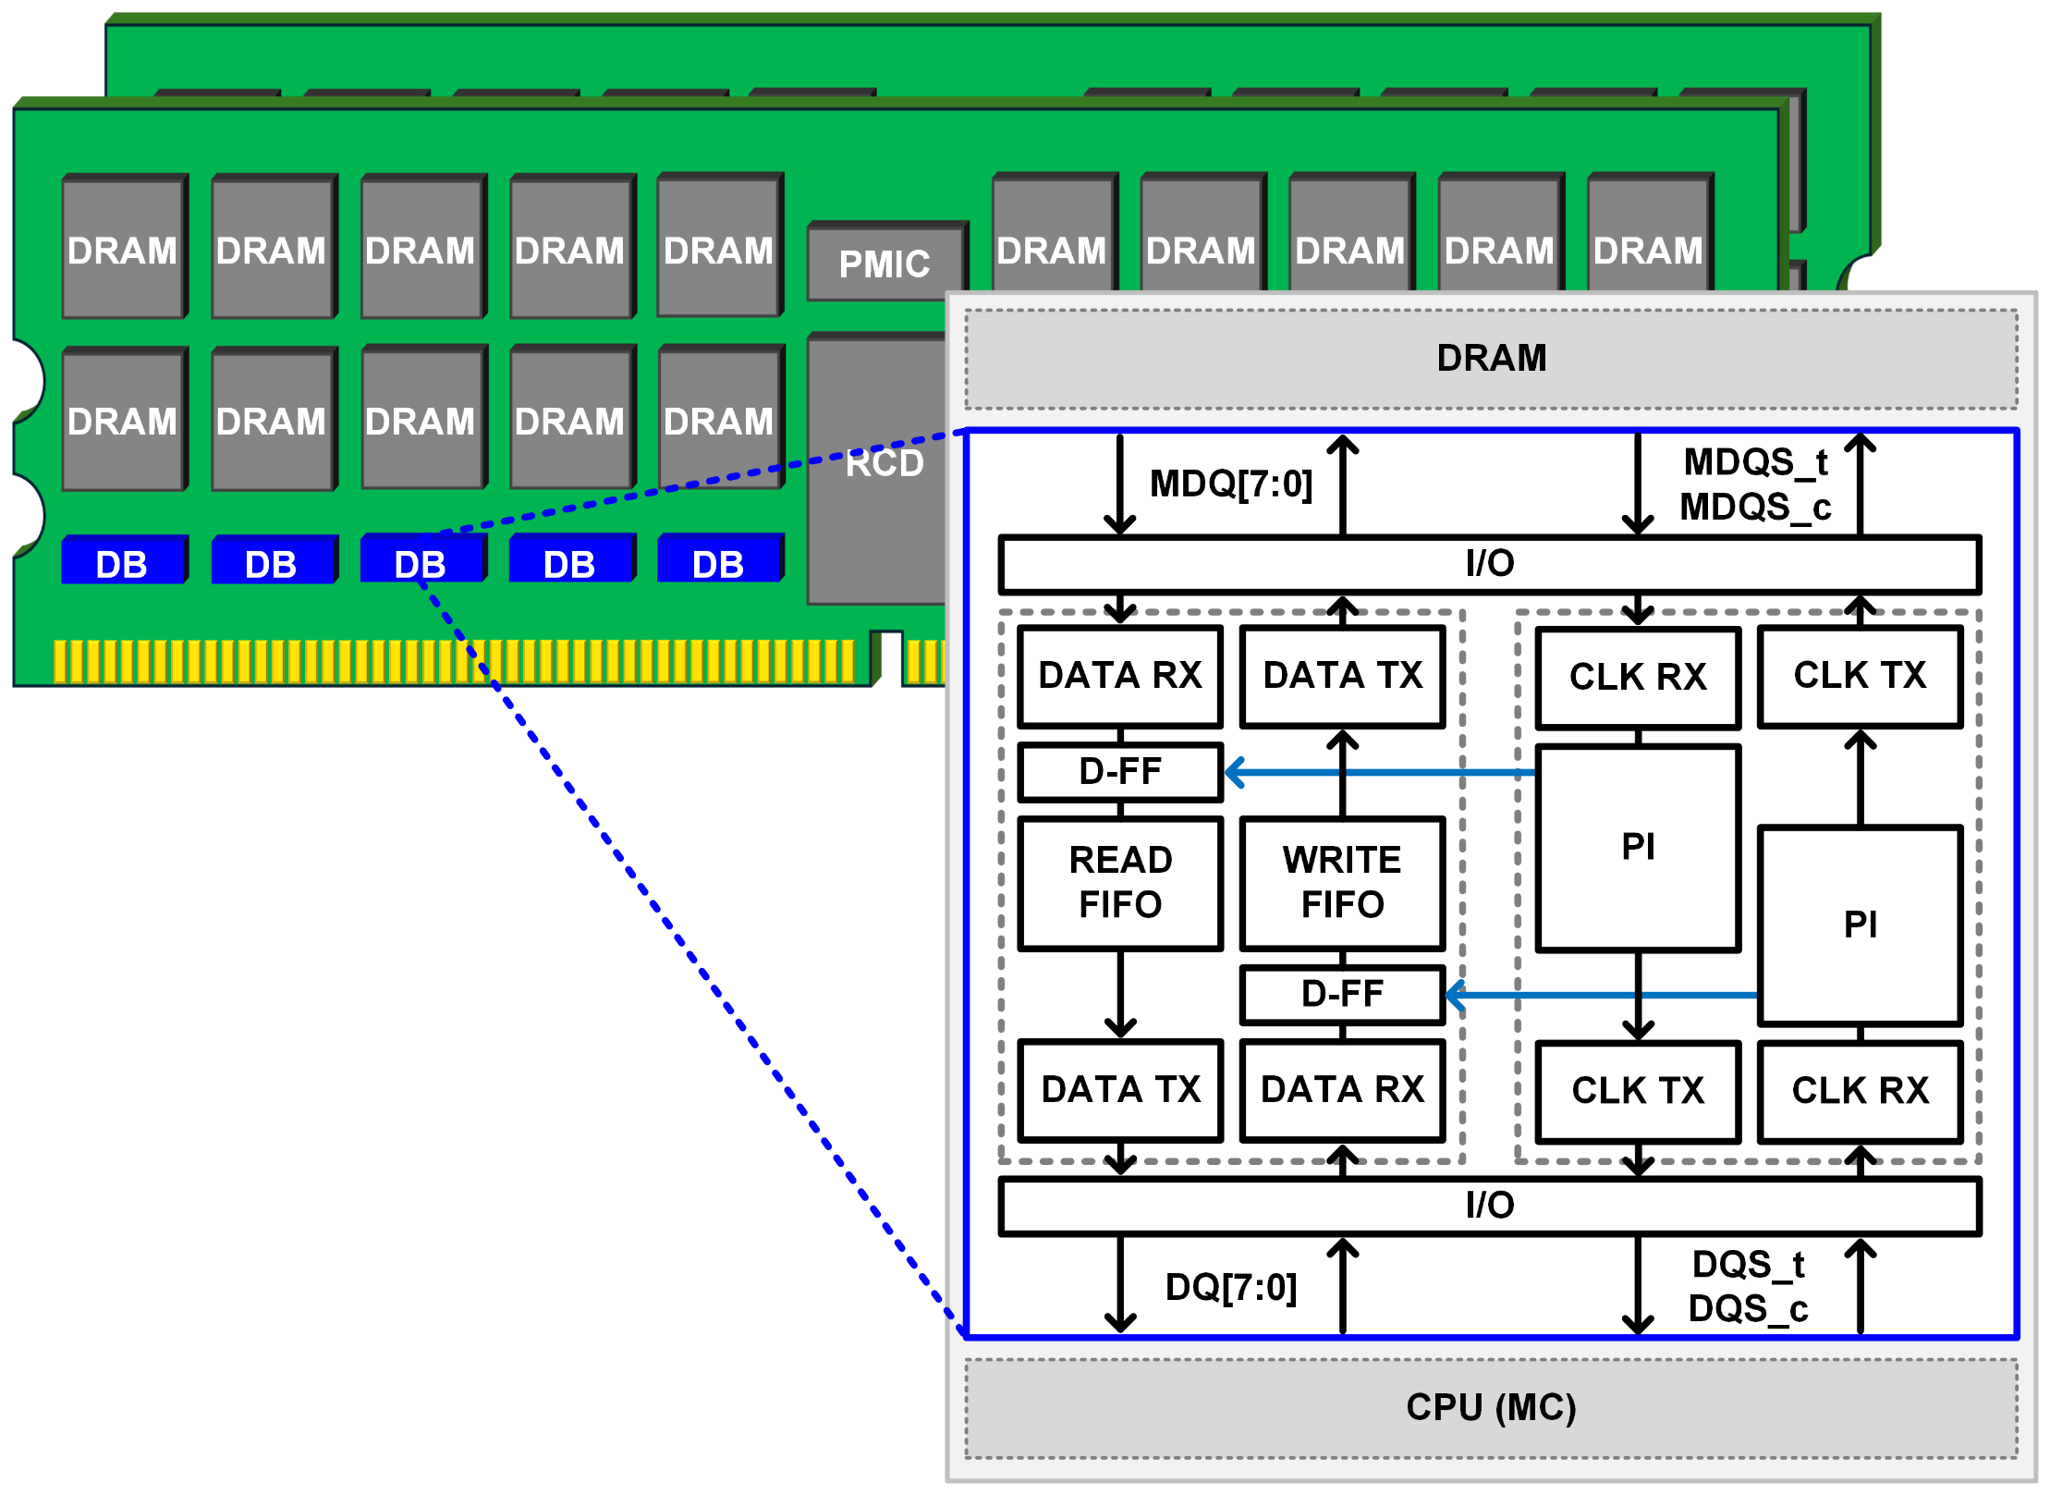
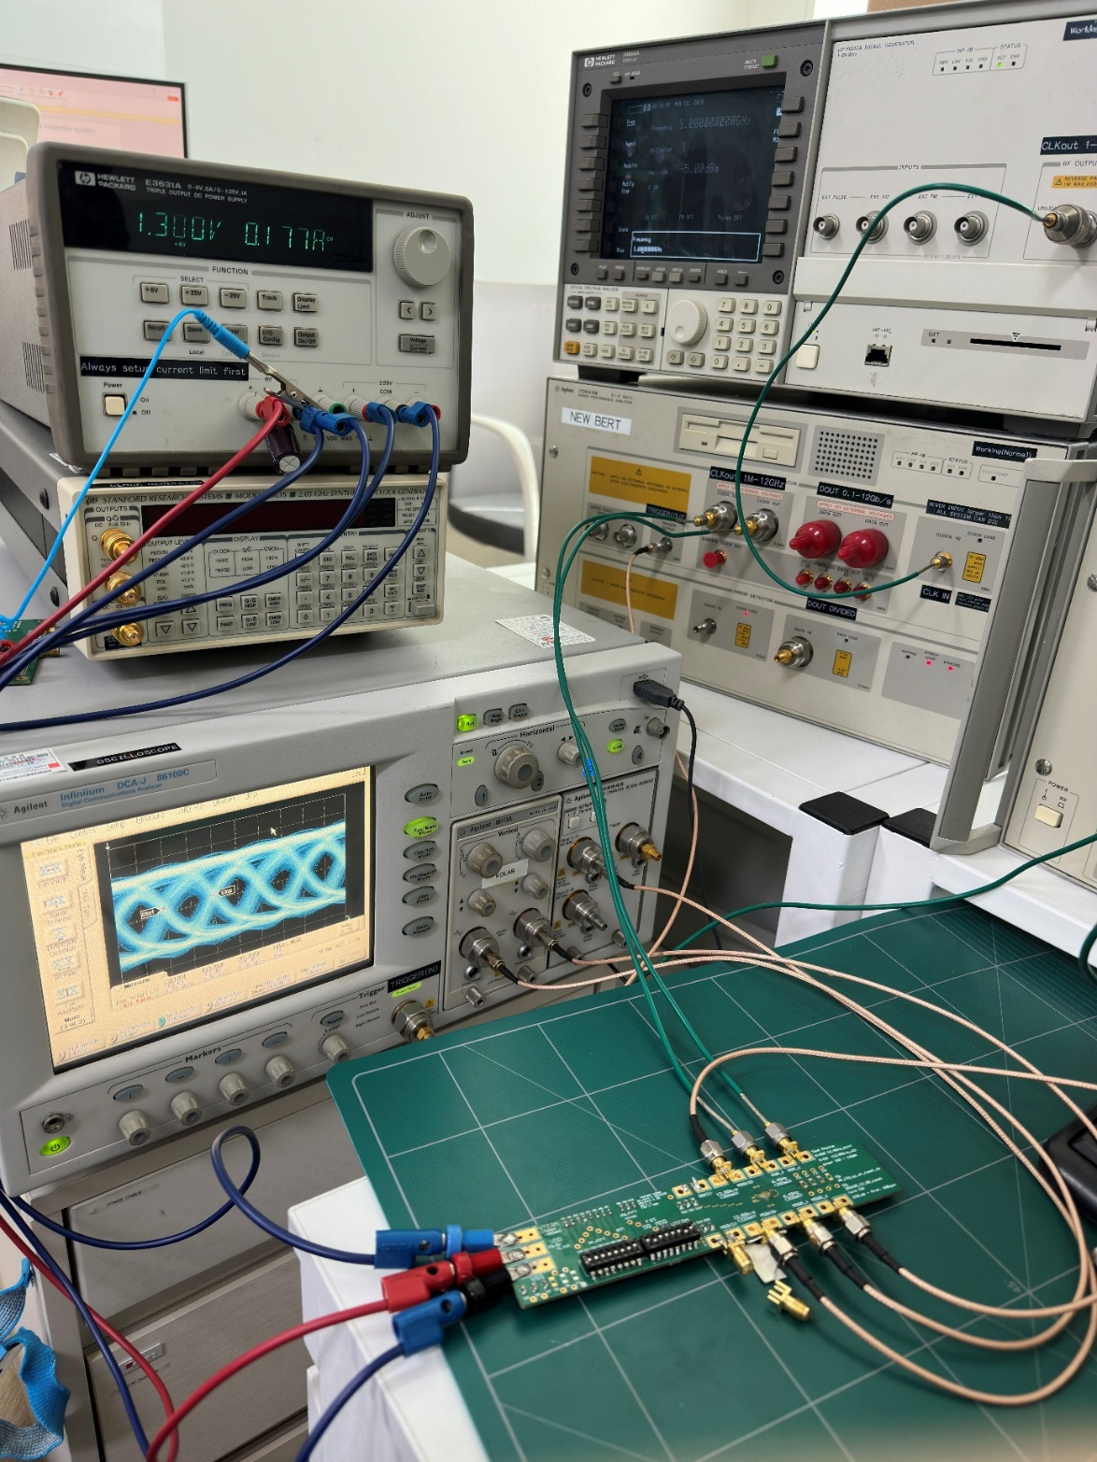
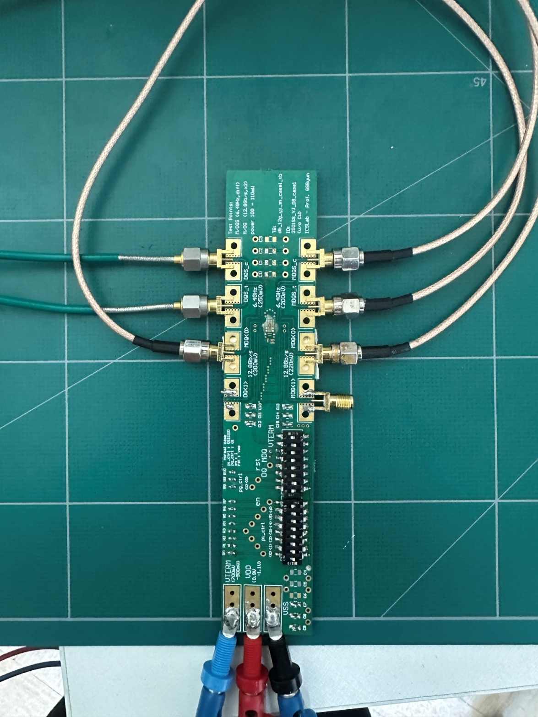
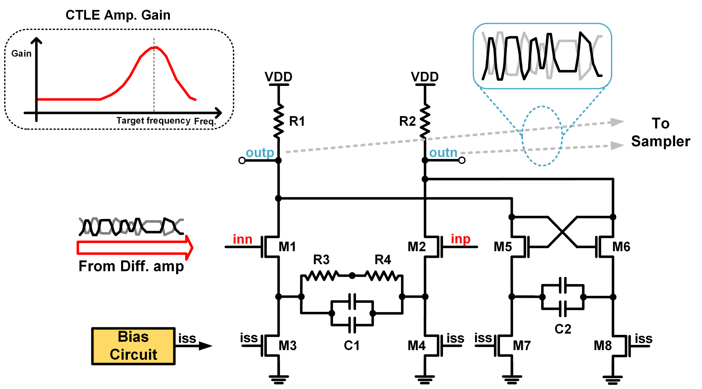
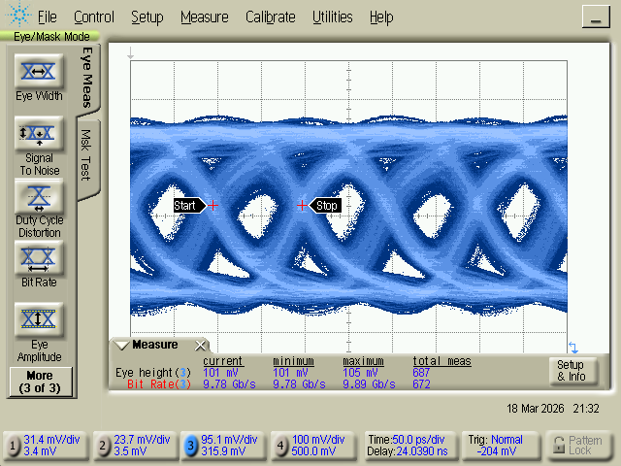
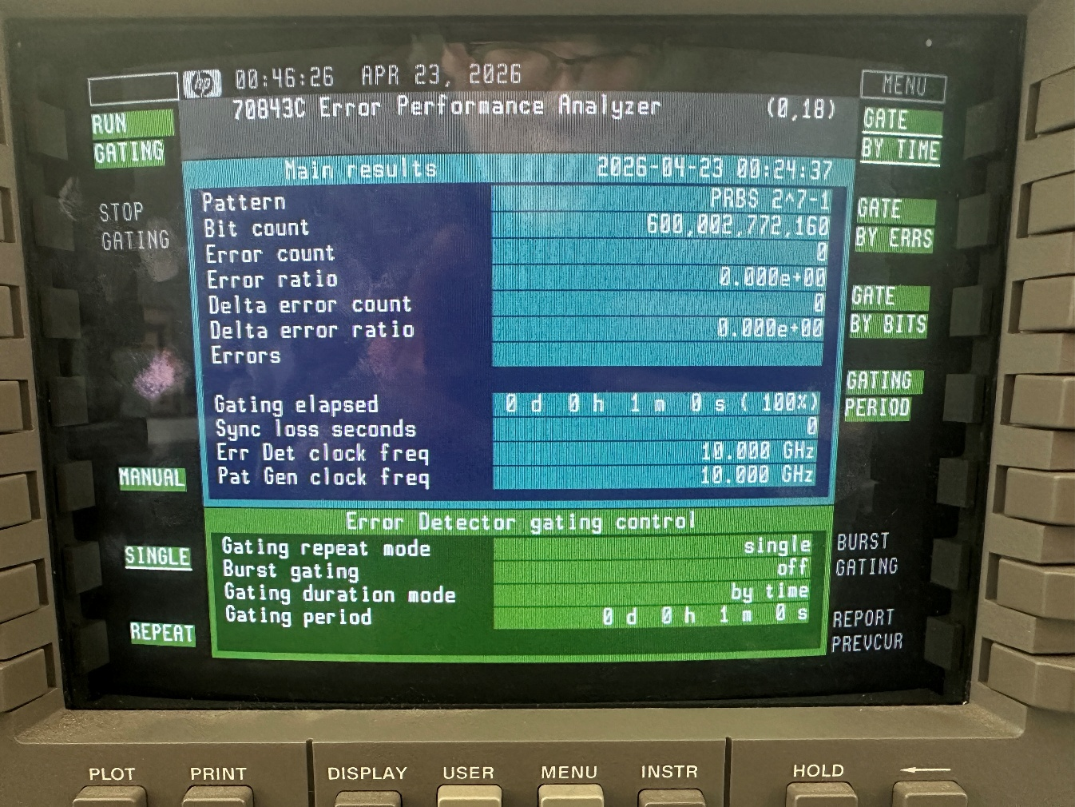
A 10Gbps High-Speed Data-Buffer Interface Using a low-power Equalization for Future LR-DIMM DDR5 Applications
Young Jun Byun, Saransh Rajjarwal, and Gyungsu Byun
Department of Electrical and computer Engineering, Inha University
Abstract
This paper presents a 10 Gbps data buffer (DB) interface chip for DDR5 Load-Reduced DIMM (LR-DIMM) applications. The proposed chip integrates an 8-bit bidirectional data path with a PI-based retiming clock distribution network and low-power equalization to mitigate ISI at the receiver. Key parameters including receiver Vref, input termination, ODT, and PI control are digitally programmable via a control word interface. Fabricated and measured at 1.3 V, the chip achieves a supply current of 177 mA, an eye height of approximately 100 mV at 10 Gbps, and error-free operation verified by a 2⁷−1 PRBS BERT test, confirming its suitability for next-generation DDR5 LR-DIMM applications.
Fig 1. Block Diagram of the proposed DDRX LR-DIMM DB chip, illustrating the host-side and DRAM side data/clock interfaces
Fig 3. Photograph of the fabricated chip mounted on the test board and the measurement setup, including high-speed signal probing equipment used for 10 Gbps characterization.
Fig 2. Schematic of the continuous-time linear equalizer (CTLE), employing a source-degenerated differential pair with a peaking network to compensate for high-frequency loss in the data path
Fig 4. Data measurement results. Eye Diagram at 10 Gbps, showing an eye height of approximately 100mV(left), BERT measurement result using a 2⁷-1 PRBS pattern, demonstrating zero bit errors(right).
Fig 1. shows the overall architecture of the proposed DDR5 LR-DIMM DB chip. The chip receives 8-bit data from the host-side (DQ[7:0]/DQS) through the DATA RX block and retransmits it to the DRAM side (MDQ[7:0]/MDQS) via the DATA TX block. Read and Write FIFOs manage bidirectional data flow, and a CLK RX followed by a PI drives the D-FFs for precise data retiming.
Fig 2. shows the CTLE schematic, employing a source-degenerated differential pair with a bias circuit to compensate for high-frequency channel loss.
Fig 3. shows the fabricated chip wire-bonded onto an FR4 PCB, with SMA connectors enabling characterization at 10 Gbps under a 1.3 V supply.
Fig 4. presents the measured results at 10 Gbps. The eye diagram shows an opening of 100 mV, confirming sufficient signal margin, and the BERT result using a 2⁷−1 PRBS pattern shows zero errors, verifying error-free operation.
Parameter | Value
Data rate | 10 Gb/s
Eye Height | 105 mV
Test pattern | PRBS 2⁷-1
Measurement Time | 60 s
Total bits | 6.0 x 10¹¹ (600,002,772,160)
Error count | 0
BER | < 1.67 x 10⁻¹²(error free)
Table 1. Measurement results of the proposed 10 Gb/s data buffer using PRBS 2⁷-1 pattern.
Conclusion
This paper presented a 10 Gbps DDR5 LR-DIMM data buffer interface chip featuring a PI-based retiming clock path and low-power equalization. Silicon measurement results at 1.3 V supply confirm a supply current of 177 mA, an eye height of approximately 100 mV at 10 Gbps, and error-free operation under a 2⁷−1 PRBS BERT test. These results demonstrate that the proposed architecture meets the signal integrity requirements of DDR5 LR-DIMM applications, establishing it as a viable solution for next-generation high-capacity memory systems.

