Slide 1



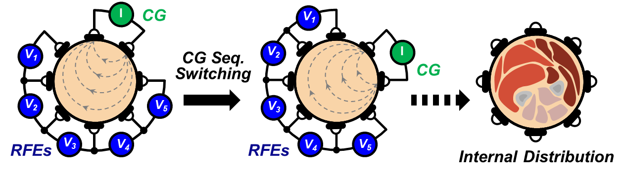
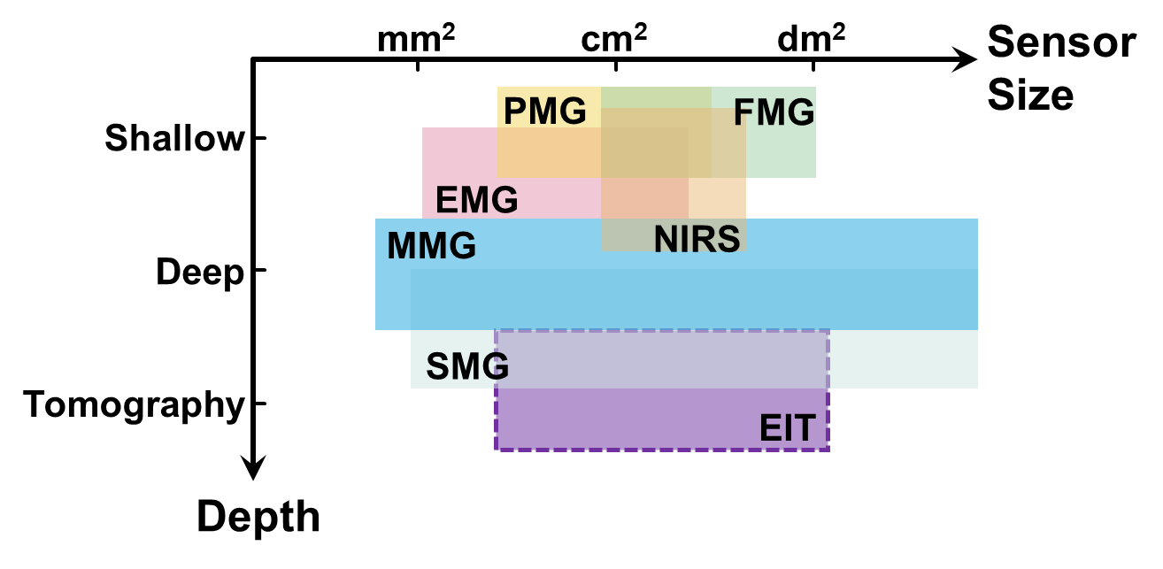
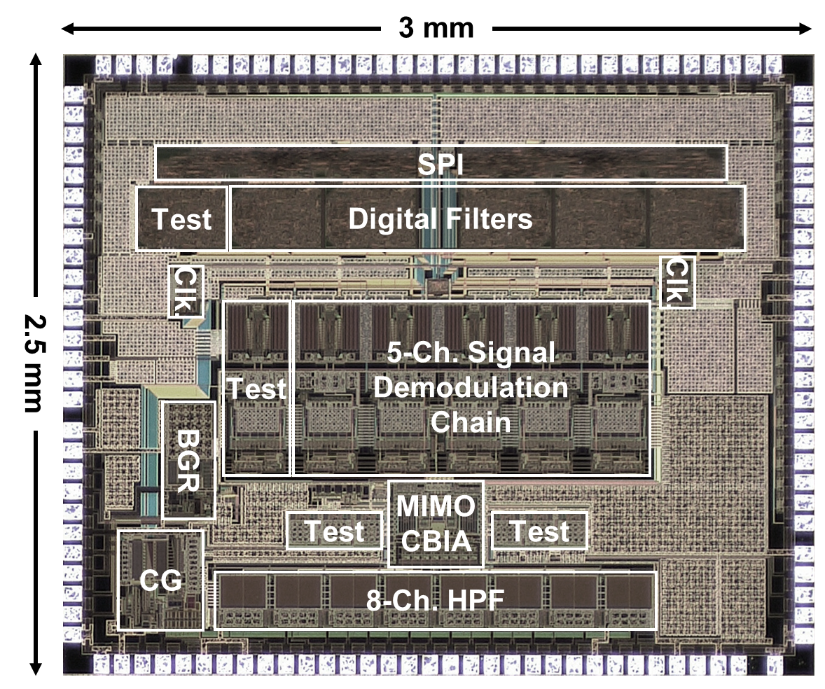
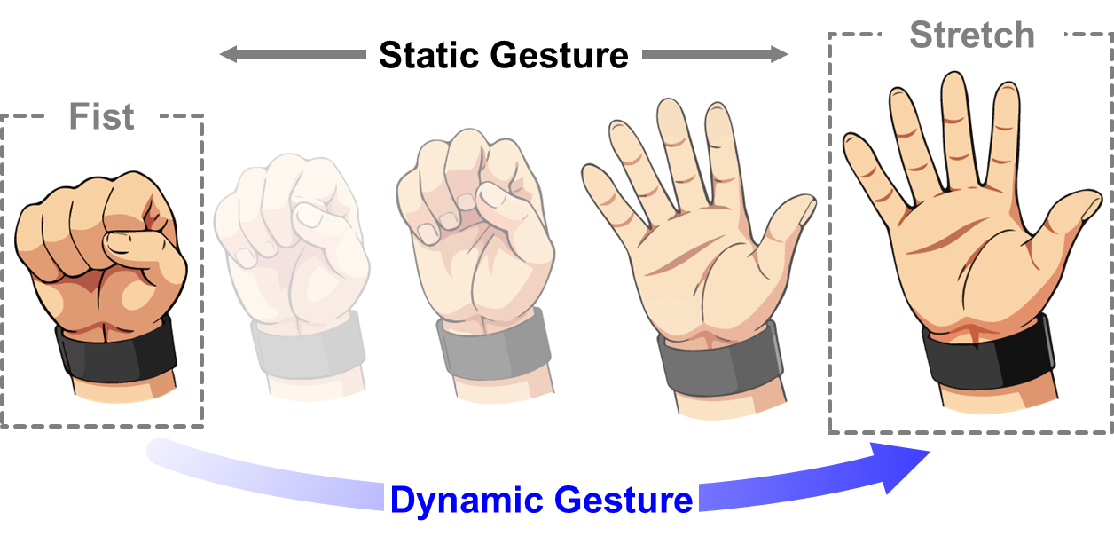
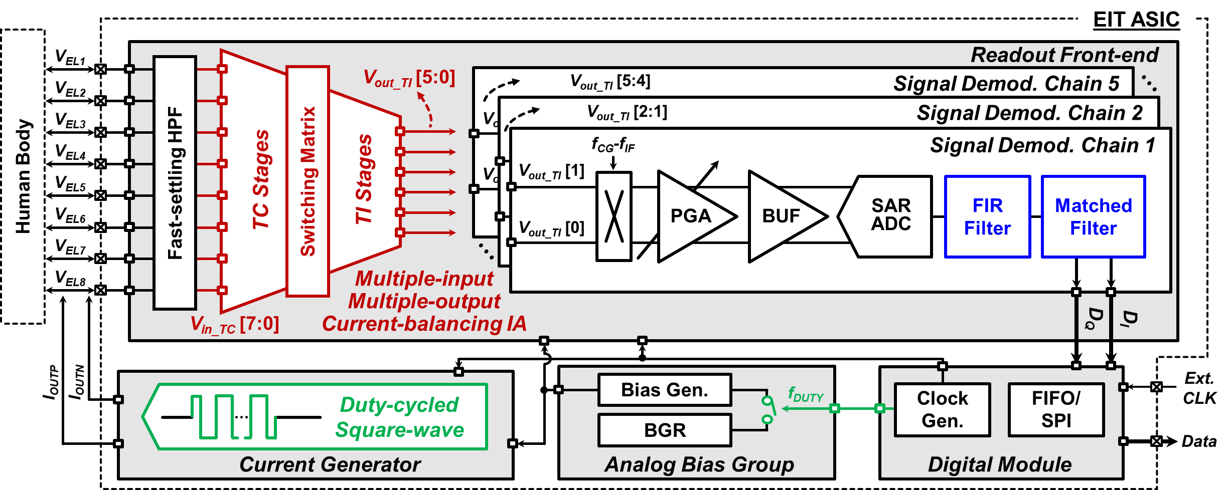
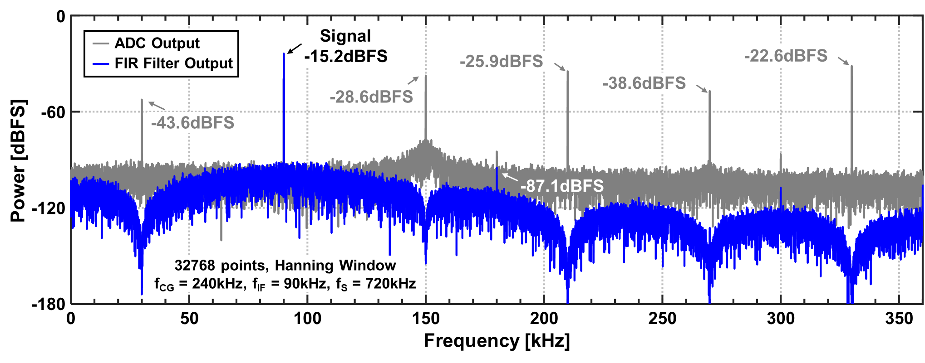
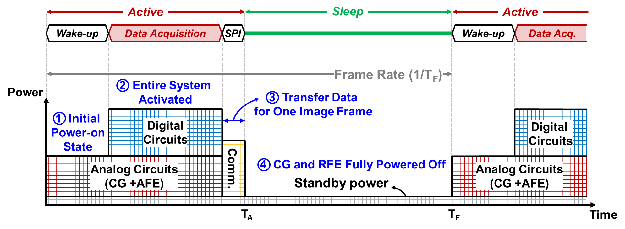
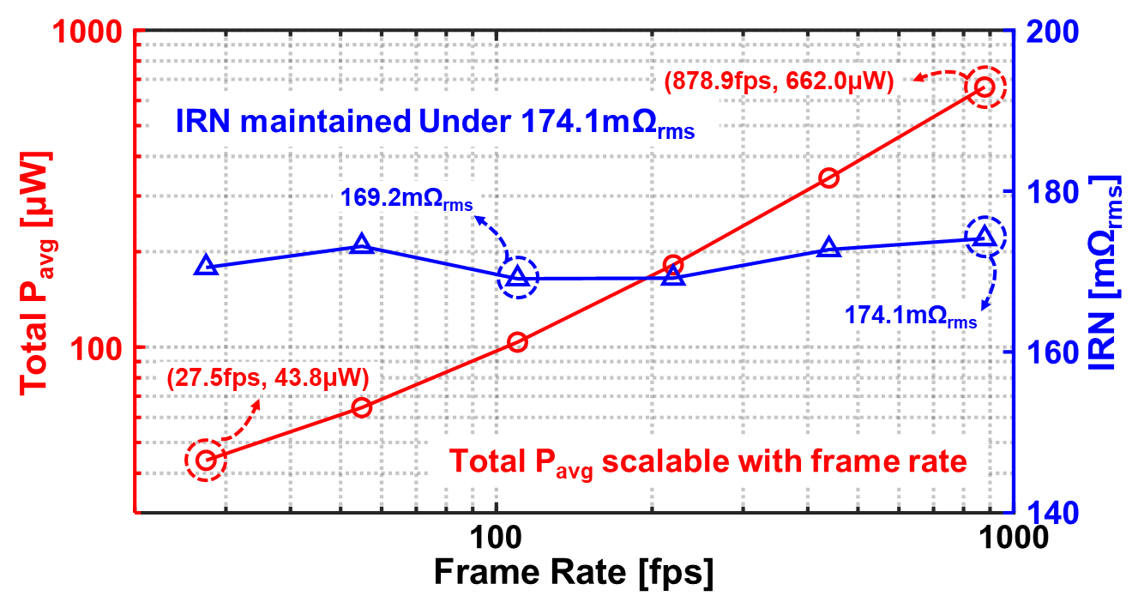
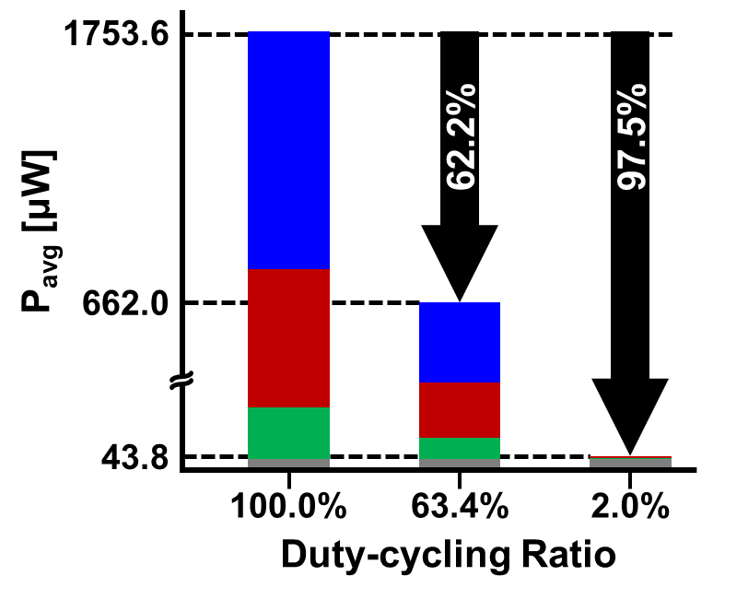
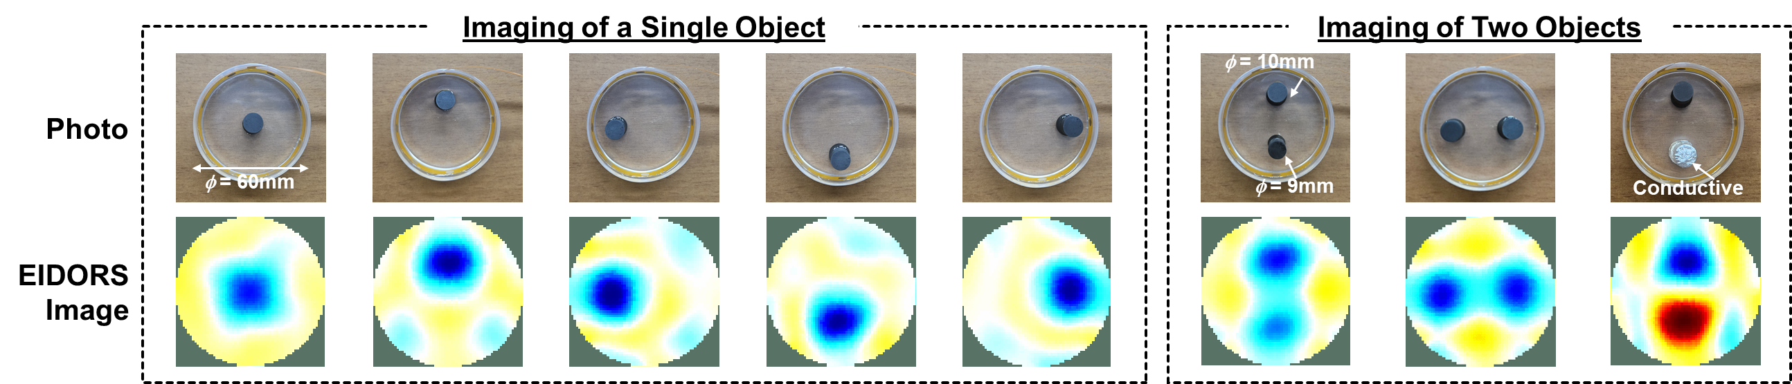
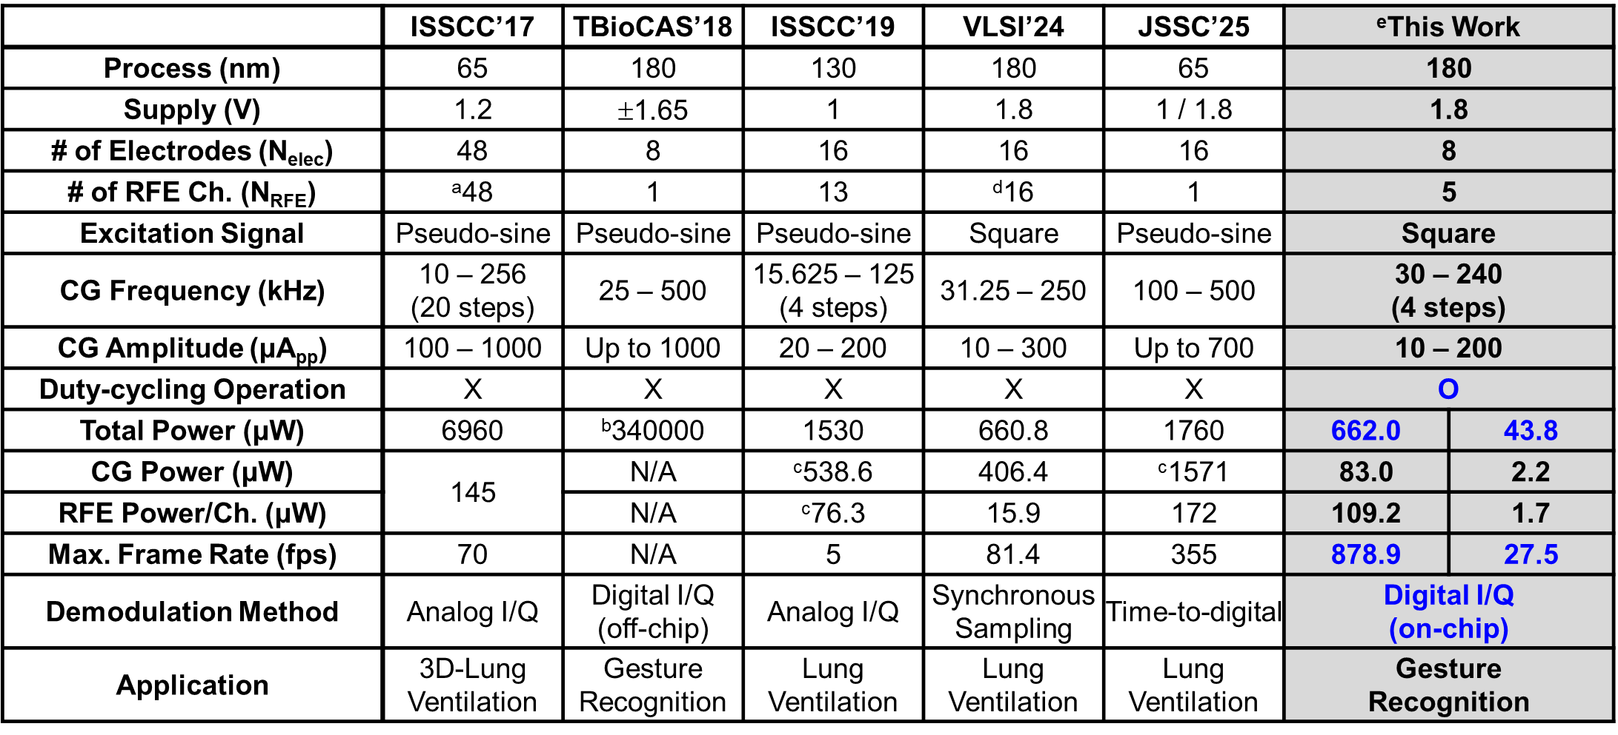
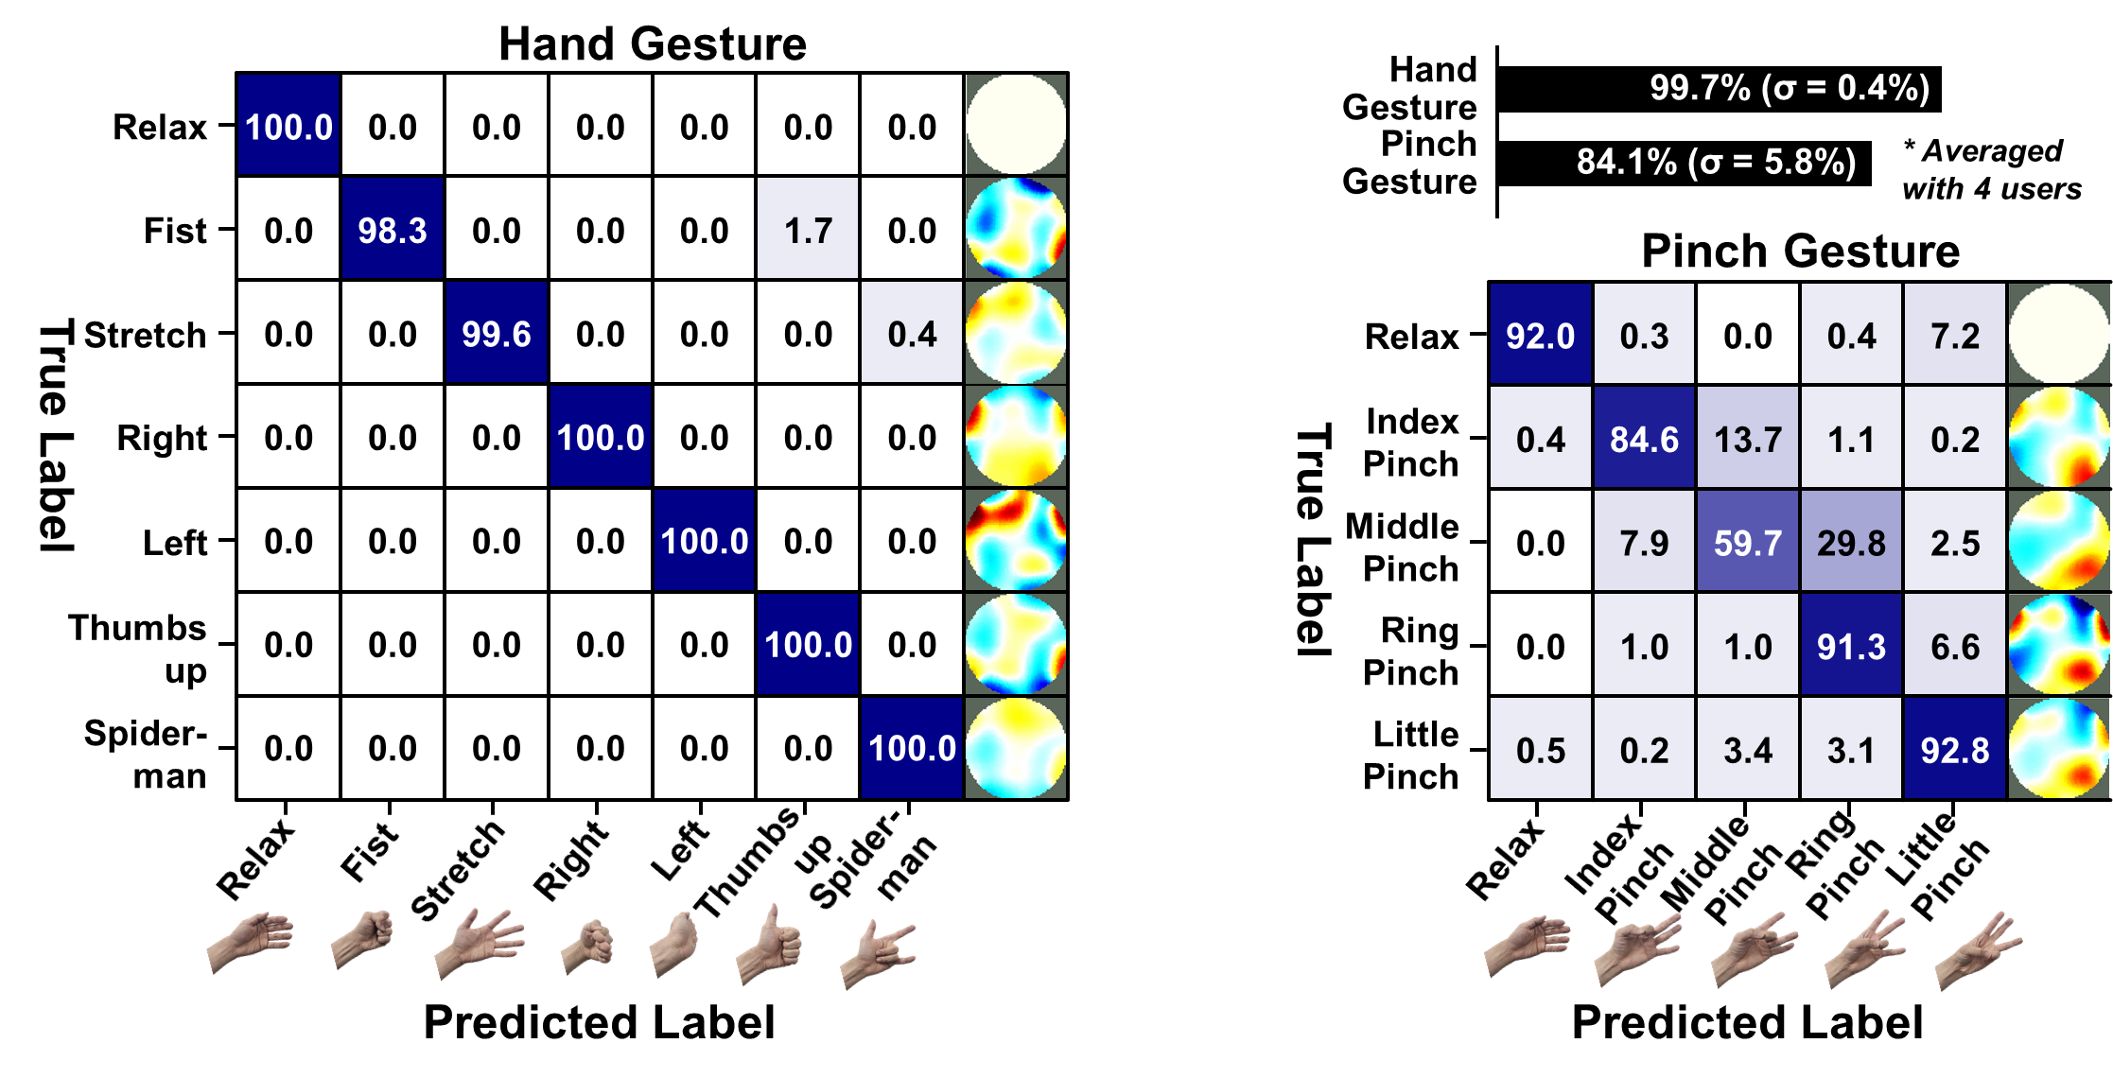
A 43.8-to-662.0µW 27.5-to-878.9fps Frame-Rate-Scalable
Duty-Cycled Electrical Impedance Tomography System
Haidam Choi^{†1}, Gichan Yun^{†1}, Sohmyung Ha² and Minkyu Je¹
¹KAIST, Daejeon, South Korea, ²New York University Abu Dhabi, Abu Dhabi, UAE, †Equally Credited Authors
Abstract: The proposed duty-cycled EIT system reduces 62.2% and 97.5% of power consumption when operating at 878.9fps and 27.5fps, respectively, from the total average power consumption of 1753.6μW. A MIMO current-balancing IA halves power, area, and input parasitics, while the FIR filter and digital matched filter suppress unwanted harmonics and reduce settling time.
Introduction
[1]
Fabricated Chip
Challenges in portable, real-time interaction
☺ Deep-muscle Information
☹ Power Consumption
☹ Measurement Time
Proposed Circuits
Measurement Results – Operation
Overall Frame-rate-scalable Duty-cycled EIT System:
The frame rate can be controlled by adjusting the duration of the sleep phase, allowing the frame rate and P_{avg} to be flexibly adjusted according to the required performance.
Measurement Results – EIT Imaging
Comparison and Performance Summary
The proposed EIT system reduce P_{avg} up to 662.0μW at 878.9fps and 43.8μW at 27.5fps.
Multi-input Multi-output CBIA halve power and area, supporting multi-channel scalability.
Harmonic-canceling filter reduce settling time with on-chip digital I/Q demodulation.
References
[1] H. Wang et al., “Wearable super-resolution muscle–machine interfacing,” Front. Neurosci., vol. 16, Art. no. 1020546, Nov. 2022.
[2] A. Kyu, H. Mao, J. Zhu, M. Goel, and K. Ahuja, “EITPose: Wearable and Practical Electrical Impedance Tomography for Continuous Hand Pose Estimation,” CHI Conference on Human Factors in Computing Systems, pp. 1–10, May 2024.
[3] A. Adler and W. R. B. Lionheart, “Uses and abuses of EIDORS: an extensible softw A. Adler and W. R. B. Lionheart, “Uses and abuses of EIDORS: an extensible software base for EIT,” Physiol. Meas., vol. 27, no. 5, p. S25-S42, Apr. 2006.

